Slide 1
Computationally guided design of MULTIPLE impurities tolerant electrode
Rui Wang¹, Jane Banner², Srikanth Gopalan², Yu Zhong¹
¹Worcester Polytechnic Institute
²Boston University
06/30/2020

Slide 2
Content
1. Introduction
2. Computational results
3. Experimental results
4. Further discussions
5. Future work

Slide 3
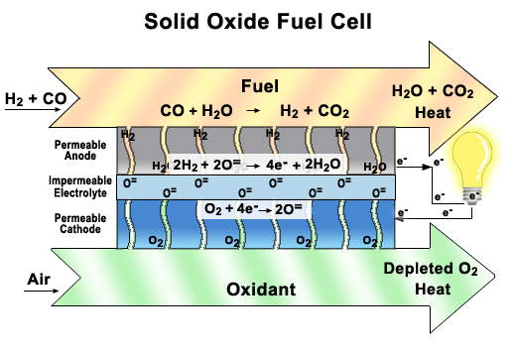
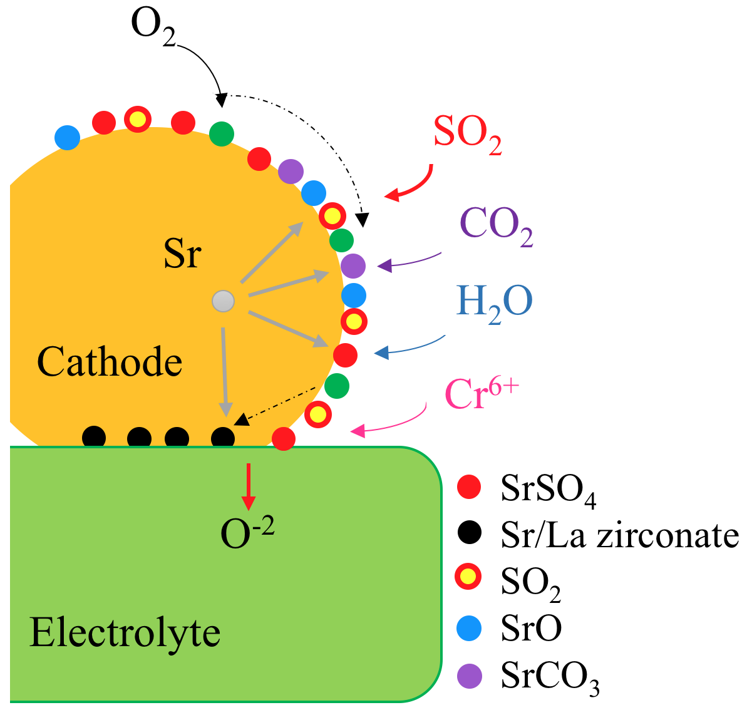
formation of detrimental phases
compositional, morphological, and crystal structure changes
1. Introduction
Activation,
ohmic polarization changes

Slide 4
Novel Integrated Approach and Objectives
Phase I:
Achieve the highest power densities of 1.5W/cm² at 800ºC
Achieve a degradation rate of 0.4%/1000hrs under realistic operating conditions with simultaneously present, MULTIPLE impurities at the cell level.
Phase II:
Achieve a degradation rate of 0.1%/1000hrs at the stack level

Slide 5
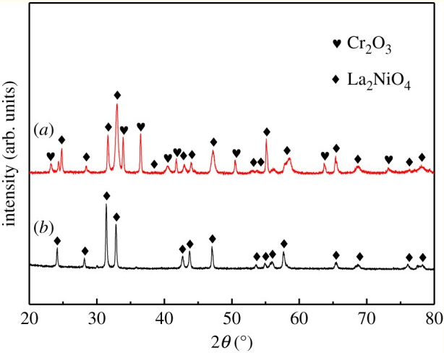
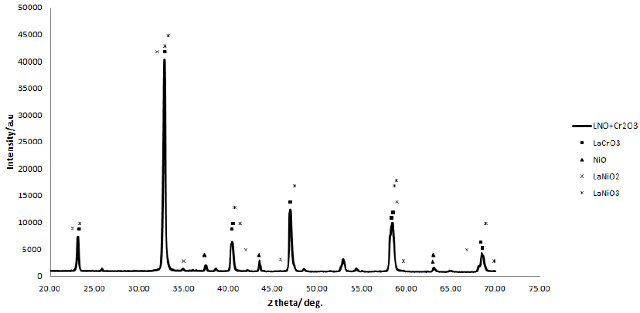
Literature reviews
Figure 1. XRD peaks obtained after powders of LNO and Cr₂O₃ were mixed and heated at 1000°C for 24h from Ref. [1].
Figure 2. XRD patterns of La2NiO4 (b) and Cr2O3 powder mixtures (a) after heated at 800°C from Ref. [2].
Predict the stability of the SOFC cathode materials with certain impurities.
[1] S.-N. Lee, A. Atkinson, J. Kilner, Chromium Poisoning of La2NiO4+δ Cathodes, ECS Transactions, 57 (2013) 605-613.
[2] B. Hou, C.C. Wang, X. Cui, Y. Chen, Chromium deposition and poisoning of La2NiO4 cathode of solid oxide fuel cell, R Soc Open Sci, 5 (2018) 180634.

Slide 6
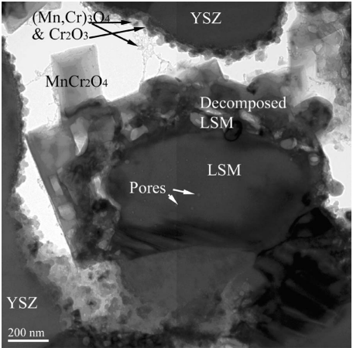
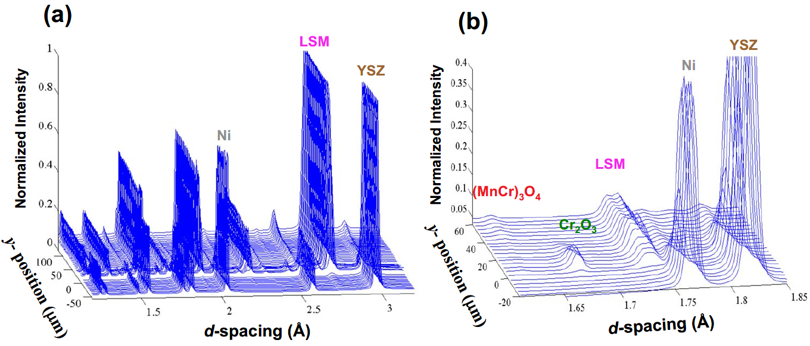
Figure 3. a) A series of angle-integrated X-ray diffraction patterns measured as a function of cell probe depth b) Zoomed spectra from the series from Ref. [3]
Figure 4. TEM images of the active cathode region operated for 504 h at 800°C and 880 mA/cm2 from Ref. [4].
Predict the formation and the threshold of secondary phases under certain operating conditions.
[3] D.-J. Liu, J. Almer, T. Cruse, Characterization of Cr Poisoning in a Solid Oxide Fuel Cell Cathode Using a High Energy X-ray Microbeam, Journal of The Electrochemical Society, 157 (2010) B744-B750.
[4] M. Krumpelt, T.A. Cruse, B.J. Ingram, J.L. Routbort, S. Wang, P.A. Salvador, G. Chen, The Effect of Chromium Oxyhydroxide on Solid Oxide Fuel Cells, Journal of The Electrochemical Society, 157 (2010) B228-B233.

Slide 7
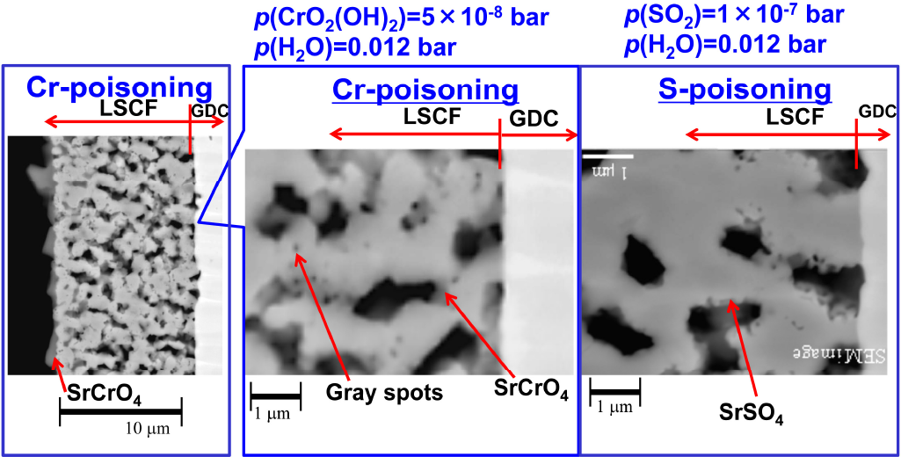
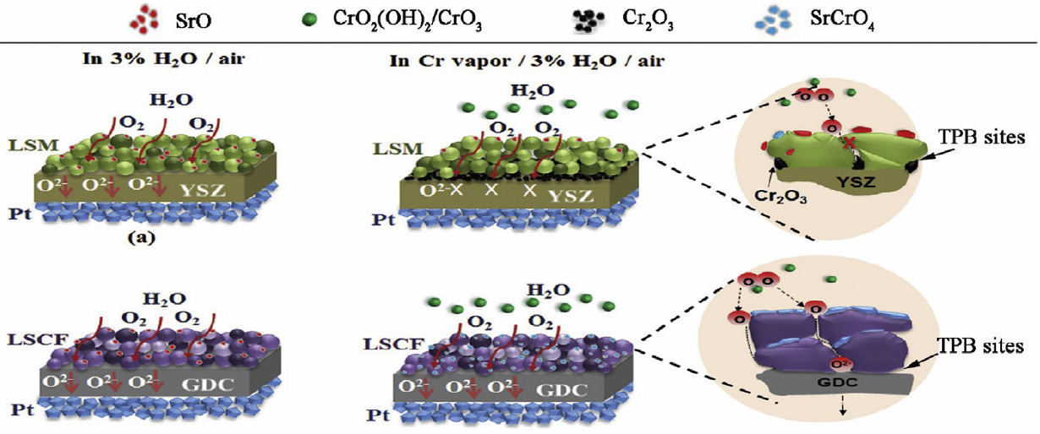
Literature reviews
Figure 5. Schematic illustration of the morphology evolution in the presence of water and Cr from Ref. [5]
Figure 6. High magnification of SEM image at the LSCF/GDC contact interfaces after poisoning from Ref. [6]
Predict the behavior and degradation mechanisms with one or multiple impurities.
[5] B. Hu, S. Krishnan, C. Liang, S.J. Heo, A.N. Aphale, R. Ramprasad, P. Singh, Experimental and thermodynamic evaluation of La1−xSrxMnO3±δ and La1−xSrxCo1−yFeyO3−δ cathodes in Cr-containing humidified air, International Journal of Hydrogen Energy, 42 (2017) 10208-10216.
[6] T. Horita, D.H. Cho, F. Wang, M. Nishi, T. Shimonosono, H. Kishimoto, K. Yamaji, M.E. Brito, H. Yokokawa, Degradation Mechanism of SOFC Cathodes under CrO3 and SO2 Impurity Exposures, ECS Transactions, 51 (2013) 69-77.

Slide 8
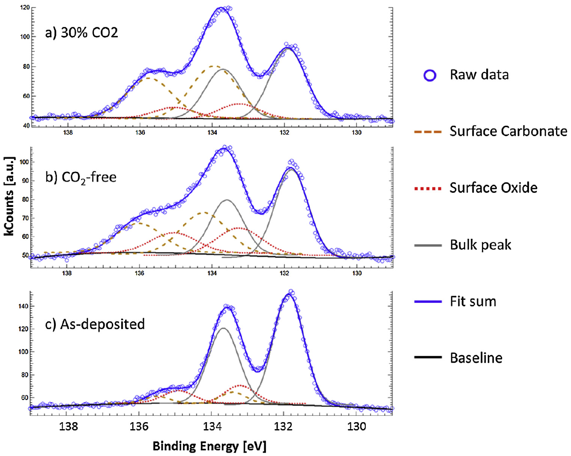
2. Computational results(CO2)
Figure 8. 3D-AFM images of surfaces under a). high-CO2 atmosphere b). CO2-free environment.
Figure 7. Sr 3d peaks of films obtained by HAXPES measurements
[7] Y. Yu, H. Luo, D. Cetin, X. Lin, K. Ludwig, U. Pal, S. Gopalan, S. Basu, Effect of atmospheric CO2 on surface segregation and phase formation in La0.6Sr0.4Co0.2Fe0.8O3− thin films, Applied Surface Science, 323 (2014) 71-77.

Slide 9
2. Computational results(CO2)
Figure 9. Phase stability simulations of LSCF under CO2 poisoning conditions.
Accelarated tests (higher P(CO2)) could result in different degradation mechanisms
SrCO3 and Spinel phases could be formed in real working conditions with CO2 atmosphere

Slide 10
2. Computational results
Figure 10. Phase stability simulations of LNO under CO2 poisoning conditions.
LNO is stable in CO2-containing reducing conditions

Slide 11
2. Computational results
Figure 11. Phase stability simulations of LSM under CO2 poisoning conditions.
LSM could also be stable in CO₂ at operation condition

Slide 12
2. Computational results(Cr)
Figure 12. Partial pressures of Cr-containing species generated by Cr₂O₃
Humidity will increase the content of Cr in the gaseous phase, especially at lower temperatures, which will increase the kinetics and the total amount of the secondary phases.

Slide 13
2. Computational results
Figure 13. Phase stability simulations of LSCF under Cr poisoning conditions.
SrCrO₄ might form during the operation conditions.

Slide 14
2. Computational results
Figure 14. Phase stability simulations of LSM under Cr poisoning conditions.
Cr will mainly enter the sublattices of the Spinel

Slide 15
2. Computational results
Figure 15. Phase stability simulations of LNO under Cr poisoning conditions.
LNO is much stable in Cr-containing conditions

Slide 16
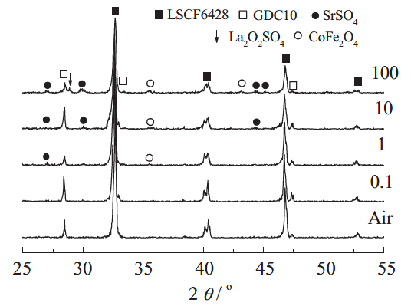
2. Computational results(S)
Figure 16. Phase stability simulations of LSCF under SO₂ poisoning conditions.
SrSO₄ and Spinel were predicted to form during the operation conditions.
[8] F. Wang, K. Yamaji, D.-H. Cho, T. Shimonosono, H. Kishimoto, M.E. Brito, T. Horita, H. Yokokawa, Sulfur Poisoning on La0.6Sr0.4Co0.2Fe0.8O3 Cathode for SOFCs, Journal of The Electrochemical Society, 158 (2011) B1391-1397.

Slide 17
2. Computational results
Figure 17. Phase stability simulations of LSM under SO₂ poisoning conditions.
SrSO₄ has more strict threshold for the formation in LSM than LSCF.

Slide 18
2. Computational results
Figure 18. Phase stability simulations of LNO under SO₂ poisoning conditions.
La₂O₂SO₄ was predicted to form during the operation conditions.

Slide 19
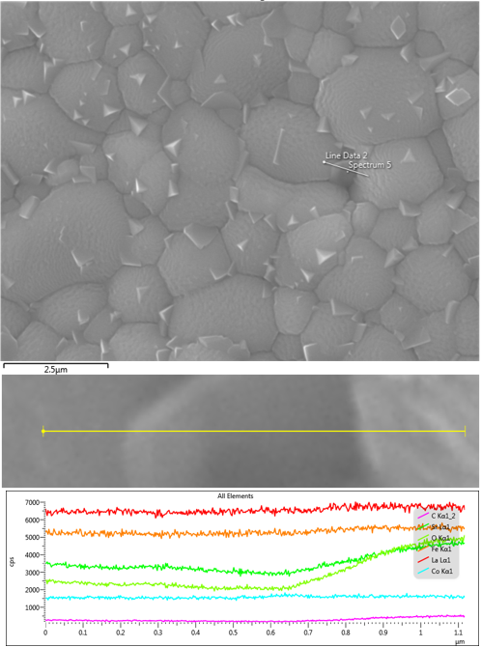
3. Experimental results(CO2)
The SEM/EDS line scan results of LSCF pellet (0.5 inch in diameter and 1mm in thinkness) at 700℃after 7 days exposure to 30%CO₂ balanced with Ar. There is no significant peak of SrCO3 in the XRD results, however, the CPS of Sr, C and O are increasing simultaneously.
Accelerated tests also need to be scrutinized, as they might exhibit different degradation mechanisms.

Slide 20
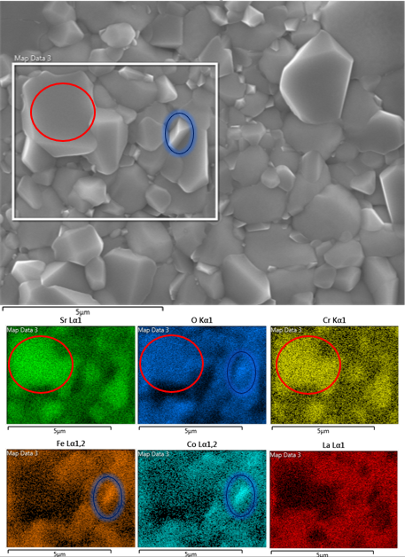
3. Experimental results(Cr)
LSCF at 1000℃ for 2 days with Cr₂O₃+Dry air
The formation of the SrCrO4 and Spinel phases agreed well with the computational predictions.

Slide 21
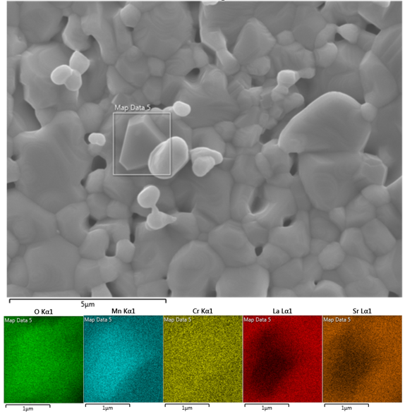
3. Experimental results(Cr)
LSM at 1000℃ for 2 days with Cr₂O₃+Dry air
The formation of the secondary phase agreed well with the computational predictions.

Slide 22
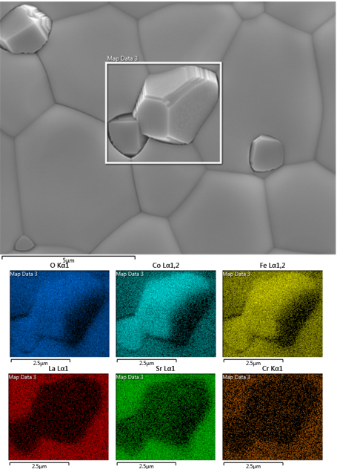
3. Experimental results(Cr)
LSCF at 1300℃ for 2 days with Cr₂O₃+Ar

Slide 23
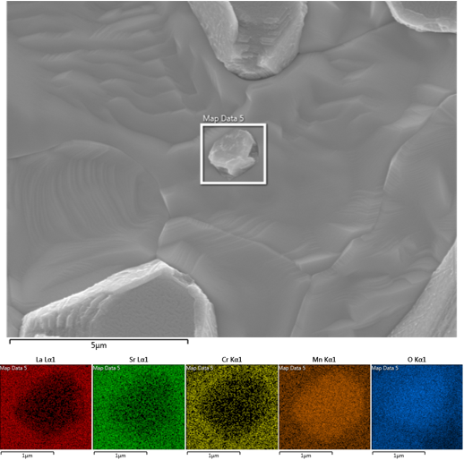
3. Experimental results(Cr)
LSM at 1300℃ for 2 days with Cr₂O₃+Ar

Slide 24
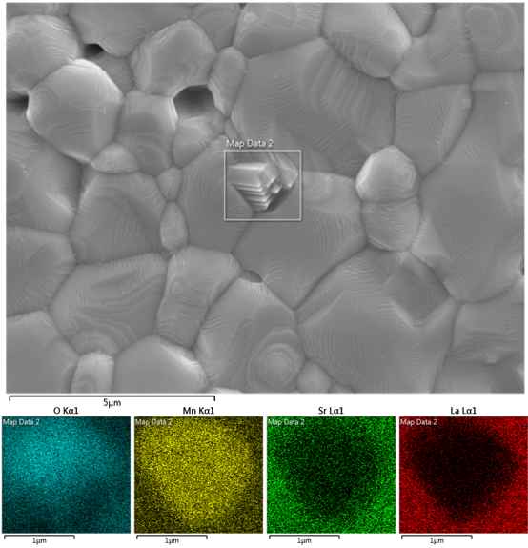
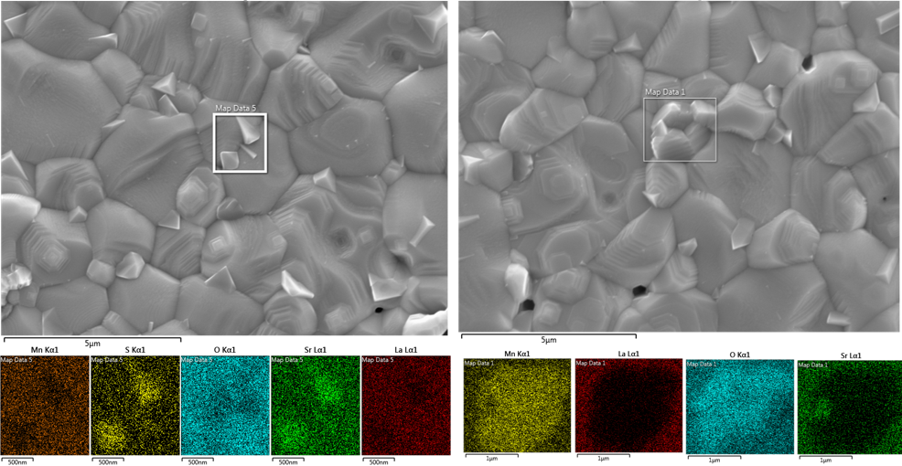
3. Experimental results(S)
LSM at 1000℃ for 2 days with 10ppmSO₂+Dry air
LSM at 800℃ for 2 days with 10ppmSO₂+Dry air
There is no signal of sulfur element on the surface of the entire sample.
SrSO4 will form at lower temperature condition. And the threshold can be well predicted through CALPHAD.

Slide 25
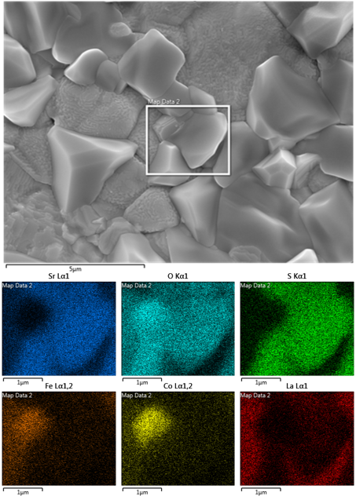
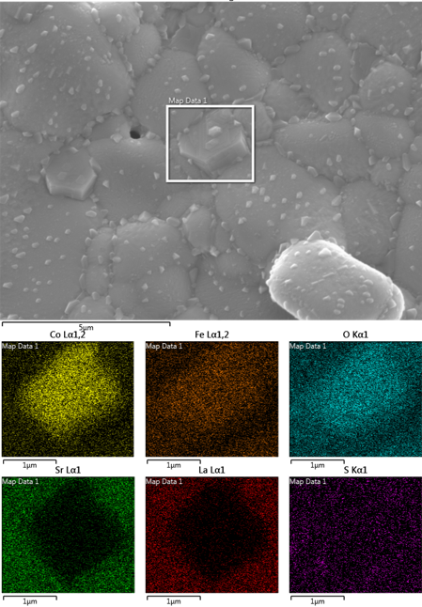
3. Experimental results(S)
LSCF at 1000℃ for 2 days with 10ppmSO₂+Dry air
LSCF at 800℃ for 2 days with 10ppmSO₂+Dry air
The small SrSO4 phases are well distributed both inter- and intragranularly.
LSCF has worse sulfur resistance in the whole operating temperature range

Slide 26
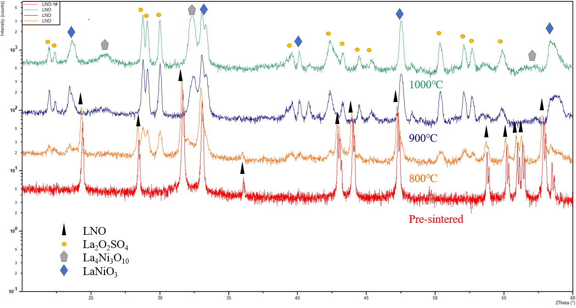
3. Experimental results(S)
LNO at 800℃, 900 ℃ and 1000 ℃ for 2 days with 10ppmSO₂+Dry air
The formation of the secondary phase La₂O₂SO₄ and La₄Ni₃O₁₀ are well predicted.

Slide 27
4. Results and discussion
Impurities:
S(SO₂): form Sulfate secondary phases (Mainly SrSO₄, La₂O₂SO₄), and LSM has distinct threshold in S-containing conditions (LSM is Sulfur-free at higher temperatures.)
Cr(CrO_{x}): form Chromate secondary phases and total amount of the secondary phases when humidity is introduced especially at lower T.
C(CO₂): form Carbonate secondary phases at very low T. Accelerated tests are very important due to the possible existence of different degradation mechanisms.
Cathodes:
LNO is much more stable under multiple impurities conditions, as only S will be very detrimental at working temperatures.
LSM is more stable in real experiments, while LSCF in all cases are less stable than LSM and LNO.

Slide 28
5. Future work
1. Multiple impurities experiments and the corresponding simulations.
Cr + Humidity; Sulfur + Humidity; Sulfur + Cr; Sulfur + Cr + Humidity; Multiple ………..
2. Simulations and experimental verifications of LSM/YSZ TPBs.
The simulations will take more factors into considerations as well as comprehensive literature reviews.
3. Long-term degradation tests.
On basis of the simulations and preliminary experiments we have so far.
4. Others.
Database re-assessment…

Slide 29
Thank you！

Slide 30
SOFC-development
Decreasing Activation Polarization by
Maximizing the Rates of the ORR Reaction
Reducing Long-term Degradation due to the Effect of Single Air-contained Impurity
GOAL:
Develop The Cathode Material with
Materials Compositional Design
External Impurity Getter
High Initial Power Density
Low Long-term Degradation Rate
CURRENT LIMITATIONS with Trial and Error Approach:
Characterization Detection of Nano-sized Secondary Phases
Difficulty of Doing In-situ or In-operando Observation
Detailed Reaction Mechanism Verification
Real Impacts of Multiple Gas Species on Cell/Stack Performance

