Slide 1
Solid Oxide Fuel Cells (SOFC)
Shailesh D. Vora Technology Manager, Fuel Cells
2020 DOE FE Fuel Cells Program Overview
July 2020

Slide 2
SOFC Program - Recommendations from Report To Congress (April 2019)
Based on the results presented in this report the Program recommends continued effort in the following areas:
DOE believes fuel cells have a role in achieving the Nation’s clean energy goals but the current state of SOFC requires additional basic R&D to mature the technology.
Validation and design of commercial systems
Continued funding of early stage applied R&D
Industry engagement and open source data
Hydrogen generation

Slide 3
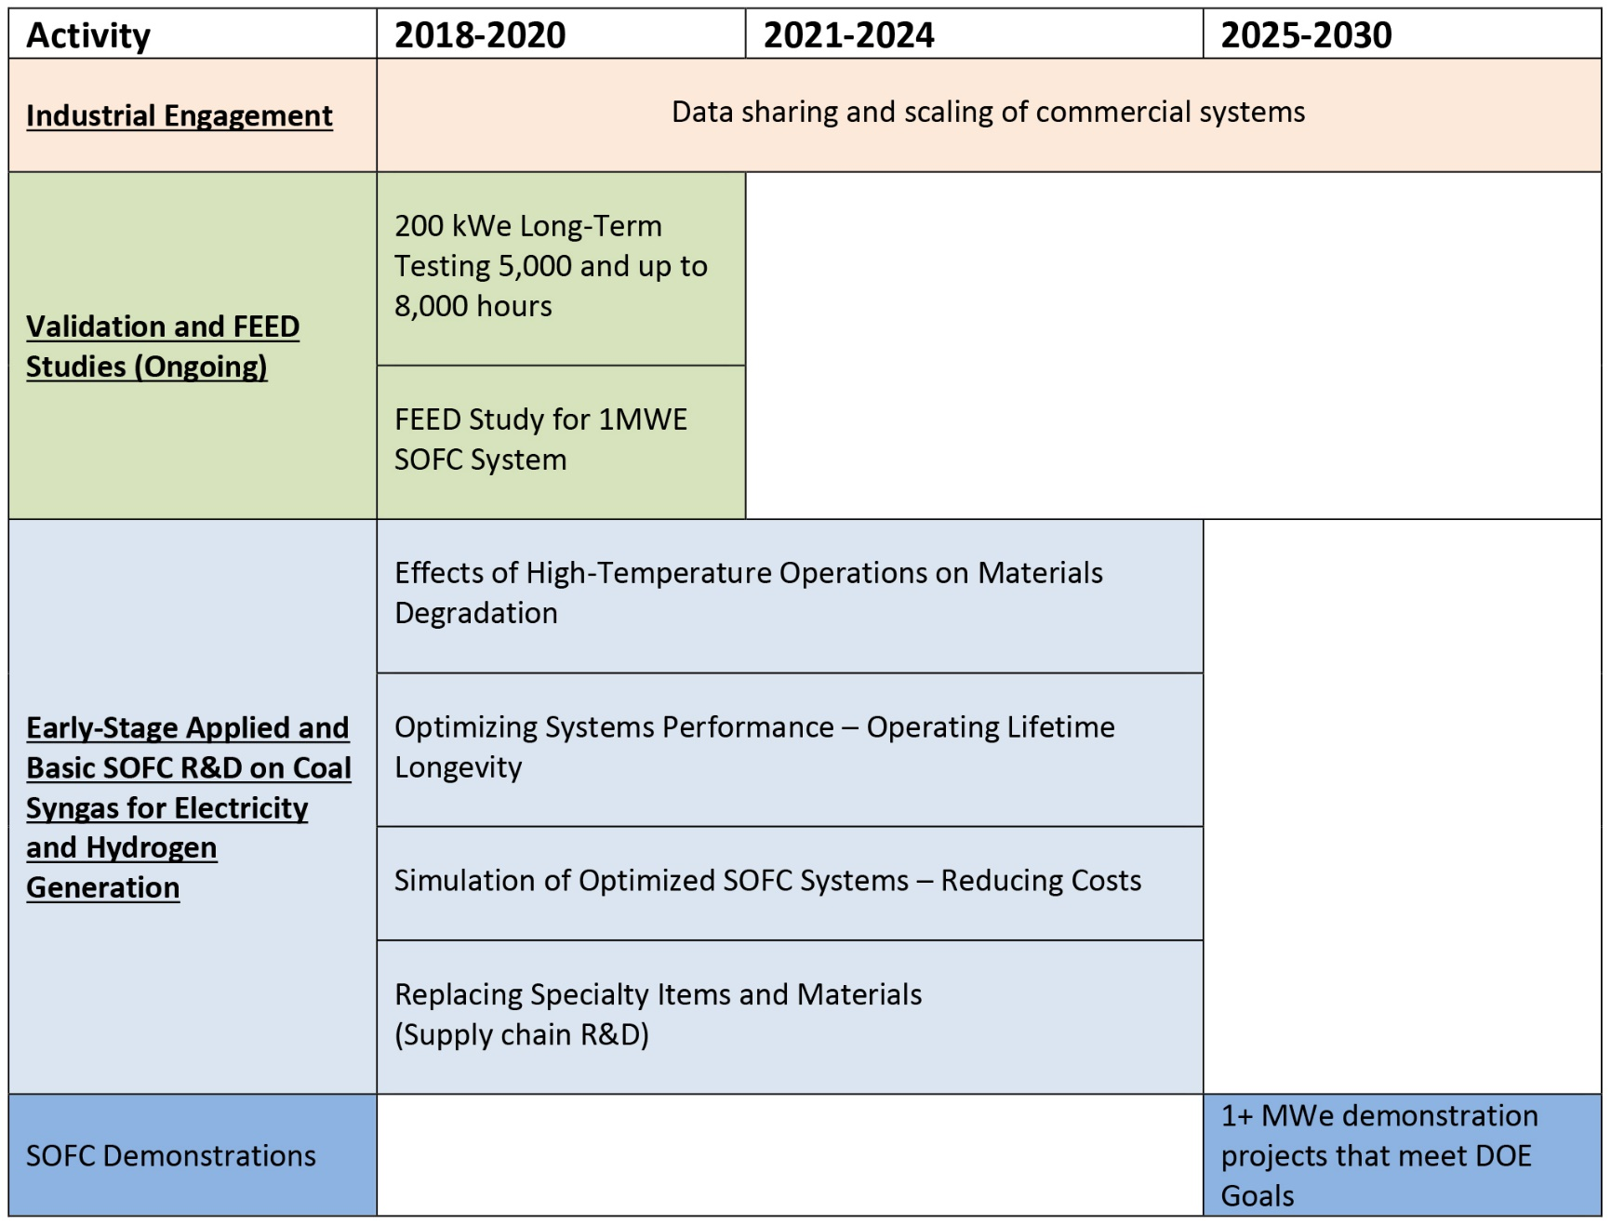
SOFC Program Development Timeline
Source: Report on the Status of the Solid Oxide Fuel Cell Program – Report to Congress (April 2019)

Slide 4
SOFC Program: Near-Term Objectives
Validate small-scale SOFC systems for distributed generation applications
Develop efficient and cost-effective electrolyzers for hydrogen production
Conduct additional basic R&D to mature SOFC technology and make progress towards low cost, high efficiency power generation

Slide 5
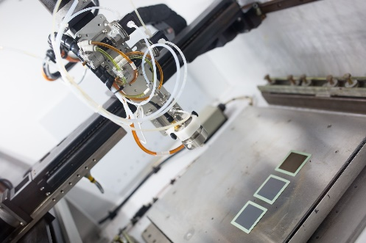
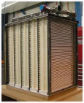
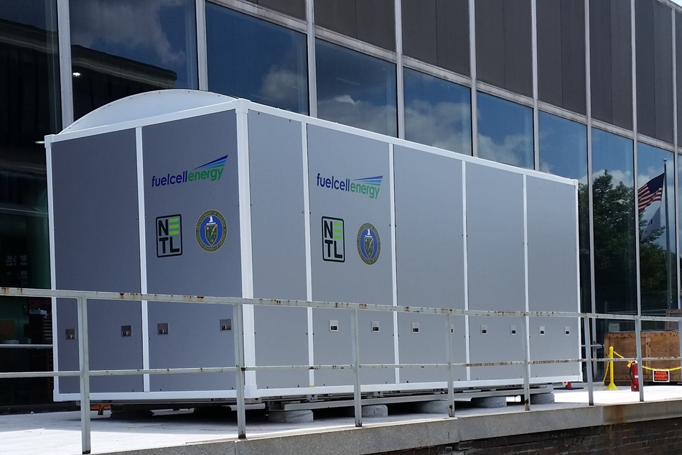
SOFC Program Structure
TECHNOLOGY AREA
KEY TECHNOLOGIES
SOLID OXIDE FUEL CELLS
Cell Development
Core Technology
Figure courtesy NETL
Figure courtesy LG Fuel Cell Systems
Systems Development
Figure courtesy FuelCell Energy

Slide 6

SOFC Program Project Portfolio
FY20 Participants

Slide 7
SOFC Program Metrics
Metric | Current | 2025/2030 Target
System Cost (100 kW- 1MW) | >$12,000/kWe | $900/kWe
System Degradation | 1 – 1.5% per 1,000 hrs | <0.2% per 1,000 hrs
Demonstration Scale | 5 kWe – 200 kWe | DG: MWe-class Utility-scale: 10 – 50 MWe
Single-cell performance and degradation are acceptable; system performance, reliability and endurance need to be demonstrated

Slide 8
SOFC Program: Funding History
*
*Directed to issue a $30M FOA in 2020, balance from other fiscal years

Slide 9
SOFC Program Accomplishments: 2019
University of North Dakota Energy and Environmental Research Center (UNDEERC)
Testing of cells and small stacks on coal syngas
Tennessee Technology University
High conductivity electrode-interconnect contact material
Mohawk Innovative Technology
Anode air recycle blower with lower part count
National Energy Technology Laboratory
Proof-tested a fuel cell system in reversible mode to produce hydrogen

Slide 10
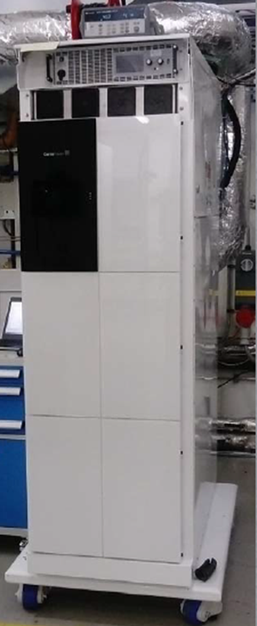
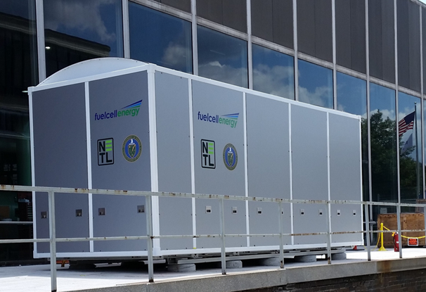
SOFC Prototype System Field Tests
FuelCell Energy
200 kWe integrated SOFC Power System
Fabrication of ~2,000 full-scale cells
~2,500 hours operation - Full power for one of the two modules
System power degradation < 1.5% per 1,000 hrs
Cummins-Ceres Power
10 kWe integrated SOFC Power System
~180 hours operation (Paused - COVID-19)
Testing to resume to complete 1,000 hrs operation
3.8’ X 1.8’ X 5.8’
20’ X 8’ X 8.5’
Photo courtesy FuelCell Energy
Photo courtesy Ceres Power

Slide 11
FY 2020 FOA (DE-FOA-002300)
Small-Scale Solid Oxide Fuel Cell Systems and Hybrid Electrolyzer Technology Development
Issue date: 5/28/2020
$30M total
AOI 1 – Small-scale distributed power generation SOFC systems.
AOI 2 – Hybrid systems using solid oxide systems for hydrogen and electricity production including the validation and development of materials and systems required for improving the cost, performance and reliability.
AOI 3 – Cleaning of coal-derived syngas for use as SOFC fuel and testing of single and multiple cells on syngas.
“Per the FY 2020 Energy and Water Appropriations Act Report (H.R. 1865 / Public Law 116–94) , “The Department is directed to issue a funding opportunity announcement for $30,000,000 for Solid Oxide Fuel Cells that includes all topic areas as outlined in the recommendations of the Department's August 2019 Report on the Status of the Solid Oxide Fuel Cell Program”

Slide 12
SOFC Program: Takeaways
Conducting additional basic R&D to address critical needs and mature technology
Acquiring fabricating and operational experience on integrated, prototype field tests
Cell Development and Core Technology R&D is aligned with industry need
SOFC power systems offer a pathway to the highest efficiency and lowest cost electric power generation from coal and natural gas with CCS

Slide 13




Questions?
VISIT US AT: www.NETL.DOE.gov
@NETL_DOE
@NETL_DOE
@NationalEnergyTechnologyLaboratory
https://netl.doe.gov/coal/research/energy-systems/fuel-cells
CONTACT:
Shailesh D. Vora, Technology Manger, Fuel Cells
Shailesh.Vora@netl.doe.gov 412-386-7515
REFERENCE SHELF:
- SOFC Program Project Portfolio
- Workshop Proceedings
- Systems Analysis

