Slide 1
A Transformational Natural Gas Fueled Dynamic SOFC for Critical Datacenter In-Rack Power
DE-FE-0031671
University of South Carolina
PI: Prof. Kevin Huang
Co-PI: Prof. Frank Chen
Project Period: August 17, 2018 – August 16, 2020
2020 Annual SOFC Review Meeting
July 10, 2020

Slide 2
Project Objective
To develop robust metal-bed compositions for new datacenter-suitable dynamic NG-fueled SOFC system

Slide 3
Project Status
Tasks | Deliverables | Status
Optimizing active metal/oxide ratio | Metal/oxide ratio (wt%): 90:10 | Complete
New metal phase compositions/segmented bed | Fe-30mol%Ni | Complete
New sintering-resistant and active oxide support | BaCe_{0.7}Zr_{0.1}Y_{0.1}Yb_{0.1}O₃ | Complete
Sintering-resistant active metal particles | Fe₂O₃@SiO₂ core-shell | Complete
SF-bed testing in SOFC | N/A | Ongoing

Slide 4
Outline
Results
New metal-bed compositions: Fe-Mn and Fe-Ni systems
New metal-support composition: BaCe_{0.7}Zr_{0.1}Y_{0.1}Yb_{0.1}O_{3-δ}
New Fe₂O₃@SiO₂ redox stable core-shell structure
TPR study
Chemical looping study
Mechanism for improved redox stability by Fe-Ni alloy
Summary
Ongoing activities
Acknowledgement

Slide 5
Metal-Bed Phase Composition Change during Redox Cycle
Fe-Mn system
(Fe₂O₃-Mn₂O₃)_{s}-ZrO₂
(Fe-Mn)_{s}-ZrO₂
Reduction
Fe-Ni system
(Fe₂O₃-NiO-NiFe₂O₄)-ZrO₂
(Fe-Ni)_{s}-ZrO₂
Reduction

Slide 6
TPR Profiles
Fe-Mn system
Fe-Ni system
Mn-addition slows down reduction
Ni-addition accelerates reduction

Slide 7
TPR of Fe-bed with Different Oxide Supports
10ºC/min
Proton containing BCZYYb (BaCe_{0.7}Zr_{0.1}Y_{0.1}Yb_{0.1}O₃) is the best to facilitate the reduction of Fe₂O₃

Slide 8
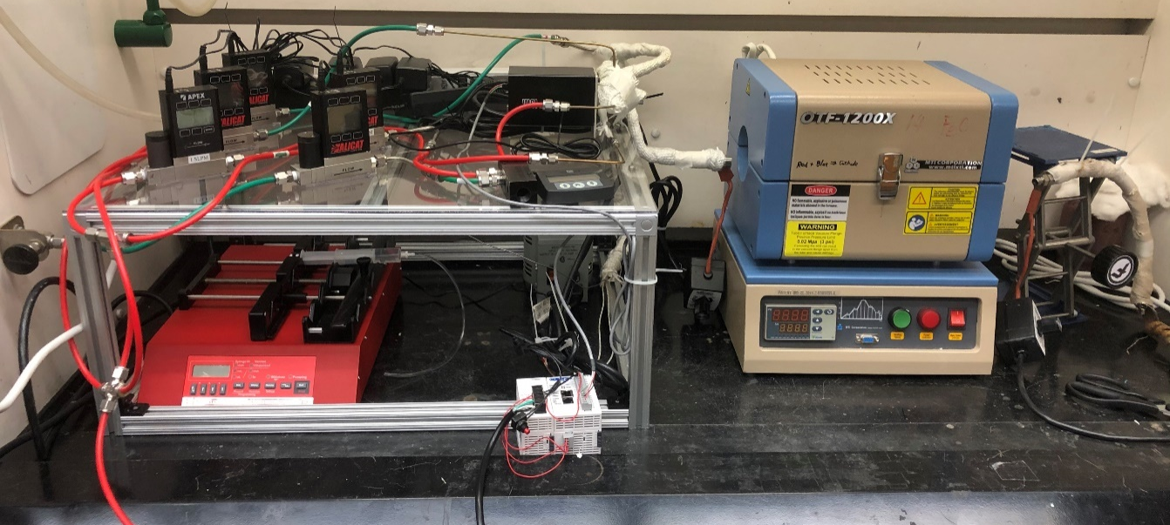
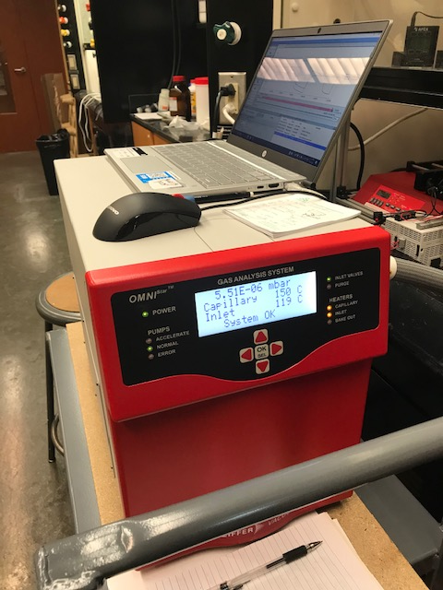
Chemical Looping Hydrogen (CLH) System
Mass flow controller
4-way switch
CLH reactor
Connect to MS
Water syringe pump
PLC controller
MS

Slide 9
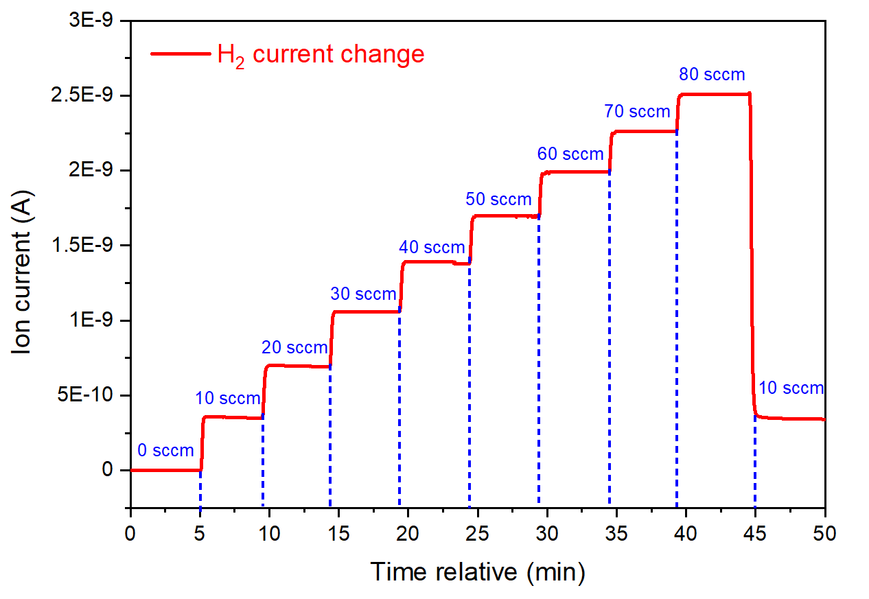
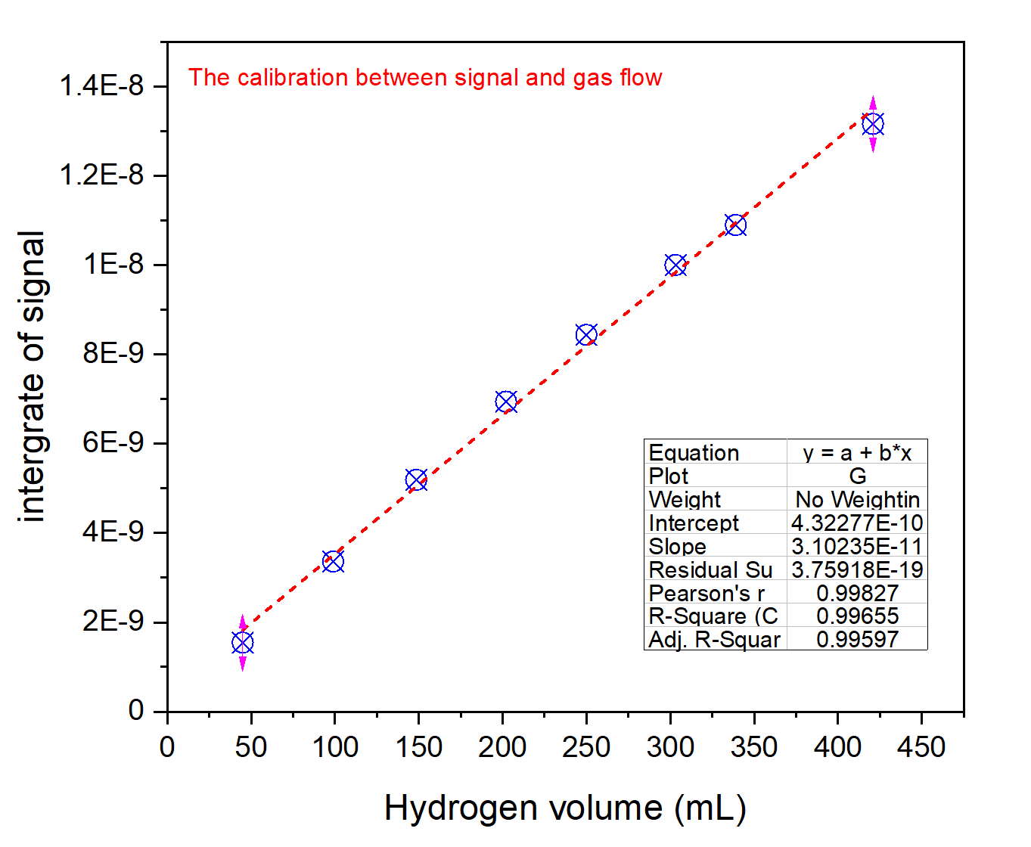
Calibration of MS
Integration of signal

Slide 10
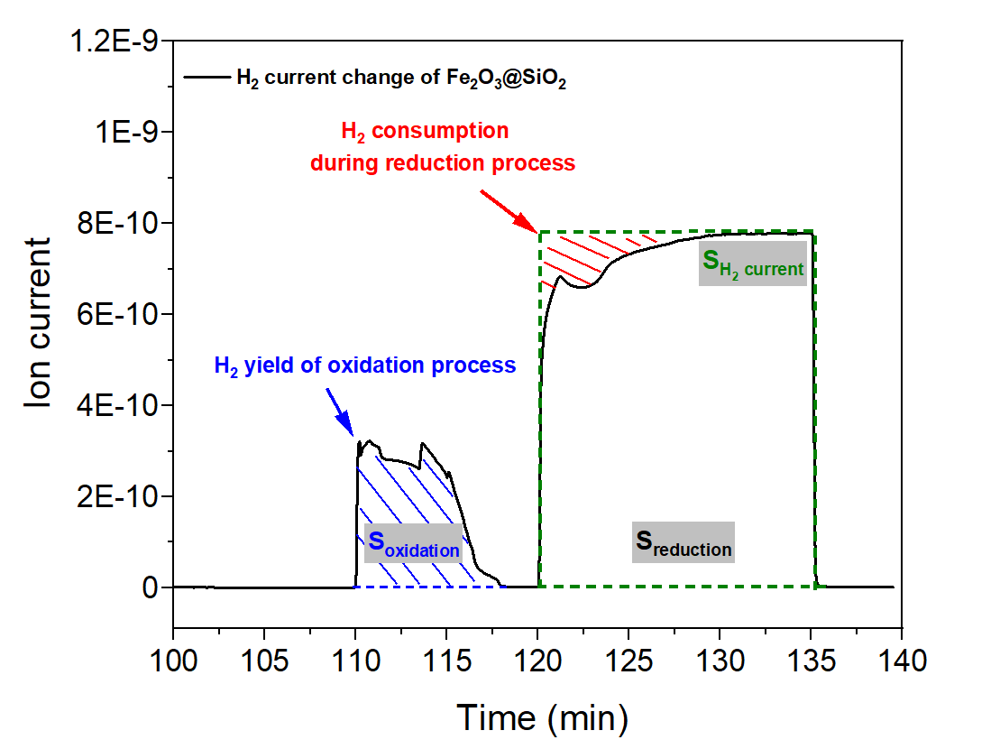
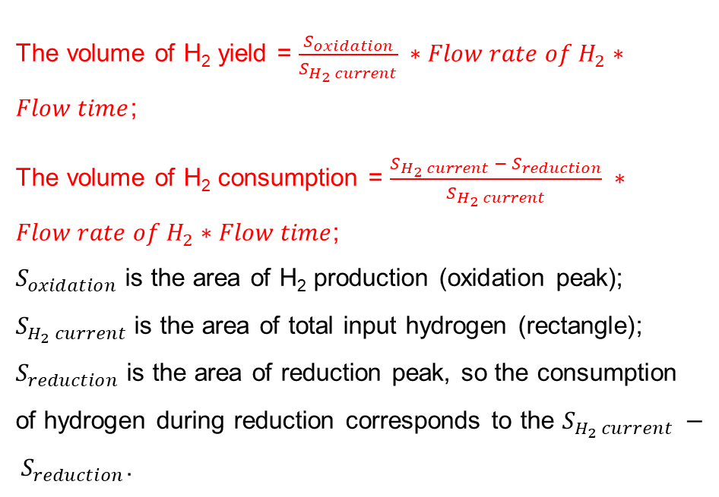
Calculation of Hydrogen Production and Consumption
The volume of H₂ yield = $\frac{S_{oxidation}}{S_{H_{2} current}} ∗Flow rate of H_{2}∗Flow time$;
The volume of H₂ consumption = $\frac{{S_{H_{2} current} − S}_{reduction}}{S_{H_{2} current}} ∗Flow rate of H_{2}∗Flow time$;
$S_{oxidation}$ is the area of H₂ production (oxidation peak);
$S_{H_{2} current}$ is the area of total input hydrogen (rectangle);
$S_{reduction}$ is the area of reduction peak, so the consumption of hydrogen during reduction corresponds to the $S_{H_{2} current} − S_{reduction}$.
10%H₂-Ar
(10 sccm H²)
10%H₂O-Ar

Slide 11
CLH – Baseline Fe-ZrO₂
Reduction
Before CLH
After CLH
No significant morphology change

Slide 12
CLH – Fe-Foam
Pure Fe-foam
Pure Fe-YSZ foam
Reduction
Reduction
Before CLH
After CLH
After CLH
Before CLH
After CLH
After CLH
Significant morphology change
Moderate morphology change

Slide 13
Comparison between Baseline and Fe-Foam
Severe sintering and low surface area in Fe-foam led to fast performance decade

Slide 14
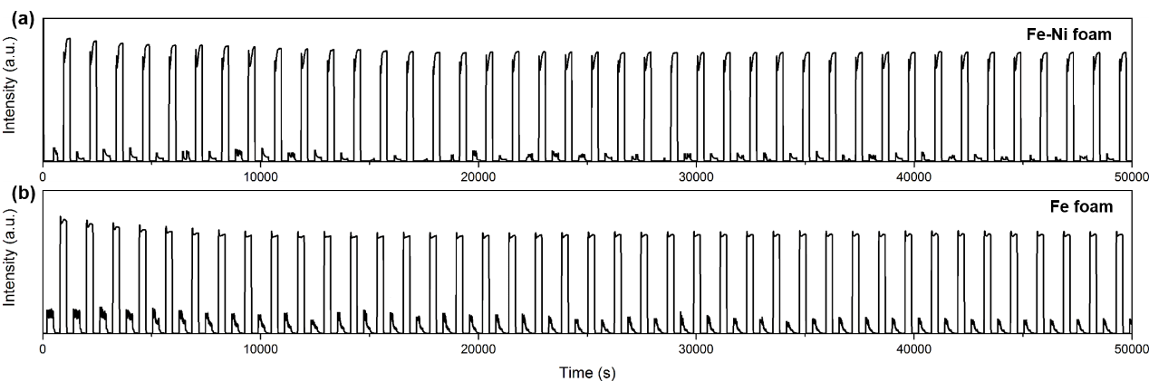
CLH – Fe-Ni Foam
Fe-Ni foam is more stable than Fe-foam during CLH, but has lower H₂ production rate

Slide 15
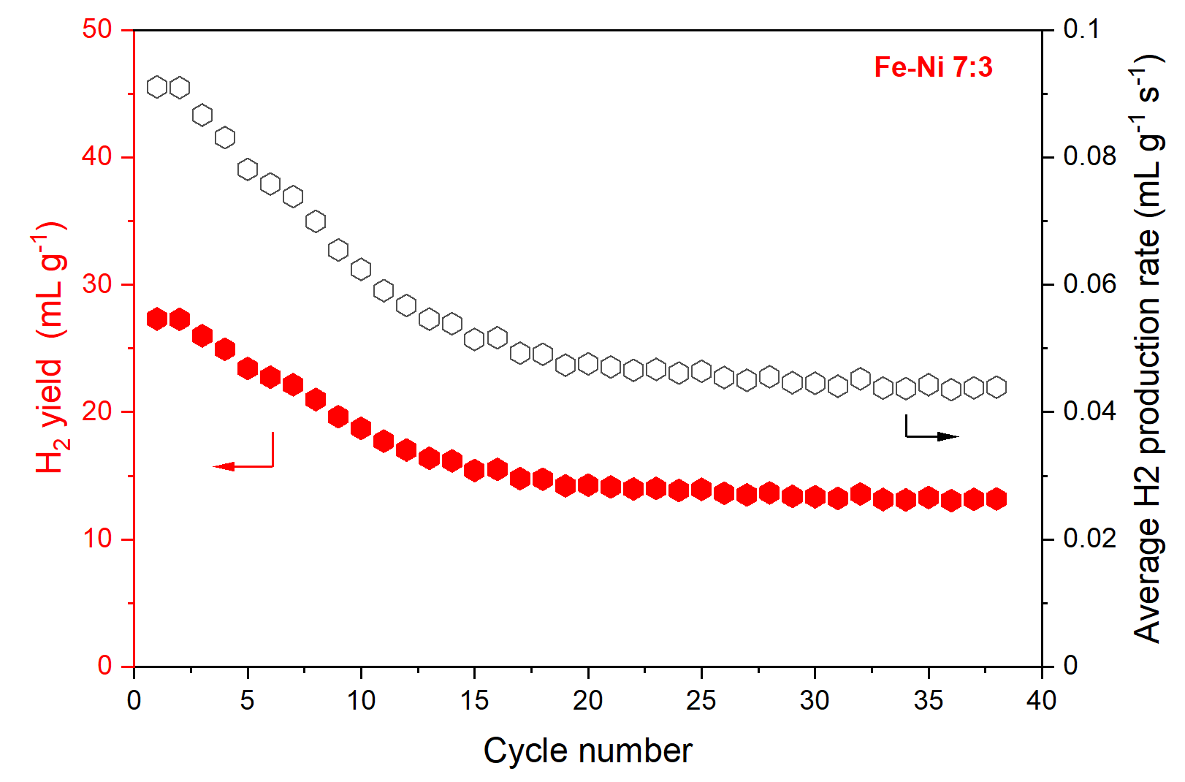
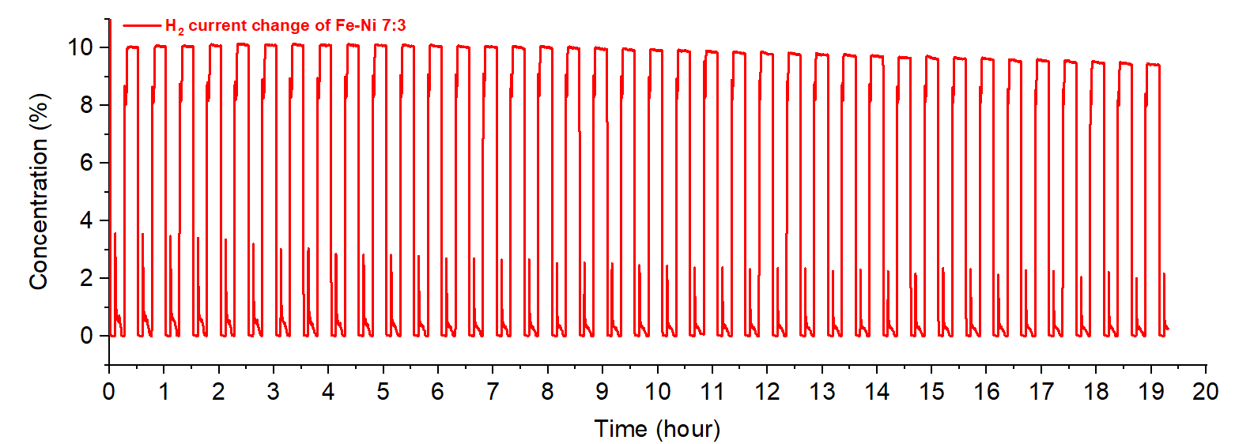
CLH – Fe-Ni-ZrO₂ (powder)
No ZrO₂ added
Testing condition: 10% H₂ and Argon, oxidation of 5 min and reduction of 15 min; 0.21g oxygen carrier materials.
The hydrogen yield was defined as the accumulated volume of hydrogen (mL g⁻¹) produced during oxidation process divided by the mass of active materials and the hydrogen production rate (mL g⁻¹ s⁻¹) is hydrogen yield divided by the oxidation- ycle time (5 min).

Slide 16
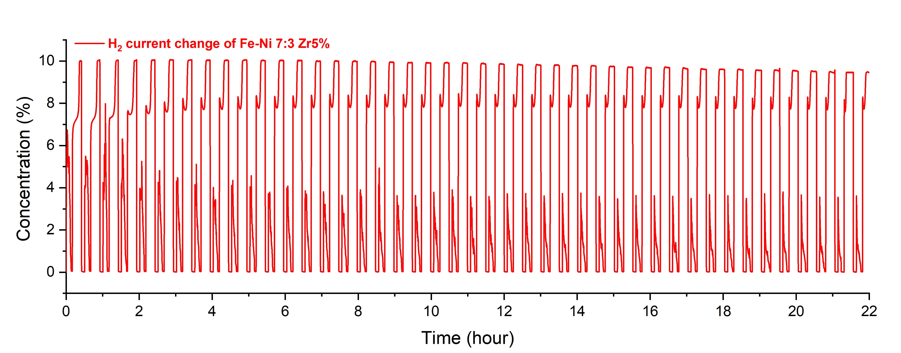
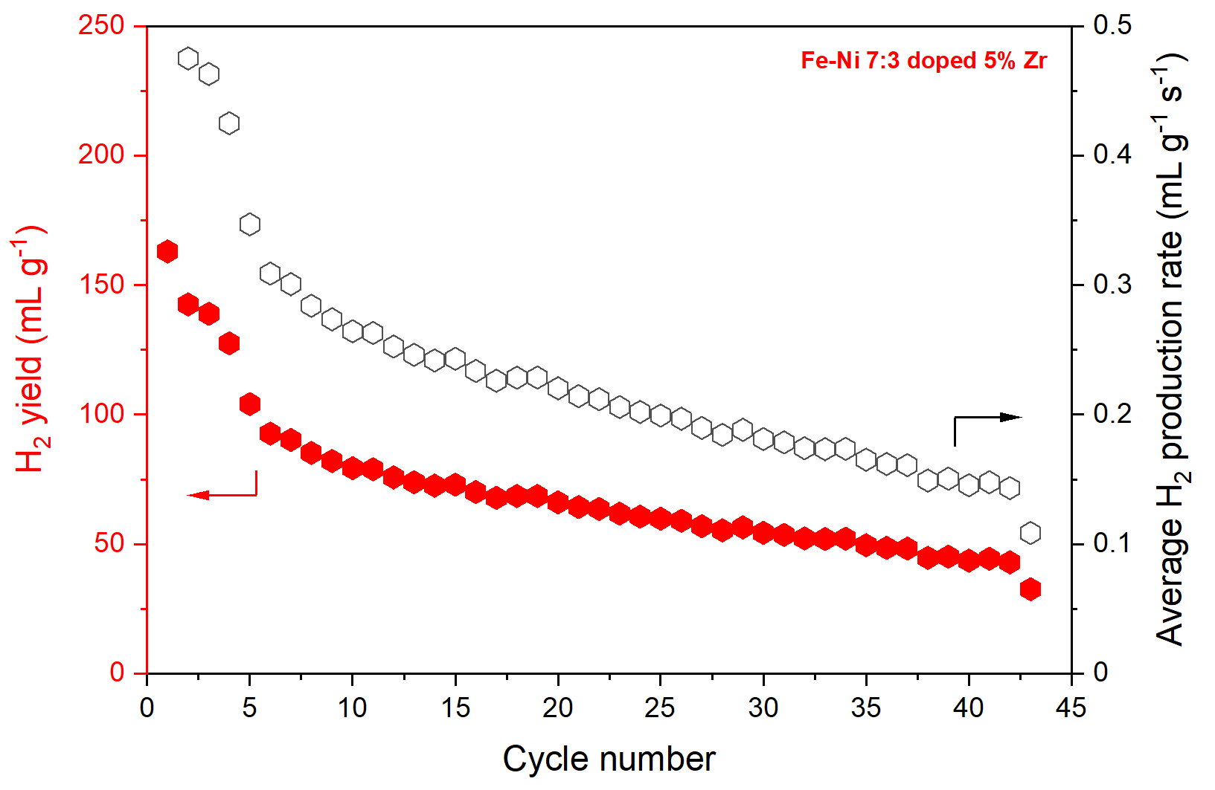
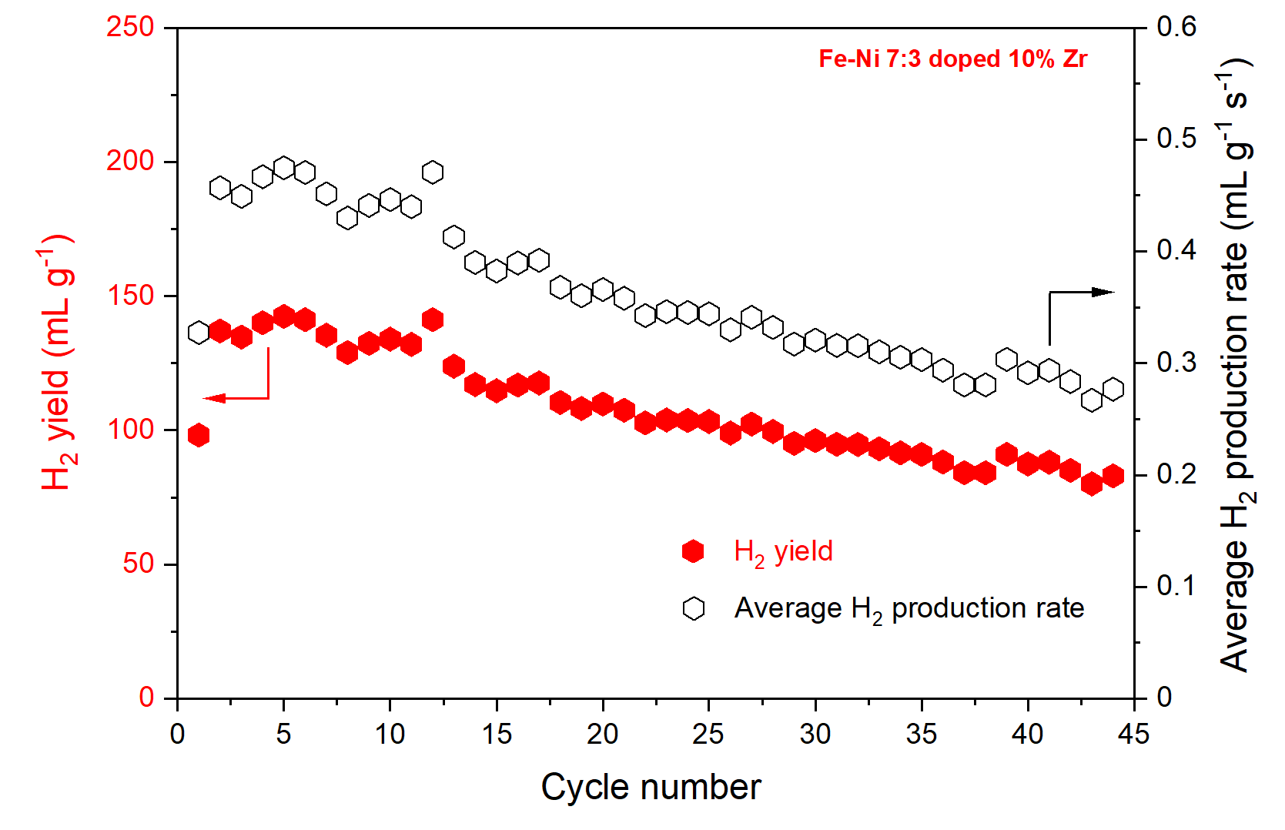
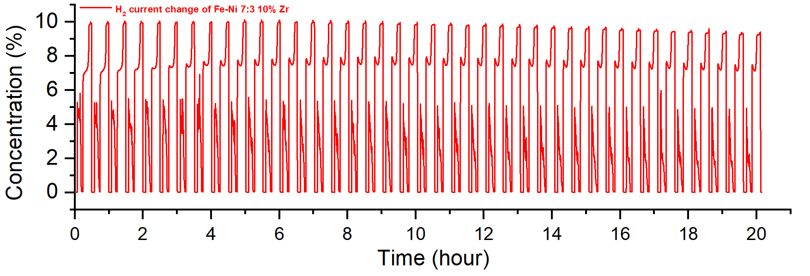
CLH – Fe-Ni-ZrO₂
5wt% ZrO₂ added
10wt% ZrO₂ added

Slide 17
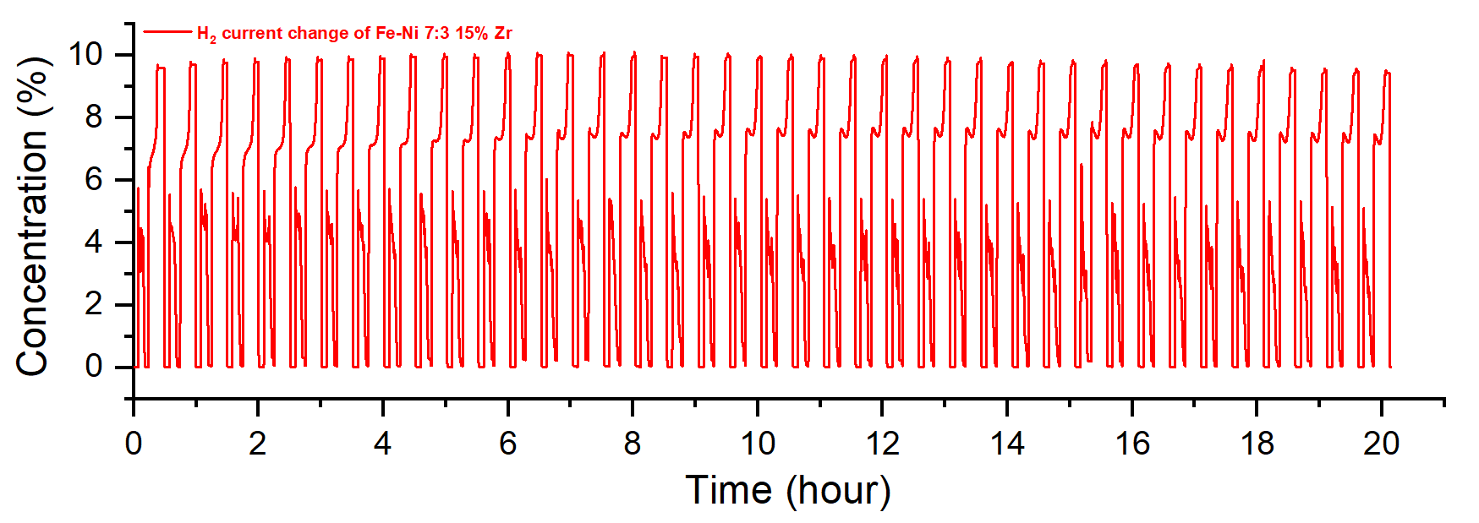
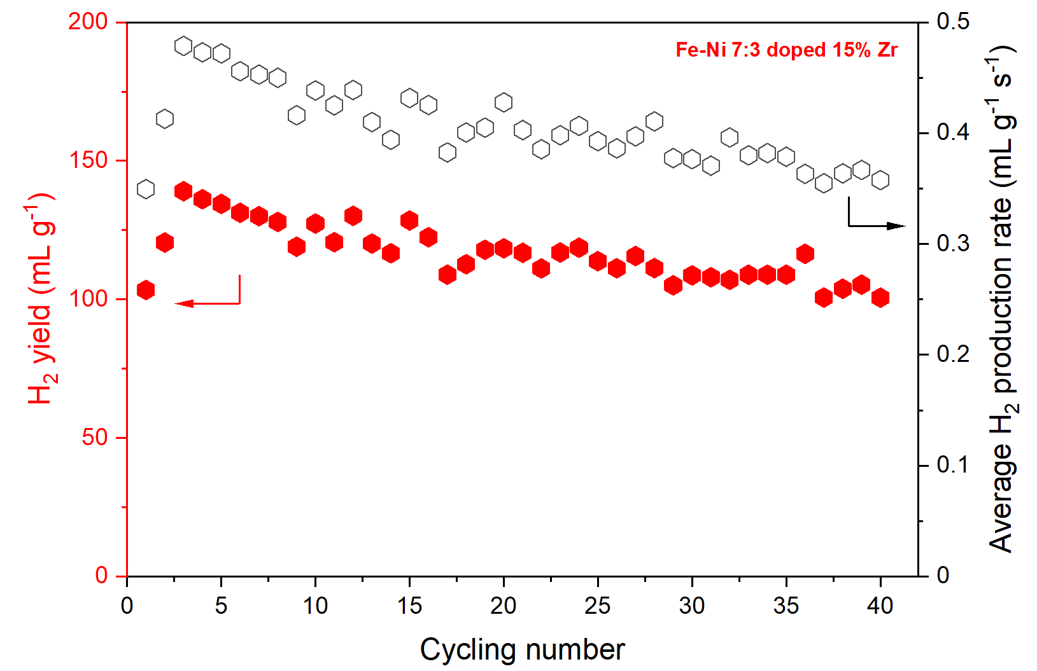
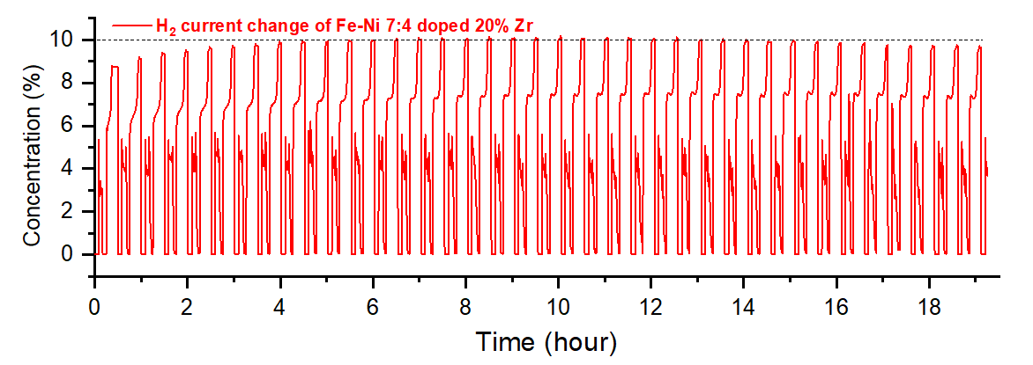
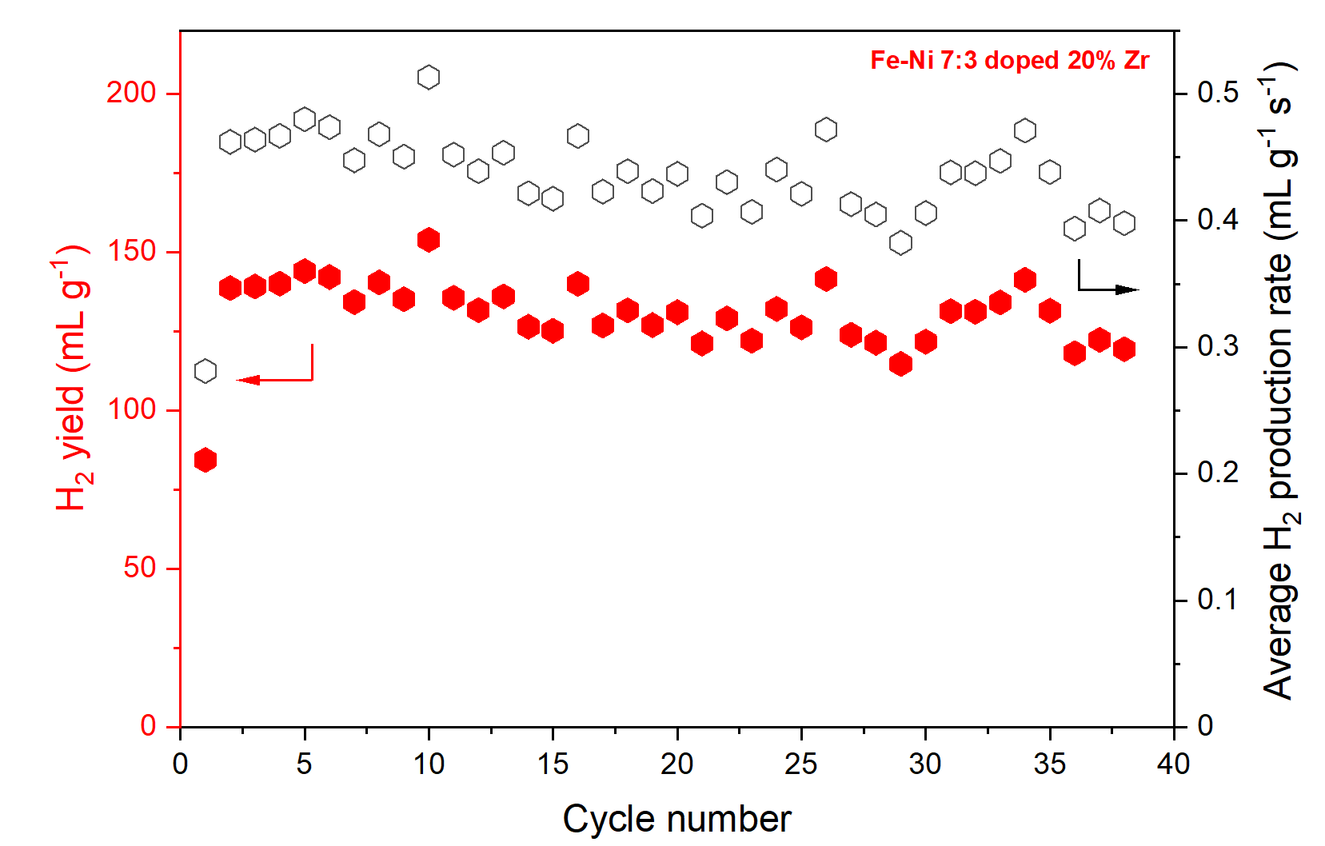
CLH – Fe-Ni-ZrO₂
15wt% ZrO₂ added
20wt% ZrO₂ added

Slide 18
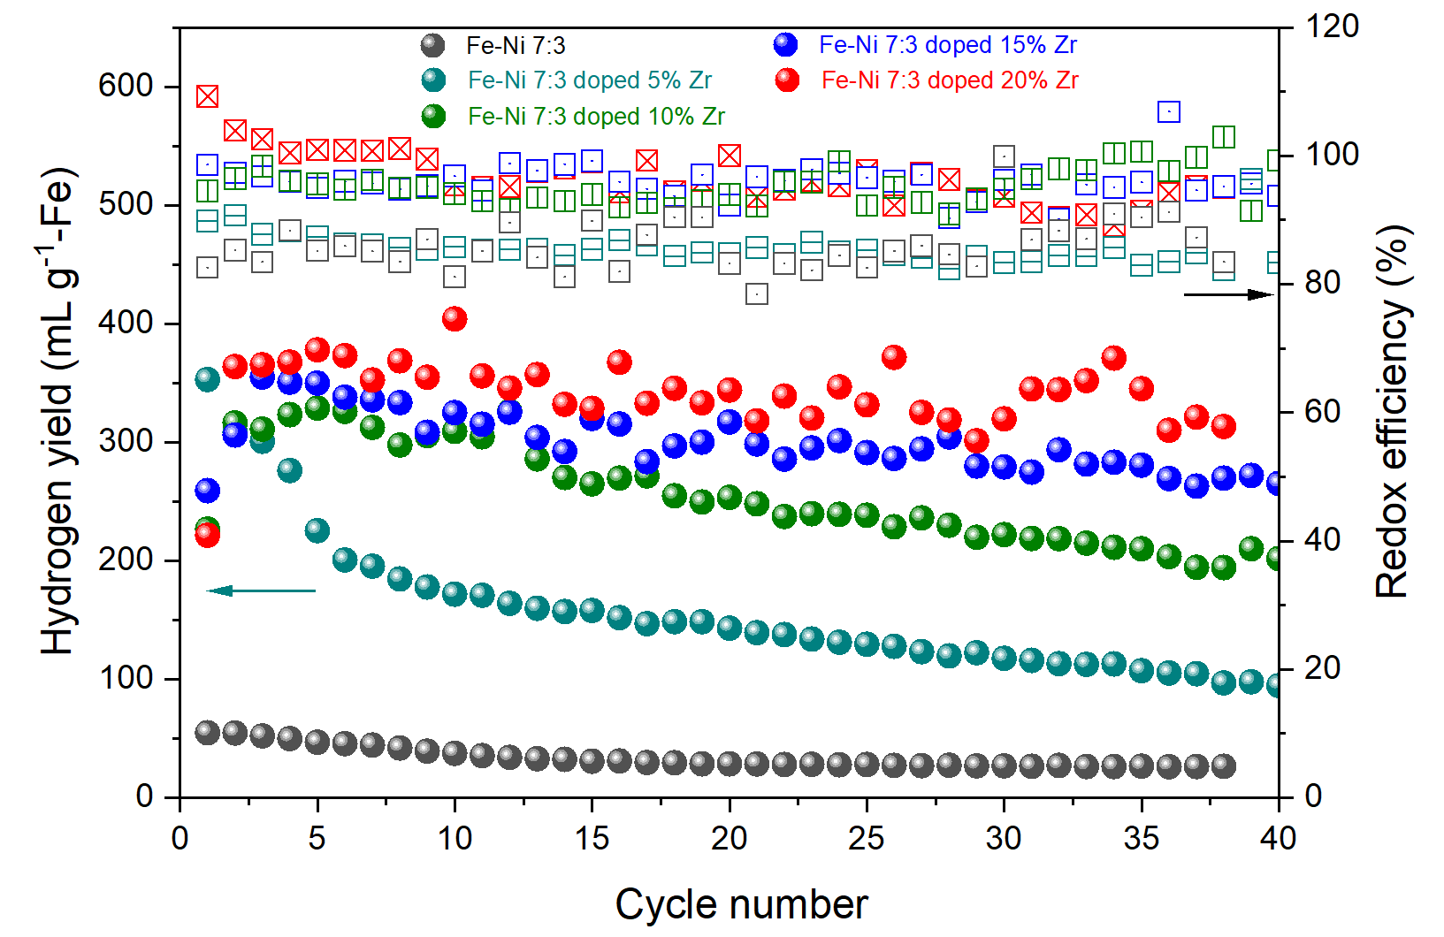
Comparison of H₂ Production by Fe-Ni-ZrO₂
From testing results, the Fe-Ni 7:3 (mol%) doped 20wt% Zr shows the highest hydrogen yield (~300 mL g⁻¹ after 40 cycles) and the best cycling stability with the redox efficiency of ~100%.

Slide 19
Fe-Ni-O Phase Diagram
XRD results are consistent with phase diagram prediction in phase composition during the oxidation cycle
Ni
Equilibrium triangles:
❶ (Fe-Ni)-FeO
❷ FeO-Fe₃O₄-NiO
❸ Fe₃O₄-NiO-NiFe₂O₄
❹ Fe₃O₄-Fe₂O₃-NiFe₂O₄
❺ Fe₂O₃-NiFe₂O₄-O₂
Fe, at%
Ni, at%
NiO
0.30Ni
Adding O (oxidation)
❷
❸
NiFe₂O₄
❶
❹
❺
Fe
O (1/2O₂)
FeO
Fe₃O₄
Fe₂O₃
O, at%

Slide 20
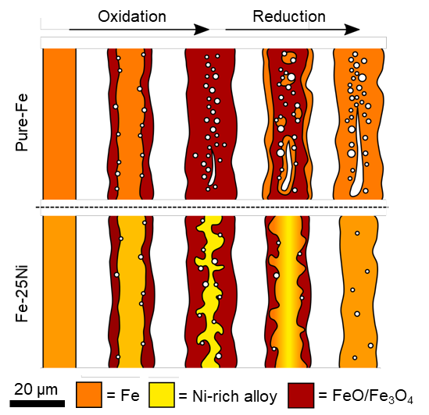
Mechanisms of Improved Fe-Ni Redox Cycle
In Pure Fe, the redox cycle causes a net outward Fe diffusion due to “Kirkendall” effect, leading to irreversible growth of internal micro-porosity in Fe body and formation of a dense, gas-blocking shell at the exterior surface
In Fe-Ni alloy, during oxidation it transforms into a composite structure with a Ni-rich alloy core and oxide surfaces. The internal Ni-rich phase imparts mechanical integrity against oxide fracture and spallation
During reduction, the Ni-rich phase maintains adhesion to the FeO/Fe₃O₄ surfaces, and Ni catalyzes Fe reduction at the metal/oxide interface, at which Fe diffuses inward to the Ni-rich core and Fe-Ni re-homogenization eliminates the micro-porosity formation during oxidation
Fe-30Ni

Slide 21
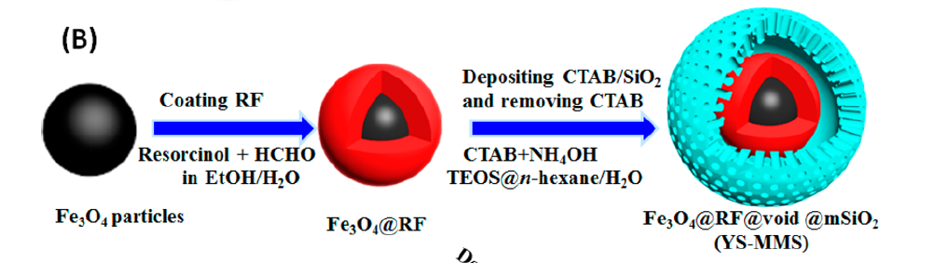

Fe₂O₃@SiO₂ Core-shell
Sintering at 600ºC for 5h
100 nm Fe₂O₃

Slide 22
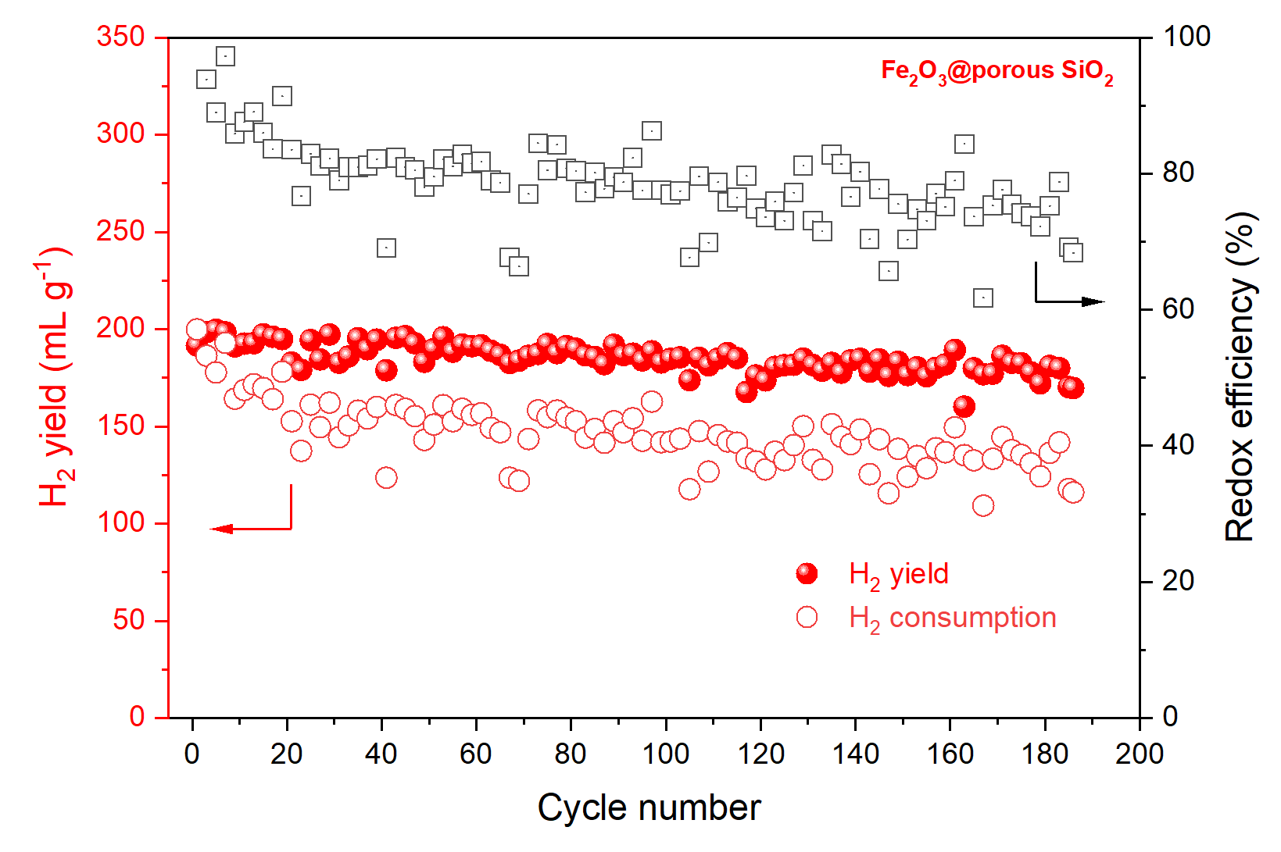
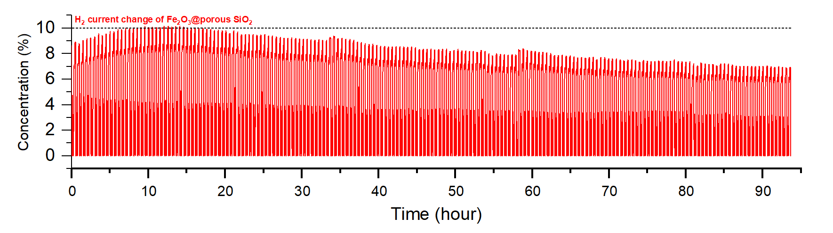
CLH - Fe₂O₃@SiO₂ Core-shell
The performance is comparable to Fe-30Ni-20wt%ZrO₂

Slide 23
Conclusions
Fe-30mol%Ni alloys is a better choice for solid-fuel composition than pure Fe due to its better resistance to “Kirkendall” effect
Chemical looping studies confirm that Fe-30mol%Ni with 20wt% ZrO₂ has the highest and most stable H₂ production rate
BaCe_{0.7}Zr_{0.1}Y_{0.1}Yb_{0.1}O₃ (BCZYYb) is a better oxide than ZrO₂ for active metal support due to its high proton concentration
A promising Fe₂O₃@SiO₂ composition is identified as a potential metal-bed composition
18

Slide 24
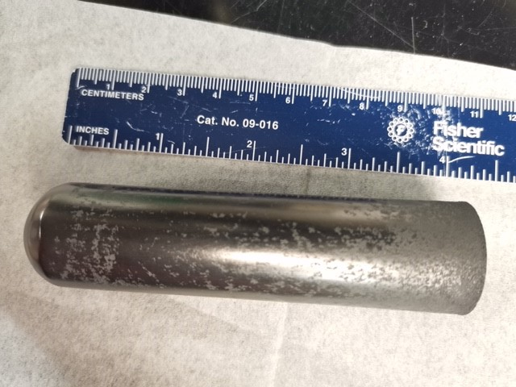
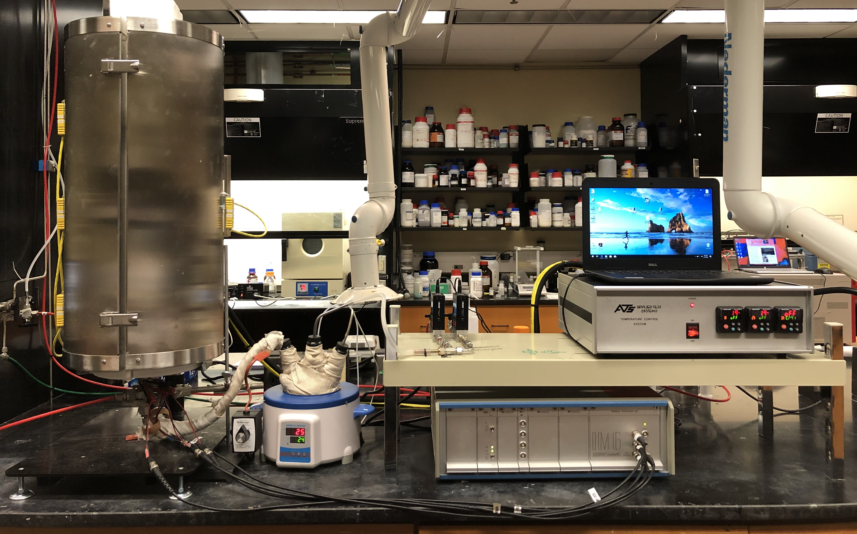
Ongoing Activities
Continuing CLH testing on Fe₂O₃@SiO₂
Tubular cell making
Testing Fe-Ni-ZrO₂ bed with BCZYYb support
Ventilation
Furnace
Computer
MFC
TC
Bubbler
EC station
18

Slide 25
Acknowledgement
DOE NETL for supporting this work under award DE-FE-0031671
Diane Revay Madden is the project manager and Dr. Shailesh Vora is the program director

