Slide 1

Enhancing Coking Tolerance and Stability of SOFC Anodes Using ALD of Oxide Thin Films
Raymond J. Gorte, John M. Vohs
University of Pennsylvania
and
Steve McIntosh
Lehigh University

Slide 2
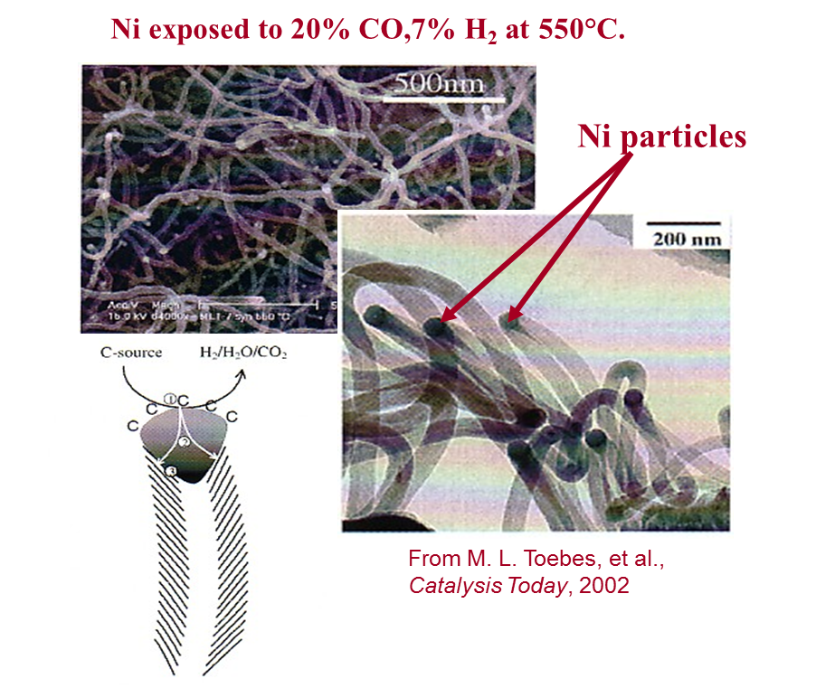
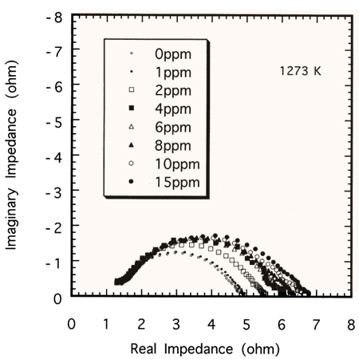
Anode Issues:
Hydrocarbon tolerance 2) Sulfur tolerance
Ni-YSZ Anode – 1273 K
H₂ + x ppm H₂S
From Matsuzaki and Yasuda, Solid State Ionics, 132 (2000) 261.

Slide 3
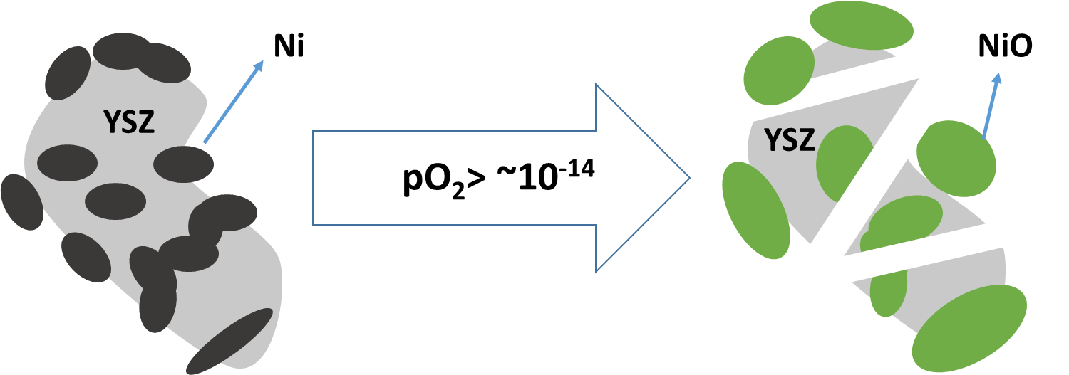
Anode Issues:
3) Poor redox stability
Ni oxidation by O₂ or high H₂O:C ratios causes fracture of the anode.

Slide 4
Program Goals and Approaches:
Goals
“Engineer” the surface composition of the anode to introduce barrier layer.
Determine the effect of oxide coatings on electrode performance.
Technical Approach
Use atomic layer deposition (ALD) to selectively deposit oxide thin films onto both cathodes and anodes.
Determine the effect of films on electrode performance.

Slide 5
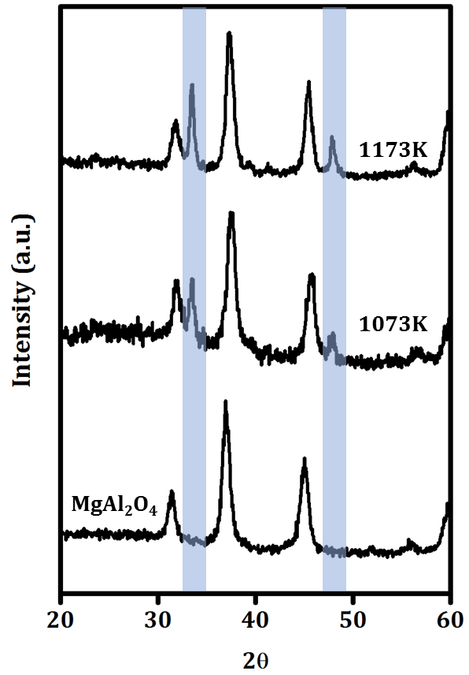
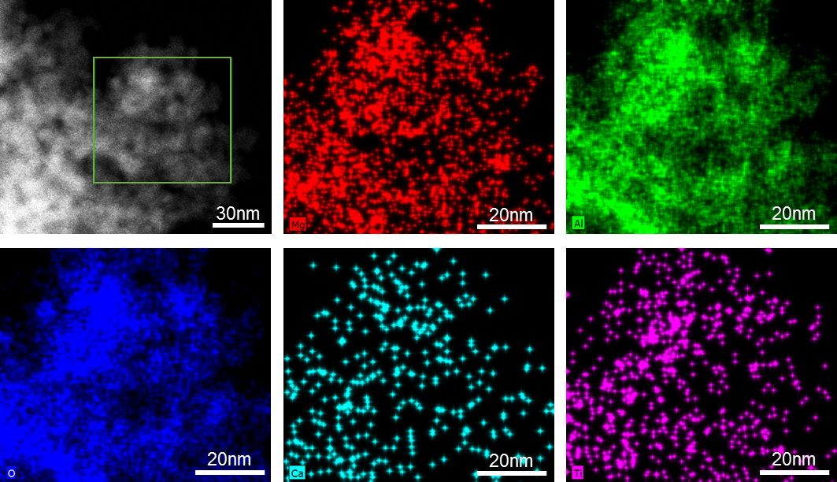
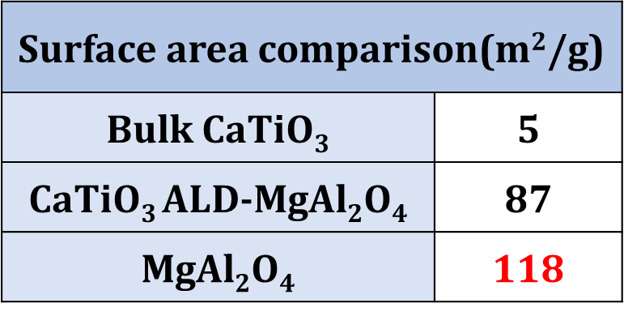
Idea: Grow CaTiO₃ on top of Ni cermet
30-wt% CaTiO₃ on MgAl₂O₄:
ACS Catal., 8 (2018) 7679.

Slide 6
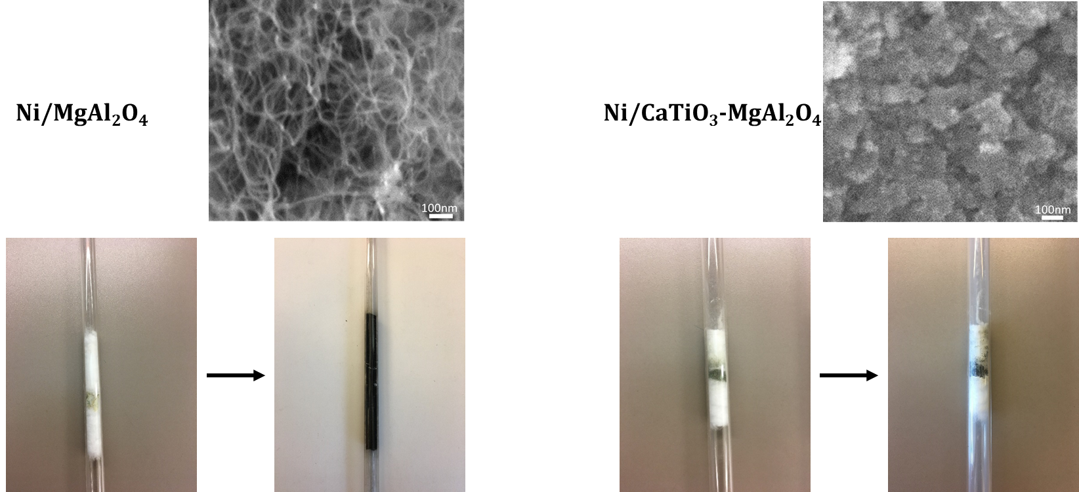
CaTiO₃ suppresses carbon formation for Ni
Ni/CaTiO₃/MgAl₂O₄ exposed to 10% CH₄-He at 800 °C for 12 h
ACS Catal., 8 (2018) 7679.

Slide 7
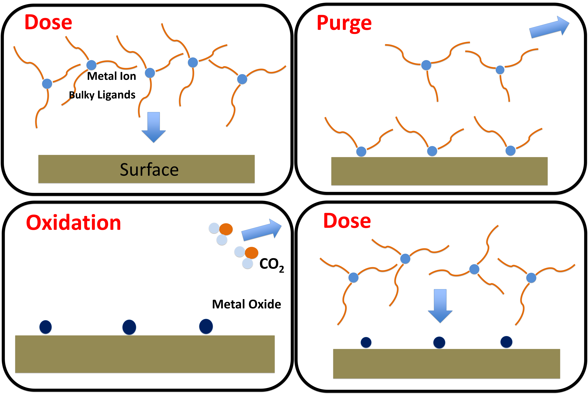
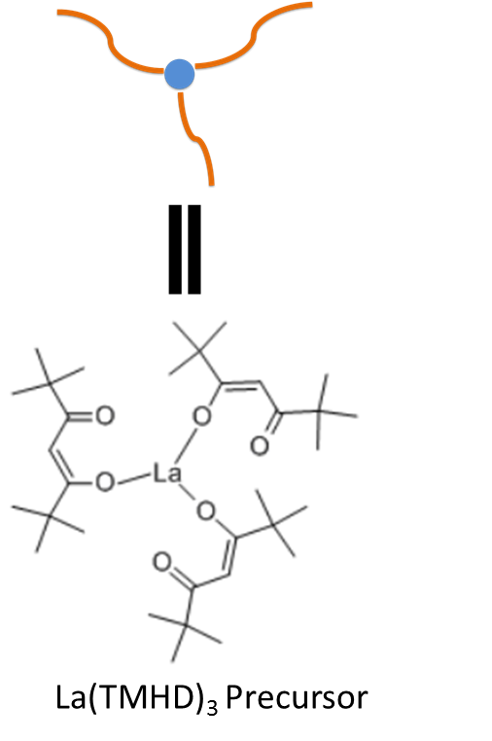
Atomic Layer Deposition (ALD)
Allows layer-by-layer control
Can deposit mixed oxides, including perovsites
Only surface composition is modified.

Slide 8
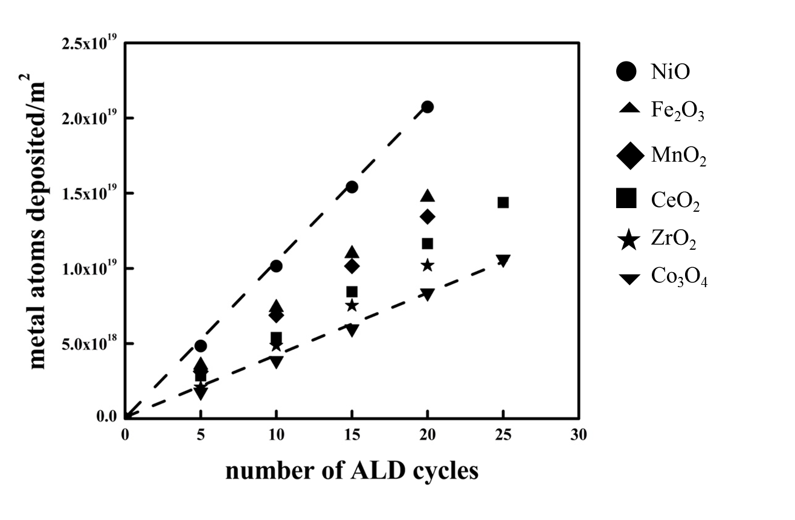
Growth rates:
1) Can be measured gravimetrically
1-nm of CeO₂ on 10 m²/g support is ~7-wt%
2) Similar for different oxides:
~1x10¹⁸ metal atoms/m²-cycle ~ 0.02-nm/cycle
3) 10 ALD cycles ~ 1 monolayer.

Slide 9
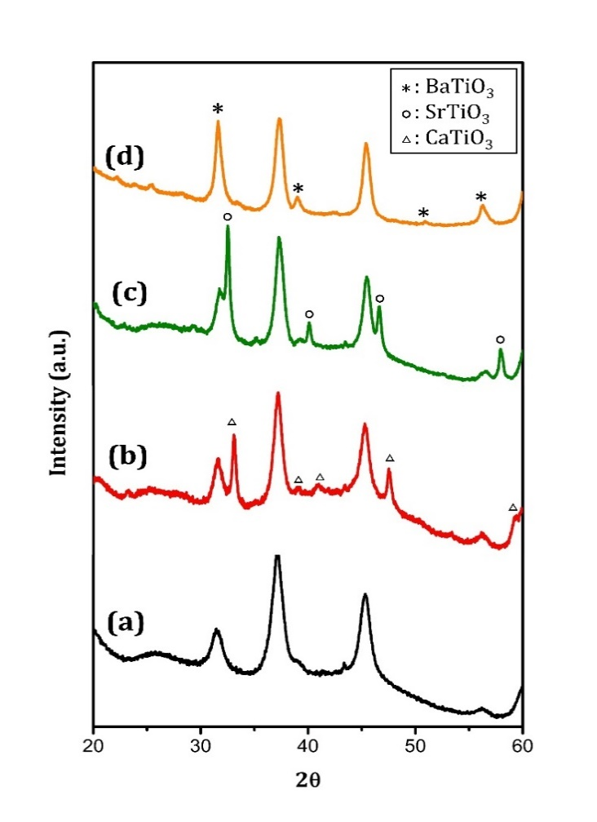
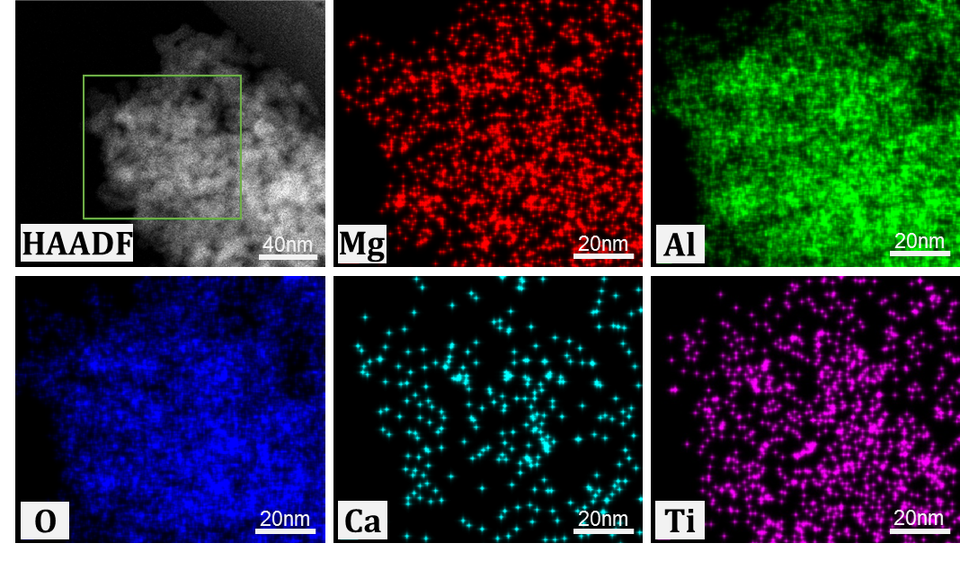
1) ALD forms uniform films (not particles).
2) ALD does not change the surface area.
3) ALD allows formation of mixed-oxide, thin films.
Why ALD and not simple infiltration?
XRD of 1.0-nm, ALD films of ATiO₃ on MgAl₂O₄
STEM of CaTiO₃ on MgAl₂O₄

Slide 10
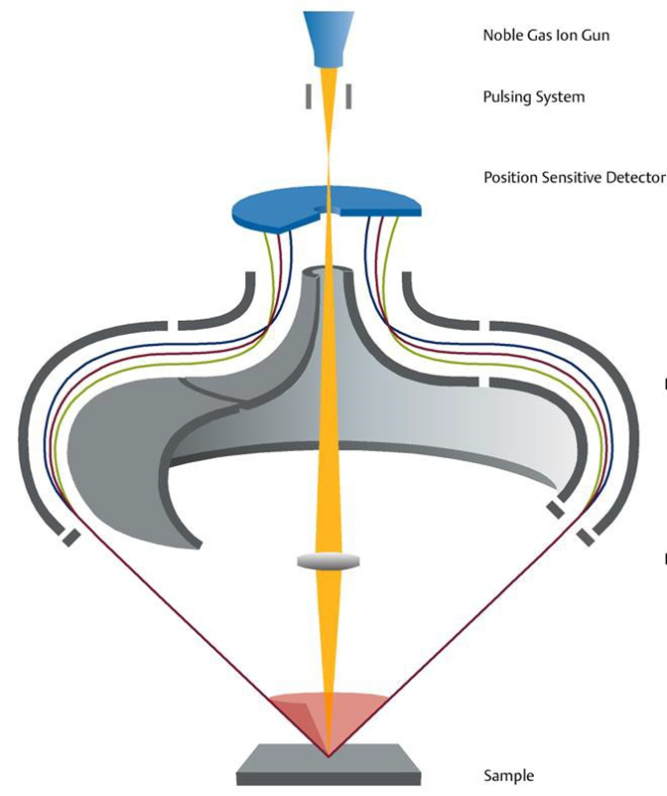
High Sensitivity-Low Energy Ion Scattering:
LEIS
HS-LEIS
Large acceptance angle ( 360º )
Parallel Energy Detection

Slide 11
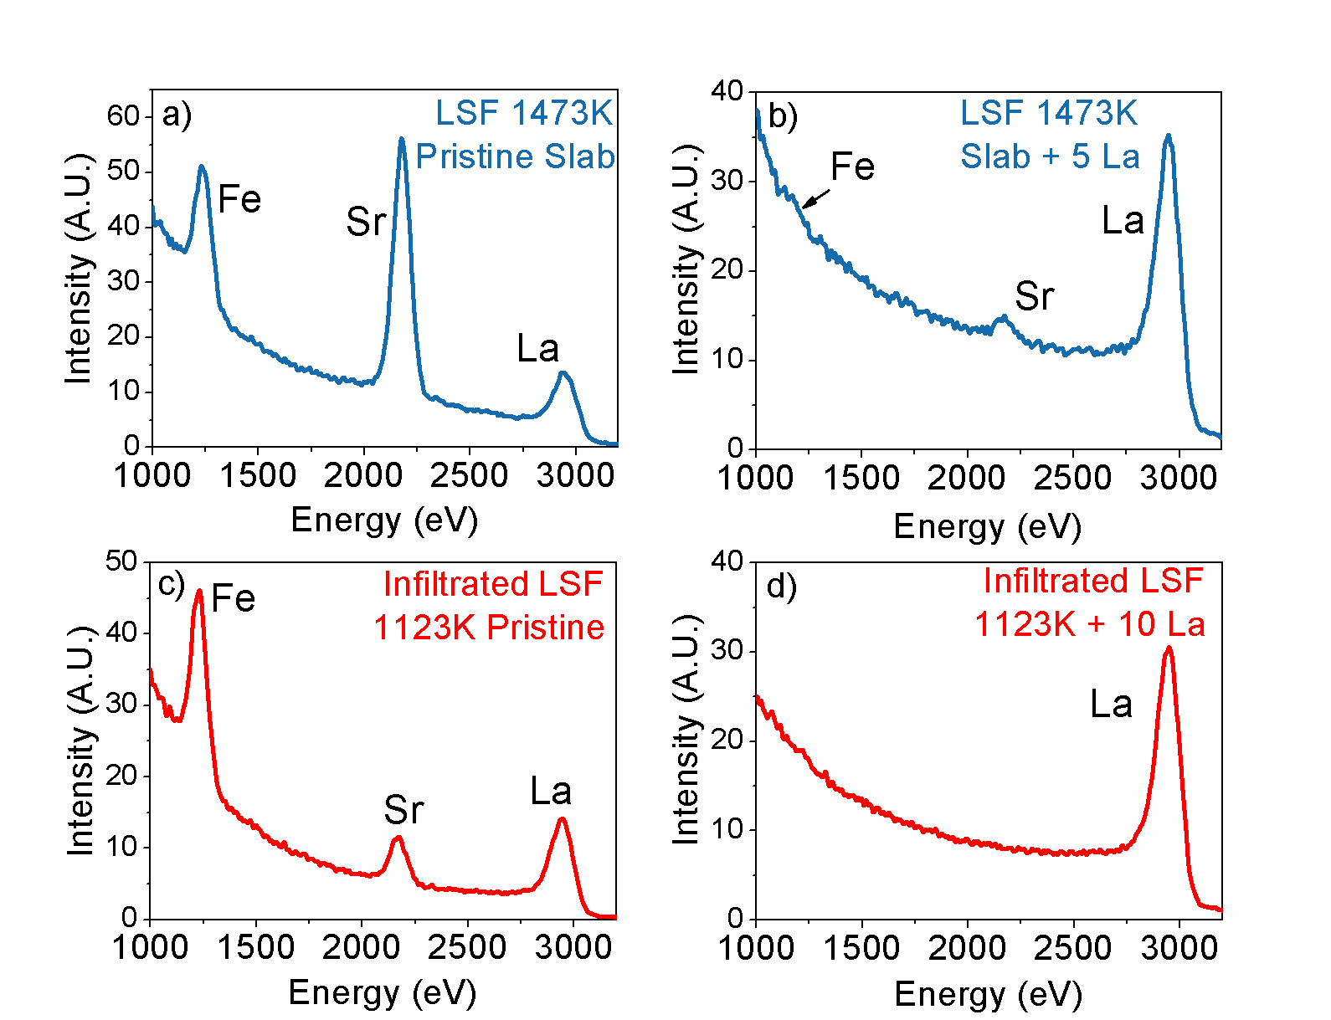
Confirmation of Film Uniformity:
LEIS
XPS
LSF cathode with:
0 cycles of Co
10 cycles of Co
40 cycles of Co

Slide 12
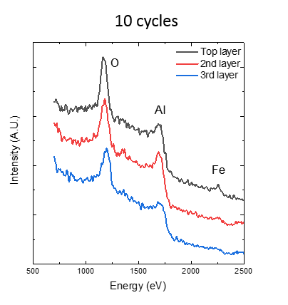
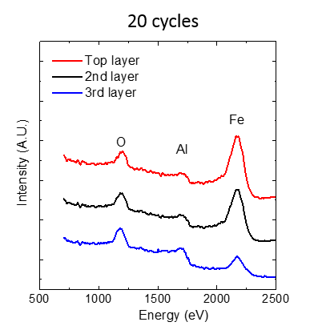
Depth Profiling of ALD by HS-LEIS
Fe deposition onto porous Al₂O₃ substrates.
Sub-monolayer coverage after 10 ALD cycles largely removed by three sputtering cycles
Full coverage after 20 ALD cycles.

Slide 13
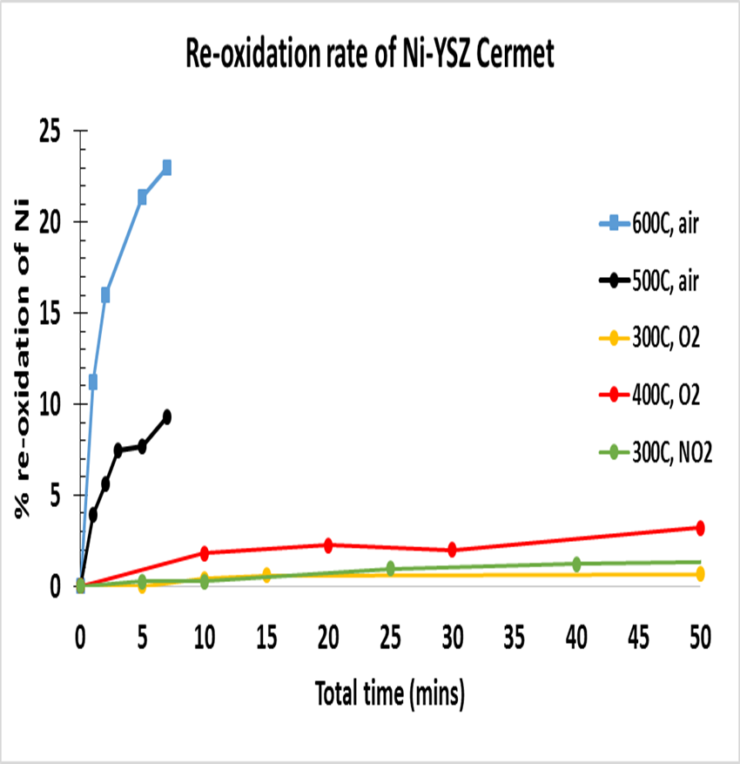
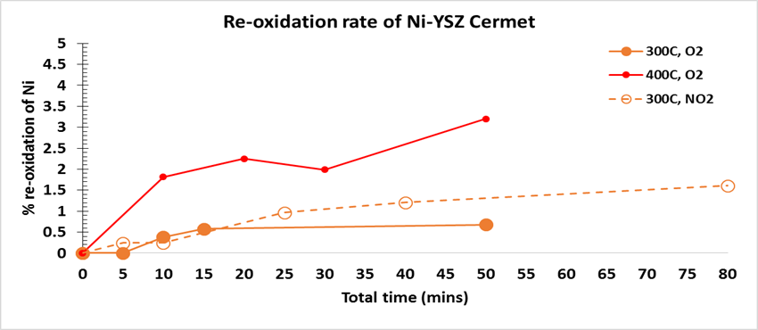
ALD Considerations:
Ni will rapidly if oxidized at high Temperatures
But to deposit metal oxides by ALD requires an oxidation step (400-500 °C in air)
Temperatures need to be lowered to prevent Ni oxidation
More reactive precursors are unstable
Stronger oxidants to lower oxidation T?
Ozone & O₂ Plasma unable to oxidize precursors in porous materials
H₂O₂ comparable to oxygen for precursors of interest.
NO₂: Strong oxidant but forms nitrates that need to be removed by a reduction step

Slide 14
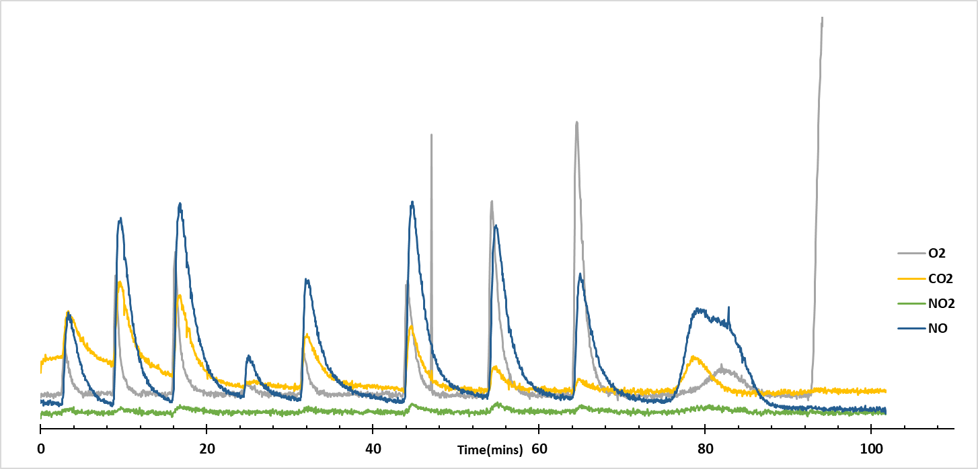
Demonstration of Precursor Oxidation by NO₂:
1 g of (120 m²/g) y-alumina with 1 cycle of Ce-THMD precursor deposited
NO₂ is pulsed in at 300 °C (detected as NO & NO₂) , CO₂ and CO are measured
O₂
He
300 °C
500 °C
NO2 exposures

Slide 15
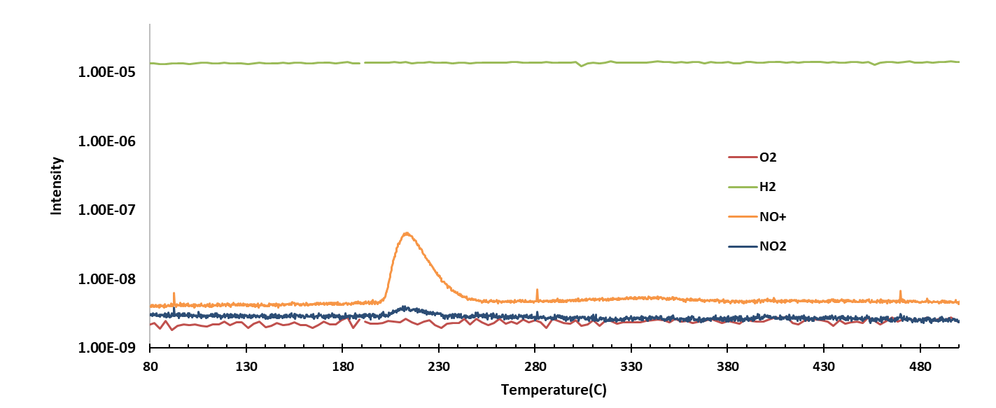
Metal Nitrate reduction:
0.5 g of y-alumina with 1 cycles of Ce-THMD precursor deposited
Sample is exposed to NO₂
TPR is performed in H₂ to enhance metal-nitrate decomposition
Evolution of NO_{x} species is clear with trace amounts of H₂O

Slide 16
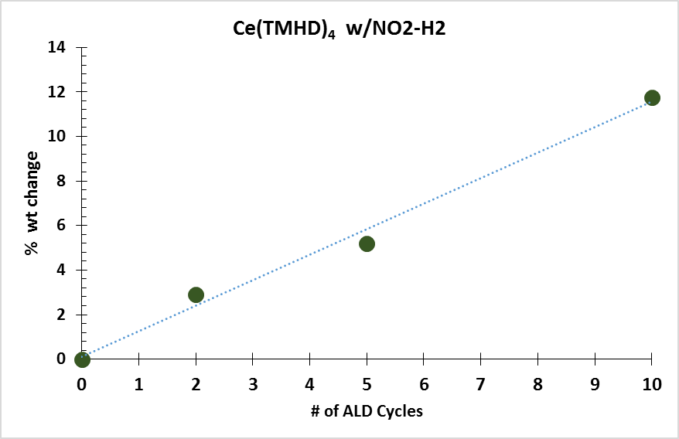
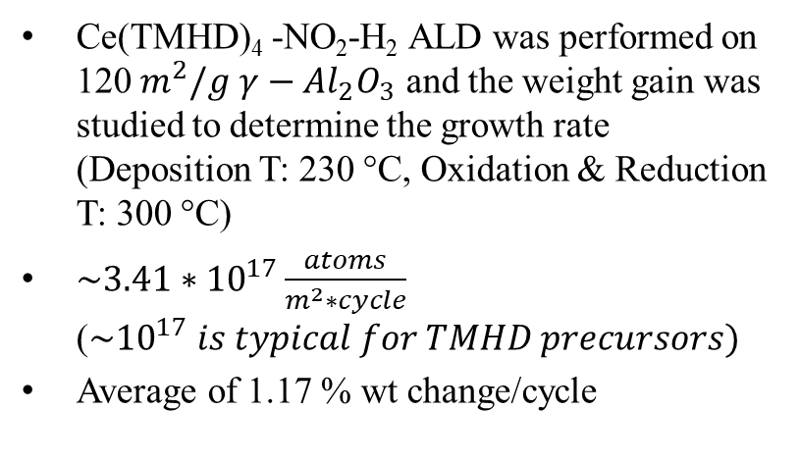
Confirmation of Ce ALD growth rate:
Ce(TMHD)₄ -NO₂-H₂ ALD was performed on 120${ m}^{2}/g$ $γ−{Al}_{2}O_{3}$ and the weight gain was studied to determine the growth rate (Deposition T: 230 °C, Oxidation & Reduction T: 300 °C)
${\sim 3.41∗10}^{17}\frac{atoms}{m^{2}∗cycle}$ (${\sim 10}^{17} is typical for TMHD precursors)$
Average of 1.17 % wt change/cycle
Proposed reactions:
$${Oxidation:Ce\left(C_{11}H_{19}O_{2}\right)}_{4}(ads)+ {200 NO}_{2}→Ce({{NO}_{3})}_{4}+{44 CO}_{2}+38{ H}_{2}O+196 NO+41 O_{2}$$
$$Reduction: 2 Ce({{NO}_{3})}_{4}+{2 H}_{2} →2 CeO_{2}+{8 NO}_{2}+{2 H}_{2}O+O_{2}$$

Slide 17
Test for Enhanced Coke Tolerance in Ni-YSZ by CeO₂ ALD.
Methods:
Ball mill NiO:YSZ+C powders (60:40, 10 wt%)
Press into slabs
Sinter at 1450 °C for 4 hours, and reduce at 700 °C for 2 hours
Deposit Ceria with ALD
Coking Test: Expose to dry CH₄ (25ml/min) at 750°C for 2 hours

Slide 18
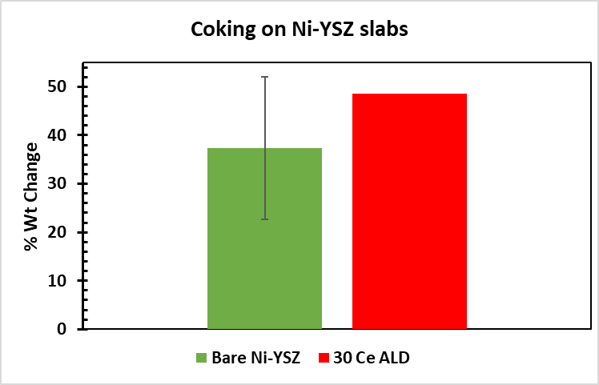
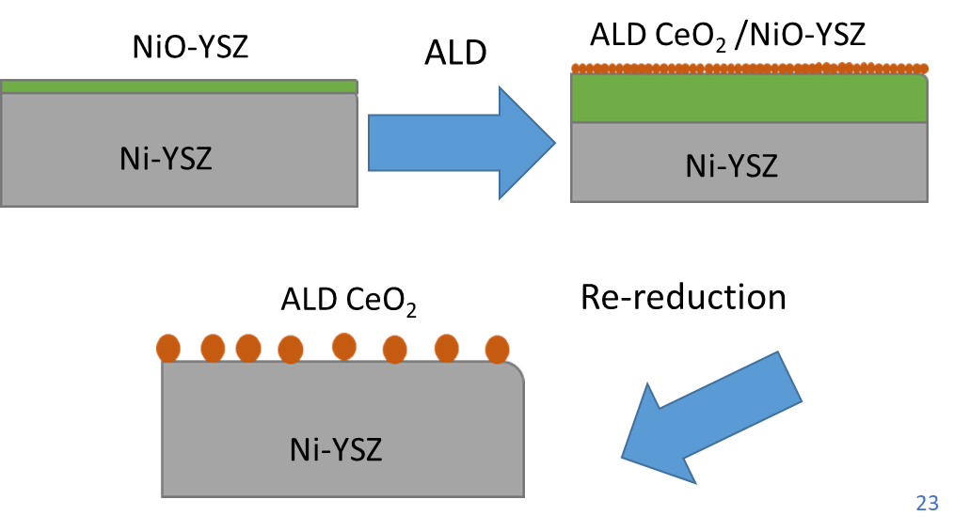
Metal surface is unstable during deposition
Large carbon deposits with or without Ceria
NiO film at RT, expands during ALD (300 °C oxidation)
Upon re-reduction the microstructure change disrupts the ALD film
Metal oxide ALD is not practical for creating continuous films on Ni cermets unless it can be performed at very low temperatures
Metal ALD (under reducing conditions) is more likely to succeed

Slide 19
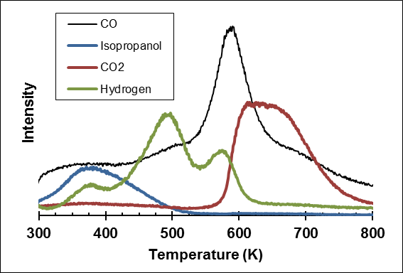
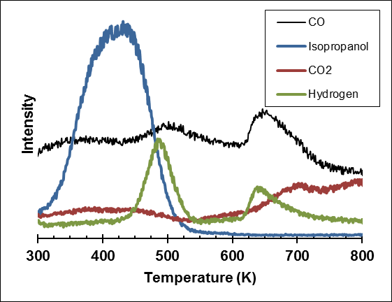
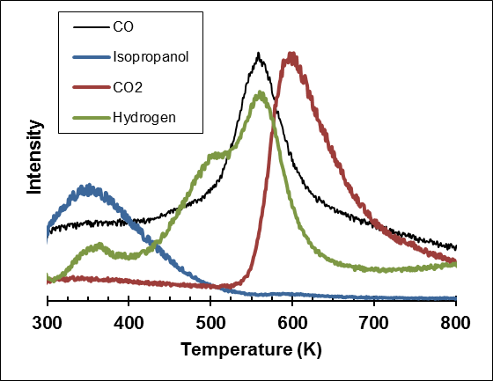
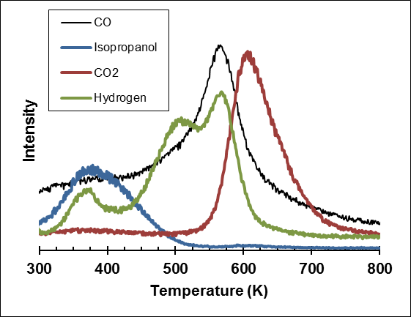
Isopropanol TPD
Surface chemistry is changed, but microstructure is unstable
20 Ceria ALD/Ni/ZrO₂
15 wt% Ceria infiltration +
20 wt% Ni/ZrO₂
20 Ceria ALD/Ni/ZrO₂
Then 2 hr re-reduction at 700 °C
20 wt% Ni/ZrO₂
Ni surface
Ceria coated surface
Ni-Ceria surface
Ni-Ceria surface
Ni is exposed! HC Cracking will occur

Slide 20
Enhancing Coking Tolerance and Stability of SOFC Anodes Using ALD of Oxide Thin Films
Raymond J. Gorte, John M. Vohs
University of Pennsylvania
and
Steve McIntosh
Lehigh University

