Slide 1

Modular Processing of Flare Gas for Carbon Nano-products (CNPs)
DE-FE0031870
Investigators:
Alan Weimer (PI), University of Colorado Boulder
Mija Hubler (co-PI), University of Colorado Boulder
Arrelaine Dameron, VP, Forge Nano
Colin Lobo, VP, National Ready Mixed Concrete Association
Program Managers:
David Cercone, Project Manager, DOE/NETL
Jodi Collins, Contract Specialist, DOE/NETL
DOE/NETL Project Kickoff Meeting, WebEx, June 29, 2020

Slide 2
Project Elements/Overview
Awarded under DOE DE-FOA-0002006 - AOI 2B - Modular Equipment and PI Design Concepts for Conversion of Flare Gas to High-Value Carbon Products
Interdisciplinary team between one university (two
departments), an industry partner, and an expert
product association
University of Colorado Boulder (Lead)
Forge Nano (industry subcontractor)
National Ready Mixed Concrete Association (non-profit association subcontractor)
Three-year project started on May 1, 2020
Total project budget: $3,750,000 ($3,000,000 from DOE and $750,000 from the participants as costshare)

Slide 3
Background
Natural Gas Flaring
Natural gas production in the United States has risen dramatically due to the “shale boom” and wide implementation of hydraulic fracturing;
With gas prices at historic lows, it is generally not cost effective to invest in expensive infrastructure to transport gas, resulting in increased flare volumes;
According to the EIA, approximately 36% of natural gas extracted in 2012 in North Dakota did not make it to market, with 29% of that gas being flared; although flaring dropped in subsequent years preceding 2015, the percentage of gas flared in October, 2018 in North Dakota grew to 20 percent, the highest the state has seen since August 2015;
This translates to about $1 billion in lost revenue, and greenhouse gas emissions equivalent to adding 1 million cars to the road.
Producers often exhaust tight oil wells rather quickly because production from a single well depletes rapidly.

Slide 4
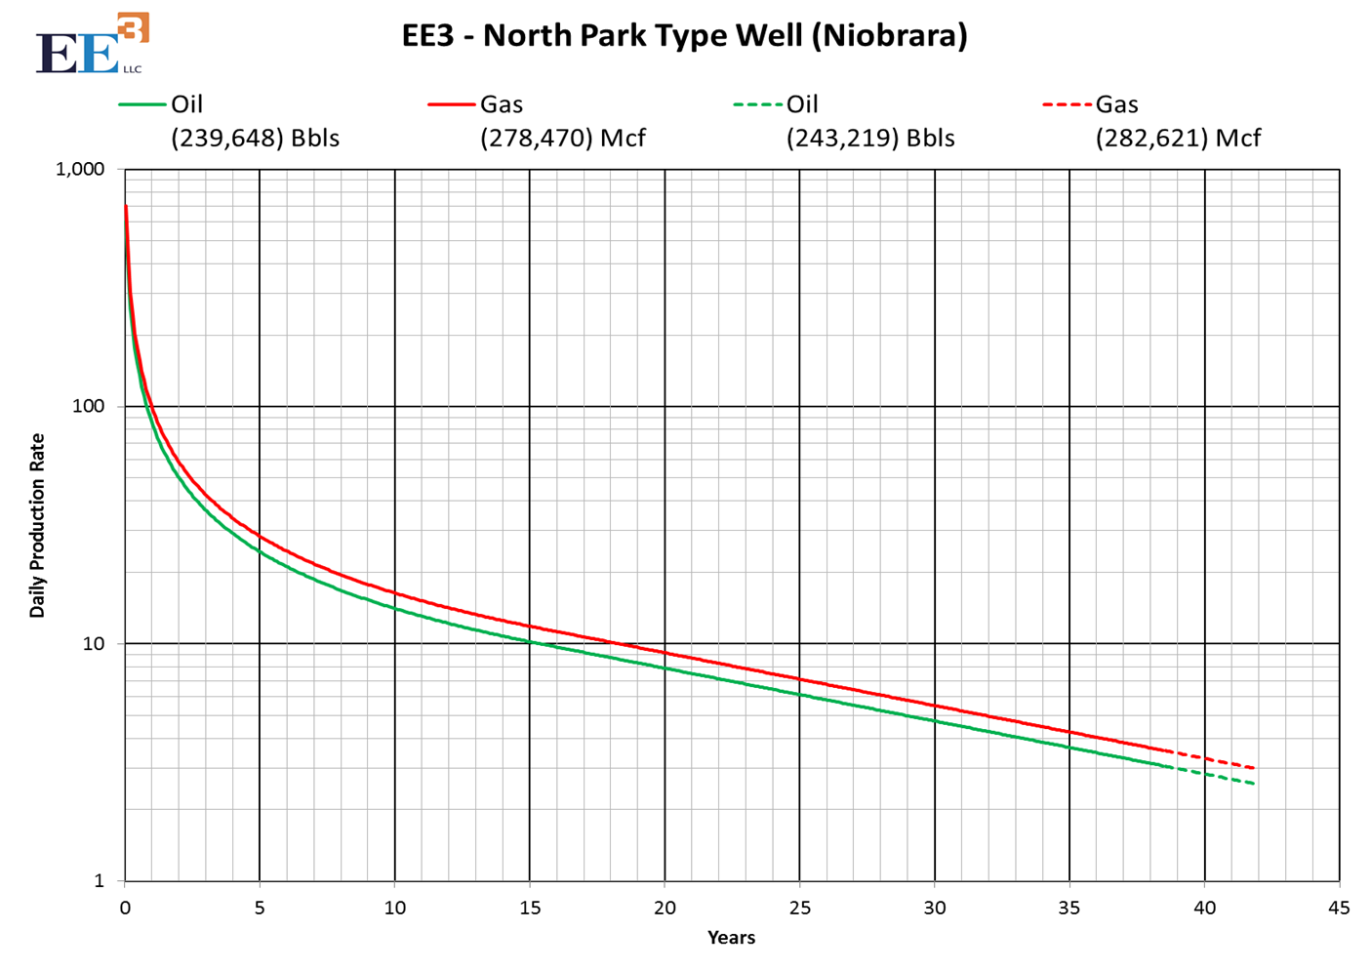
Daily Production Rate from a Typical Tight Well
~ 20X decrease in 1st 5 years
700 Mcf/d
30 Mcf/d
Mcf/day

Slide 5
Proposed Profitable Alternative
Distributed NG de-carbonization to value-added product
Chemical vapor deposition (CVD) to carbon nano-product (CNP)
CNP (carbon powder and carbon nanofibers) is value-added concrete additive for infrastructure
Sequesters carbon in concrete & decreases CO₂ emissions
CNP addition to concrete could double concrete lifetime
Reduce CO₂ emissions by 0.9 to 1.4 B kg CO₂/yr
Build mobile CVD reactors that can be deployed as needed
Simple 1-step chemical process (CH₄ ➔ CNP + 2H₂)
Use sacrificial catalyst, eliminating expensive separation to recycle the catalyst; burn resulting H₂ with unreacted CH₄ to supply heat needed to drive the reaction
Similar to commercial gas phase polymerization

Slide 6
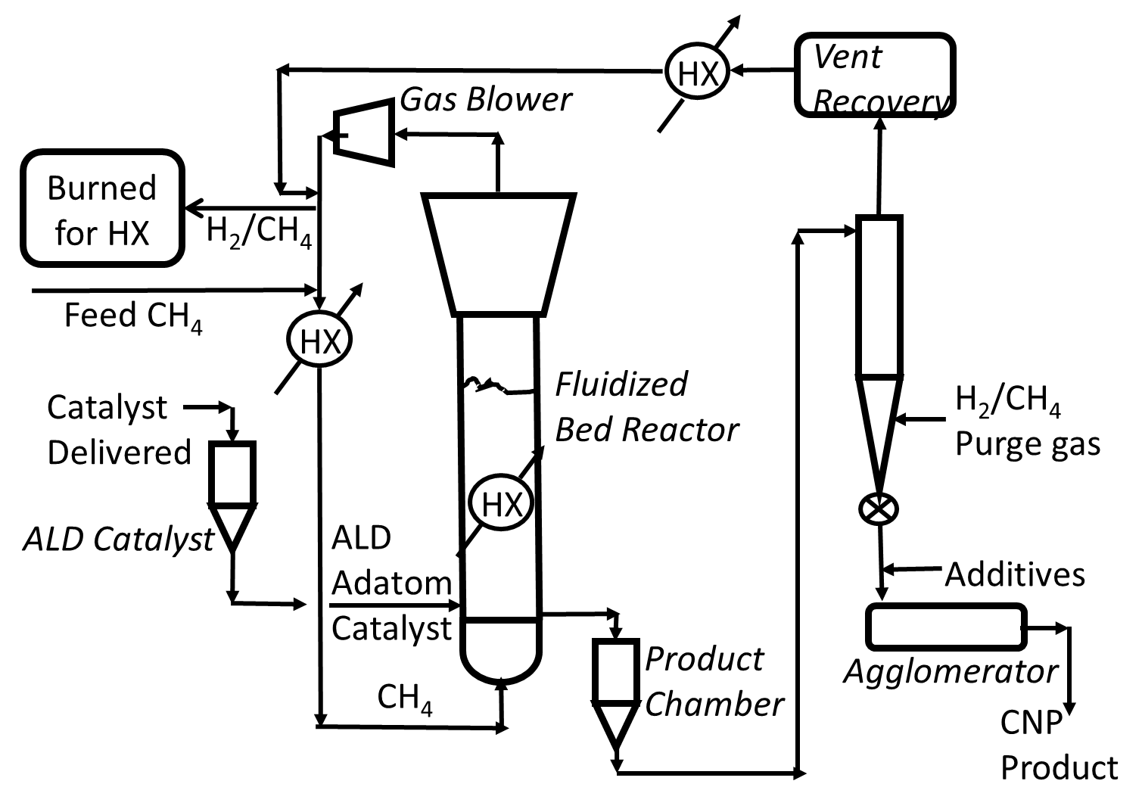
Proposed Process Schematic
CHEN
CVEN

Slide 7
Proposed Process Schematic
CHEN
CVEN

Slide 8
Proposed Process Schematic
NewCo
NRMCA
Forge Nano

Slide 9
Proposed Process Schematic
NewCo
CHEN
NRMCA
Forge Nano
CVEN

Slide 10
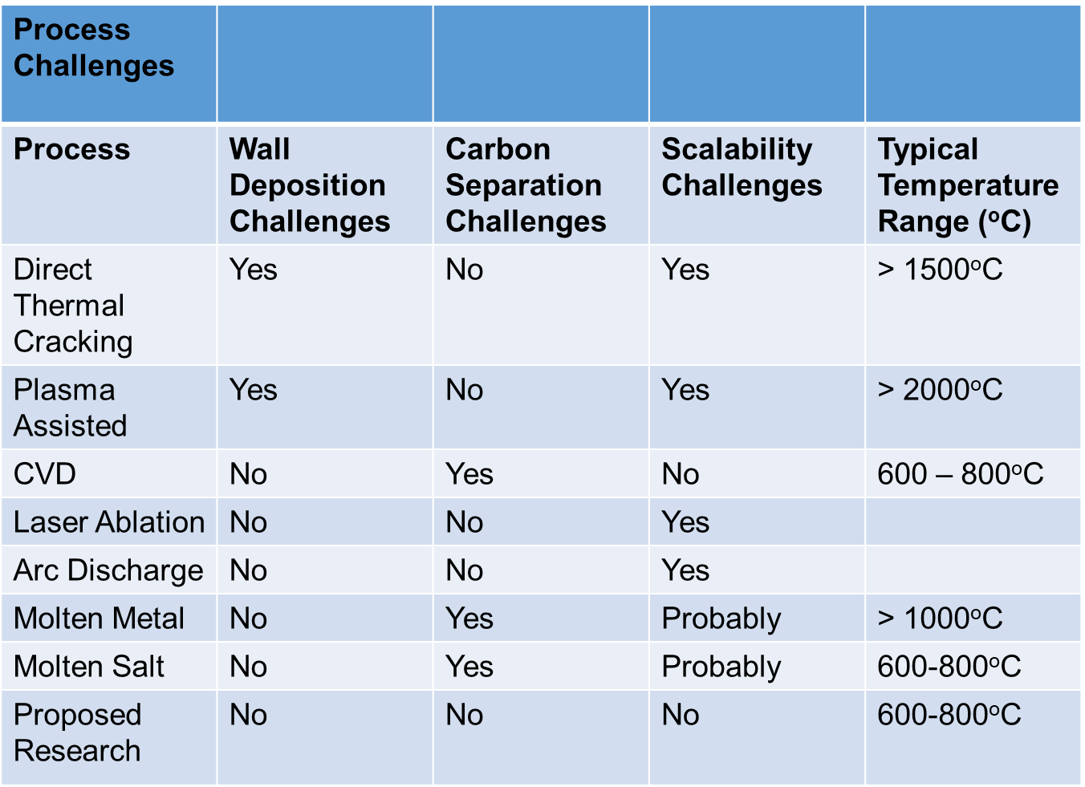
CVD Using a Sacrificial Catalyst
CH₄ ➔ C + 2H₂

Slide 11
CVD Using a Sacrificial Catalyst
CH₄ ➔ C + 2H₂

Slide 12
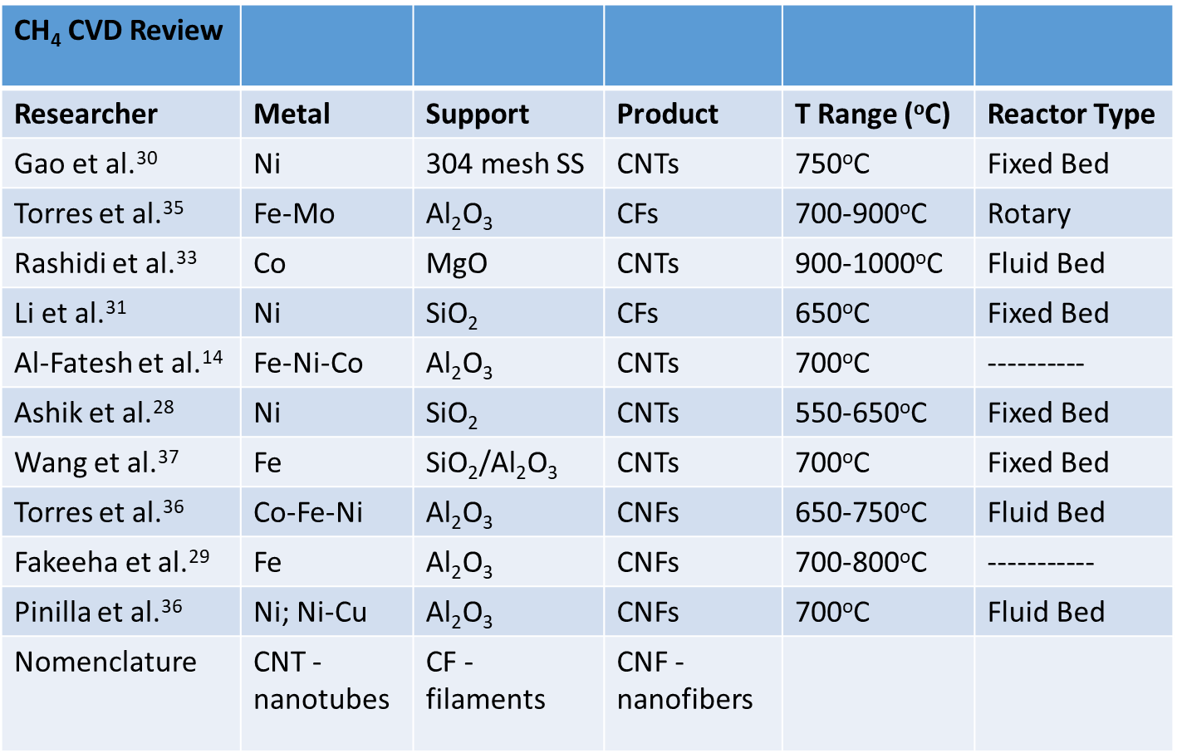
Active CVD Catalysts (Fe, Ni, Co)

Slide 13
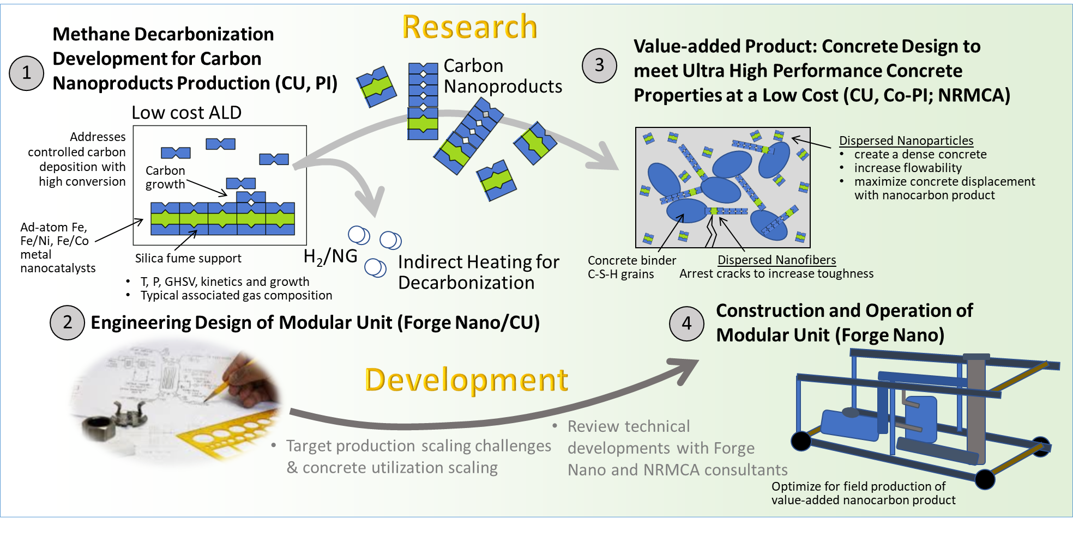
Complete R&D Effort of the Project

Slide 14
Complete R&D Effort of the Project
Overall Objective: Develop a simple and low-cost, CVD, one-step,
modular/mobile process to grow CNPs on a sacrificial catalyst that
will improve the durability of concrete (achieve TRL 5)

Slide 15
The Team
Alan Weimer (PI)
Professor, Chemical Engineering, University of Colorado Boulder (CU)
Particle ALD, fluidization, solids processing, high-temperature chemistry
Kent Warren, Post Doctoral Associate
Gage Sowell, Jessica Hauck (pending), GRAs
Theodore Champ, Research Assistant
Mija Hubler (Co-PI)
Asst. Professor, CVEN, CU
Cementitious materials, microstructure design, fracture mechanics
Linfei Li, Post Doctoral Associate (FN pending)
Arrelaine, Dameron
R&D Director, Forge Nano (FN)
Andy Broerman, Principle Engineer
Colin Lobo
VP Engineering, National Ready Mixed Concrete Assocation (NRMCA)

Slide 16
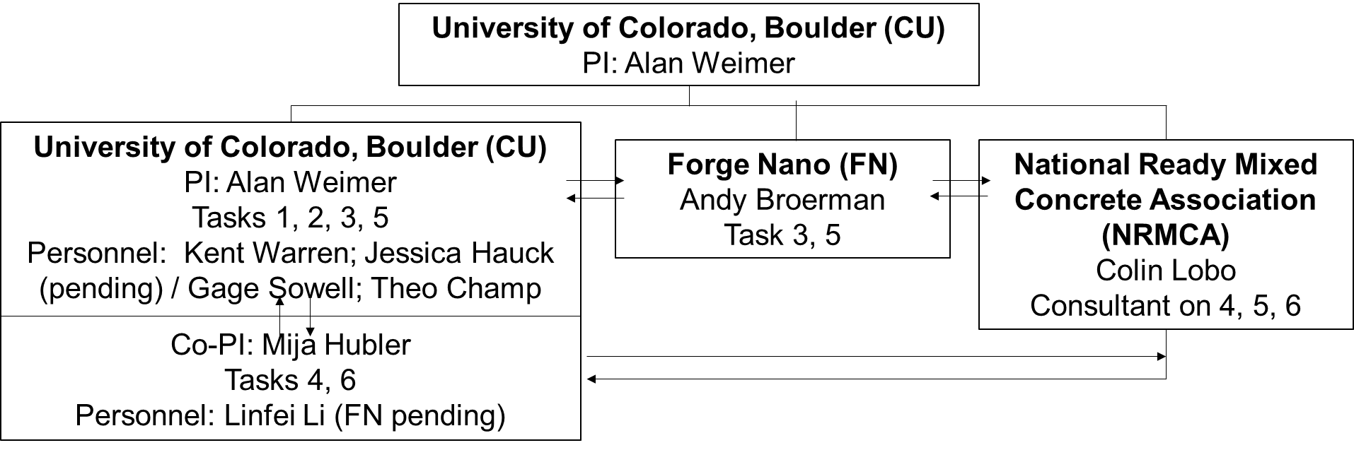
Roles, Responsibilities and Collaborations (Project Management)
Task 1: Project Management & Planning
Task 2: Particle ALD Catalysis and CVD Synthesis Range Finding
Task 3: Design and construction of modular process
Task 4: Cement Mix Design using Commercially Available CNPs
Task 5: Bulk Production of CNPs and Technology to Market
Task 6: Cement Mix Design using Produced CNPs
Weekly 1 hr Meetings (Mondays 1300-1400, MST)

Slide 17
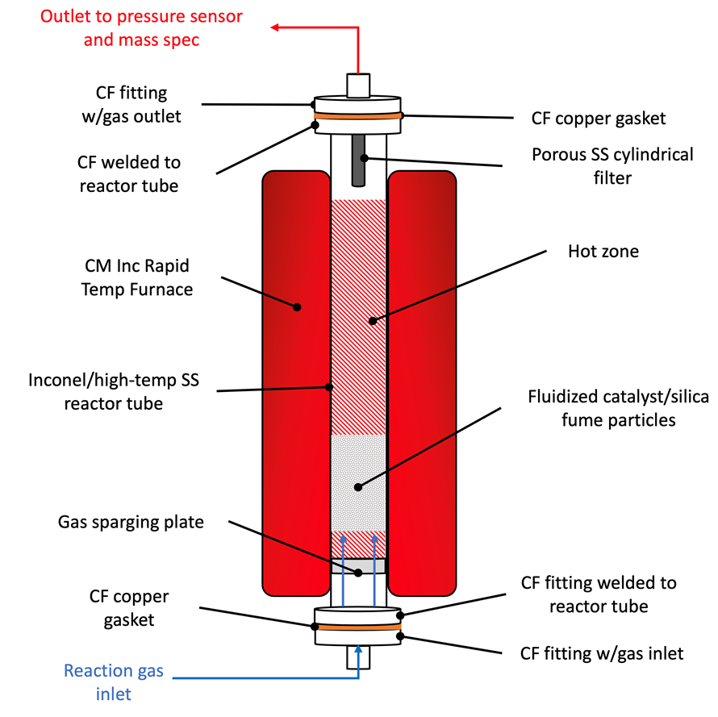
Pressurized CVD Lab Reactor System
Capable of operating up to 450 psig and 900ºC
CNFs grow on the fluidized catalyst/silica fume particles
Inconel or high-temp SS reactor tube/components
Reaction progress measured by in-situ mass spectrometer/NDIR at outlet

Slide 18
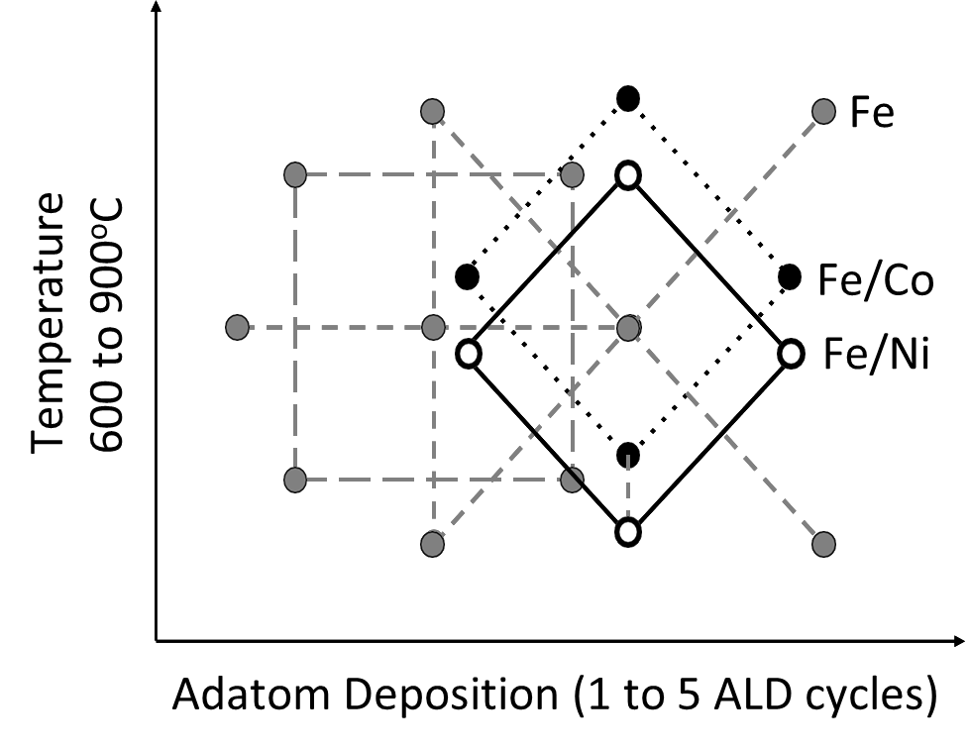
Experimental Plan
Design methods leveraged to reduce experiment plan complexity, while maximizing insight
Catalyst synthesis: metal, cycle number, reaction temperature
CVD/CNF Growth: Gas hourly space velocity of natural gas, operating pressure
Species | Mole Fraction (%)
CH₄ | 52.7
C₂H₆ | 24.6
C₃H₈ | 12.9
C₄H₁₀ | 1.3
H₂S | 3.8
CO₂ | 2.8
N₂ | 0.0
He | 0.4
Total | 98.5

Slide 19
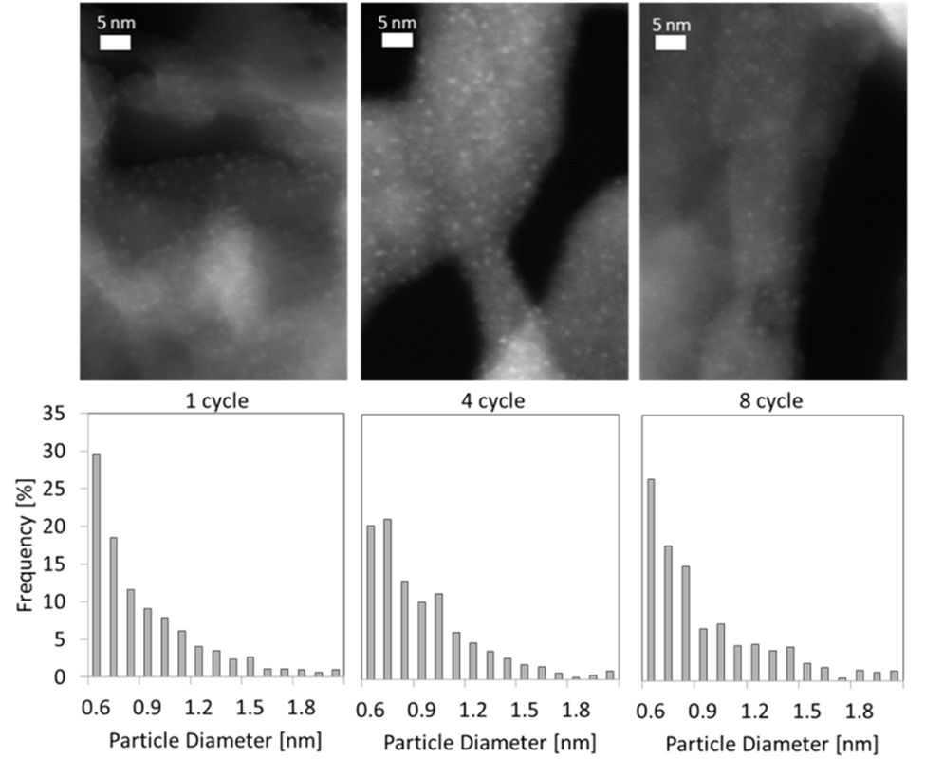
Particle ALD Catalyst
Adatom nanoparticles (Fe, Co, or Ni) uniformly deposited on silica fume via ALD…
Maintain catalytic activity
Remain stable, e.g., resist further oxidation upon exposure to air
Promote efficient use of the metal/M-ocene precursors

Slide 20
Envisioned Process Flow Diagram for R&D Skid
Electric furnace
Gas Solid separation
Gas Analysis
Product gas to safe location
Fresh Catalyst
Fluidized reactor
Feed Gas
Mixing
CNT Product

Slide 21
Envisioned Industrial Mobile Skid
Gas out
ALD Catalyst Storage
Optional Regenerative Burner
ALD Catalyst Lock Hopper
Heat
Reactor 700-900°C
Air
Exhaust
ALD Catalyst
Heat
Product
Natural Gas Feed
Lock Hopper
and Cooling
Agglomerator
And Storage

Slide 22
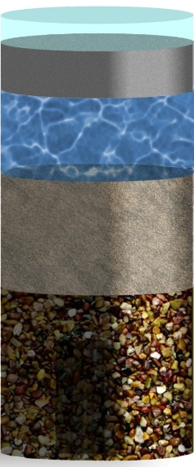
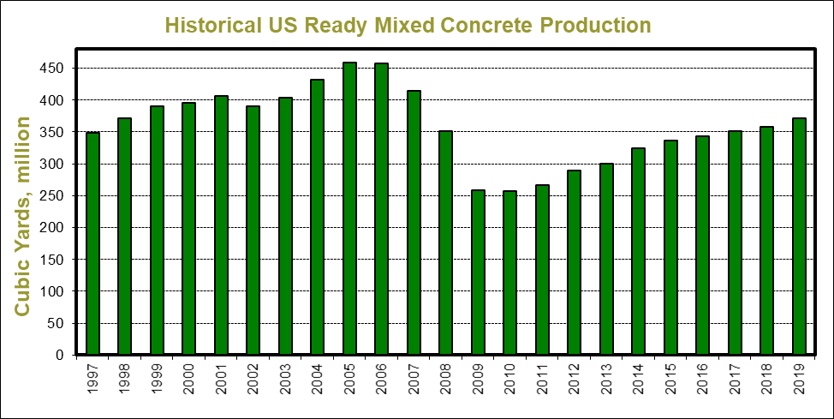
Ready Mixed Concrete
Concrete - most used construction material
US Consumption (2019)
Cement – 100 M metric tons
Concrete – 500 M cu. yds. (RMC = 370 M yd³)
Industry Value (USGS)
Cement - $12.5B
Concrete - $65B
Average Price
Cement - $120 – 150 / t
Concrete - $100 – 500 / yd³
Vol.
Wt.
6%
Air
0%
10%
Cement
15%
18%
Water
10%
25%
Sand
30%
40%
Stone
45%

Slide 23
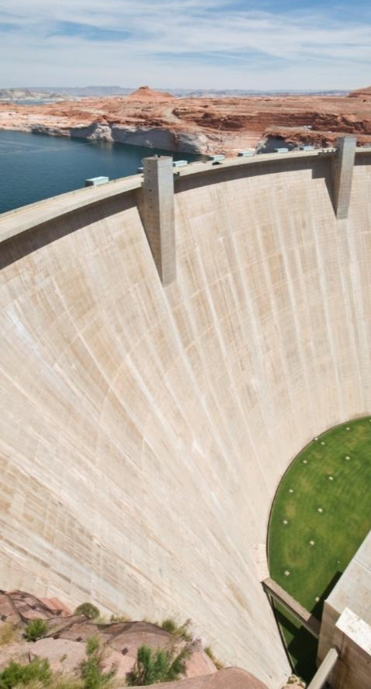
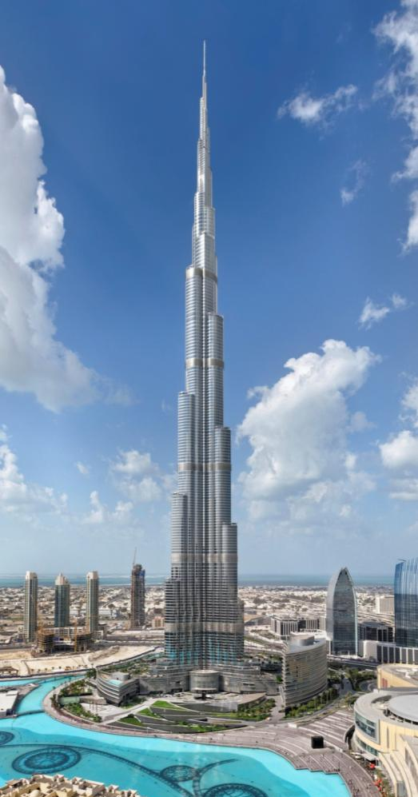
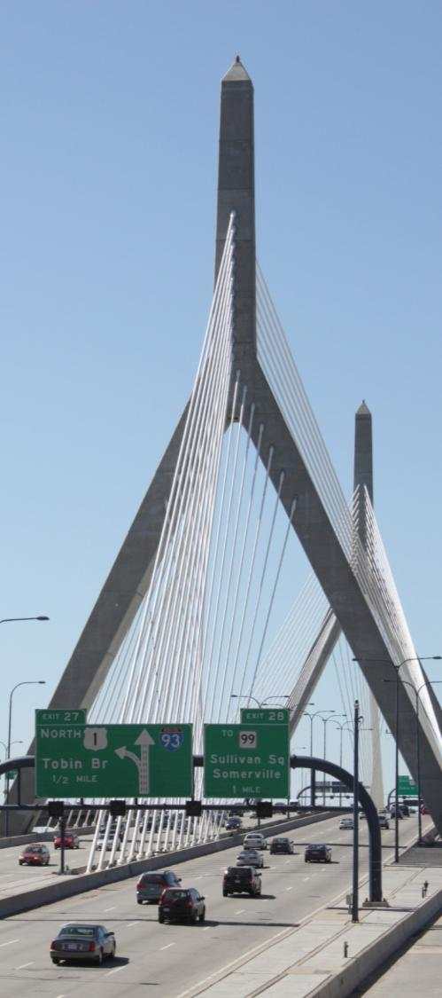
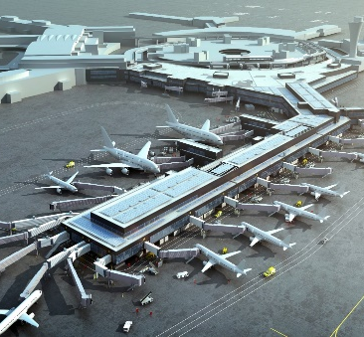
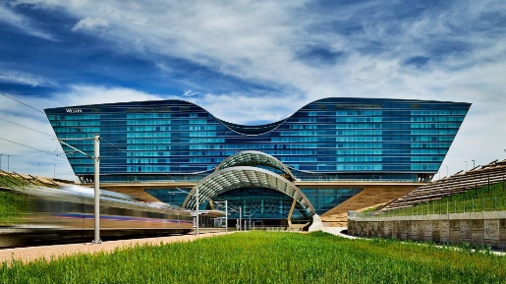
Ready Mixed Concrete
Concrete is versatile
Design for varying strength, durability, aesthetics
Strong, resilient, minimum maintenance
Long service life – 20, 50, 100+ years
Cement manufacture attributed to 5% global CO₂
Calcination of limestone
Burning fossil fuels
Concrete uses recycled materials to minimize cement use
Ash from burning coal
Slag from iron manufacture
Other materials
Contributes to sustainable construction
Design and structural efficiency
Resilience, energy use, service life,
End of life recycling

Slide 24
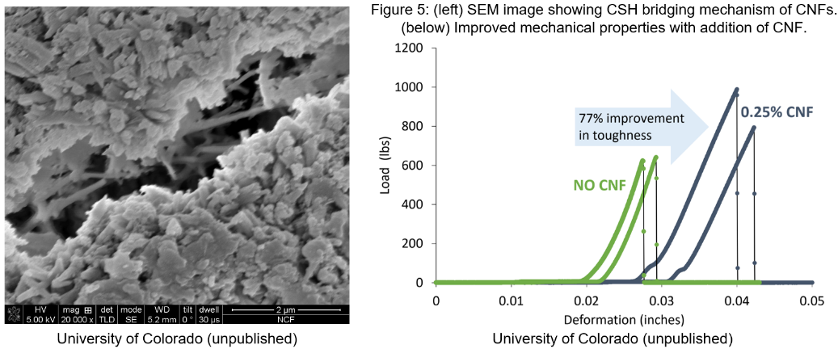
Scientific Principles & Objectives for CNF Integration into Concrete
Identify optimal processing methods
Determine permeability mechanisms
Standard product testing
Determine cracking mechanisms
Establish governing-processing-performance relations

Slide 25
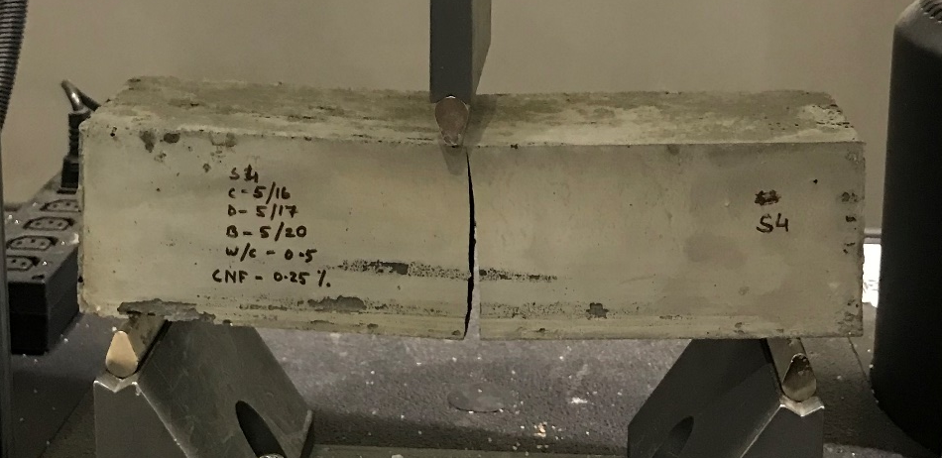
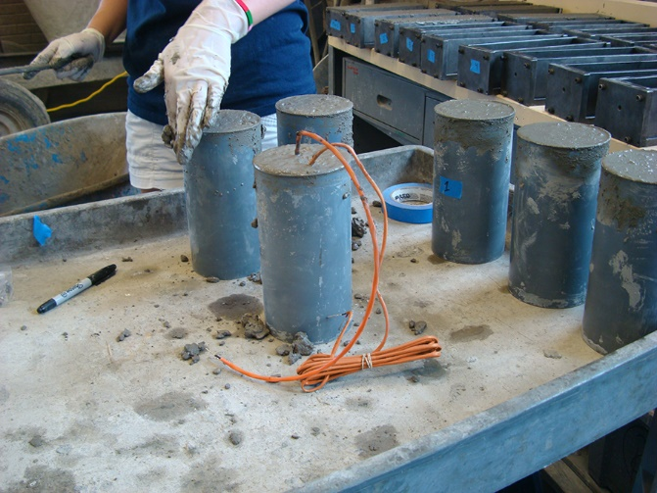
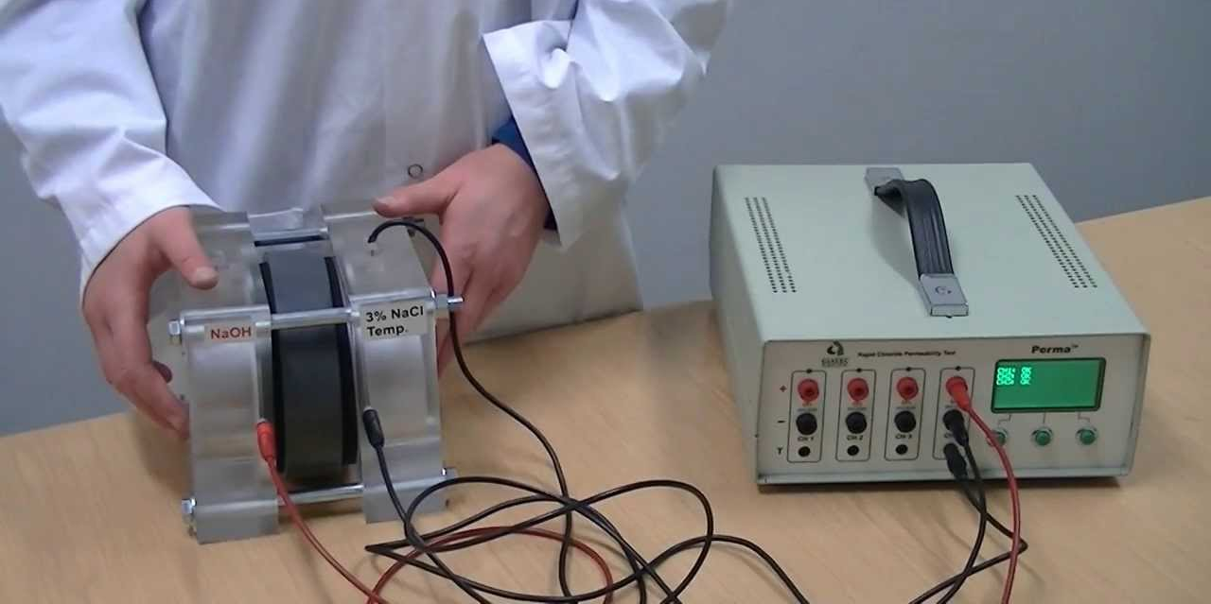
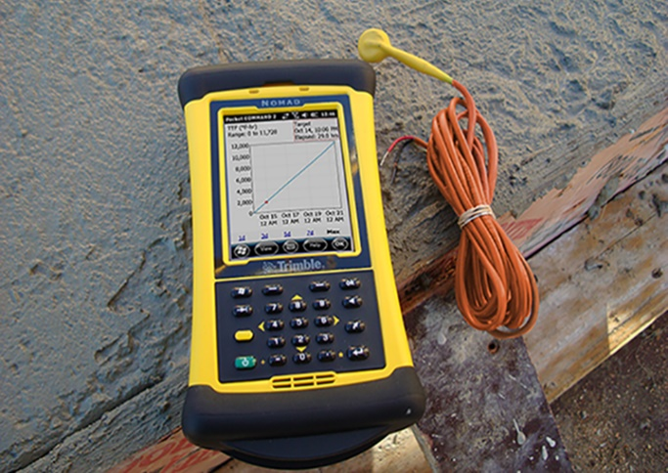
Concrete Design

Slide 26
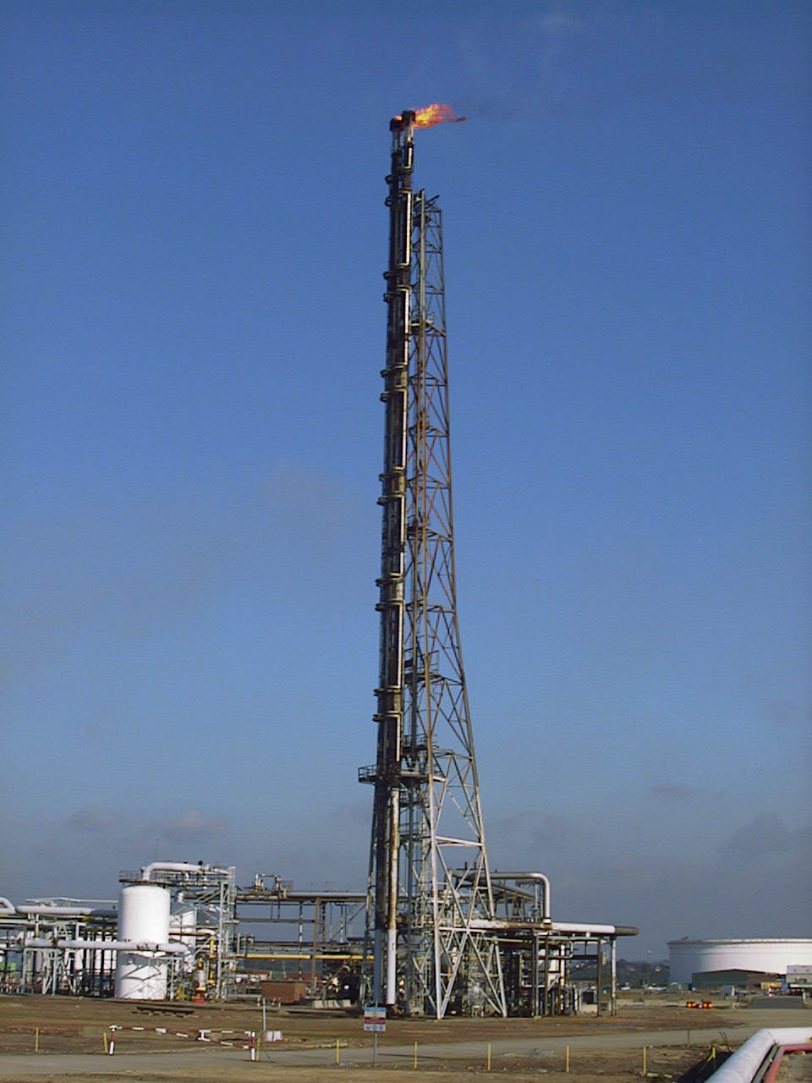
TEA - Flare Gas Properties
Planned Site Location: Bakken Region, North Dakota
Average Flare Volume, 2018: 27.4 MCF per day¹
Inlet pressure: 500 psi (34.47 bar)
Composition of Flare Gas Stream¹
²
Species | Mole Fraction (%)
CH₄ | 52.7
C₂H₆ | 24.6
C₃H₈ | 12.9
C₄H₁₀ | 1.3
H₂S | 3.8
CO₂ | 2.8
N₂ | 0.0
He | 0.4
Total | 98.5
1 National Energy Technology Laboratory, personal correspondence
2 Wikimedia Commons, https://commons.wikimedia.org/w/index.php?curid=5667339

Slide 27

TEA - Process Flow Diagram
Flare Gas Feed
1,142 scf hr ⁻¹
Catalyst & Support
16.8 kg hr ⁻¹
CNF
900°C
560°C
34.2 bar
70% conv
Mole Fractions
73% N₂
9.1% O₂
2.9% CO₂
15% H₂O
99.9% H₂
23,800 scf hr ⁻¹
Air

Slide 28
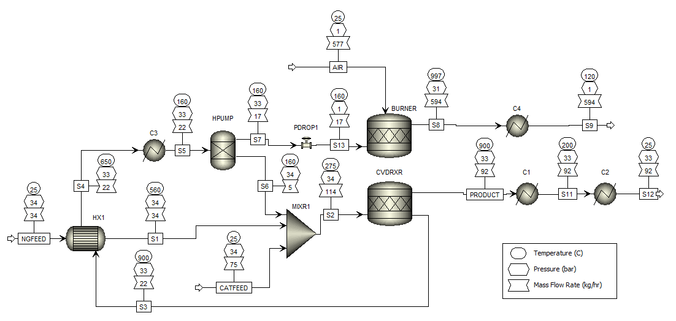
TEA - Process Simulation
Heat Streams (Negative is exothermic)
C1: -6950 cal/sec
C3: -5509 cal/sec
BURNER: -19922 cal/sec
C2: -1748 cal/sec
C4: -42483 cal/sec
CVDRXR: 75022.6 cal/sec

Slide 29
Scope of Work
Three Budget Periods
Budget Period I (17 months): Build lab research reactor process & initiate Particle ALD catalyst/CVD process research, preliminary TEA, pilot skid designed & construction started, concrete studies with purchased CNPs
Budget Period II (12 months): Build pilot skid & start up, Test particle ALD mixed-metal catalysts & select preferred catalyst and operating conditions (T, GHSV, …), optimize cement mix design using purchased CNPs, TEA will be updated
Budget Period III (12 months): Optimize pilot skid performance and produce CNPs for in-house testing, optimize cement mix design using in-house produced CNPs, kinetics studies using preferred catalyst, finalize TEA and T2M

Slide 30
Gantt Chart

Slide 31
Deliverables (Tasks 2 to 6)
Task/ Subtask | Milestone Title & Description | Planned Completion Date | Verification method
2.1 | A: The Lab Particle ALD FBR reactor system is started up Go/No Go | End of Q6 | Minimum fluidization velocity determined for fumed silica at up to 900ºC.
2.2 | B: CVD will be carried out | End of Q8 | The solid product will comprise at least 25 wt% as measured using LECO combustion analysis
3.1 | C: Complete plans for module construction | End of Q6 | Review by engineer leading construction
3.2 | D: Pilot skid is started up Go/No Go | End of Q10 | Production of carbon nanoproduct from associated gas at the prescribed scale
4.1 | E: Mix design including carbon products | End of Q4 | Minimal (< 3 min) reduction in set time and an improved ductility compared to the baseline mix.

Slide 32
Deliverables (Tasks 2 to 6)
Task/ Subtask | Milestone Title & Description | Planned Completion Date | Verification method
4.2 | F: Optimal cement mix design parameters will be identified | End of Q6 | Meet UHPC performance metrics using commercially available carbon nanoparticles and CNFs.
5.1 | G: Mix design including produced carbon product from sacrificial adatom catalyst | End of Q13 | Minimal (< 3 min) reduction in set time and an improved ductility compared to the baseline mix.
6.2 | H: Cement mix design parameters will be identified for mixes that meet UHPC performance using carbon products synthesized from sacrificial adatom catalyst. End of Project (final report) | End of Q14 | Meet compressive strength, flowability, flexural strength, and hydration time of UHPC using synthesized carbon products.

Slide 33
Success Criteria
Phase 1: Solid CNPs are synthesized using ALD processes in the lab;
Phase 2: A pilot modular unit designed by CU and Forge Nano, constructed at CU, and set up at Forge Nano for experimentation;
Phase 3: Cement cylinders containing the CNPs which meet or exceed UHPC performance metrics;
Phase 4: The pilot unit demonstrates methane decarbonization producing the CNPs in bulk (>1kg of carbon product) and meeting metrics prescribed in Task 5.
Final Project Success: A TRL=5 is achieved

Slide 34
Risk Management
Perceived Risk | Risk Rating |  |  | Mitigation/Response Strategy
 | Probability | Impact | Overall
 | (Low, Med, High)
Technical/Scope Risks:
Performance of the catalyst | Med | Med | Med | Consider multiple catalysts simultaneously to discover the best performing one
Management, Planning, and Oversight Risks:
Hiring challenges for GRA or PRA | Low | High | Med | Initiate search immediately upon award and transition those already at CU
ES&H Risks:
Nanoparticle release | Low | High | Med | Agglomerate and disperse all carbon products in liquids

Slide 35
Budget

Slide 36


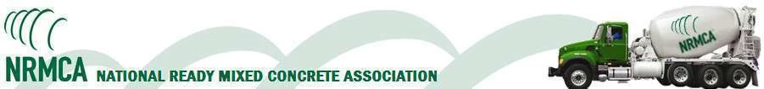
Questions?

