Slide 1
DE-FOA-0002736
BIL40101(d) – PREVENTING OUTAGES AND ENHANCING THE RESILIENCE OF THE ELECTRIC GRID FORMULA GRANTS TO STATES AND INDIAN TRIBES
Award Kickoff Meeting
8/14/24

Slide 2
DE-FOA-0002736 Award Kickoff Meeting
Agenda
  Introductions and Program Overview
    Meet your Federal Project Officer (FPO) and the DOE Team.
  BIL40101(d) Overview
    Review Grant Performance and Administration Requirements.
  Award Administration
    Award Scope, Award Schedule, Spending for Upcoming Activities
    Subaward
  Reporting Overview and Guidance
    PMP/QPR, Annual Metrics
  Resources and Next Steps
  Questions

Slide 3










Federal Project Officer (FPO) Team
Sean Curtis
Rob Gross
Lucas Greza
Amie Heath
Phuong Nguyen
  Your FPO is identified in block 15 of the Assistance Agreement Cover Page as the ‘Program Manager’.
Brittany Rehe
Ryan Moore
Virginia Chambers
Josh Metz
Lauren Timko

Slide 4
DOE Structure and Project Roles

Slide 5


MISSION
Driving innovation and delivering solutions for an environmentally sustainable and prosperous energy future:
Ensuring affordable, abundant and reliable energy that drives a robust economy and national security, while
Developing technologies to manage carbon across the full life cycle, and
Enabling Environmental Sustainability for all Americans.
VISION
To be the nation’s premier energy technology laboratory, delivering integrated solutions to enable transformation to a sustainable energy future.

Slide 6
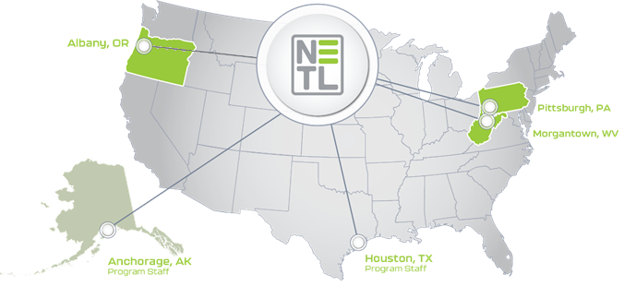
NETL Overview
Snapshot
3 Research labs & 2 Strategic Offices
Energy Delivery & Security Team (EDST):
Grid Deployment Office (GDO)
Transmission Division
Grid Modernization
Generation Credits Division
Office of Electricity (OE)
Advanced Grid Research and Development (AGR&D)
Electricity Delivery Cybersecurity Research and Development
Office of Cybersecurity, Energy Security, & Emergency Response (CESER)
Risk Management Tools and Technologies (RMT)
Preparedness, Policy, and Risk Analysis (PPRA)
Response and Restoration
Office of Petroleum Reserves
One of 17 DOE national laboratories
Only Government owned & operated
1,000+ R&D projects in 50 states
https://www.energy.gov/oe/mission
https://www.energy.gov/ceser/ceser-mission
https://www.energy.gov/gdo/grid-deployment-office

Slide 7

Department of Energy
Organizational Structure
OFFICE of the SECRETARY
Secretary
Deputy Secretary
Federal Energy
Regulatory Commission
Boards & Councils
Inspector General
Ombudsman
Chief of Staff
Office of the Under Secretary for Nuclear Security
and National Nuclear Security Administration
Under Secretary for Nuclear Security Administrator (S5)/ Administrator, NNSA
Office of the Under Secretary
for Science and Innovation
Under Secretary for Science and Innovation (S4)
Office of the Under Secretary for Infrastructure
Under Secretary (S3)
U.S. Energy Information Administration
Advanced Research Projects Agency - Energy
Assistant Secretary for International Affairs
Assistant Secretary for Congressional & Intergovernmental Affairs
Deputy Administrator for Defense Programs
Deputy Administrator for Defense Nuclear Nonproliferation
Assistant Secretary for Energy Efficiency & Renewable Energy
Office of Clean Energy Demonstrations (CD)
Grid Deployment Office (GDO)
Office of Enterprise Assessments
Office of Public Affairs
Office of State & Community Energy Programs (SCEP)
Office of Technology Transitions (OTT)
Office of Policy (OP)
Deputy Administrator for Naval Reactors
Associate Administrator for Emergency Operations
Arctic Energy Office
Office of Federal Energy Management Programs (FEMP)
Office of the General Counsel
Office of the Chief Financial Officer
Associate Administrator for Safety, Infrastructure & Operations
Chief & Associate Administrator for Defense Nuclear Security
Office of Science
Office of Cybersecurity, Energy Security & Emergency Response (CESER)
Office of the Chief Human Capital Officer
Assistant Secretary for Nuclear Energy
Indian Energy Policy & Programs (IE)
Office of Chief Information Officer
Associate Administrator for Counter-Terrorism & Counter-Proliferation
Associate Administrator for External Affairs
Assistant Secretary for Electricity
Office of Manufacturing & Energy Supply Chains (MESC)
Office of Environment, Health, Safety and Security (EHSS)
Office of Small and Disadvantaged Business Utilization
Loan Programs Office
Associate Administrator for Management & Budget
Associate Administrator for Acquisition & Project Management
Office of Artificial Intelligence and Technology
Office of Management
Office of Economic Impact & Diversity
Power Marketing Administrations
Bonneville Power Administration (BPA)
Southeastern Power Administration (SEPA)
Southwestern Power Administration (SWPA)
Western Area Power Administration (WAPA)
Office of Intelligence & Counterintelligence
Office of General Counsel
Associate Administrator for Information Management & Chief Information Officer
Assistant Secretary for Fossil Energy and Carbon Management (FECM)
Office of Legacy Management
Office of Hearings & Appeals
Assistant Secretary for Environmental Management
Office of Project Management (PM)
Updated March 2022

Slide 8
Grid Deployment Office (GDO)
Mission Statement: The Grid Deployment Office (GDO) works to provide electricity to everyone, everywhere by maintaining and investing in critical generation facilities to ensure resource adequacy and improving and expanding transmission and distribution systems to ensure all communities have access to reliable, affordable electricity.
Generation Credits Division
The Generation Credits Division works with existing generation facilities to ensure resilience and reliability and works to improve electricity markets at the wholesale and distribution level.
The Transmission Division supports innovative efforts in transmission reliability and clean energy analysis and programs, and energy infrastructure and risk analysis in support of the Administration’s priorities to enhance grid resilience.
Transmission Division
Grid Modernization Division
The Grid Modernization Division oversees activities that prevent outages and enhance the resilience of the electric grid.

Slide 9
Federal Roles and Responsibilities
Federal Project Officer (Program Manager) | Monitors performance and provides technical oversight of approved scope, budget, and schedule. Serves as DOE technical representative to the Contracting Officer (CO). | Identified in Assistance Agreement
Contract Specialist (CS) (Award Administrator) | Administers the business and financial aspects of the Agreement to ensure indirect costs, cost match, reporting, etc., are in compliance with award terms and conditions and federal regulations. | Identified in Assistance Agreement
Contracting Officer (CO) | Is the only person authorized to obligate the government to any contractual agreement and/or to approve changes to the Agreement (e.g., scope, budget, schedule, etc.). | Identified in Assistance Agreement

Slide 10
NETL versus Recipient
Roles and Responsibilities*
Recipient | NETL
Assign Principal Investigator (aka - Technical Project Manager) and Business Point of Contact. | Assign a Contracting Officer, Contract Specialist (aka - Award Administrator), and Federal Project Officer.
Receive the Award and manage subawards as needed. | Award the Award Agreement to the Recipient, and as needed approve any subsequent subawards.
Manage project(s) and perform SOPO tasks. | Manage and administer Agreement.
Notify DOE of proposed resilience projects and subawards. | Notify recipient of acceptance of notification of proposed resilience projects and subawards.
Manage project team members.
Manage project against planned schedule and budget. | Monitor performance against Agreement requirements.
Create deliverables. | Determine acceptability of deliverables.
*Not all inclusive.

Slide 11
BIL40101(d) Overview

Slide 12


BIL40101(d) - DE-FOA-0002736
Objective: Improve the resilience of the electric grid against disruptive events.
Eligible Investments
Adaptive protection technologies
Advanced modeling technologies
Fire-resistant technologies and fire prevention systems
Hardening of power lines, facilities, substations, or other systems
Monitoring and control technologies
Relocation of power lines or reconductoring of power lines with low-sag, advanced conductors
Replacement of old overhead conductors & underground cables
Undergrounding of electrical equipment
Use or construction of DERs for enhancing system adaptive capacity during disruptive events, including microgrids and battery-storage subcomponents
Utility pole management
Vegetation and fuel-load management
Weatherization technologies and equipment
Ineligible Investments
Construction of a new electric generating facility
Large-scale battery storage facilities not being used to supply electricity where needed during disruptive events
Cybersecurity measures

Slide 13
Federal Acquisitions and Assistance
This award is financial assistance.
    Financial assistance is used for the transfer of value from a federal agency to a Recipient to carry out a public purpose of support or stimulation authorized by a US law.
    This award is a Grant.
This award is not a contract.
    A contract is used for the acquisition of property or services for the direct benefit or use of the federal government.
The State* or Indian Tribe is the grant Recipient.
    The organization, individual, or other entity that receives an award and is responsible for carrying out the terms and conditions of the award.
  Please note your award may be a “Conditional Award” for the first few months, meaning there are some additional conditions on your agreement (noted in the Terms and Conditions). Please ask your FPO if unsure.
Indian tribes and other Tribal applicants needing assistance or additional information may contact the DOE Grid Deployment Office at GDOTribalAssistance@hq.doe.gov.
* “State” includes States, U.S. Territories, and the District of Columbia

Slide 14
Federal Acquisitions and Assistance Cont.
  Period of Performance – 5 Years (initially)
  Total Project Amount – See Block 12 of your Assistance Agreement Cover Page
  Administrative and Technical Assistance:
      Up to 5% of federal funding can be used for technical assistance and program administration.
      The 15% cost match can also be used for technical assistance and program administration.
Cost Match Requirements
State/Tribes | 15% of Federal Allocation
Subawardee *Selling more than 4M MWh per year | 100% of Subaward Value
Subawardee *Selling 4M MWh or less per year | 1/3 of Subaward Value

Slide 15
Small Utilities Set Aside
40101(d)(6)
A State or Indian Tribe receiving a grant under the program shall ensure that, of the amounts made available to eligible entities, the percentage made available to eligible entities that sell not more than 4,000,000 megawatt hours of electricity per year is not less than the percentage of all customers in the State or Indian Tribe that are served by those eligible entities.
See BIL40101(d) Subsection 6.
If the eligible utility is not listed on the below website, another data source is acceptable if it contains relevant, recent, and complete data. If no data source is available, please have the utility submit a formal letter certifying the electricity sales to qualify.
Note: Website for Utility Sales (as of 2022)
  https://www.eia.gov/electricity/sales_revenue_price/pdf/table_10.pdf

Slide 16
Project Post-Award Phase
Entering Post-Award Phase:
Begin Technical Assistance & Administration
Identify Resilience Projects
Initiate Reporting Requirements
Exiting Application Phase

Slide 17
Assistance Agreement Documents
Award Documents
Assistance Agreement Documents are accessed through FedConnect
Award Documents
      Assistance Agreement
      Terms and Conditions
    Attachments
            Intellectual Property Provisions
            Statement of Project Objectives (SOPO)
            Federal Assistance Reporting Checklist

Slide 18
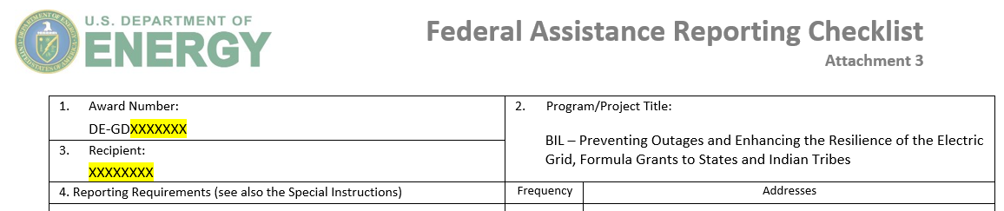
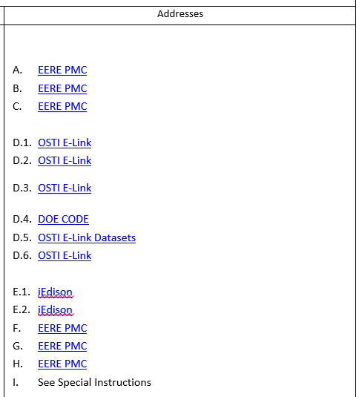
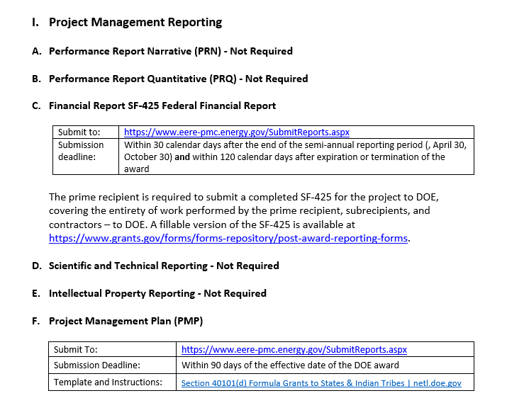
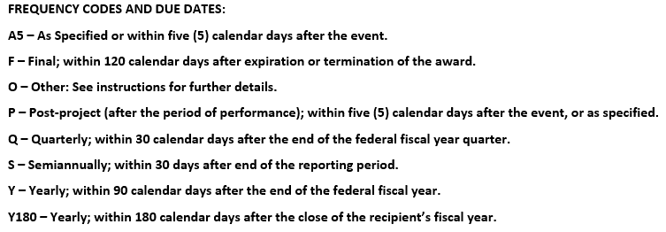
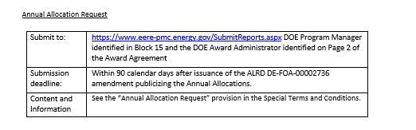
Federal Reporting Checklist
Reporting Requirements
Frequency
Submission Method
Instructions

Slide 19
Subaward Process

Slide 20
BEFORE YOU MAY PROCEED WITH A RESILIENCE PROJECT…

Slide 21
Resilience Project Subaward/Subcontract Process
Next Steps
Once an award Recipient has identified a project or projects and subawardee(s), the DOE Contracting Officer (CO) and Federal Project Officer (FPO) MUST BE NOTIFIED in writing prior to execution of any project work in accordance with the Resilience Project and Subaward/Subcontract Notification process located in the Assistance Agreement Terms and Conditions.
The Recipient is responsible for awarding and/or modifying subaward/subcontracts but may not proceed with the resilience project and/or subaward/subcontract until DOE Officials determine, and provide the Recipient written notification, that the information provided is adequate.​
Any project work completed WITHOUT DOE notification is at risk of being deemed unallowable and not reimbursable.

Slide 22
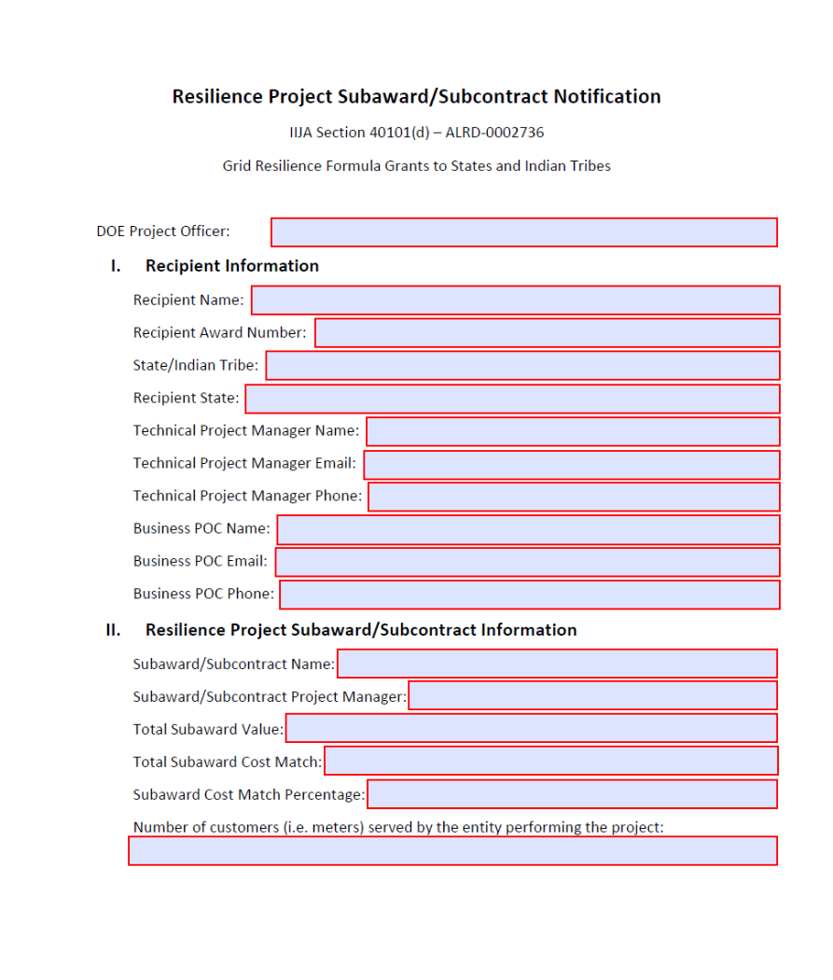
Subaward/Subcontract Notification Package
A Resilience Project Subaward/Subcontract Notification Package must be submitted for all resilience project subawards and any other subaward over $250,000 (i.e., TA more than $250,000).
The proposed project schedule should allow for varying time for DOE officials to review your Subaward/Subcontract Notification Package and request additional information or consultation prior to approval.
Submission Requirements:
Subaward/Subcontract Notification Form​ (available at https://netl.doe.gov/bilhub/grid-resilience/formula-grants/post-award-documents)
Environmental Questionnaire​
Signed Cost Match Commitment Letter (which includes the cost match value/kind)​
Detailed Budgetary Information (Budget Justification documents)​

Slide 23
Subaward
Eligible Entities and Cost Match
Eligible Entity >4,000,000 MWh of electricity per year:
Eligible Entities
Electric grid operator;
Electricity storage operator;
Electricity generator;
Transmission owner or operator;
Distribution provider;
Fuel supplier; and
Any other relevant entity, as determined by the Secretary (of DOE).
Any eligible entity that sells >4,000,000 MWh of electricity per year must match 100% of the amount of the subaward value.
However, if the eligible entity sells ≤4,000,000 MWh of electricity per year, the required match will be 1/3 of the amount of the subaward value.
Subaward for Resilience Projects
Total Investment Funding
Subawardee Match (100%)
$95k
$190k
$95k
Illustrative
Eligible Entity ≤4,000,000 MWh of electricity per year:
Subaward for Resilience Projects
Subawardee Match
(1/3)
Total Investment Funding
$95k
$127k
$32k
Illustrative

Slide 24
Secretary Designation - Eligible Entity
Designation of an Eligible Entity
If the proposed entity is not an “eligible entity” as defined in BIL 40101(a)(2), or if you are unsure, the Recipient may request the Secretary to designate the proposed entity as an eligible entity.
  Approval of eligible entities is not an automatic process, but at the discretion of the Secretary.
The request should be made through your DOE FPO. Request template: https://netl.doe.gov/bilhub/grid-resilience/formula-grants/post-award-documents
The appropriate cost match will be determined by the type of eligible entity being proposed during the secretarial designation process.

Slide 25
Reporting Overview and Guidance

Slide 26
Major Reporting Requirements
    Project Management Plan (PMP): Due 90 days after the effective award date
      Revised PMPs are due within grant years as a result of major project plan changes.
      Quarterly Progress Reports (QPR): Due 30 days after the end of each Quarter (first QPR due 30 days after the first full quarter of performance)
      Recipient Reporting
      Project Reporting
      Annual Program Metrics and Impact Report: Due 90 days after reporting year (October 1 – September 30)
      Other reporting requirements (such as the Demographic Reporting) as identified by the Reporting Requirements Checklist contained in the Assistance Agreement (Attachment 3).

Slide 27
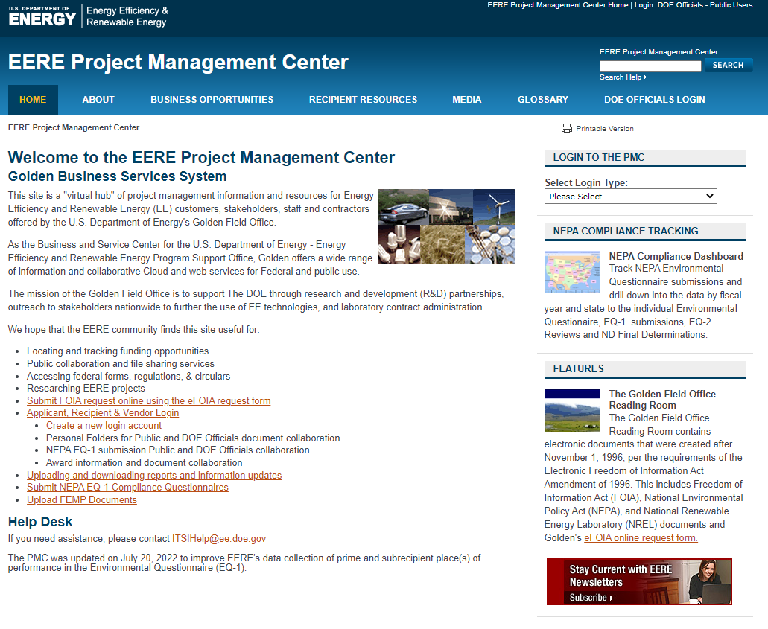
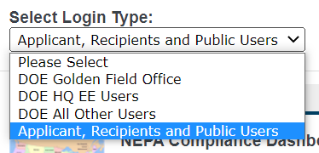
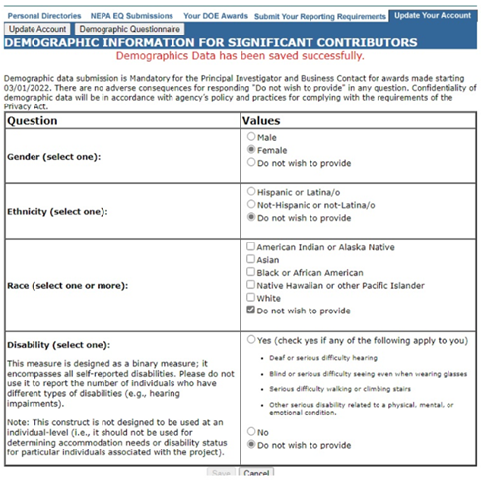
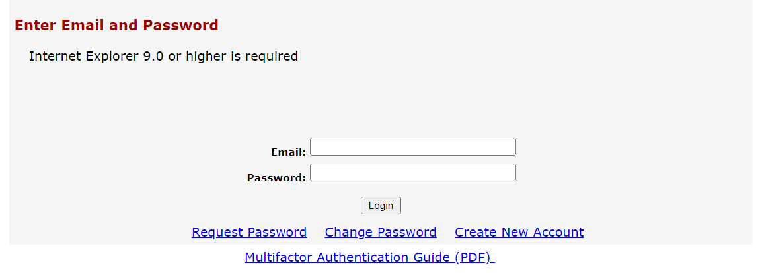
EERE-PMC Portal
Document and Report Submission
https://www.eere-pmc.energy.gov/Default.aspx
Step 1: Create Recipient/Applicant Login
Instructions for Creating Account
Step 2: Submit and archive all recipient reports and documentation over the life of the project.
Instructions for Uploading Reports
For help with the EERE-PMC Portal:
ITSIHelp@ee.doe.gov
Demographic Questionnaire

Slide 28
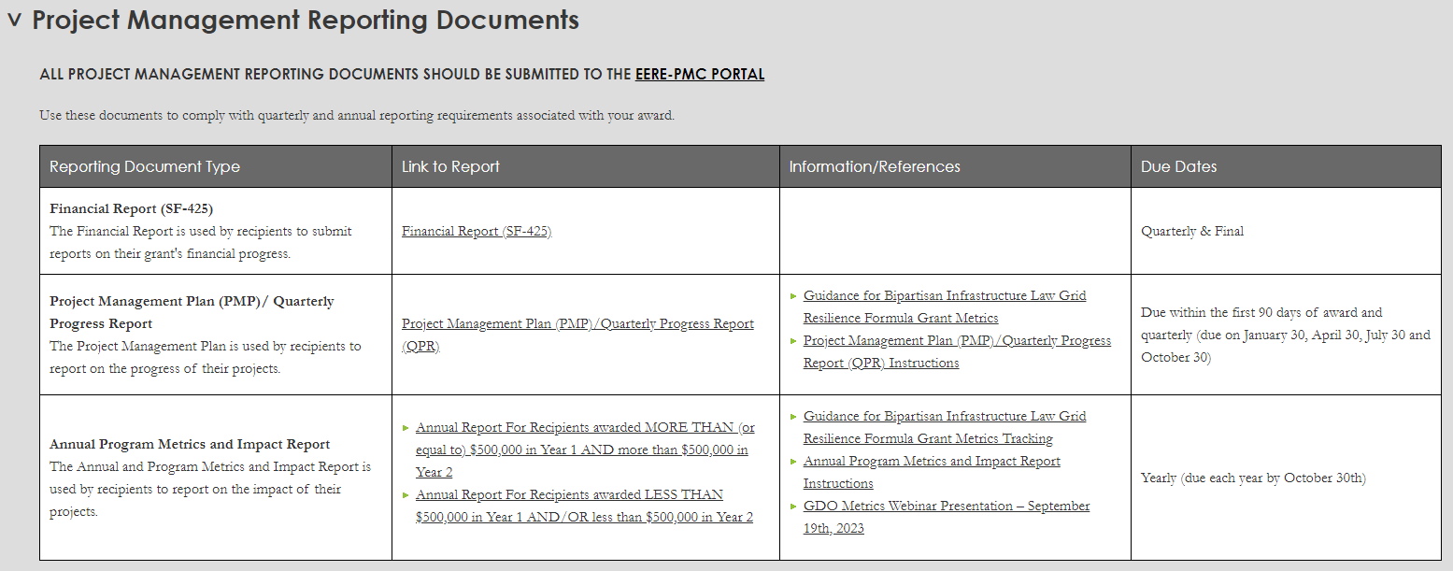
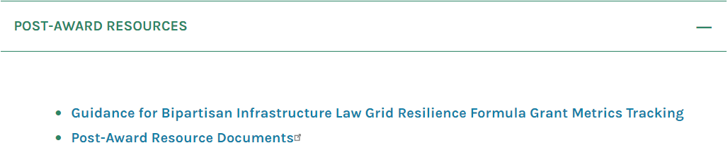
Reporting Resources
NETL Post-Award Resource Page
https://netl.doe.gov/bilhub/grid-resilience/formula-grants/post-award-documents
GDO Post-Award Resource Page
https://www.energy.gov/gdo/grid-resilience-statetribal-formula-grant-program

Slide 29
PMP/QPR Overview

Slide 30
PMP/QPR Overview
Recipient and Project Tab(s)
The PMP/QPR is an Excel file containing a Recipient tab and at least one Project Tab. Project tabs will be populated for each Subaward that is added to the agreement.
The template contains 5 Project tabs as a starting point. Individual Project/Subaward tabs contain a slightly more detailed Project Information section, along with individual tables specific to just that Project.
The PMP/QPR is a document that will be updated on a quarterly basis; the same file should be edited and re-submitted throughout the grant period.

Slide 31
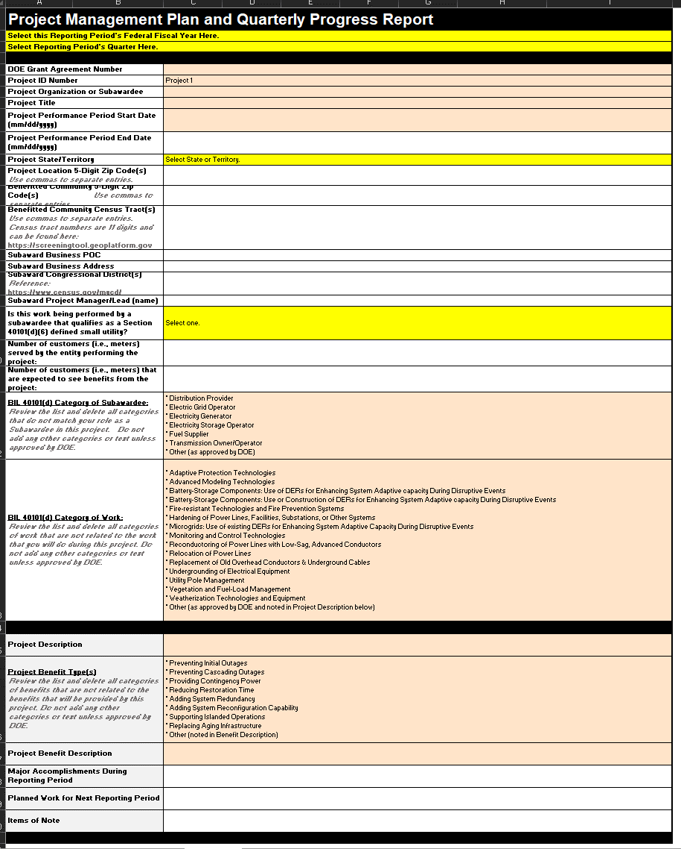
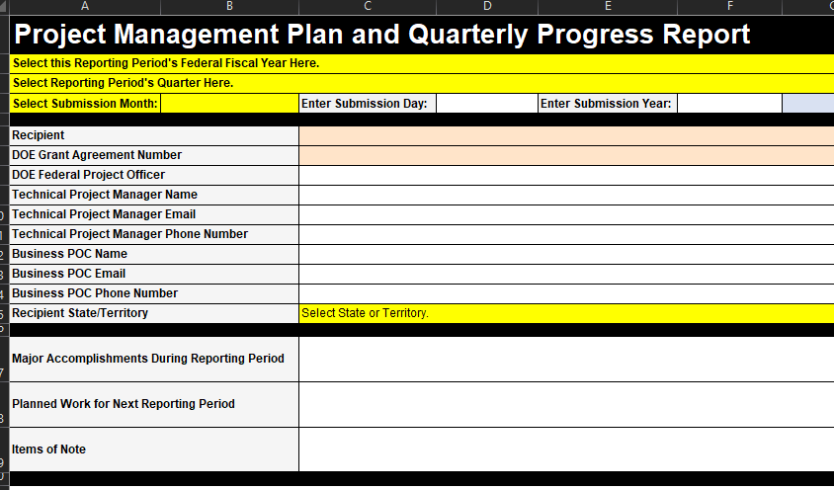
Recipient/Project Comparison
Recipient sheet (above)
Project sheet (right)
Yellow Boxes – Drop-Downs
Blue Text – Static Items / Don’t Need Changed
Red Text – Specific Information to a Project/Section

Slide 32
PMP/QPR Content
Information collected in the PMP/QPR
  Recipient section: general information related to the award, recipient, administrative info, major accomplishments, and items of note at the recipient and project levels
  Budget section: information specific to the recipient budget, broken out into a quarterly spend plan, administrative costs, and a baseline budget at the recipient and project levels
  Small Utility section: information related to the Small Utility Set Aside including specifics on percent of customers served by small utilities and amounts made available and awarded to small utilities at the recipient and project levels
  Milestone section: information related to milestones at the recipient and project levels
  Technical and Administrative Contracts section: information related to contracts specifically related to technical and administrative activities
  Build Metrics section: specific metrics associated with the projects being implemented
  Risk section: risks and associated mitigation strategies at the recipient and project levels

Slide 33
Annual Metrics and Yearly Reporting

Slide 34
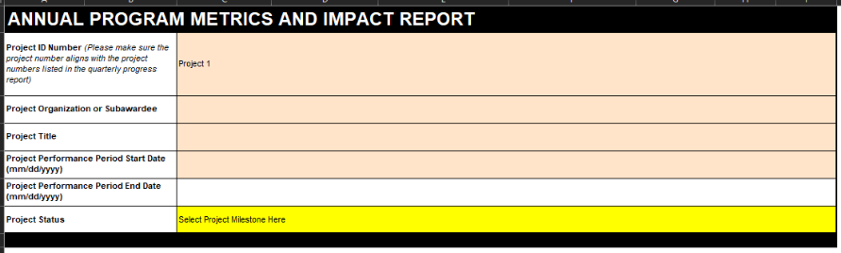
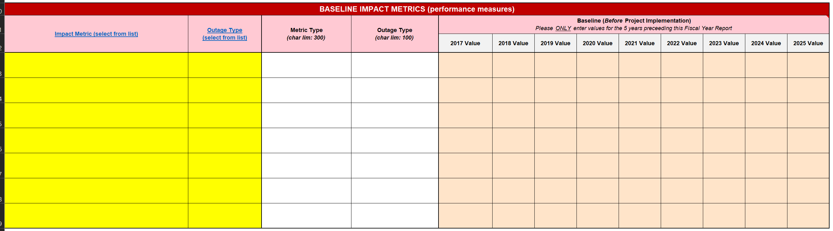
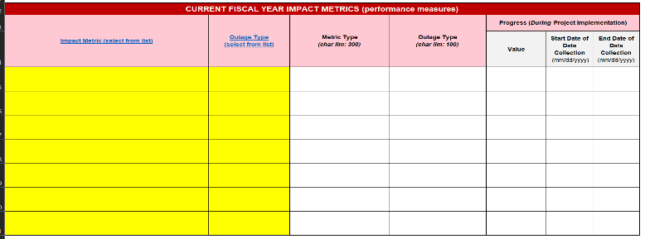
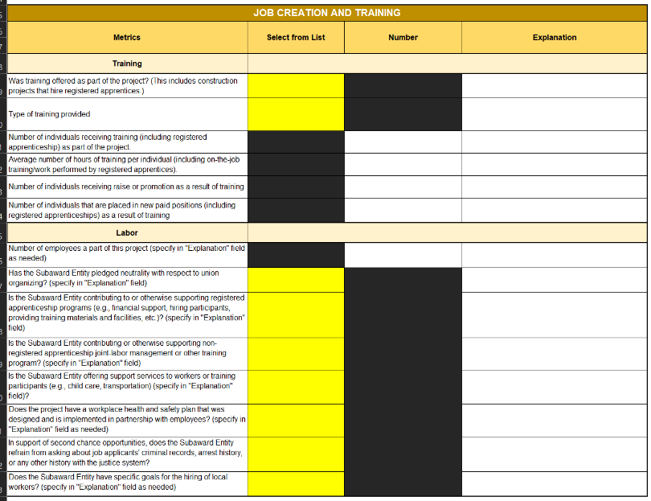

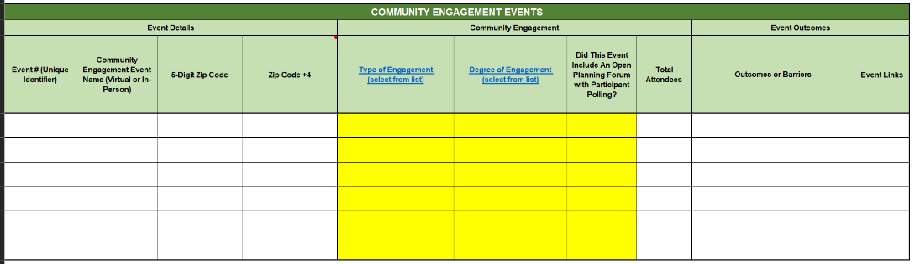
Annual Program Metrics & Impact Report
At the end of each Fiscal Year of the grant period, Recipients will complete an Annual Metrics & Impact Report. Metrics will be captured for the overall award and for each resilience project. This report includes the following topic areas:
Impacts (e.g., performance measures)
Job Creation/Training
Workforce Demographics
Community Engagements
https://www.energy.gov/gdo/events/september-19-grid-resilience-formula-grant-metrics-guidance-webinar-grant-recipients

Slide 35
Resources and Next Steps

Slide 36
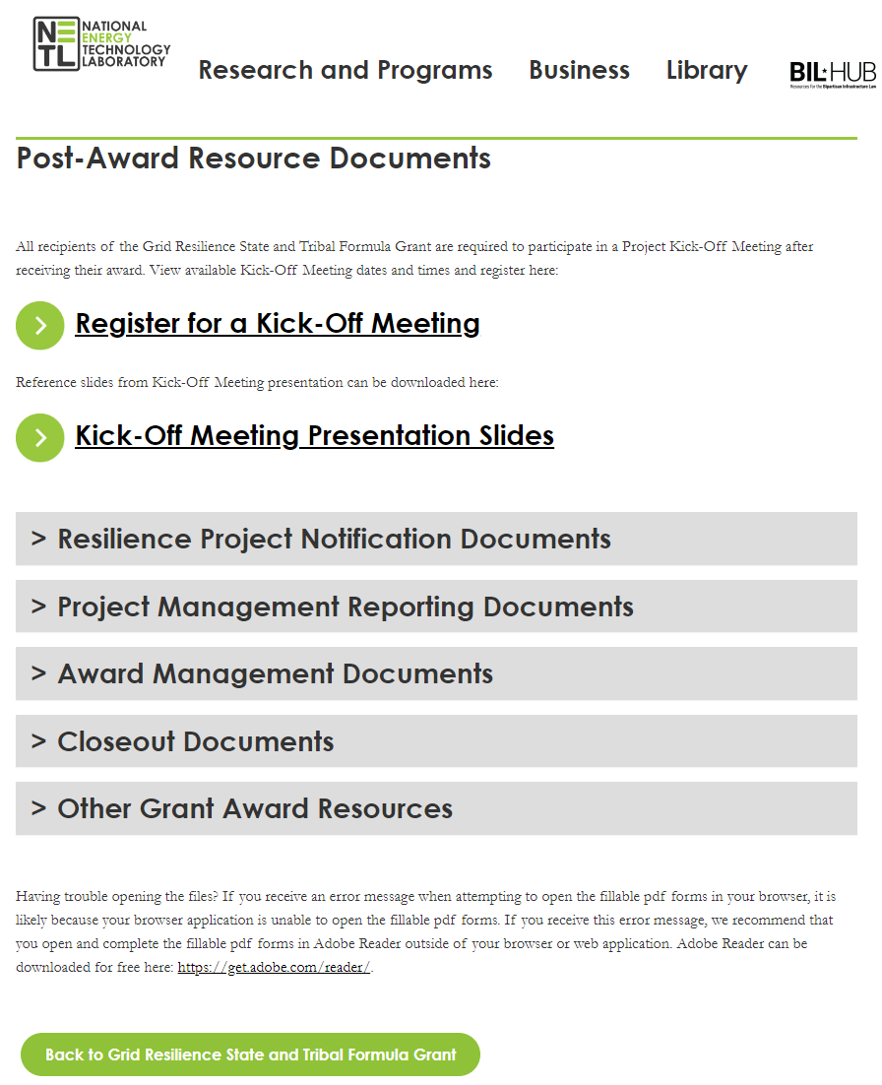
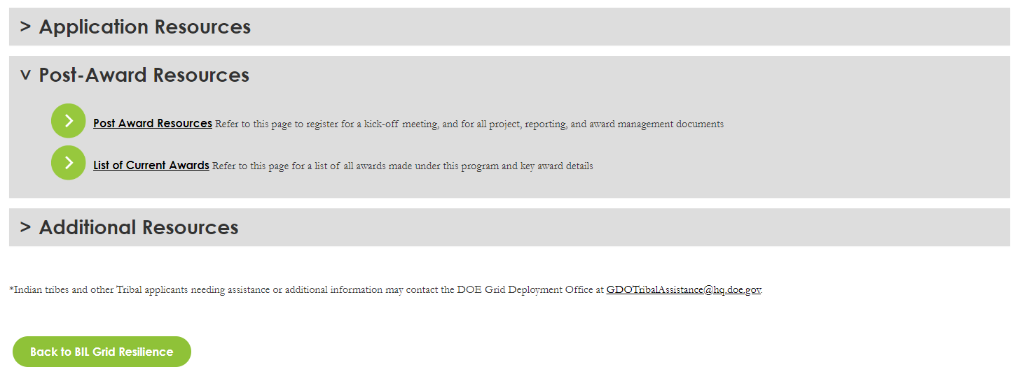
Award Administration Resources
Useful Links and Locations
Main 40101d Website HERE
Post-Award Resources HERE
  Subaward Notification
  Secretary consideration of Eligible Entity
  PMP/QPR template
  This Kickoff (KO) meeting presentation
  Etc.
Website links as of 1/3/2024

Slide 37
Financial Assistance Resources*
DOE Guide to Financial Assistance
      https://www.energy.gov/management/financial-assistance
      2 CFR 200 as amended by 2 CFR part 910 is the Code of Federal Regulations pertaining to DOE Financial Assistance - https://www.ecfr.gov/current/title-2/subtitle-A/chapter-II/part-200
      Subpart E of 2 CFR 200 contains the cost principles
*Not all inclusive.

Slide 38
Future Annual Allocations
The Annual Allocation process is addressed in the Terms and Conditions of the Agreement.
The Annual Allocation Request must include the following information:
  SF-424 reflecting the new allocation and cost match amounts.
  Cost Match Information for the additional allocation.
    Cost Match Value
    Identify the source/organization of the proposed cost match
    Type of Cost Match (cash or in-kind)
    Provide a description of the proposed cost match
  Program Narrative – if there are no changes, submit a copy of your current Program Narrative or an updated Program Narrative to reflect any changes. If changes have occurred, a Public Notice and Hearing must be documented in the updated Program Narrative.
Unlike the initial award, which included Years 1 & 2 (combined allocations), future grant awards will only be for 1 year of funding at a time.

Slide 39
Payments Using ASAP and VIPERS
ASAP (Automated Standard Application for Payments)
  Post-Award - should have received instructions for registering & creating ASAP account. Please be sure to register SPECIFICALLY FOR THE 40101d GRANT. ASAP POC has 45 business days to complete the enrollment.
  The Federal grant funds will be placed in the U.S. Treasury account associated with the grant agreement:
    May electronically transfer funds from the U.S. Treasury account to the Recipient’s bank account as needed to either be reimbursed for allowable expenses, or immediately prior to making payments for allowable expenses.
    The Reimbursement vs Advance option was based on information provided in the Pre-Award Information Sheet submitted with the grant application.
  DO NOT DRAW EXCESS FUNDS from the U.S. Treasury account such that you maintain excess Federal cash on-hand. Draw funds only as they are needed to make payments or receive reimbursements, as close to when they are needed by the Recipient as administratively feasible. Transfers may be made as frequently as needed.
  If a Recipient is determined to be high risk based on past performance or other audit information, they may be placed on traditional invoicing using VIPERS.

Slide 40
Payments Using ASAP and VIPERS
  VIPERS (Vendor Invoicing Portal & Electronic Reporting System)
  Recipients authorizing a Third Party to submit invoices, make payments and receive reimbursements (into the Third Party’s bank account) must use the traditional invoicing process (VIPERS).
    A letter of authorization from the Recipient (i.e., Indian Tribe or Tribal Entity) must be provided to DOE prior to submitting the first invoice. A template for the letter of authorization is available from your Federal Project Officer.
    Contact your Federal Project Officer and the Award Administrator for additional information regarding the Third Party invoicing and reimbursement process.

Slide 41
Payments Using ASAP and VIPERS
ASAP (Automated Standard Application for Payments)
  Recipients using ASAP system must enroll in ASAP
    https://www.fiscal.treasury.gov/asap/
  Recipient should take the ASAP training
    https://www.fiscal.treasury.gov/training/
  VIPERS (Vendor Invoicing Portal & Electronic Reporting System)
  Recipients using VIPERS system must request access and account
    https://vipers.doe.gov/RequestAccess.aspx

Slide 42
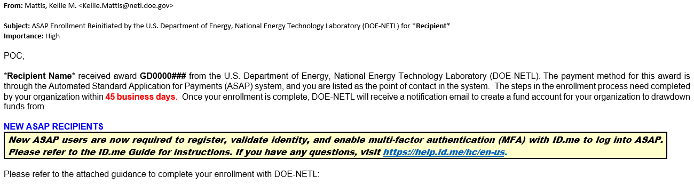
ASAP Enrollments
  ASAP Enrollment Email:
  Reminder - ASAP POC has 45 business days to complete the enrollment. Please be sure to register SPECIFICALLY FOR THE 40101d GRANT.
  Enrollment Email will contain guides and instructions for different aspects of enrollment.

Slide 43
Compliance Requirements

Slide 44
Build America, Buy America (BABA)
To the greatest extent practicable, all equipment and products purchased with funds made available under this award should be American-made.
The Recipient must ensure that the Buy America Requirement flows down to all subawards and that the subawardees and subrecipients comply.
When necessary, the Recipient may apply for, and DOE may grant, a waiver from the BABA Requirement. Details on this process can be found in the Terms and Conditions of your Agreement.
More information about DOE BABA requirements can be found at: https://www.energy.gov/management/build-america-buy-america

Slide 45
National Environmental Policy Act
DOE must comply with NEPA to authorize the use of federal funds. Proposed resilience project activities and all subawards must go through the NEPA review and approval process.
For projects with potential environmental impacts, please allow adequate time in your schedule for the NEPA compliance process.
Some examples of Categorical Exclusions (CXs) are:
  Construction of powerlines 10 miles or less, or 20 miles or less along existing rights-of-way
  Upgrading or rebuilding 20 miles or less of existing powerlines
  Routine maintenance:
    Repair or replace facility equipment, structure repair/replacement (doors, windows, floor, etc.)
    Repair, maintenance, testing, calibration, decontamination, and other activities related to some grid components
A full list of DOE Categorical Exclusions (CXs) can be found here:
10CFRPart1021.pdf (energy.gov)
The NEPA compliance officer will make the CX determination based on the EQ submitted by the Recipient.

Slide 46
Davis-Bacon Requirements
All laborers paid by funds made available under this award shall be paid wages at rates not less than those prevailing on similar projects in the locality, as determined by the Davis-Bacon Act (DBA).
The Recipient must ensure that the Davis-Bacon Requirement flows down to all subawards and that the subawardees and subrecipients comply.
DOE intends to make payroll documentation software available for assistance in complying with these requirements.

Slide 47
Recipient Next Steps
Immediate
Read and thoroughly understand the Terms and Conditions of your Agreement
Submit 1st QPR 30 days after the end of the 1st full quarter of performance (All submissions to the EERE PMC Portal)
Ongoing
Good Ideas
Maintain communication with project personnel and DOE FPO
Submit Subaward Notification Documents to FPO as projects and subawardees are identified
Adhere to the Terms and Conditions of the agreement, including the reporting requirements identified in the Reporting Requirements Checklist contained in the Assistance Agreement (Attachment 3)
Remember to not make multiple versions of the PMP/QPR Excel File
Allow sufficient time in your schedule for DOE review of proposed subawards and resilience projects
Demographic Reporting in PMC Portal (both Business Officer and TPM)
Submit PMP within 90 days

Slide 48
Questions?

Slide 49
Backup Slides

Slide 50
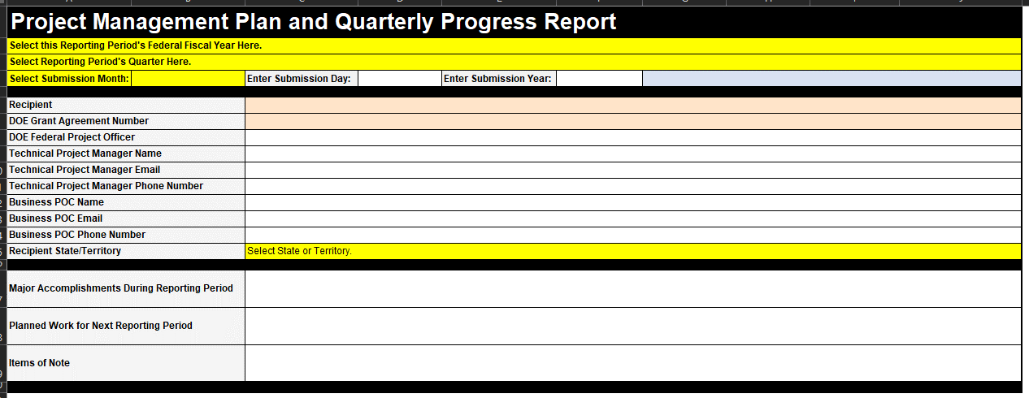
PMP/QPR - Recipient Information
This section details the information related to the recipient as an organization

Slide 51
PMP/QPR - Recipient Information
This section details the information related to the recipient as an organization
  Recipient: This is the name of the recipient organization.
  DOE Grant Agreement Number: The number assigned to your award (GD0000001 for example).
  DOE Federal Project Officer: Your DOE-NETL Point of Contact (POC).
  Technical Project Manager: This is the person in charge of overseeing the project for the recipient.
        Name, email and phone for this person.
  Business POC: This is the person in charge of business operations for the project.
        Name, email and phone of this person.
  Recipient State: State or Territory to which the award is granted.
  Major Accomplishments: Include any major accomplishments during the reporting period.
  Planned Work: Describe major work activities planned for the next reporting period.
  Items of note: Anything DOE should know about the project that isn’t reported elsewhere in the QPR.
PMP
QPR

Slide 52
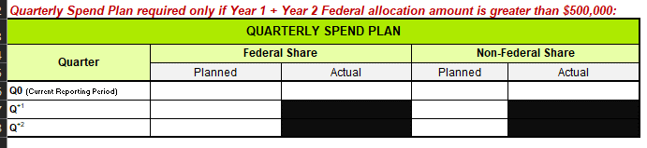
PMP/QPR - Quarterly Spend Plan
This section details the information related to the quarterly spending

Slide 53
PMP/QPR - Quarterly Spend Plan
This section details the information related to the quarterly spending
Federal Share:
    Planned: Incurred cost planned from Federal share for current quarter and the next two quarters
    Actual: Actual cost incurred from Federal share for current quarter
Non-Federal Share:
    Planned: Incurred cost planned from non-Federal share for current quarter and the next two quarters
    Actual: Actual cost incurred from non-Federal share for current quarter

Slide 54
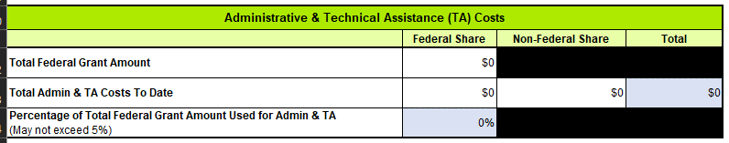
PMP/QPR - Administrative and Technical Assistance Costs
This section details the information related to the Admin and TA costs

Slide 55
PMP/QPR - Administrative and Technical Assistance Costs
This section details the information related to the Admin and TA costs
Total Federal Grant Amount: the total amount of Federal dollars granted to the Recipient.
Total Administrative and TA Costs to Date:
    Federal Share: the amount of Federal dollars spent to date on Administrative and TA tasks.
    Non-Federal Share: the amount of non-Federal dollars spent to date on Administrative and TA tasks.
    Total: the sum of Federal and non-Federal dollars spent to date on Administrative and TA tasks.
Percentage of Total Federal Grant Amount Used for Admin and TA: the percentage of Federal dollars spent on Administrative and TA tasks.
Note: percentage of total Federal dollars spent on Admin and TA costs cannot exceed 5% of the total dollar amount granted.

Slide 56
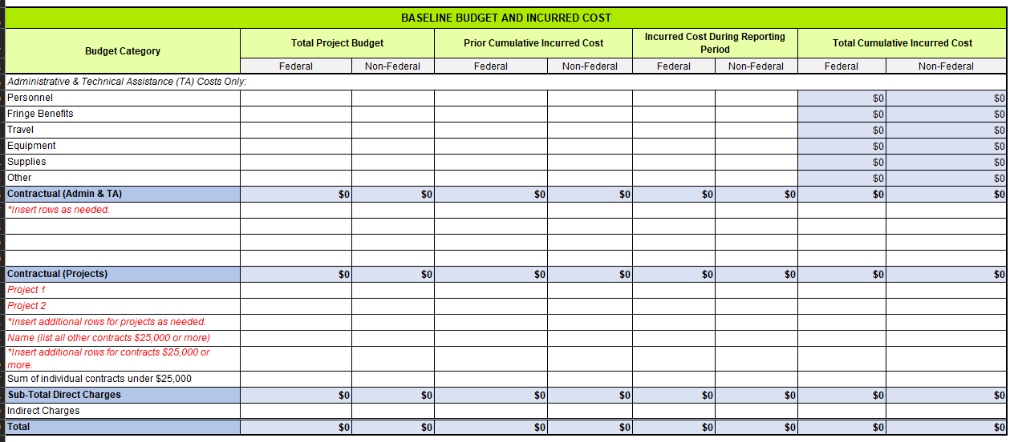
PMP/QPR - Baseline Budget and Incurred Cost
This section details the information related to baseline budget and incurred cost

Slide 57
PMP/QPR - Baseline Budget and Incurred Cost
This section details the information related to baseline budget and incurred cost
Personnel: costs paid for by Federal funds and non-Federal cost match:
    Total approved project budget, prior cumulative incurred cost, incurred cost during reporting period, and total cumulative incurred cost
Fringe Benefits: costs paid for by Federal and non-Federal cost match:
    Total approved project budget, prior cumulative incurred cost, incurred cost during reporting period, and total cumulative incurred cost
Travel: costs paid for by Federal and non-Federal cost match:
    Total approved project budget, prior cumulative incurred cost, incurred cost during reporting period, and total cumulative incurred cost
Equipment: costs paid for by Federal and non-Federal cost match:
    Total approved project budget, prior cumulative incurred cost, incurred cost during reporting period, and total cumulative incurred cost
Supplies: costs paid for by Federal and non-Federal cost match:
    Total approved project budget, prior cumulative incurred cost, incurred cost during reporting period, and total cumulative incurred cost

Slide 58
PMP/QPR - Utility Size, Funding and Customer information
This section details the information related to the size of the Utility
This section helps monitor compliance with the Small Utility Set Aside requirement.

Slide 59
PMP/QPR - Utility Size, Funding and Customer information
This section details the information related to the size of the Utility
Reference BIL40101(d) Subsection 6
Percentage of customers within jurisdiction served by utilities that sell not more than 4,000,000 megawatt hours (MWh) of electricity per year: provide the number of customers in the jurisdiction that are served by utilities that sell 4,000,000 MWh of electricity or less.
Amount of subaward funds that have been awarded to Section 40101(d)(6) defined small utilities: provide the amount of subaward funds that have been awarded to small utilities as defined in Section 40101(d)(6) – utilities that sell not more than 4,000,000 MWh of electricity per year.
Percentage of total Resilience Project subaward funds that have been awarded to Section 40101(d)(6) defined small utilities: the percentage of total resilience project subaward funds allocated to small utilities, presented as a percentage of total funds.
Note: Website for Utility Sales (as of 2021)
  https://www.eia.gov/electricity/sales_revenue_price/pdf/table10.pdf

Slide 60
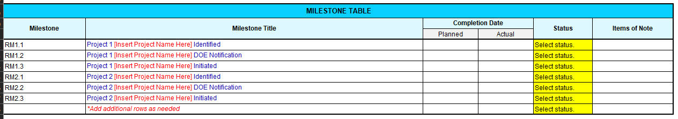
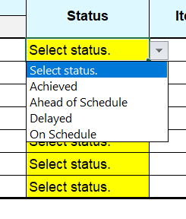
PMP/QPR - Milestone Table
This section details the information related to the project milestones
Three Milestones should be listed on the Recipient sheet for each corresponding Project (Identified, DOE Notification, Initiated).
Once Project is Initiated, individual Project Milestones will be captured in the Project sheet.

Slide 61
PMP/QPR - Milestone Table
This section details the information related to the project milestones
  Milestone: the number of the milestone
  Milestone Title: the title of the milestone
      These have been provided with a placeholder for the Project Name(s) from the Project tabs.
  Completion date:
      Planned: the planned completion date
      Actual: the actual completion date
  Status: the status of the milestone – achieved, ahead of schedule, delayed, on schedule
  Items of note: anything the FPO and DOE-NETL should know regarding the milestone.

Slide 62
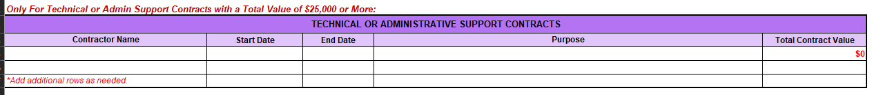
PMP/QPR - Technical or Administrative Support Contracts
This section details the information related to Administrative and Support Contracts

Slide 63
PMP/QPR - Technical or Administrative Support Contracts
This section details the information related to Administrative and Support Contracts
  Contractor Name: the name of the contractor
  Start date: the date the contractor is starting support
  End date: the date the contractor ends support
  Purpose: the purpose of the support contract, be as detailed as possible including specific items they’re supporting
  Total contract value: the total value of the contract

Slide 64
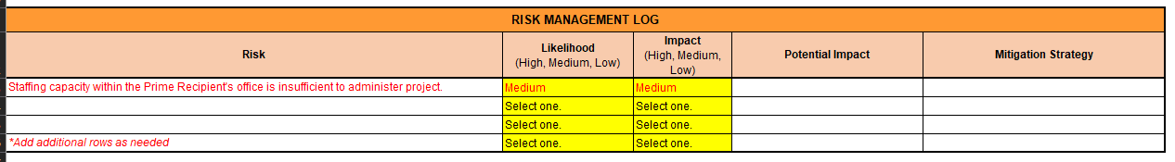
PMP/QPR - Risk Management Log
This section details the information related to the risk management of the project

Slide 65
PMP/QPR - Risk Management Log
This section details the information related to the risk management of the project
  Risk: detail the risk identified
  Likelihood: the likelihood that the risk will occur – low, medium, or high
  Impact: the impact on the project success or schedule that the risk will have should it occur – low, medium, or high
  Potential Impact: detail the potential impact the risk would have should it occur
  Mitigation Strategy: the mitigation strategy the project team is implementing to make sure the risk either doesn’t happen or it is managed effectively

Slide 66
Definitions
Running List
Allocation: BIL Section 40101(d) prescribes a formula to allocate funds to States and Indian Tribes. The formula includes five factors based on population, land area, probability of disruptive events, economic impact of past disruptive events, and amount of expenditures spent to mitigate likelihood and consequence of disruptive events. The resulting allocations are the amount a State or Indian Tribe may receive during each of the five years of grant funding. Annual allocation amounts will be determined each year based on available BIL Section 40101(d) funding and annual updates to the data relating to the five factors.
ALRD: An Administrative and Legal Requirements Document (ALRD) is the instrument the government uses to announce and describe a financial assistance opportunity, such as a formula grant. It is similar to a Funding Opportunity Announcement (FOA), except that an ALRD is typically used for a non-competitive grant program whereas a FOA is typically used for a competitive financial assistance opportunity. The ALRD provides the administrative and legal requirements of the formula grant program and instructs eligible applicants on the process and documents needed to apply for the grant.
Applicant: An Applicant is a State, U.S. Territory, District of Columbia or Indian Tribe (normally referred to as “State and Indian Tribes” for the purpose of BIL Section 40101(d)) eligible to receive a formula grant under Section 40101(d) Formula Grant Program of the Bipartisan Infrastructure Law (BIL).
Application: There are two definitions for an application, depending on the stage of the award process:
Grant Application: States and Indian Tribes must submit a grant application to the U.S. Department of Energy to receive a formula grant under BIL Section 40101(d). Section 40101(d) requires that applications include a plan (referred to as the Program Narrative) that describes the criteria and methods that will be used by the State or Indian Tribe to award grants to eligible entities; be adopted after notice and a public hearing; and describe the proposed funding distributions and recipients of the grants to be provided by the State or Indian Tribe. In addition to the Program Narrative, the ALRD Sections IV.A and IV.B require additional information and documents needed to apply for and receive a grant.
Allocation Application: States and Indian Tribes must submit an annual allocation application to request and receive their annual funding allocations (this is after receipt of their initial award). The allocation request for Year 1 is considered to be part of the initial grant application. Additionally, the U.S. Department of Energy will be releasing the Year 2 formula allocation amounts by January 2023. States and Indian Tribes may request both Year 1 and Year 2 allocation amounts in the initial grant application. Or, if a State or Indian Tribe submits an application prior to the release of the Year 2 allocations, requesting only the Year 1 allocation, they must submit a separate Year 2 allocation application prior to March 31, 2023 in order to receive the Year 2 allocation. The Grant Agreement will contain instructions on the requirements and process for annual allocation application submittals. Annual allocations will be obligated to the same grant agreement awarded in Year 1, thereby increasing the grant amount with each annual allocation.

Slide 67
Definitions Cont.
Running List
Cost Match: Cost Match under BIL Section 40101(d) is the amount of non-Federal funding a State or Indian Tribe must provide to match the amount of Federal funds awarded under a Section 40101(d) formula grant. Under the Section 40101(d) each State and Indian Tribe is required to match 15 percent of the amount provided to it under the program. Further, an Eligible Entity that receives a subaward under this program is required to match 100 percent of the amount of the subaward as required by Section 40101(h)(1). However, if the Eligible Entity sells not more than 4,000,000 megawatt hours of electricity per year (i.e., is a Small Utility), the required match will be one-third of the amount of the subaward as required by Section 40101(h)(2).
Eligible Entity: States and Indian Tribes may use BIL Section 40101(d) formula grant funds to issue subawards to Eligible Entities for the purpose of implementing eligible resilience measures that achieve the objectives of Section 40101(d). An Eligible Entity is defined by Section 40101(d) as
  an electric grid operator;
  an electricity storage operator;
  an electricity generator;
  a transmission owner or operator;
  a distribution provider;
  a fuel supplier; and
  any other relevant entity, as determined by the Secretary (of the U.S. Department of Energy).
Formula Grant: A formula grant is a type of financial assistance award in which the government awards grants to eligible applicants, with the grant amount being based on a prescribed formula. BIL Section 40101(d) prescribes a formula to allocate Section 40101(d) funds to States and Indian Tribes. The formula includes five factors based on population, land area, probability of disruptive events, economic impact of past disruptive events, and amount of expenditures spent to mitigate likelihood and consequence of disruptive events.
GDO: The Grid Deployment Office (GDO) is the programmatic office within the U.S. Department of Energy responsible for implementing the BIL Section 40101(d) and other BIL grid resilience programs. Information about GDO is available here: Grid Deployment Office | Department of Energy
Grant Agreement: A grant agreement is the contractual financial assistance instrument in which a State or Indian Tribe and the Department of Energy enter into for the purpose of the Department of Energy making available funds to the applicant to achieve grant objectives. The grant agreement contains the Terms and Conditions the State or Indian Tribe must adhere to when utilizing grant funds. The U.S. Department of Energy will award Section 40101(d) grant agreements with an initial Period of Performance of five years.

Slide 68
Definitions Cont.
Running List
NETL: The National Energy Technology Laboratory (NETL) is administering the BIL Section 40101(d) and other BIL grid resilience programs on behalf of the U.S. Department of Energy Grid Deployment Office (GDO), and will provide administrative and technical oversight over the formula grants. NETL will assign Federal Project Officers, Award Administrators, and Contracting Officers to negotiate, award, monitor and administer the BIL Section 40101(d) formula grants to States and Indian Tribes. Information about NETL is available here: https://netl.doe.gov.
New Generation: BIL Section 40101 prohibits a grant awarded to an Eligible Entity under the program being used for construction of a new electric generating facility. In this context, new generation is defined as construction of a facility that produces electricity, including emergency back-up generation, solar generation or any other electric generation unit or facility.
Power Line: The term “power line” includes a transmission line or a distribution line, as applicable. Distribution power lines are considered to be below 69kV.
Program Narrative: The Program Narrative is a critical part of the grant application. Section 40101(d) requires that applications include a plan (referred to as the Program Narrative) that as describes the criteria and methods that will be used by the State or Indian Tribe to award grants to eligible entities; be adopted after notice and a public hearing; and (iii) describe the proposed funding distributions and recipients of the grants to be provided by the State or Indian Tribe. The ALRD provides additional requirements for the Program Narrative, which include”
  Objective and metrics
  Criteria
  Methods
  Funding distribution
  Equity Approach
  Technical assistance and administration
  Public notice and hearing
Section 40101(d): Section 40101(d) of the Bipartisan Infrastructure Law (BIL) authorizes the U.S. Department of Energy to award formula grants to States and Indian Tribes to improve the resilience of their electric grids.
Small Utility: As defined in BIL Section 40101(h)(2) for the purpose of this grant program, a Small Utility sells not more than 4,000,000 megawatt hours of electricity per year.
Weatherization: Technologies or equipment that can be used to enhance reliability and resiliency of electric grid components in preparation for extreme weather conditions.

Slide 69
Acronyms
Running List
AGR&D – Advanced Grid Research and Development
ASAP – Automated Standard Application for Payments
BIL – Bipartisan Infrastructure Law (also referred to as IIJA)
CESER – Office of Cybersecurity, Energy Security, & Emergency Response
CFR – Code of Federal Regulations
CO – Contracting Officer
CS – Contract Specialist
DOE – Department of Energy
EDST – Energy Delivery & Security Team
EERE – Energy Efficiency and Renewable Energy
FOA – Funding Opportunity Announcement
FPO – Federal Project Officer (also referred to as TPO and Program Manager)
GDO – Grid Deployment Office
GD### – NETL’s Project Numbering System
GRIP – Grid Resilience & Innovative Partnerships
IIJA – Infrastructure Investment and Jobs Act
MWh – Megawatt Hours
NETL – National Energy Technology Laboratory
OE – Office of Electricity
PM – Project Milestone (Milestone Table)
PMP – Project Management Plan
POC – Point of Contact
PPRA – Preparedness, Policy, and Risk Analysis
QPR – Quarterly Progress Report
R&D – Research & Development
RM – Recipient Milestone (Milestone table)
RMT – Risk Management Tools and Technologies
SOPO – Statement of Project Objectives
TA – Technical Assistance
VIPERS – Vendor Invoicing Portal & Electronic Reporting System

