Slide 1
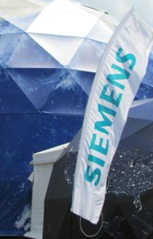
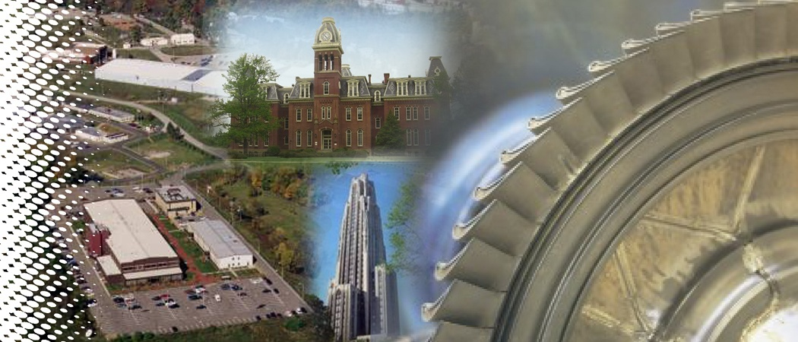


Integrated Transpiration & Lattice Cooling Systems Developed by Additive Engineering with Oxide Dispersed Strengthened (ODS) Alloys
Minking Chyu, Albert To University of Pittsburgh
Bruce S. Kang West Virginia University

Slide 2
University Turbine Systems Research
Outlines
Background, Challenges, Objectives, Benefits of Technology, Research Task Plans
Additive Manufacturing Processes
ODS Powder Development
Heat Transfer Results: Transpiration Cooling
Heat Transfer Results: Lattice Cooling
Summary
Notes:
Presentation outline:
A brief introduction to the challenges in turbine blades, which are related to our project.

Slide 3
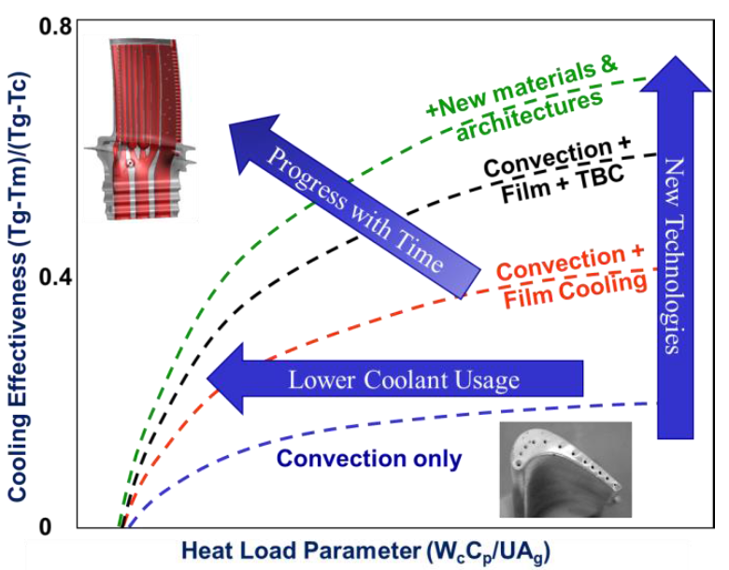
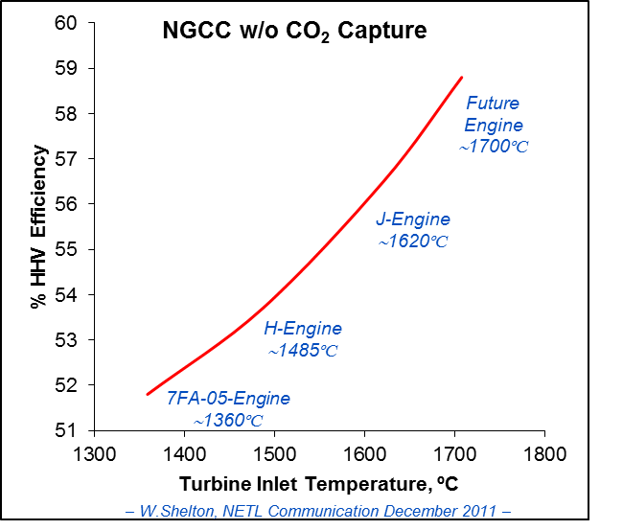
Technical Background: Need for Turbine Cooling
Bunker RS. Evolution of Turbine Cooling. ASME. Turbo Expo: Power for Land, Sea, and Air, Volume 1: Aircraft Engine; Fans and Blowers; Marine; Honors and Awards ():V001T51A001. doi:10.1115/GT2017-63205.
Turbine Inlet Temperature continues to rise
“One key will be the marriage of design and manufacturing to bring about the concurrent use of engineered micro cooling or transpiration, with the ability of additive manufacturing. If successful, this combination could see a further 50% reduction in coolant usage for turbines”
Notes:
This viewgraph on left summarized the projected turbine inlet temperature of advanced gas turbine engines that continue to increase, which demands higher cooling load to combat the aerothermal challenges.
The right view graph is from Bunker 2017. The “heat load parameter” is basically a non-dimensional mass flow rate of the coolant. The figure illustrated the progressing of cooling technologies over the past few decades. Overall cooling effectiveness has been increased from 0.1 at the beginning to 0.7 today, which includes the contribution of convection cooling, film cooling, and TBC. Meantime, the coolant amount instantly decrease with the progress with time, to enhance the turbine cycle efficiency.
Bunker pointed out that “one key avenue for turbine airfoil cooling might be “bringing about micro cooling or transpiration cooling with the ability of additive manufacturing”. By introducing complex geometry to achieve near wall or transpiration cooling, the coolant usage might be further reduced for 50%.
Typical failure of turbine blades included hot corrosion, thermal fatigue and thermal creep. All related to the high temperature condition the airfoils suffers from.
As a consequence, novel cooling technology and new material are urgently in need.

Slide 4
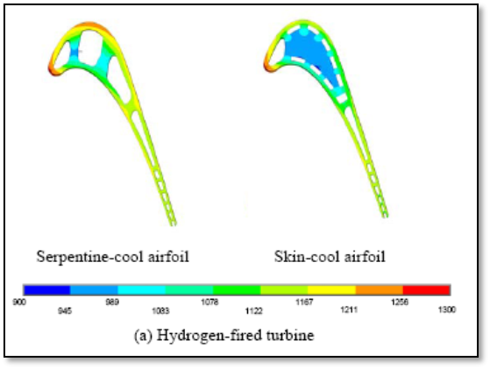
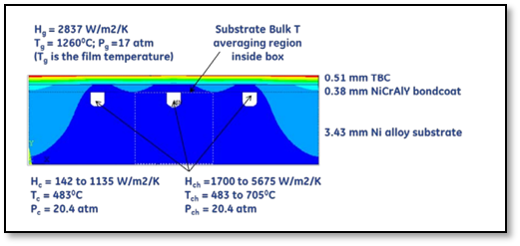
Technical Background
Siw, S.C., Chyu, M.K., Karaivanov, V.G., Slaughter, W.S., and Alvin, M.A., 2009, “Influence of Internal Coolinjg Configuration on Metal Temperature Distributions of Future Coal-Fuel Based Turbine Airfoils,” Turbo Expo 2009, GT2009-59829.
Bunker, R.S., 2013, “Gas Turbine Cooling: Moving from Macro to Micro Cooling,” Turbo Expo 2013, GT2013-94277
Near surface ‘skin cooling’ or ‘double-wall’ internal cooling arrangement leads to a significant reduction of metal surface temperature, which can be in the order of 100 degrees, compared to conventional serpentine cooling designs
Notes:
This viewgraph on left summarized the projected turbine inlet temperature of advanced gas turbine engines that continue to increase, which demands higher cooling load to combat the aerothermal challenges.
The right view graph is from Bunker 2017. The “heat load parameter” is basically a non-dimensional mass flow rate of the coolant. The figure illustrated the progressing of cooling technologies over the past few decades. Overall cooling effectiveness has been increased from 0.1 at the beginning to 0.7 today, which includes the contribution of convection cooling, film cooling, and TBC. Meantime, the coolant amount instantly decrease with the progress with time, to enhance the turbine cycle efficiency.
Bunker pointed out that “one key avenue for turbine airfoil cooling might be “bringing about micro cooling or transpiration cooling with the ability of additive manufacturing”. By introducing complex geometry to achieve near wall or transpiration cooling, the coolant usage might be further reduced for 50%.
Typical failure of turbine blades included hot corrosion, thermal fatigue and thermal creep. All related to the high temperature condition the airfoils suffers from.
As a consequence, novel cooling technology and new material are urgently in need.

Slide 5
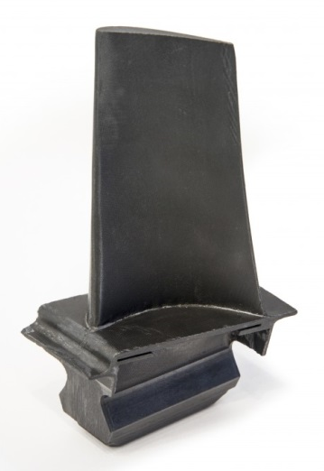
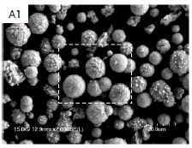
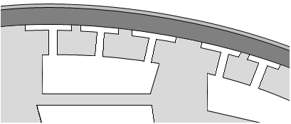
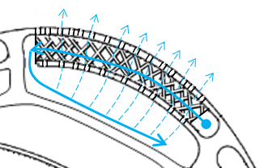
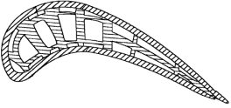
Proposed Technologies
Advanced Additive Manufacturing
Intricate Heat Transfer Enhancement Features
ODS
Enhanced oxidation resistance and high temperature strength
Near Surface Embedded Cooling Channel (NSECC )
Integrated Transpiration and Lattice Cooling Systems
αAl₂O₃ / NiO
Transpiration Cooling
ODS Structural Layer
Substrate (Superalloy)
Internal Cooling
ODS Layer Cooling Passage
Internal Cooling Passage
Hollow Lattice
ODS with AM
Both internal and external protection.
Oxidation Resistance
Realized with additive manufacturing
Novel ODS Surface Coating
Ultra-High Temperature (1200°C) Strength: thinner outer wall for better cooling
Oxidation Resistance
Higher turbine inlet temperatures
Enhanced Heat Removal
NSECC: high internal heat transfer and higher coolant flow near hot end wall.
Lattice and transpiration combined conjugate cooling: ~2x of state-of-the-art film cooling.
Notes:
Such a marriage between material and manufacturing is the prime focus of our two UTSR research. The novel ODS material being developed has been proven to have extremely high oxidation resistance and high temperature strength (1200 C). This high strength makes it difficult for conventional machining to be used to form parts from ODS. However, we showed that AM is a viable approach to consolidate ODS powder into desired part form or coating.
The first project demonstrated the use of DED for deposition of ODS on superalloy substrate. This allowed to push the cooling channels closer to the hot side end wall and also in thinner end wall owing to the high temperature strength of the ODS.
The second project focuses on taking this approach further by fabricating a novel integrated transpiration and lattice cooling structure out of ODS. Such a geometry takes the advantage of AM and ODS and is capable of providing external and internal thermal protection in addition to being less susceptible to oxidation.

Slide 6
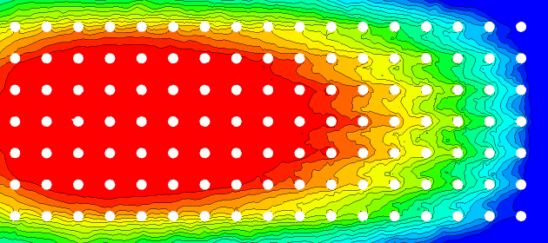
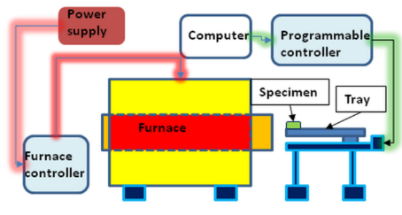

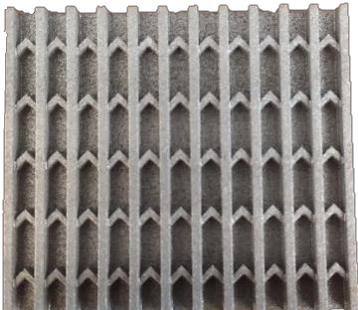

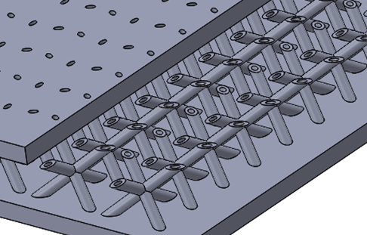
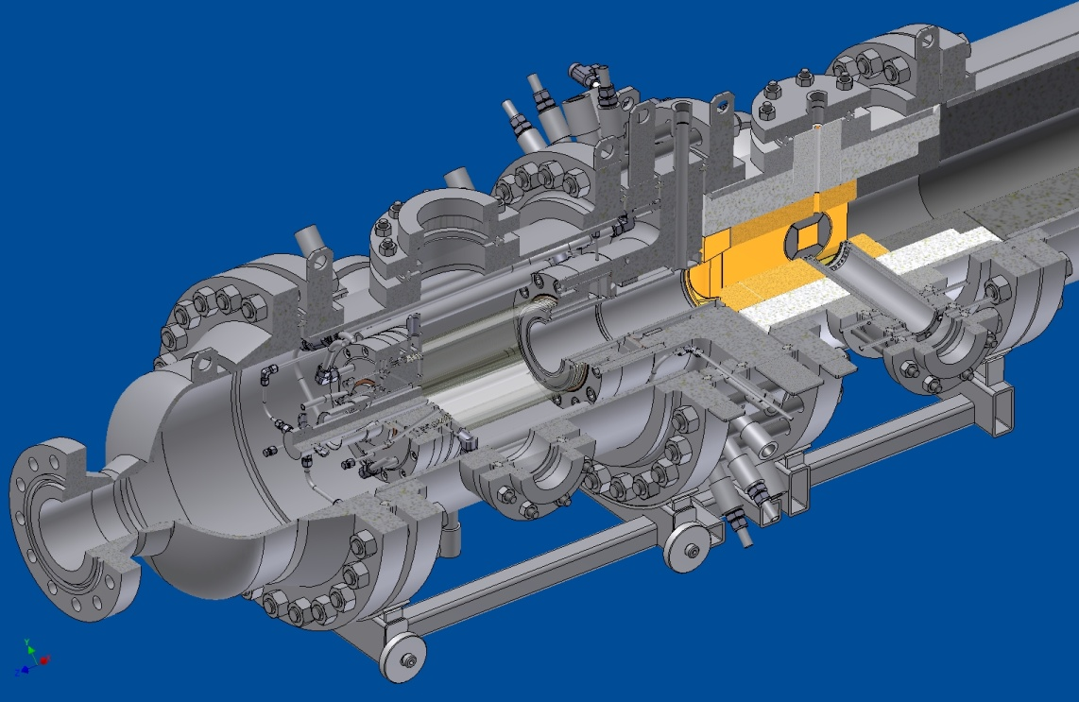
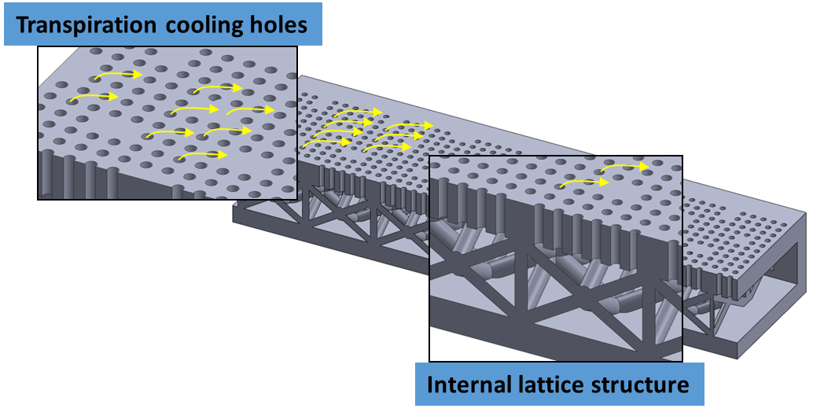
Project Work Breakdown Structure
Goal: Enhanced Oxidation Resistance and Thermal Protection of Turbine Blades
ODS Powder Fabrication and Characterization
MCB/BM for powders fabrication
Characterization
Cooling Geometry Design
Wall jets, Transpiration and Lattice Geometry development and optimization
Lab-Scale Heat Transfer Characterization
CFD modeling & steady state and scaled TLC testing
Mini/micro scale cellular units
Thermal Cyclic Testing
In-situ non-destructive micro indentation facility
Thermal Cyclic Tests, Micro-hardness
High Temperature Heat Transfer Characterization
High Temperature, Pressurized Testing (NETL)
Process Optimization to Fabricate ODS Transpiration and Lattice Structures
DMLS, BJT printing parameters
Posting printing characterization
OM, SEM
Combustor
Aerothermal Test Section
Notes:
Main advantages:
Provide protection from oxidation and ultra high temperature strength
provide cooling efficiency more than 0.6.
Complex ODS lattice structure, - ultra high temperature strength, coupled with high oxidation resistance.
Broadly speaking, the Projects have following 6 sub-tasks
– U Pitt is responsible of exploring different configurations that can be considered as wall jet geometries, and Integrated Transpiration and Lattice Cooling Systems. Siemens will also provide suggestions and guidance on this part.
– U Pitt will develop optimal AM process for ODS lattice structure in the ANSYS Additive Manufacturing Research Lab. Siemens has rich experience on AM turbine components and we will exchange knowledge during this phase.
- U Pitt and NETL will conduct high temperature heat transfer experiments on the finalized ODS lattice structures
– WVU will further improve the production process and continuously produce adequate powder for the AM process. The time cost will be further reduced.
- WVU will exam the oxidation characteristics of ODS lattice structures under cyclic high temperature conditions to prove anti-oxidation properties of ODS.

Slide 7
University Turbine Systems Research
Outlines
Background, Challenges, Objectives, Benefits of Technology, Research Task Plans
Additive Manufacturing Processes
ODS Powder Development
Heat Transfer Results: Transpiration Cooling
Heat Transfer Results: Lattice Cooling
Summary
Notes:
Presentation outline:
A brief introduction to the challenges in turbine blades, which are related to our project.

Slide 8
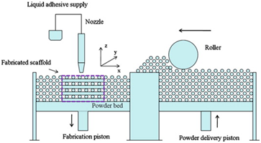
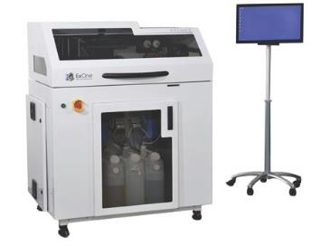
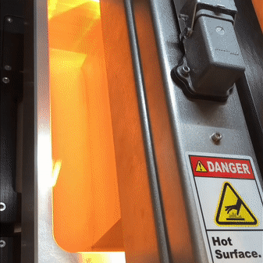
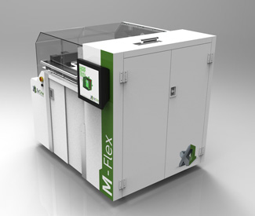
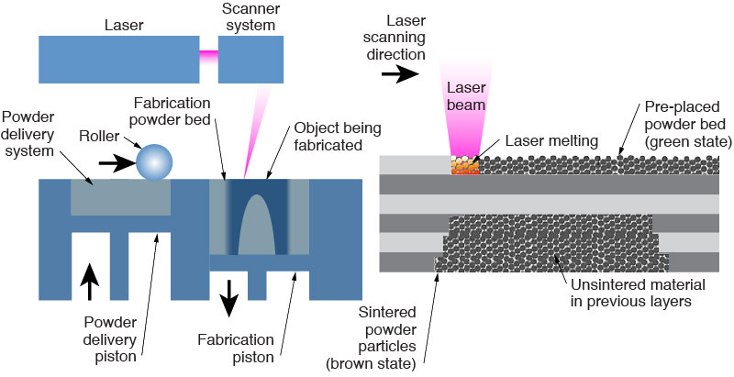
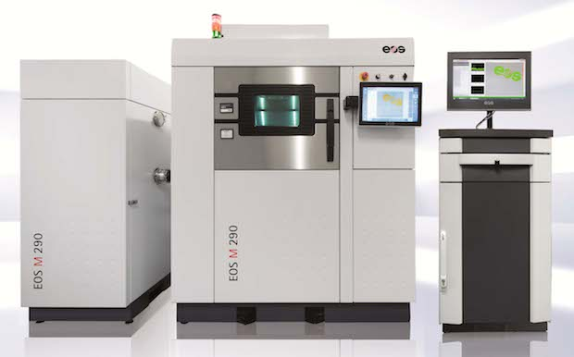
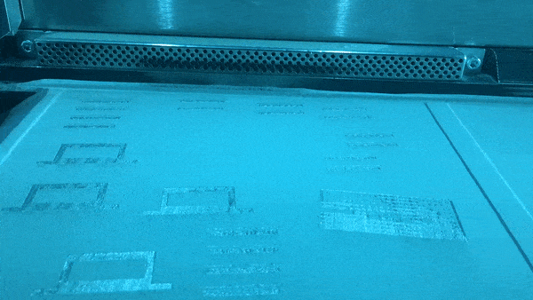
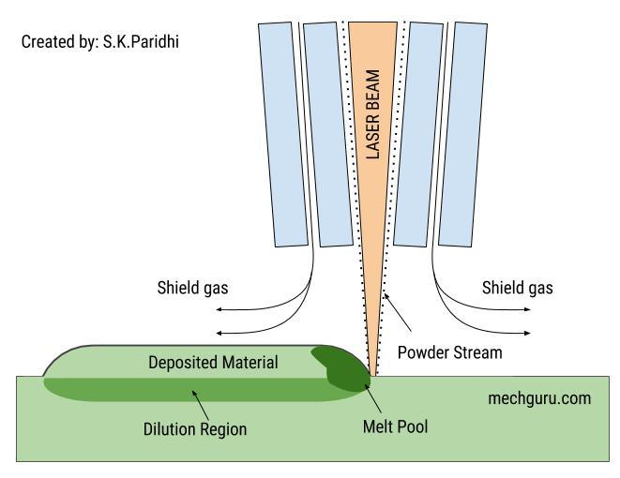
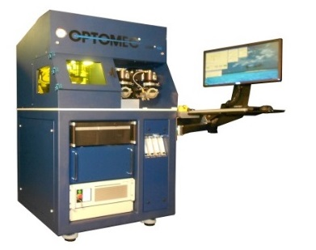
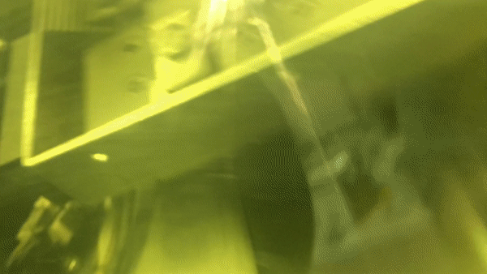
AM Processes Utilized
Bind Jetting
(EXOne)
Pros: geometry free
cons: high porosity
Powder Bed Fusion (EOS)
Pros: complex geometry
cons: single material
Direct Energy Deposition (LENS)
Pros: multiple materials
cons: no overhangs or unsupported structure
As metallic additive manufacturing technologies advance significantly over the recent past, complex metal products, such as turbine components, can be manufactured by this innovative technology.
Notes:
Binder Jetting: ExOne. Adhesive binder to form the built product, then heat treatment to burn away the binder and create sintering effects to form the product. The advantage is that the energy to produce the build is low and without laser melting; but the product with too high porosity, such as hipping process.
EOS is laser melt powder bed process and is very popular in aero and energy sectors. EOS provides recipe of process for a number of materials
LENS is a direct laser-melt particle deposit technology. This is a popular method for part repairing and using the method to develop new material or composite of new material characteristics. The limit is that this is a “free-form” technology, not a “powder bed” technology, so the part-building is processed without lateral support; hence it is difficult to bulid bridges and hangovers.
Powder Bed Direct Metal Laser Sintering: EOS
a production machine for complex geometries
Direct Energy Deposition: LENS
for multiple material or coating/combining materials
do not allow overhangs or unsupported structures

Slide 9
University Turbine Systems Research
Outlines
Background, Challenges, Objectives, Benefits of Technology, Research Task Plans
Additive Manufacturing Processes
ODS Powder Development
Heat Transfer Results: Transpiration Cooling
Heat Transfer Results: Lattice Cooling
Summary
Notes:
Presentation outline:
A brief introduction to the challenges in turbine blades, which are related to our project.

Slide 10
Pros and Cons of Gas Atomization (GA)
for AM Metal Powder
Pros:
Atomization processes are capable of producing high quality metal powders, such as aluminum, brass, iron, stainless steel, titanium and superalloys with uniform particle distribution and spherical shape.
Current standard fabrication method to produce metal powders for metal AM.
Cons:
ODS powder fabrication using GA becomes problematic due to high melting temperature of yttrium oxide (Y₂O₃, 2425°C) compared to iron (Fe, 1538 °C), nickel (Ni, 1668 °C), chromium (Cr, 1907 °C) and aluminum (Al, 660 °C), thus, uniform dispersion of Y₂O₃ is problematic for production of ODS powders.
Post alternations of atomized powder (i.e. ball milling) must be done to produce ODS powder.

Slide 11
Ni- and Fe-based ODS powder development for Additive Manufacturing of gas turbine component with better high temperature (up to 1200 ºC) oxidation/corrosion resistance and material strength (i.e. creep and fatigue)
(i) (to produce) ODS powder for AM with lower manufacturing cost and better yttria dispersion using a combined Hosokawa mechano chemical bonding (MCB) and ball milling (BM) process:
(a) MCB + BM
(b) MCB only
(ii) AM processing optimization
(iii) (to achieve) a durable α-Al₂O₃ oxide layer (via external oxidation) with strong adhesion to substrate for better oxidation and corrosion resistance (e.g. molten chloride)

Slide 12
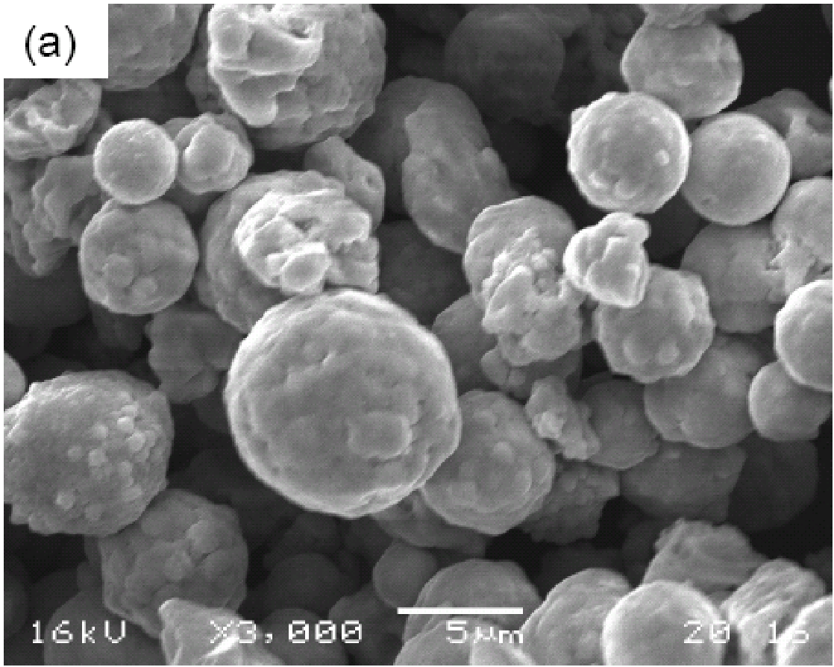
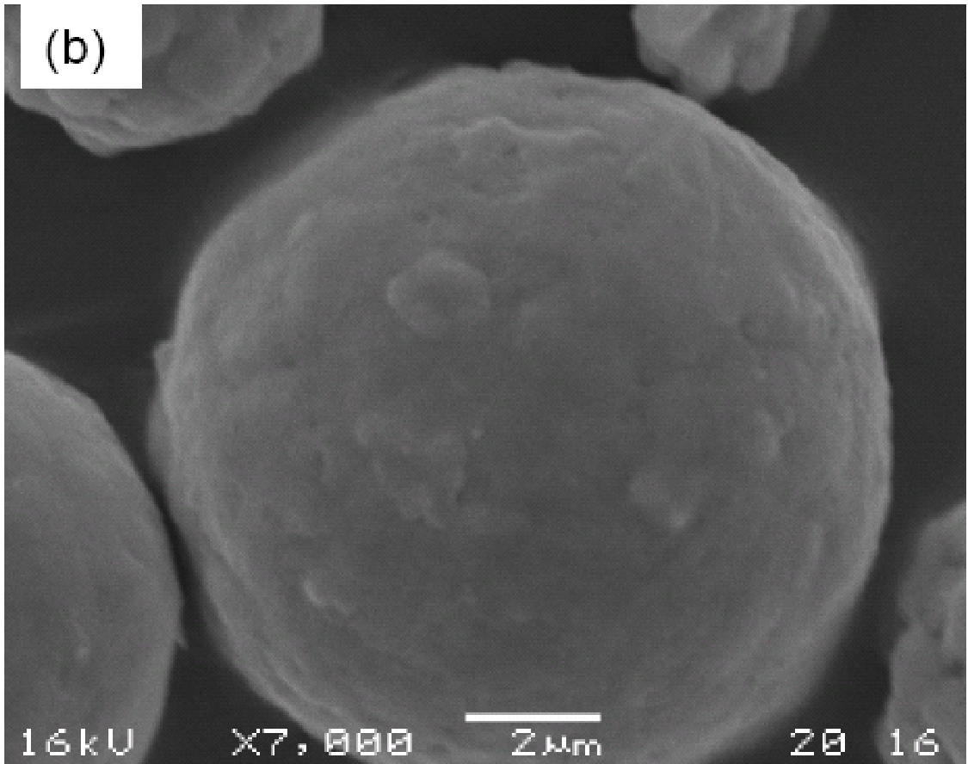
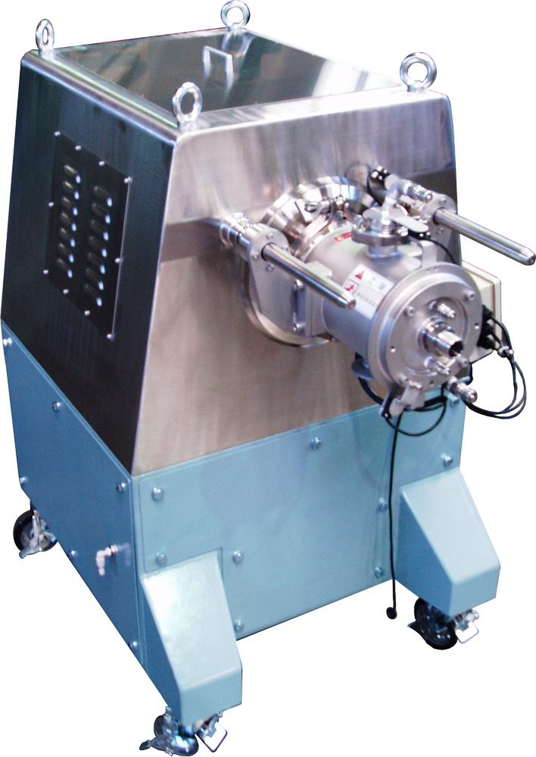
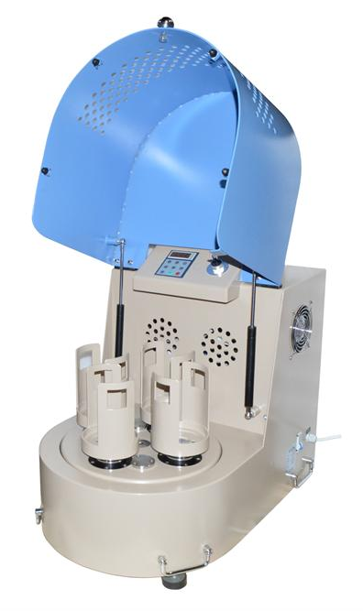
Mechano-Chemical Bonding (MCB) Technique
Cr (7.5~10 µm) | Al (4.5 ~ 7 µm) | Y₂O₃ < 50nm | W (~1 µm) | Ni (4 ~ 8 µm)
20 | 5 | 1.5 | 3 | 70.5
SEM micrographs of MCB processed ODS powder sample
(a). As-processed from MCB; (b) close view of (a)
*Challenge: uniform dispersion of nano-sized Y₂O₃ through out the matrix
Hosokawa MCB machine
Mixing time: 1hour
Y₂O₃ is uniformly coated
on master particles
Ball milling time: 40 hours
Forming alloyed ODS powder
Notes:
Benefits of ODS – Y2O3 – high temp creep alloy
How to uniformly dispersed Y2O3 onto the alloy?
Y2O3 gave high temperature resistance
Challenge in ODS community is to coat Y2O3 on the master particle

Slide 13
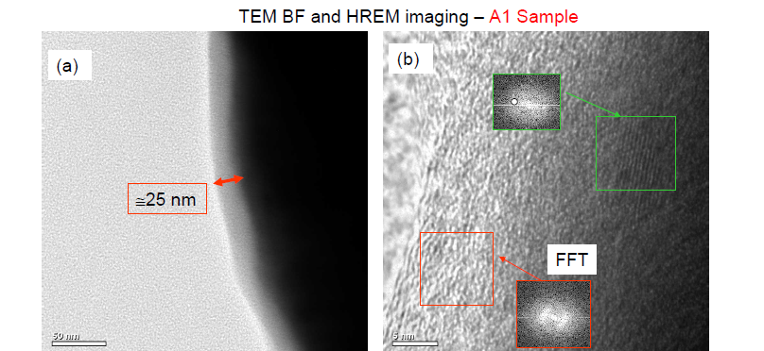
ODS Powder Characterization
TEM BF image (a) shows a layer of Y₂O₃ thin film with thickness about 25nm around the edge of particle. The film thickness is relatively homogeneous.
HREM image (b) shows the fine structure of the thin film. Most area of the film is amorphous and the corresponding FFT (Fast Fourier Transform) image show the diffusive feature.
There is crystal structure within film as FFT indicated. The embedded FFT shows the spots and image shows the orientation fringe. The growth of film may involve crystallization of Y₂O₃.
Notes:
Each host/master particle – evidently clear that coated with Y2O3.
BF: bright field mode of the TEM (to show Y2O3)
The following areas appear with dark contrast in BF mode:
thick areas,
areas in which heavy atoms are enriched,
crystalline areas
HREM: High-resolution transmission electron microscopy

Slide 14
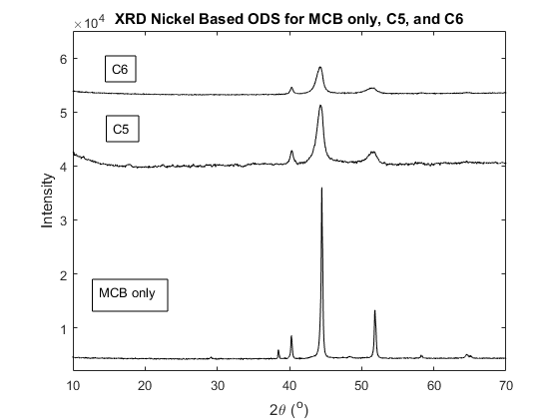
XRD of ODS Powders MCB only, MCB + Ball Mill for 20 hours, and MCB + Ball Mill for 40 hours
C5 depicts MCB plus ball milling process for 20 hours at 400 rpm, with a BPR of 15:1.
C6 depicts MCB plus ball milling process for 40 hours at 400 rpm, with a BPR of 15:1.
Ni₃Al-
NiAl-
Cr-
Ni-
W-
Al-

Slide 15
ODS Powder processed by MCB+BM
Ni-20Cr-5Al-3W-1.5Y2O3 in Weight.%

Slide 16
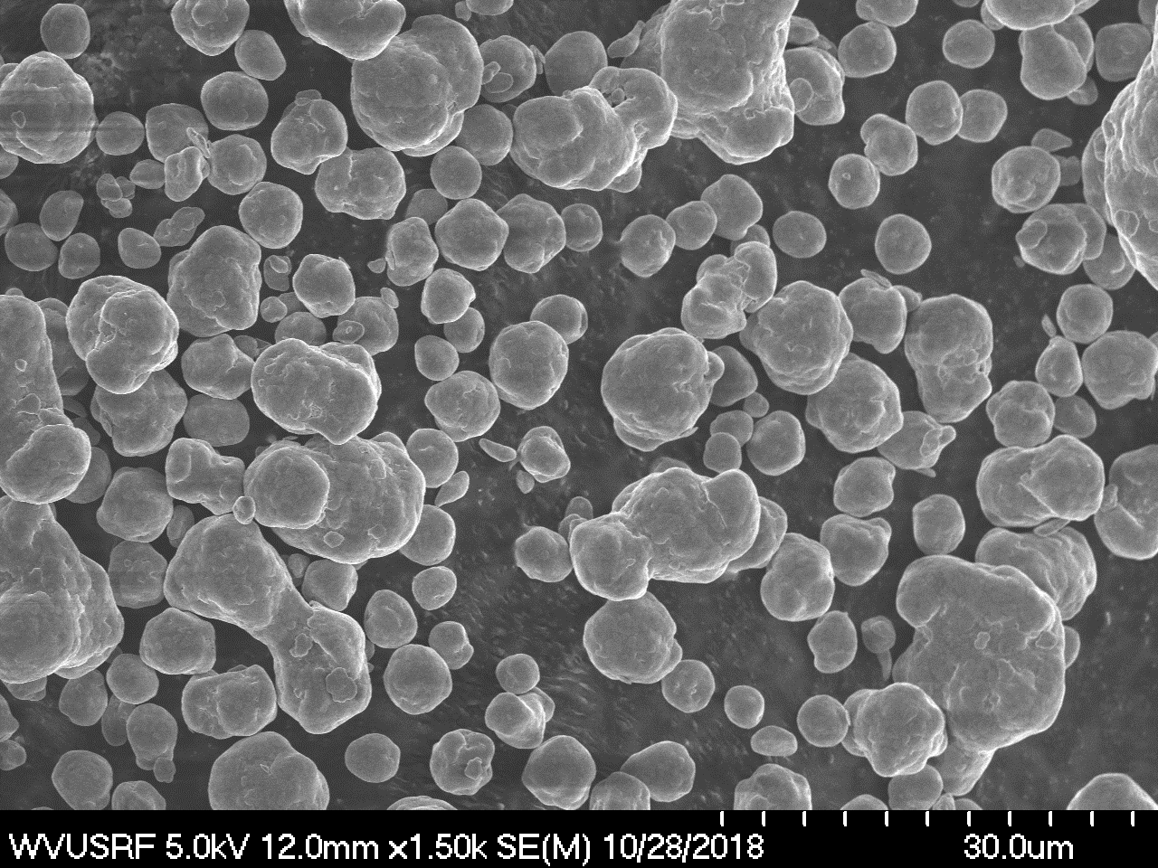
MCB only

Slide 17
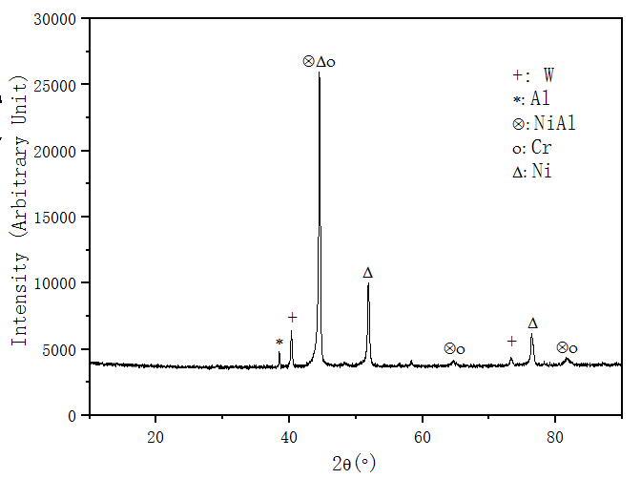
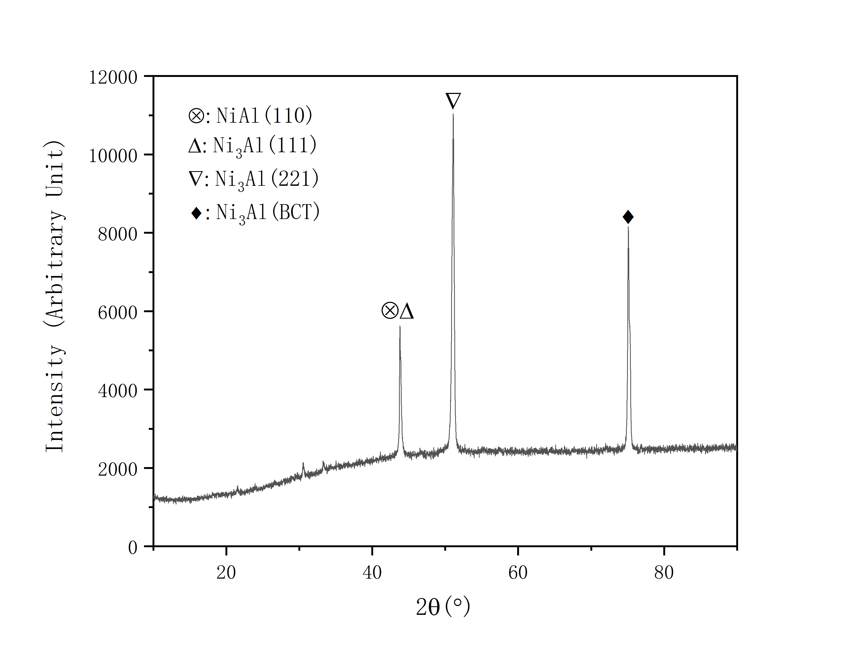
Mechano-Chemical Bonding (MCB)
XRD, ODS powders (MCB only, M6)
XRD, AM sample (M6 ODS powder)
MCB only, M6 ODS powder, 5000 rpm 11 hours

Slide 18
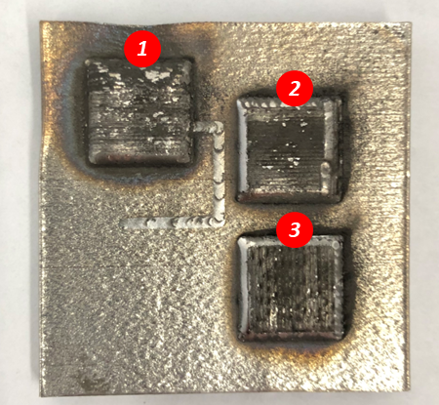
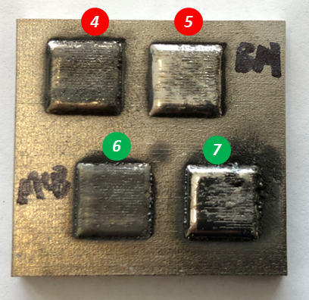
ODS Coatings by LENS
Powder
Printing Parameters
Heat
Treatment
1
MCB 4000rpm 1h, +BM 400rpm 40h
250W,5mm/s,
0°+90°
N/A
Scan Speed
2
MCB 4000rpm 1h, +BM 400rpm 40h
250W,10mm/s,
0°+90°
N/A
3
MCB 4000rpm 1h, +BM 400rpm 40h
250W,15mm/s,
0°+90°
N/A
4
MCB 4000rpm 1h, +BM 400rpm 40h
250W,10mm/s,
0°+90°
100W,
10mm/s
Heat Treatment
5
MCB 4000rpm 1h, +BM 400rpm 40h
250W,10mm/s,
0°+90°
200W,
10mm/s
10mm x 10mm x 0.5~1mm
Flowability of MCB only powder improved significantly
Surface becomes smoother after 200W laser surface heat treatment.
MCB only, 5000rpm 11h, acid+sieved
250W,10mm/s,
0°+90°
100W,
10mm/s
6
MCB only, 5000rpm 11h, acid+sieved
250W,10mm/s,
0°+90°
200W,
10mm/s
7
Notes:
In general, the MCB + BM powders show good flowability for AM systems, which can provide stable flow rate in LENS system.

Slide 19
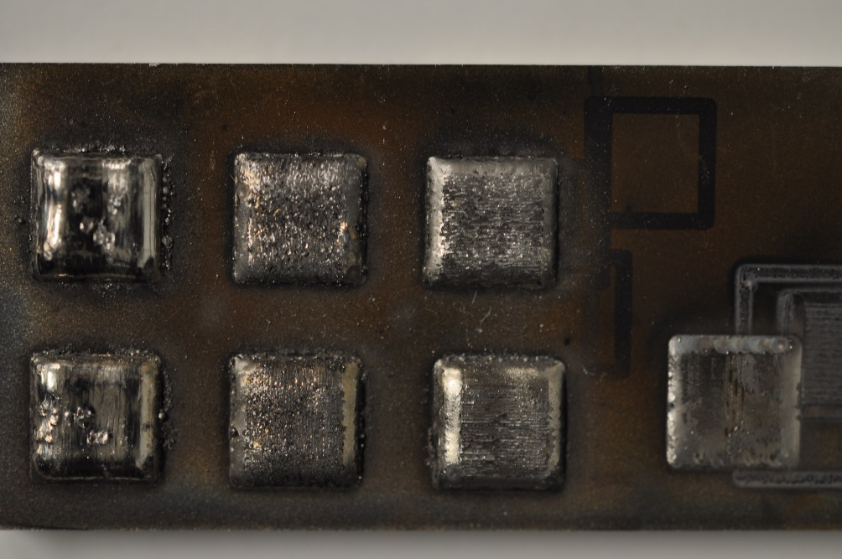
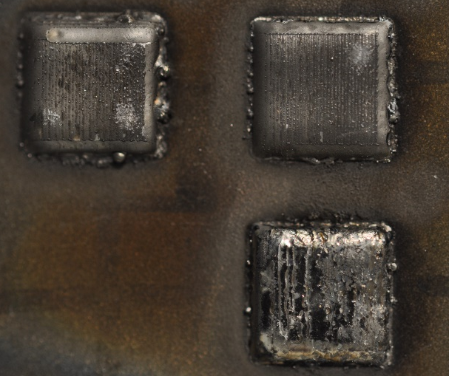
(MCB only) ODS Coatings by LENS
Powder
Printing Parameters
Heat
Treatment
2
2a
2b
2
MCB 4000rpm 1h, +BM 400rpm 40h
250W,10mm/s,
0°+90°
N/A
2a
MCB 4000rpm 1h, +BM 400rpm 40h
250W,10mm/s,
0°+90°
100W,
10mm/s
2b
MCB 4000rpm 1h, +BM 400rpm 40h
250W,10mm/s,
0°+90°
200W,
10mm/s
MCB 4000rpm 1h, +BM 400rpm 40h
250W,5mm/s,
0°+90°
N/A
1
1
1a
1b
1a
MCB 4000rpm 1h, +BM 400rpm 40h
250W,5mm/s,
0°+90°
100W,
10mm/s
1b
MCB 4000rpm 1h, +BM 400rpm 40h
250W,5mm/s,
0°+90°
200W,
10mm/s
8
MCB 4000rpm 1h, +BM 400rpm 40h
250W,10mm/s,
0°+90°
N/A
6
MCB only, 5000rpm 11h, acid+sieved
250W,10mm/s,
0°+90°
100W,
10mm/s
8
6
7
MCB only, 5000rpm 11h, acid+sieved
250W,10mm/s,
0°+90°
200W,
10mm/s
7

Slide 20
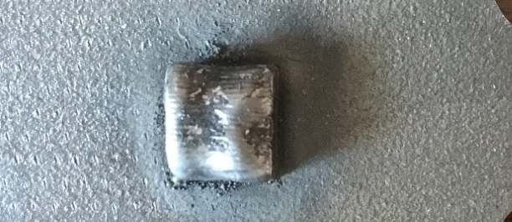
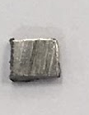

Oxidation Weight Gain
length
width
Schematic of the cyclic thermal exposure apparatus setup (WVU)
** Each cycle consists of moving test sample to the furnace within 15 minute and kept at 1100 ºC for 45 minutes and moved out within 15 minutes, kept for 45 minute at room temperature.

Slide 21
Weight Gain Comparison (ODS sample 1)
Pitt-WVU ODS: Ni-20Cr-5Al-3W-1.5Y2O3(Thermal cyclic Test at 1100 degree C)
APM FeCrAl: Fe-20.42Cr-5.54Al-0.08Mn-0.03Ti-0.23Si-0.03C( cyclic-oxidation tests,1100 degree C)
ODS Fe3Al: Fe–28Al–2Cr–0.5Y2O3( cyclic-oxidation tests,1100 degree C)
Fe-35Ni-25Cr-4Al+Ti,C/Fe-35Ni-25Cr-4Al+Nb,C/Fe-25Ni-15Cr-4Al( Mass change at 1100 degree C in air with 10% H2O vs. time (100 h cycles)
[1] Wright, I.G., Pint, B.A. & Tortorelli, P.F. Oxidation of Metals (2001) 55: 333. https://doi.org/10.1023/A:1010316428752
[2] Brady, M.P., Muralidharan, G., Yamamoto, Y. et al. Oxid Met (2017) 87: 1. https://doi.org/10.1007/s11085-016-9667-3

Slide 22
Microstructure Stability Analyses of AM-processed ODS using LENS
Stability of oxide layer
Stability of ODS coating
Stability of interface
Stability of substrate

Slide 23
200W- MCB+BM ODS– AM Printed
ODS Coating
Nano-sized γ’phase
850nm
Nano-sized γ’phase preserved at ODS coating.

Slide 24
200W- MCB+BM ODS – 2200 Cycles
ODS Coating
Nano-sized γ’phase
750nm
Nano-sized γ’phase preserved at ODS coating after 2200 cycles

Slide 25
200W ODS – 2200 Cycles
Aluminum Oxide Scale
Oxide Scale
30um
Stable 10 – 15 um of uniform stable aluminum oxide scale

Slide 26
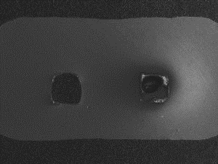
Isothermal Test for Full ODS Channel
1200C
1900h
Oxide layer stables after 100h during Isothermal test.
10 µm
10 µm
10 µm
400h
10 µm
100h
200h
700h
10 µm
800h
10 µm
1200h
10 µm
1600h
10 µm
1900h

Slide 27
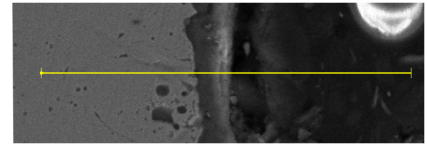
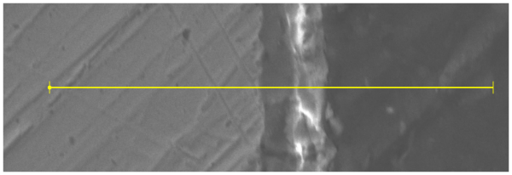
Stable Alumina in Oxide Layer
1700h
1600h
1900h
Weight
Percentage
(%)
1
1
Al
Ni
Cr
O
Thickness (µm)
Thickness (µm)
1700h
Zone : Mainly Al₂O₃
1900h
1
Total thickness of oxide layer is around 10-15 µm, and the Al₂O₃ dominated layer thickness is 5-10 µm.

Slide 28
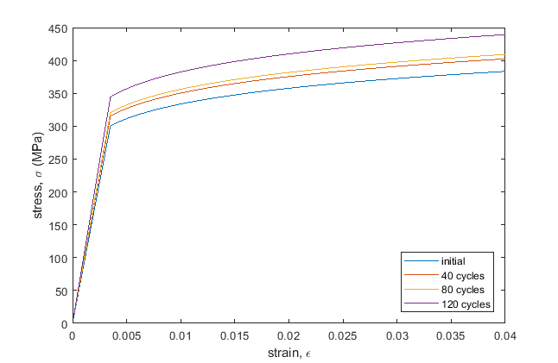
ODS coating stress/strain curve

Slide 29
University Turbine Systems Research
Outlines
Background, Challenges, Objectives, Benefits of Technology, Research Task Plans
Additive Manufacturing Processes
ODS Powder Development
Heat Transfer Results: Transpiration Cooling
Heat Transfer Results: Lattice Cooling
Summary
Notes:
Presentation outline:
A brief introduction to the challenges in turbine blades, which are related to our project.

Slide 30
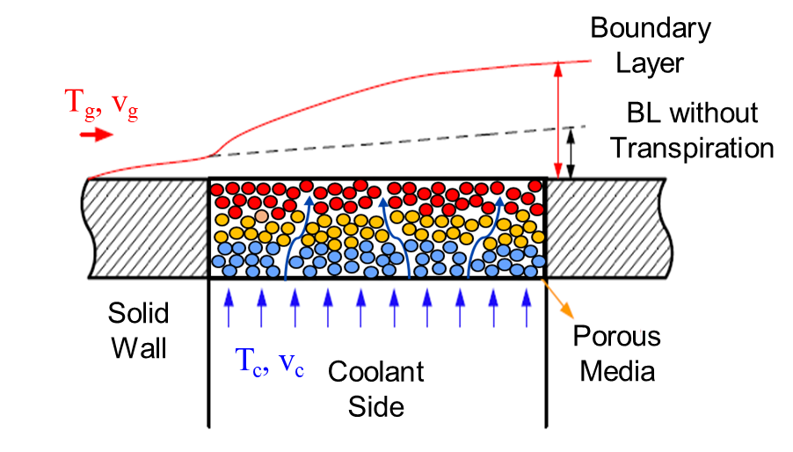
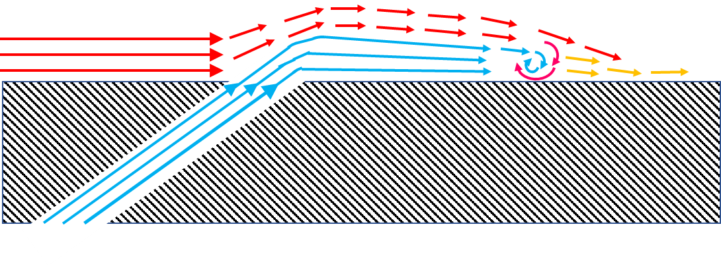

Introduction: Transpiration Cooling
Concept: The coolant was forced through a porous wall or multiple micro-cooling channels to form an insulating layer of coolant film between the outer wall surface and hot stream.
Conventional Film Cooling
Transpiration Cooling
Turbulence
Mixing Area
Mainstream
Mainstream
Coolant
“Lift-off” of the film due to jet momentum at the outlet
Film gradually spread diffused downstream by flow mixing
Uniform coolant film coverage
Enhanced heat removal ability due to higher inner-wall heat transfer
Challenges
Oxidation due to Vortex Mixing with Hot Gas
Mechanical Strength Concern with Porous Media
Manufacturing Difficulties
High Anti-oxidation Resistance
High Temperature Mechanical Strength
Comparable Strength with Casting
Complexity and Design Freedom
Fast and Low-cost Fabrication for Intricate Features
ODS
AM
Notes:
Now we are working on applying transpiration cooling designs into turbine blade. In general, the transpiration cooling will provide better film coverage and enhance the heat removal ability due to higher inter-media heat transfer compared to conventional film cooling. However, the manufacturing difficulties, mechanical strength concerns and possible oxidation due to vortex mixing with hot gas. As shown in this slides, the development of AM significantly alleviated the manufacturing difficulties for such delicate features. Now the parts made by AM has comparable or even slightly higher mechanical strength than those of cast. In addition, the inherently remarkable mechanical strength and anti-oxidation properties of ODS alloy at high temperature makes it a perfect candidate for turbine airfoil.

Slide 31
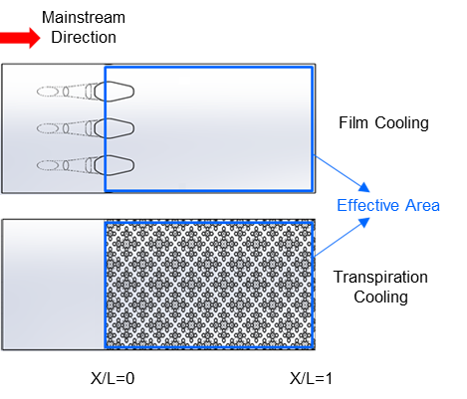
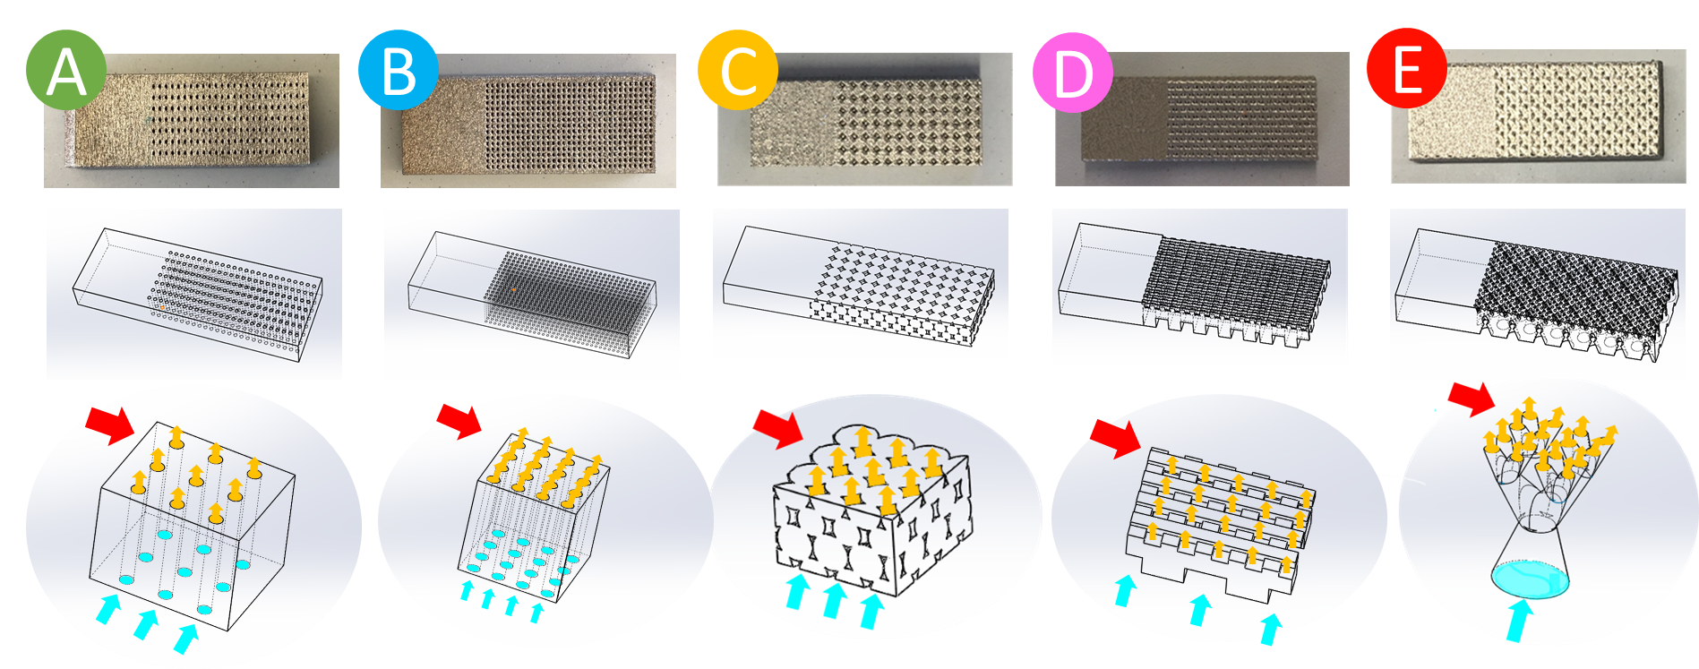



Transpiration & Film Cooling Test Structures
0
F
D=1mm
(A) Round
Holes with Pitch of 3D
(RH-3D)
(B) Round Holes with Pitch of 2D
(RH-2D)
(C) Spheres
Packing
(SP)
(D) Wire Mesh
(WM)
(E) Blood Vessel Shaped
(BV)
(F) Laidback Film Cooling
(FC)
Design Parameters:
Material: In718
Test Plate Size (mm) : L30×W12×T3.2
Cooling effective area: L20 ×W12
$F=\frac{ρ_{c}v_{c}}{ρ_{g}v_{g}}$ ;
$$v_{c}=\frac{\dot{mc}}{ρ_{c}A_{effective}}$$
Injection Ratio:
Notes:
As for transpiration part, first we experimentally investigated different structures as shown in this picture and compared to laidback shaped holes film cooling. The structure designs include round holes with pitch of 3D and 2D, sphere packing design which originated from the powder compaction sintering, wire matrix design which comes from woven wire matrix and blood vessel shaped micro-channels design. To fairly compare the cooling performance, only the part of the plate is porous for transpiration cooling coupons to make sure the coolant covered area is the same as the downstream area of the film cooling holes.

Slide 32




Results – Local Cooling Effectiveness
F=1.2% and 2.4%, other 4 transpiration structures > FC ≈ RH-3D
F=3.6%, all 5 transpiration structures > FC
BV and SP are better than others
BV has the highest average cooling effectiveness
$$η=\frac{T_{a}−T_{w}}{T_{a}−T_{c}}$$
$T_{a}:$ adiabatic wall temperature
$T_{w}$: wall temperature
T_{C} :coolant temperature
Notes:
This slide shows the heat transfer test results. The figure on the left hand side shows the cooling effectiveness distributions of the effective area.
Based on the results we can see almost all the transpiration cooling structures have higher cooling effectiveness than film cooling except for the RH-3D case at the lowest injection ratio. One possible reason is the cooling passages are not dense enough to provide full film coverage of the hot surface.
At higher injection ratio, all transpiration cooling structures have better performance than film cooling.
Among the transpiration cooling structures the performance of the blood vessel shaped micro-channels seems the best

Slide 33





Tensile Test Results
Porosity
$φ$=0%
$φ$=3.03%
$φ$= 9.52 %
$φ$=5.74%
$φ$=23.37%
$φ$=15.48%
$φ$=9.96%
$φ$=12.8%
sintered
porous
AM made specimen
All tensile bars made by AM have much higher ultimate tensile strength than the one made by traditional In718 powder sintering(1250C, 6h).
Notes:
This slide the tensile test for the printed coupons(extended work, not included in the paper). The gauge parts of the tensile bars are using the same design of the transpiration cooling and film cooling structures for heat transfer test. One porous media made by conventional powder sintering process has also been tested in this test. The strain-stress curve showed that all tensile bars made by AM have much higher ultimate tensile strength(at least 2-3 times) than the one made by traditional In718 powder sintering(1250C, 6h).

Slide 34




Effect of Hole Configurations
Cooling Effectiveness of Different Hole Configurations
θ
Porosity: 1) inline and staggered P=nD: ϕ(n) ~ 1/n²
2) inclined: ϕ(n, θ) ~ 1/n²cosθ
Notes:
This slide shows the effect of hole configurations, two major findings are:
Smaller pore size increases the ratio of the internal air-metal interface area to the volume(compactness), thus the cooling effectiveness is enhanced for the same hole pitch
Staggered hole pattern or inclined cooling channel towards downstream also increase the cooling effectiveness by providing better coolant film coverage and reduce the lift-off of the film.
Porosity: 1) inline and staggered P=nD: ϕ(n) ~ 1/n²
2) inclind: ϕ(n, θ) ~ 1/n²cosθ
Internal Surface: 1) inline and staggered P=nD : A_{i} ~ 1/ n²D
2) inclind: A_{i} ~ 1/ n²Dcosθ

Slide 35
University Turbine Systems Research
Outlines
Background, Challenges, Objectives, Benefits of Technology, Research Task Plans
Additive Manufacturing Processes
ODS Powder Development
Heat Transfer Results: Transpiration Cooling
Heat Transfer Results: Lattice Cooling
Summary
Notes:
Presentation outline:
A brief introduction to the challenges in turbine blades, which are related to our project.

Slide 36







Approaches to Fabricate ODS Lattice Structures
Internal Cooling with Macro Scale Lattice (Phase 1)
Transpiration Cooling with Micro Scale Lattice (Phase 2)
Coupon with solid lattice and porous channel wall
Combined Internal and External Cooling with Multi-scale Lattice (Phase 3)
Challenges:
AM process parameters for ODS
Controlling dimension change and deformation
Identify minimum limitation of pore diameters
Notes:
There are three phases to explore the ODS lattice structure:
Phase 1 will focus on the internal cooling usage of lattice structures. The main effort is to figure out the AM process parameters and printable capable dimensions.
Phase 2 will consider the application in transpiration cooling and the lattice will have smaller scales. The main challenge is the printing quality of the pores.
Phase 3 will integrate the geometry from the previous two phases and develop a combined internal and external cooling approach. This is targeted at high cooling efficiency and robust anti-blockage property.
The image on the right bottom corner shows an exploratory intermediate step between phase 1 and phase 2. The coupon has an internal solid lattice network and an external porous wall with transpiration holes (0.3 mm, 2D pitch). The coolant is introduced from the left in the internal channel. This coolant then flows over the lattice and parallel to the channel wall to provide internal cooling. In addition, the spent coolant also bleeds through the transpiration holes to form the external protective film coverage.

Slide 37









Internal Cooling with Macro Scale Lattice (Phase 1)
Overview of unit cells under investigation:
Kagome (corner sharing triangles)
Face centered (FC)
Front View
Top view
Perspective
Front View
Top view
Perspective
Body centered (BC)
Octahedral (Octa)
Front View
Top view
Perspective
Front View
Top view
Perspective
Parameters
Ligament diameter: d
Unit cell base: a
Unit cell height: h
Porosity: p
Total surface area: A_{surf}
Footprint area: A_{fp}
Orientation with flow: $θ$
h
$θ$
a
$θ$= 0
$θ$= 45
Notes:
This slide summarized different type of unit cells and preliminary heat transfer results of two Kagome lattices.
Lattices in a cubic unit can have different topologies by changing the connection between the vertices. Meantime, the diameter of each connection bar can vary to form different density or opening.
Besides the cubic lattices, there are still numerous bionic or irregular shaped lattices to explore, e.g blood vessel lattices
The tetrahedral lattice is relatively more used in making components with lighter weight but desired stiffness. Tetrahedral name refers to the “tetrahedron” formed by the top as well as the bottom ligaments of the unit cell.
The cubic lattice unit cells are derived from the prevalent molecular lattice unit cells in crystals. Body centered and face centered names are derived from the location of the node formed from intersection of the ligaments. The octahedral unit cell is a slight modification of the facecentered, wherein, an additional 4 sided pyramid like structure has been introduced on both top and bottom half of the unit.
Some of the ky parameters are depicted which include the ligament diameter, unit cell dimensions, surface area and porosity. In addition, the angle at which the flow is incident with respect to the upstream face forms another parameter.

Slide 38









Lattice Geometries
BC 0
BC 45
FC
FC 45
OCTA0
OCTA45
Kagome
Pin HD2 SD2.5
True scale unit cell
a = 4 mm
h = 2.54 mm
θ = 0 and 45 degrees
D = 0.75 mm
Scaled up (5x)
a = 20 mm
h = 12.7 mm
D = 3.75 mm
Thermally inactive lattices
Fabricated using SLA
Nylon pin fins
Transient liquid crystal technique for HT studies

Slide 39














Measured Local HTC at Re ~15100
Pin Fins
HD2 SD2.5
BC
0 degree
45 degree
FC
OCTA
Kagome
Top Plate
Bottom Plate
Notes:
HTC distribution varied among the cases.
BC: near channel center
FC: near vertices, around the junction of rods for 0 degree; more evident for 45 degree
OCTA: wake of middle vertex
Kagome: top and bottom plates are different
Kagome: in the wakes, but asymmetric

Slide 40




Overall Nu and f Comparison
OCTA
Kagome
Kagome
Pressure drop improvement: 45 degree rotation improved pressure drop by 25% - 32% in OCTA, 18% to 20% for FC, while only 3% to 7% for BC.
Heat transfer: At lower Re, upto 15% lower enhancement in FC, and 18% lower enhancement in OCTA. Not much effect on BC.
The efficiency factor varied from ~0.6 to ~1.2 and similar for all cases

Slide 41
Summary
Transpiration cooling
The AM transpiration cooling structures could provide significant improvement on cooling efficiency ( > 30%) compared to film cooling.
Mechanical strength of the AM transpiration wall was much higher than conventionally fabricated(compressing and sintering) porous wall.
The cooling effectiveness could be further improved by increasing the compactness of the structure(ratio of the internal air-metal interface area to the volume).
Lattice cooling
Lattices provided higher heat transfer compared to that of the baseline pin-fin bank.
The unit cell geometry as well as their orientation w.r.t. flow affected the heat transfer and pressure drop behavior. However, the pressure drop characteristics had a stronger dependency on the unit cell rotation or angle-of-attack than heat transfer.
Secondary flows with flow diversion induced primarily by unit cell nodes, provide a unique opportunity to tailor a favorable coolant re-distribution inside channel.

