Slide 1







University Turbine Systems Research
2019 Project Review Meeting
Integrated Turbine Component Cooling Designs Facilitated by Additive Manufacturing and Optimization.
Students:
Fraser Jones, U. of Texas
Chris Yoon, U. of Texas
Alexander Wildgoose, Penn State U.
David Bogard, PI, U. of Texas
Karen Thole, Co-PI, Penn State U.
Todd Oliver, Co-PI, U. of Texas

Slide 2
Background
The focus of this study will be to use additive manufacturing (AM) to:
Develop new internal and film cooling hole configuration which maximize overall cooling effectiveness.
Rapid prototyping of turbine vane and blade models for experimental testing.
Critical aspects of this study:
Use of computational predictions and experimental model testing to optimize the integrated internal channel and film cooling hole geometries.
Quantify and mitigate inherent limitations of AM with particular focus on internal roughness effects.
Develop optimized cooling configurations without and with TBC.
Validate using a full vane models incorporating optimized cooling configurations and test engine scale models with simulated engine flow and thermal conditions.

Slide 3
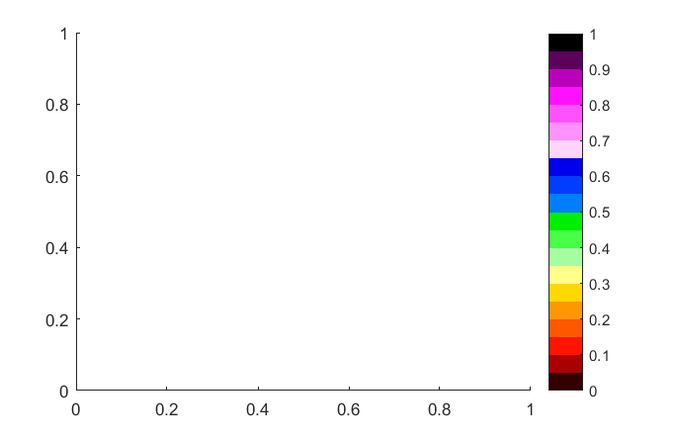
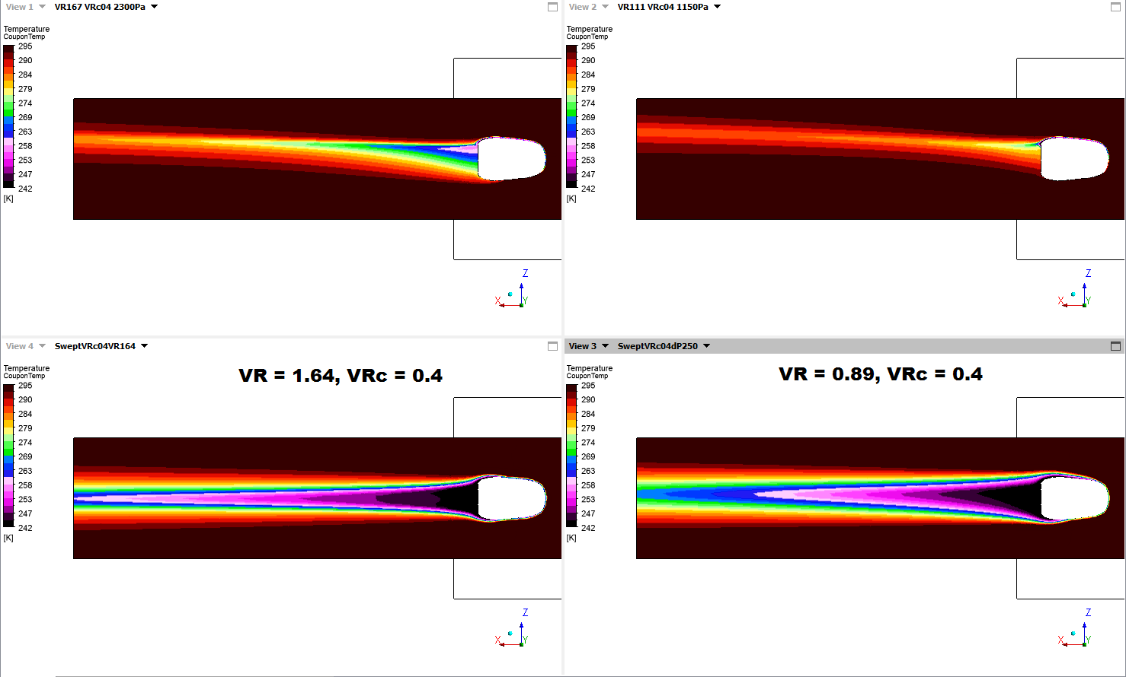

Objectives
Use a RANS based optimization analyses to determine geometric configurations for internal channels and film cooling holes which provide maximum overall cooling effectiveness. This is to be done without and with TBC. These analyses will include optimization for AM built configurations and for conventionally manufactured configurations.
AM design
Standard
Experimentally determine the actual performance of engine scale (1X) coupons for a baseline incorporating internal channels and film cooling constructed with state-of-the-art AM techniques.
Experimentally determine the effects of internal surface roughness inherent in metal AM builds. This will be done using 10x test coupons based on the optimum 1x builds. This will provide understanding of the cooling performance of relatively smooth coupons and coupons with roughness corresponding to current metal AM limits.
$$η$$

Slide 4
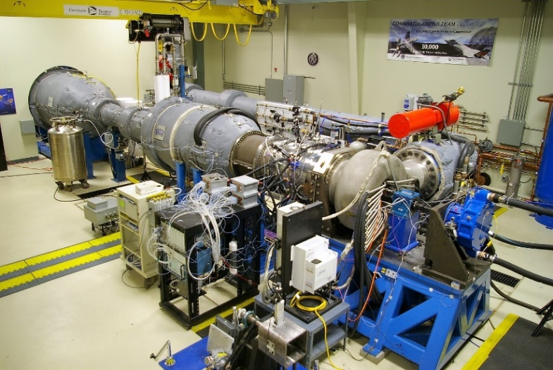
Objectives (continued)
Experimentally determine the performance of cooling configurations which include TBC using the 10X test coupons. These configurations are expected to be significantly different than the no-TBC cases with potentially very different internal channel and film cooling hole configurations.
Evaluate overall cooling performance for complete vane models incorporating the optimum internal cooling, film cooling, and TBC configurations. This will done in a low speed cascade facility with large scale model that provide well resolved measurements.
Evaluate AM built vane models at engine scale in the START rig which closely simulate engine operating conditions. This will be a test of using AM build parts for rapid prototyping and testing new cooling designs.

Slide 5
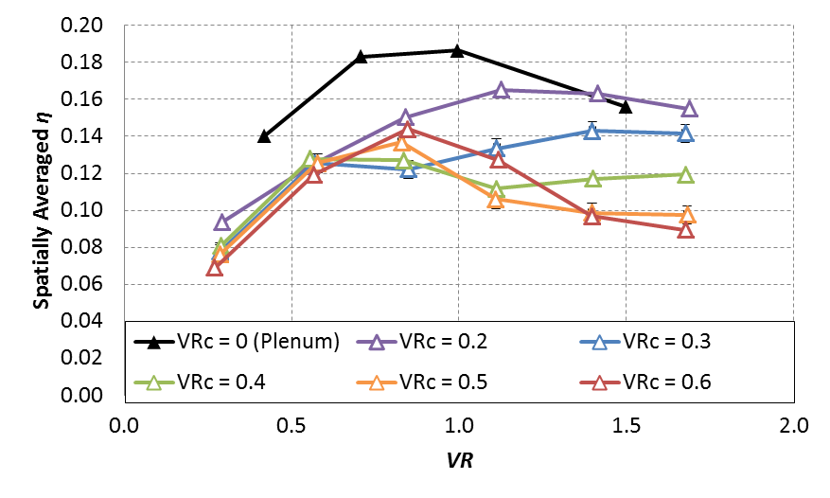
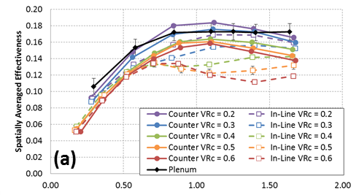
Previous studies at UT show significant effects on film cooling performance when coolant holes are fed by an internal crossflow channel
7-7-7 shaped holes
VR = V_{j} / V∞ VR_{c} = V_{c} / V∞
Axial holes
Compound angle (45°) holes
Solid lines: counter flow
Dashed lines: in-line flow
VR
Experimental studies showed decreased performance when shaped film cooling holes are fed by internal cross-flow, but compound angle injection mitigates this effect.

Slide 6
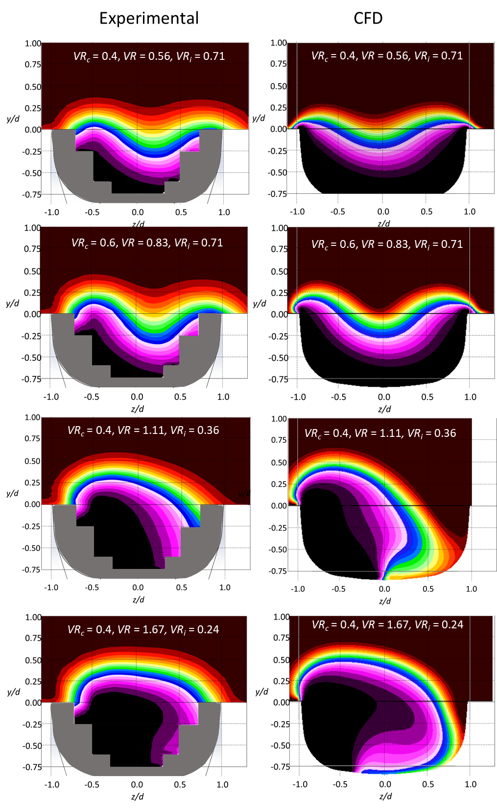





A key aspect of this study will be the use of RANS to predict film cooling performance for different internal channel/hole geometries. Our previous studies has shown good predictions by RANS through the holes and at the exit.
EXPERIMENTAL CFD
Measurements made in a plane within the coolant hole at the mid-point between leading and trailing edges.
These predictions were sensitive to the turbulence model used, only Realizable Κ-ε model accurately predicted the crossflow effect.
The bias to one side of the hole due to the internal crossflow was well predicted by RANS.
VR = 0.56, VR_{c} = 0.4
VR = 0.56, VR_{c} = 0.4
$${VR}_{i}=1.4$$
VR = 0.83, VR_{c} = 0.6
VR = 0.83, VR_{c} = 0.6
$${VR}_{i}=1.4$$
VR = 1.11, VR_{c} = 0.4
VR= 1.11, VR_{c} = 0.4
$${VR}_{i}=2.8$$
VR = 1.67, VR_{c} = 0.4
VR = 1.67, VR_{c} = 0.4
$${VR}_{i}=4.2$$
Internal coolant cross-flow direction.
Notes:
Matches VRi Trend Matches VR/VRc trend

Slide 7
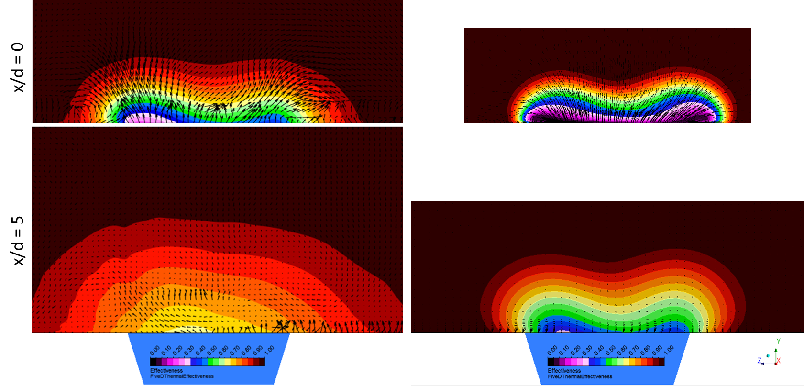
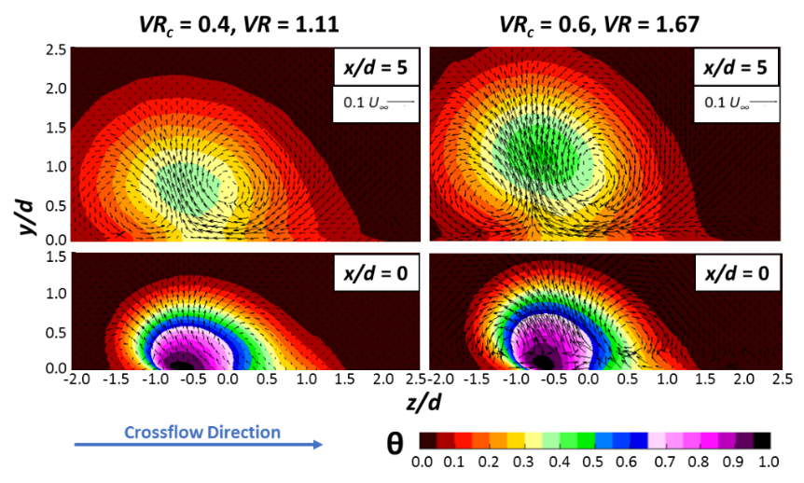
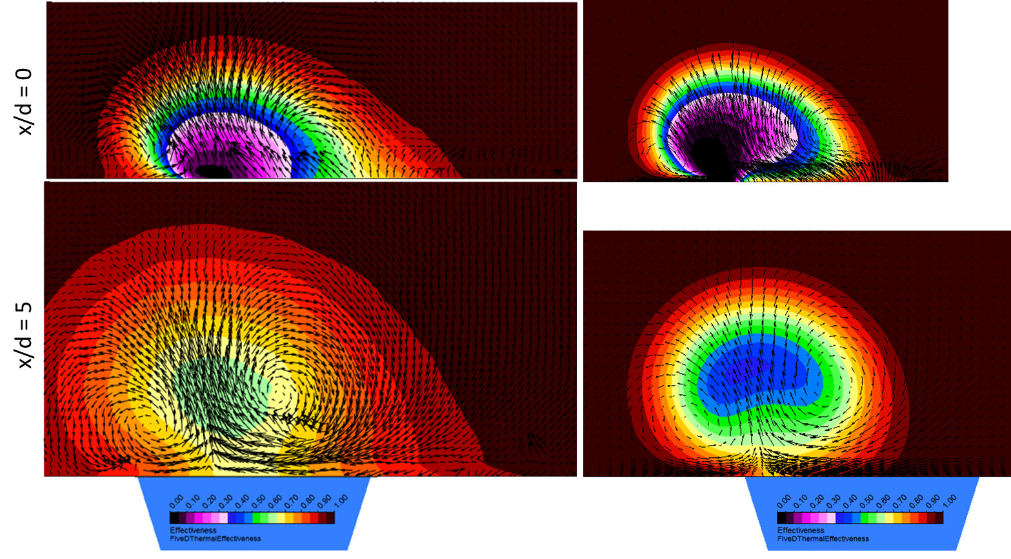
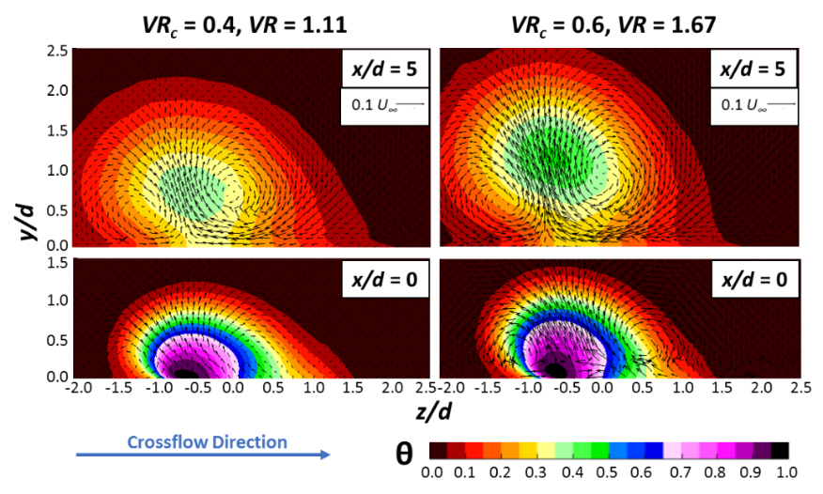

Thermal and velocity fields predicted by RANS at x/d = 0 correspond reasonably well with experiment, but by x/d = 5 the RANS predictions are poor.
Experimental
CFD
(a)
VR = 0.56, VR_{c} = 0.4,
Thermal fields at x/d = 0 have similar profiles, though computation show slightly less diffusion.
By x/d = 5 there were significant differences, with the RANS prediction having much less coolant dispersion.
x/d = 0
x/d = 5
(b)
VR = 1.11, VR_{c} = 0.4
x/d = 0
x/d = 5
Notes:
RANS diffusing much less
Prediction is good at x/d = 0
Poor at x/d = 5

Slide 8
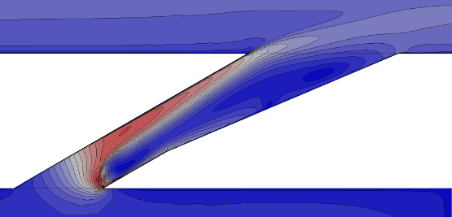

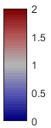
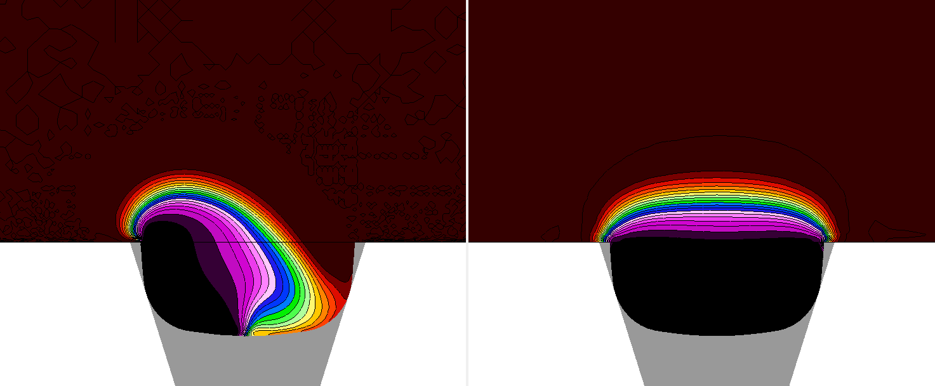
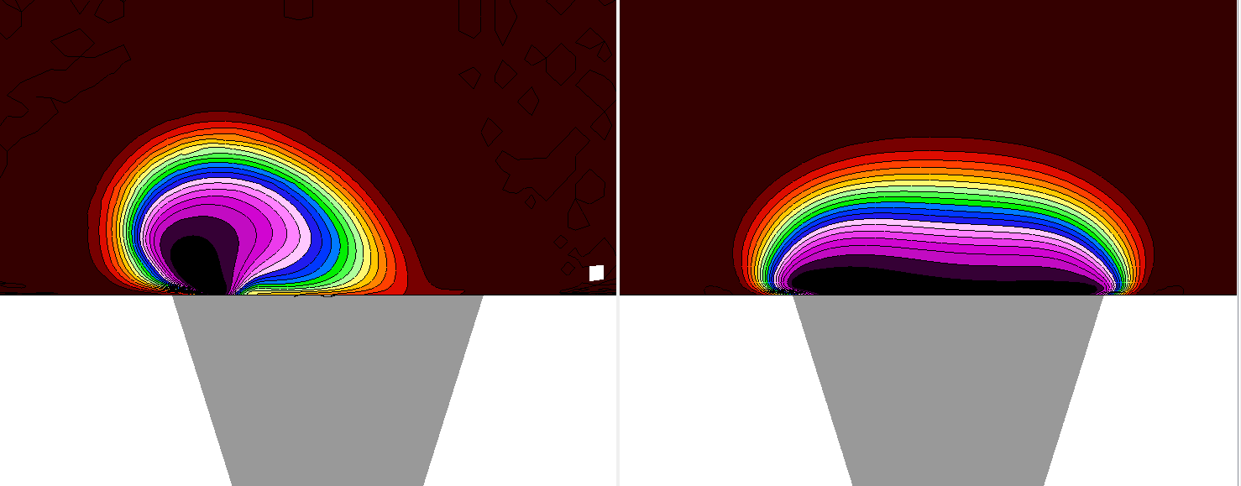
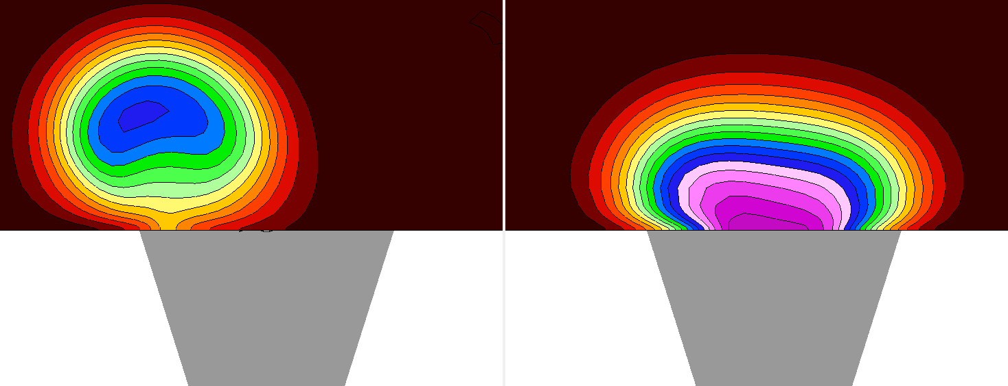


New internal geometries are made possible by additive manufacturing. We investigated a new “swept inlet” design using RANS simulation and predicted significantly improved performance.
Standard 7-7-7
New swept inlet
VR = 1.11
$$\frac{U}{U_{j}}$$
Note modification of hole inlet
x/D
Standard 7-7-7
Swept Inlet
-2D
$$θ$$
VR = 1.11
0D
5D

Slide 9
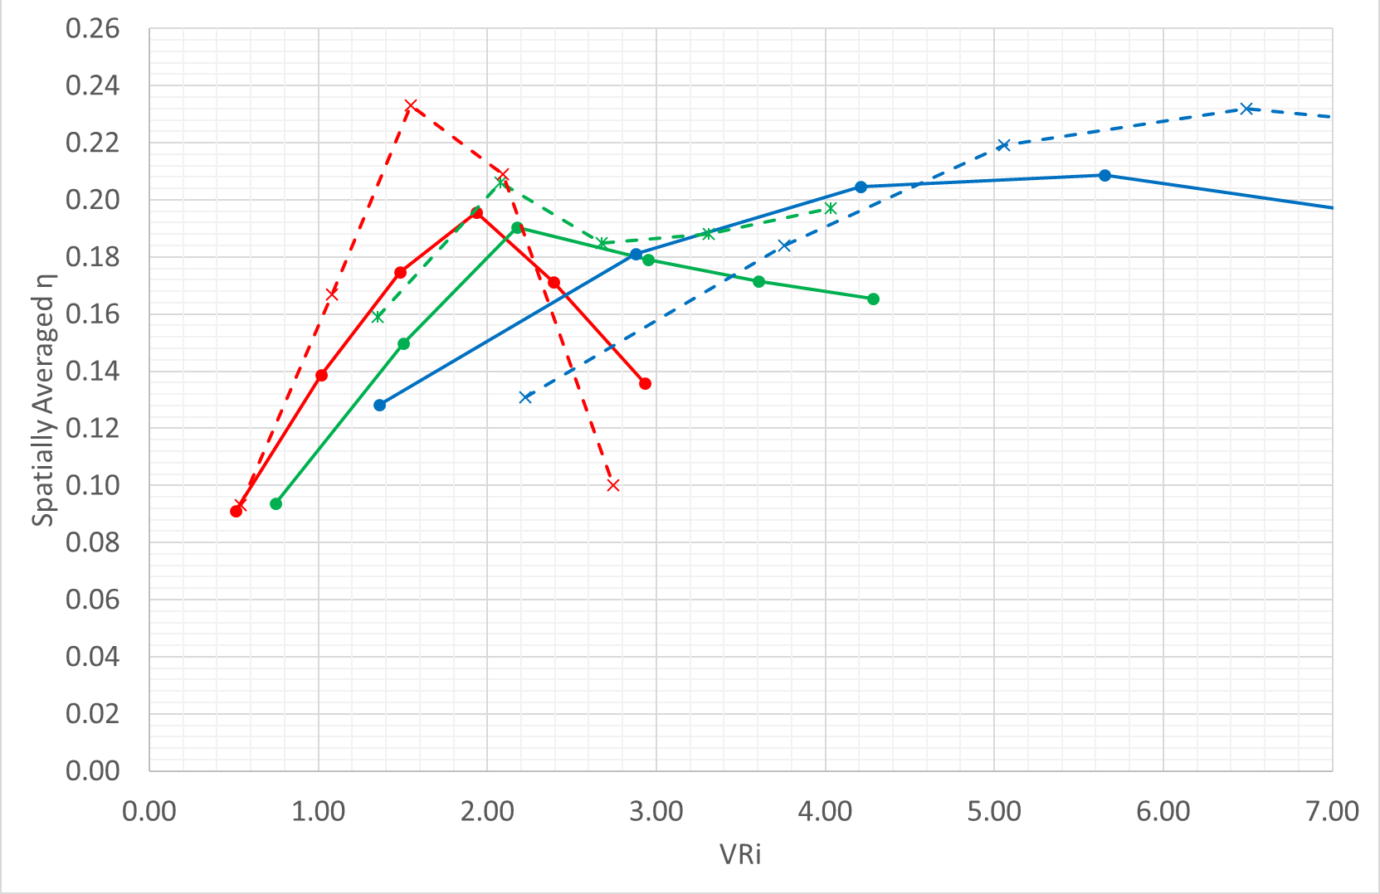
Experimental measurements with rounded inlet film cooling holes (7-7-7 shaped holes) show performance characteristics similar to that predicted by RANS CFD simulations
These results validate the use of RANS CFD to predict film effectiveness trends for new integrated internal and film cooling hole geometries.

Slide 10
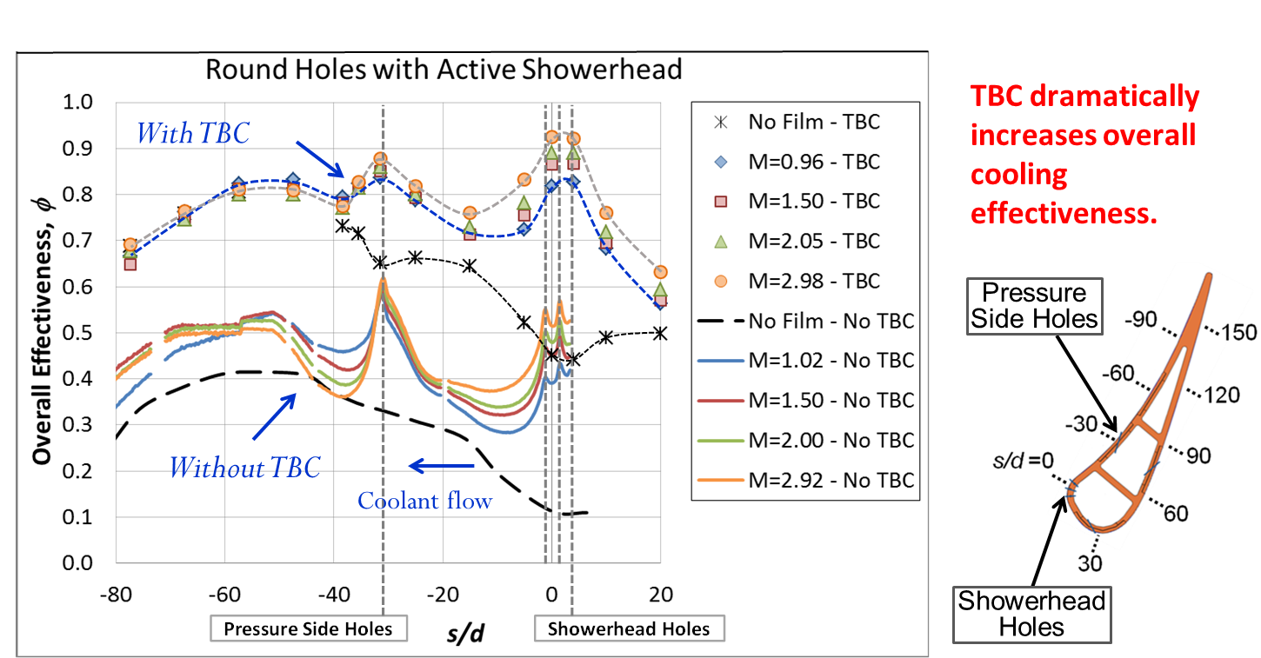
As TBC becomes more reliable, it is important to include TBC affects in designs to maximize overall cooling effectiveness
Previous studies in our lab have shown the dramatic effects of TBC on improving overall cooling effectiveness.

Slide 11
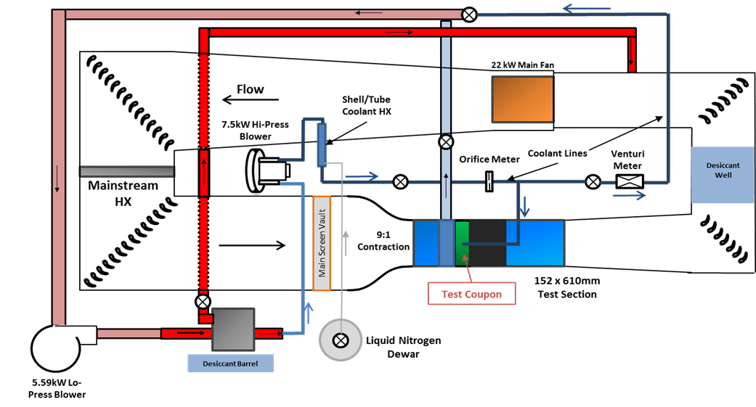
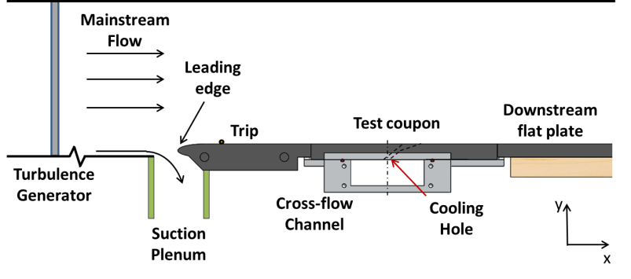
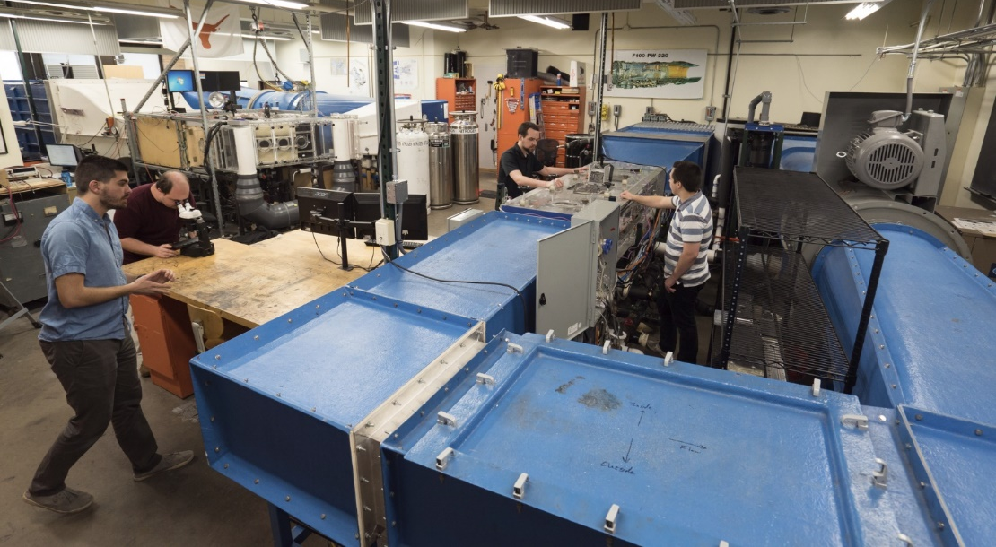
Schematics of UT low-speed wind tunnel facilities at UT

Slide 12
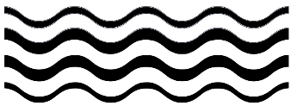
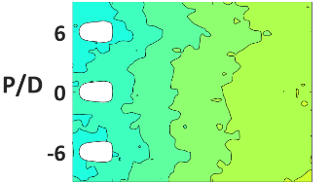
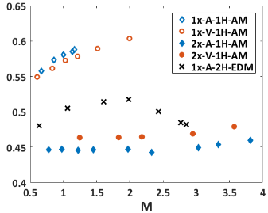
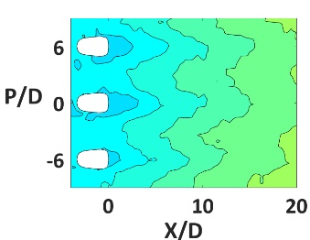
Previous studies have positioned us to perform proposed research to further advance turbine cooling
Previous optimization studies
Impact on cooling effectiveness due to …
Supply Channel and Direction
Manufacturing Method
Film Hole Size
Build Direction

Slide 13
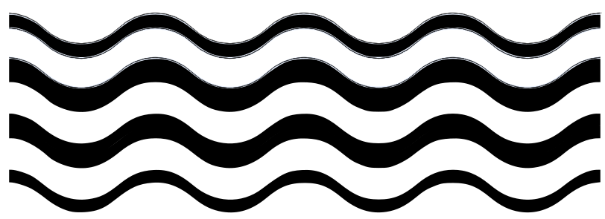
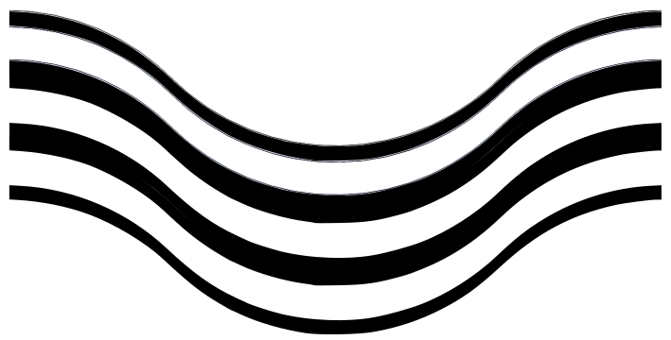
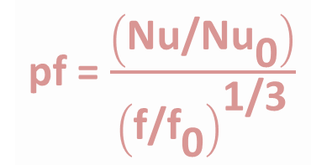
Two baseline wavy channel configurations were designed
,
and three objective functions were posed
1. min(ΔP)
λ=0.1·L
2. max(Q)
3. max(Q/ΔP^{1/3})
λ=0.4·L
pf = $\frac{\left(\text{Nu}\text{/}\text{N}{\text{u}}_{\text{0}}\right)}{{\left(\text{f}\text{/}{\text{f}}_{\text{0}}\right)}^{\text{1/3}}}$
L

Slide 14
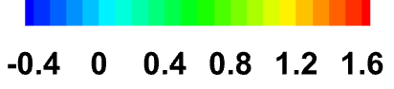
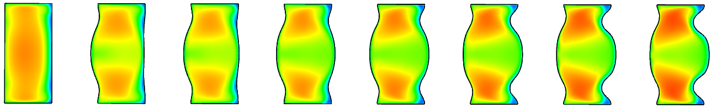
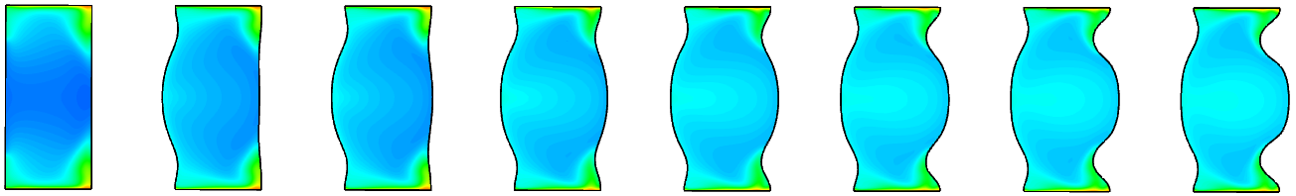
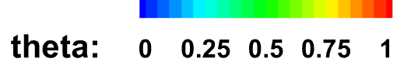
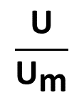

When heat transfer was to be maximized, the channel wall shapes promoted stronger vortices
Flow
z
x
$$\frac{\text{U}}{{\text{U}}_{\text{m}}}$$
y
z
Increasing Iteration #
$$\text{θ}\text{=}\frac{\text{T}\left(\text{z}\text{,}\text{y}\right)\text{−}{\text{T}}_{\text{i}}}{{\text{T}}_{\text{s}}\text{−}{\text{T}}_{\text{i}}}$$
Notes:
At teal location

Slide 15
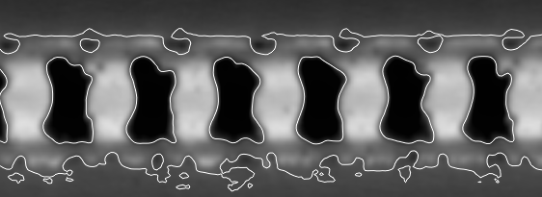
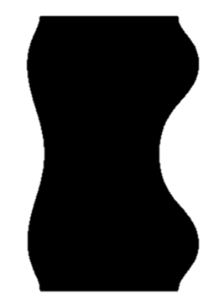
For the λ=0.1L case, the increase in Nusselt number outweighed the increase in friction factor
max(Q/ΔP^{1/3})
% Difference from Baseline
λ |  | (f/f₀)^{1/3} | Nu/Nu₀
0.1 | L-PBF | 1.1% | 9.5%
 | k-ε | 1.7% | 32%
0.4 | L-PBF | 6.5% | 4.4%
 | k-ε | 1.8% | 4.6%

Slide 16
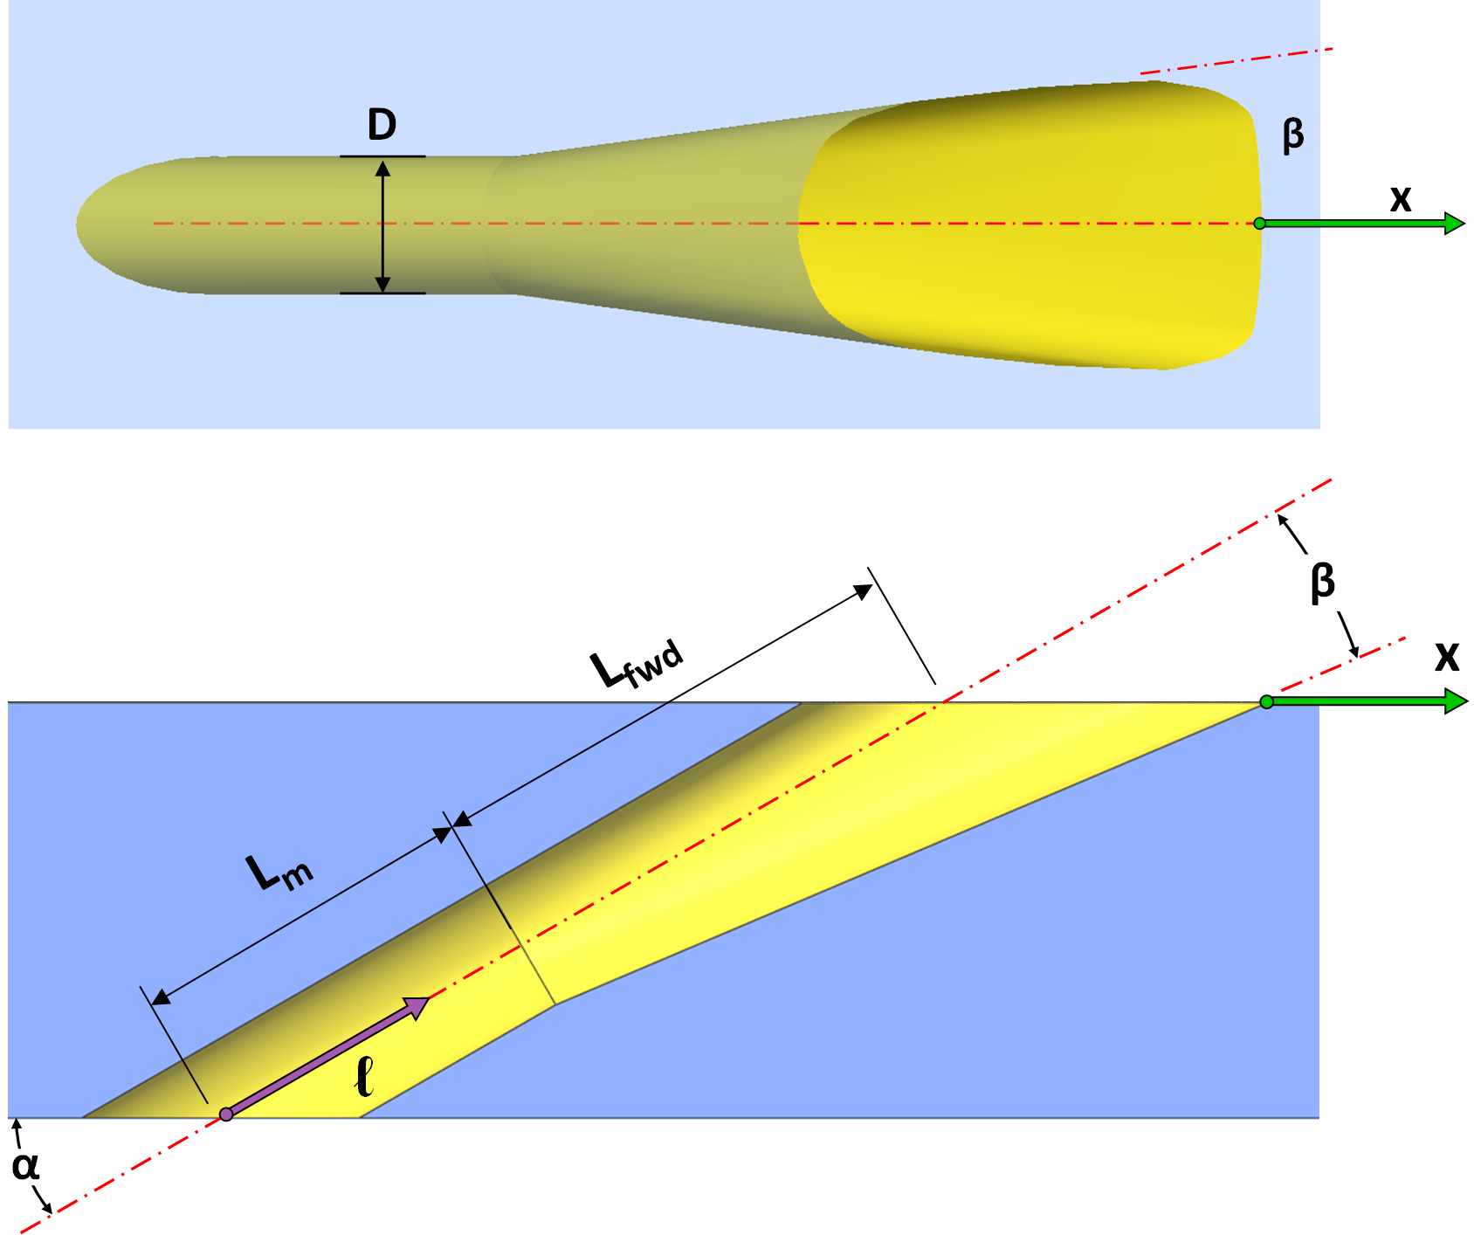
Previous studies have shown influences of an AM cooling hole using a 7-7-7 shaped hole
7-7-7 shaped film cooling hole
[Schroeder and Thole, 2015]
 | 1x | 2x
D | 0.38 mm (0.015 in) | 0.76 mm (0.030 in)
t | 3D | 3D
H | 1.7D | 1.7D
β | 7° | 7°
α | 30° | 30°
Notes:
Same relative dimensions as Roberts paper so wall thickness was dictated by hole diameter

Slide 17
SEM micrographs show high levels of roughness in the diffuser and metering section of AM film holes
1x Vertical
(D=0.015”)
1x EDM
(D=0.015”)
2x Angled
(D=0.030”)
(black regions on surfaces are paint)

Slide 18
Coupons were tested in an open loop rig in a co-flow coolant supply configuration
IR Camera
Bi and h_{i}/h∞ matched
to engine
Bi | 0.1
h_{i} / h∞ | ~1.0
Ma∞ | 0.3
Ma_{i} | <0.1
DR | 1.7
M | 0.5-4.0
Re_{i} | 9 – 14e3

Slide 19
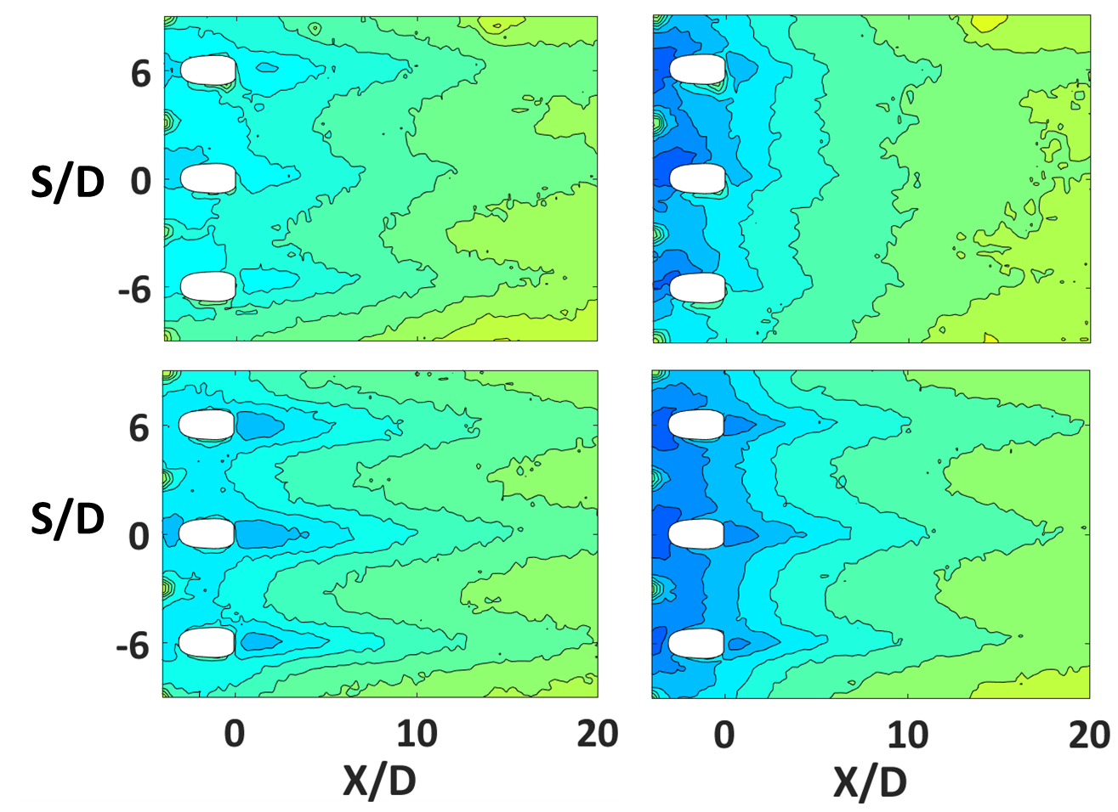
The build direction affects the type of roughness in the hole, which affects film performance
Hole Scale | Build Dir | Chan Height | Mfg Method | R_{a}/D*
2x | Ang | 1.7D | AM | 0.02
2x | Vert | 1.7D | AM | 0.01
φ
0.8
0.7
0.6
0.5
0.4
0.3
0.2
0.1
0
M = 1.2
M = 3.0
2x Ang
2x Vert

Slide 20
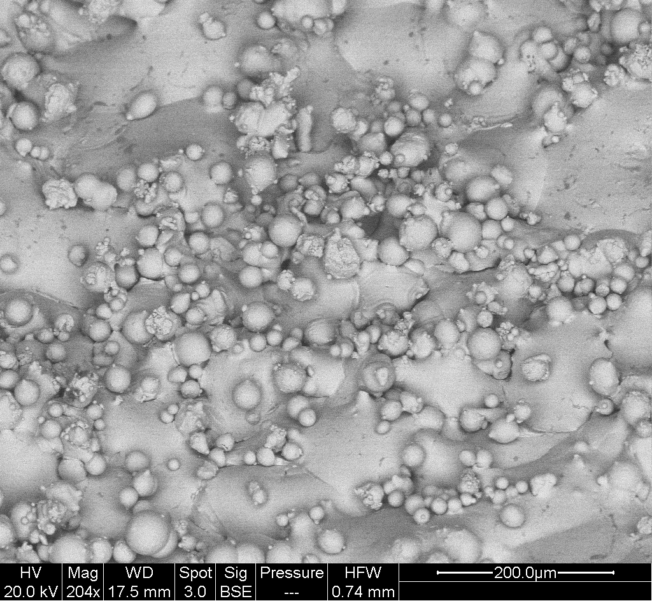
Two different parameter sets were used to build film cooling coupons
Build 1
Build 2
Smaller total melt pool volume, 2 slow contours
Upskin
50% reduction in R_{a}
Smaller melt pool depth, 2 fast contours
Downskin
50% reduction in R_{a}
0.2mm
Notes:
US →smaller melt pools, 2 slow stable contours with high level of overlap
DS → reduced melt pool depth, high speed since it doesn’t matter as much?, high speed contour w/high overlap

Slide 21
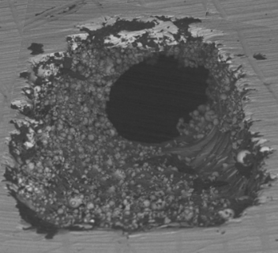


Film cooling holes with lower roughness showed higher cooling performance
$$\frac{\overset{̿}{\text{φ}}}{\overset{̿}{\text{φ}}0}$$
$$\frac{\text{φ}}{\text{φ}\text{0}}\text{= 1 + }\text{χη}\left(\text{Bi} \text{+}\frac{\text{h}\text{∞}}{\text{h}\text{i}}\right)$$
Notes:
- Build 1 params same despite large diff in morphology. “Threshold” roughness to regain performance. More work needed to figure this out.
--

Slide 22
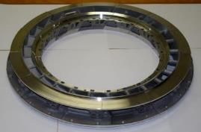

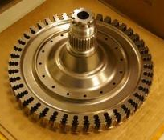

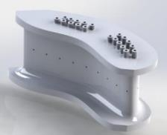
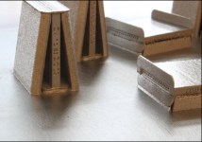
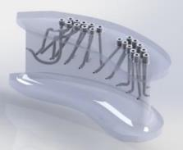
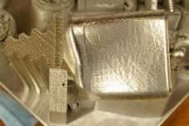
The National Experimental Turbine (NExT) will be used as the testbed to perform optimized cooling in the vane tests
Use engine relevant parameters and scales
Provide s full characterization using IR
Integrate sensors directly into AM vanes
AM vanes with optimal cooling
Notes:
Study methods for improving turbine cooling with turbine engine hardware to give relevant data and reduce overall costs of testing
Provide a test bed for new instrumentation development
Advance the use of additive manufacturing for turbine components
Integration of instrumentation and sensors directly into turbine components

