Slide 1
Next Generation Environmental Barrier Coatings
B. A. Pint and K. A. Kane
Corrosion Science & Technology Group Materials Science and Technology Division
Oak Ridge National Laboratory
Oak Ridge, TN 37831
November 6, 2019

Slide 2
Acknowledgments
Funding from U.S. DOE, Office of Fossil Energy, Turbine Program
  Rich Dennis, Manager; Rin Burke, Project Monitor
  Nuclear Science User Facility: FEI Talos F200X S/TEM
ORNL Team
  J. A. Haynes - TBC procurement
  M. J. Lance - characterization (PSLS, GDOES, Raman)
  K. A. Unocic – TEM (D. Coffey – FIB)
  E. Cakmak – XRD
  G. Garner, M. Howell - oxidation experiments
  T. Lowe - SEM
  T. Jordan, T. Geer – metallography
  E. Lara-Curzio, J. A. Haynes, R. Lowden – input on CMCs
Stony Brook Univ., Center for Thermal Spray Research
  S. Sampath and E. Garcia-Granados

Slide 3
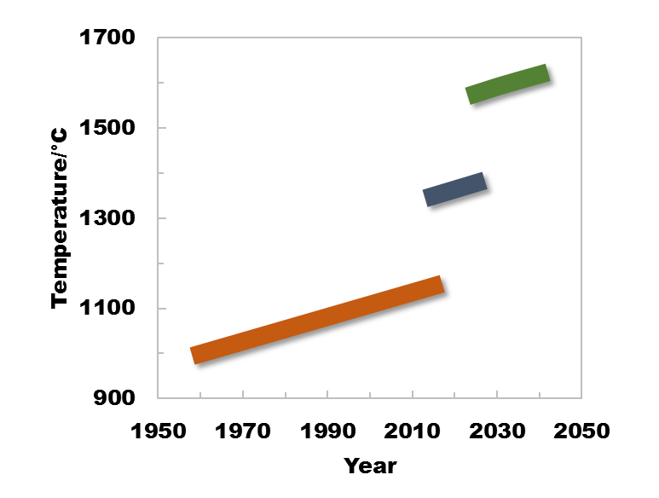
ORNL project moving from turbine coatings for metals (TBC) to turbine coatings for ceramic matrix composites (EBC)
Structural materials temperature capacity
UHT
CMCs
DOE turbine targets
~175ºC
Part 2: Environmental Barrier Coatings
- durable, H₂O stable
150ºC
SiC/SiC
CMCs
LEAP aero engine
Part 1: Thermal Barrier Coatings
durable
oxidation resistant
low T conductivity
Superalloys/TBCs
CMC = Ceramic Matrix Composite, UHT = ultra high temperature

Slide 4
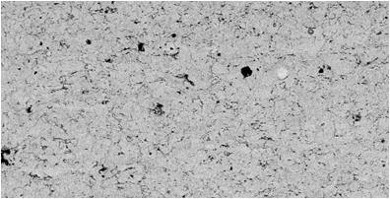
Looking for turbine TBC improvements
Focus on thermally-sprayed coatings
  HVOF: high-velocity oxy-fuel
  APS: air plasma spray
  VPS: vacuum plasma spray
  Fabricated at Stony Brook’s CTSR
Project specifics
  Focus on alumina scale “weak link”
  Original goal to push deployment of multi-layer coatings
  Directional solidified 247 superalloys
  PWA286: NiCoCrAlYHfSi bond coatings
ORNL: Environments (higher H₂O, CO₂, SO₂)
Erosion & CMAS resistant GDZ Layer
Dense or DVC architecture
CTSR:
Multi-layer top coatings
Porous TBC (YSZ or GDZ)
Low conductivity
Low Elastic modulus
Dense or DVC YSZ Layer - High K_{IC}
Al₂O₃ scale
Optimal bond coating:
Y+Hf+Si
Bond coat
Superalloy substrate
Explored different superalloy substrates
Material | Ni | Co | Cr | Al | Y | Hf | Si | Ti | W | Ta | Mo | C | Other (ppmw)
YHfSi Bond Coating | 48.0 | 21.6 | 16.7 | 12.3 | 0.68 | 0.25 | 0.36 | < | 0.01 | < | < | < | 2 S
Y-only Bond Coating | 47.1 | 23 | 16.6 | 12.8 | 0.42 | < | 0.04 | < | 0.02 | < | < | < | 8 S
Alloy 247 | 59.1 | 10.2 | 8.5 | 5.6 | < | 1.32 | 0.06 | 1.0 | 10.0 | 3.2 | 0.6 | 0.2 | 200 Re, 11 S

Slide 5
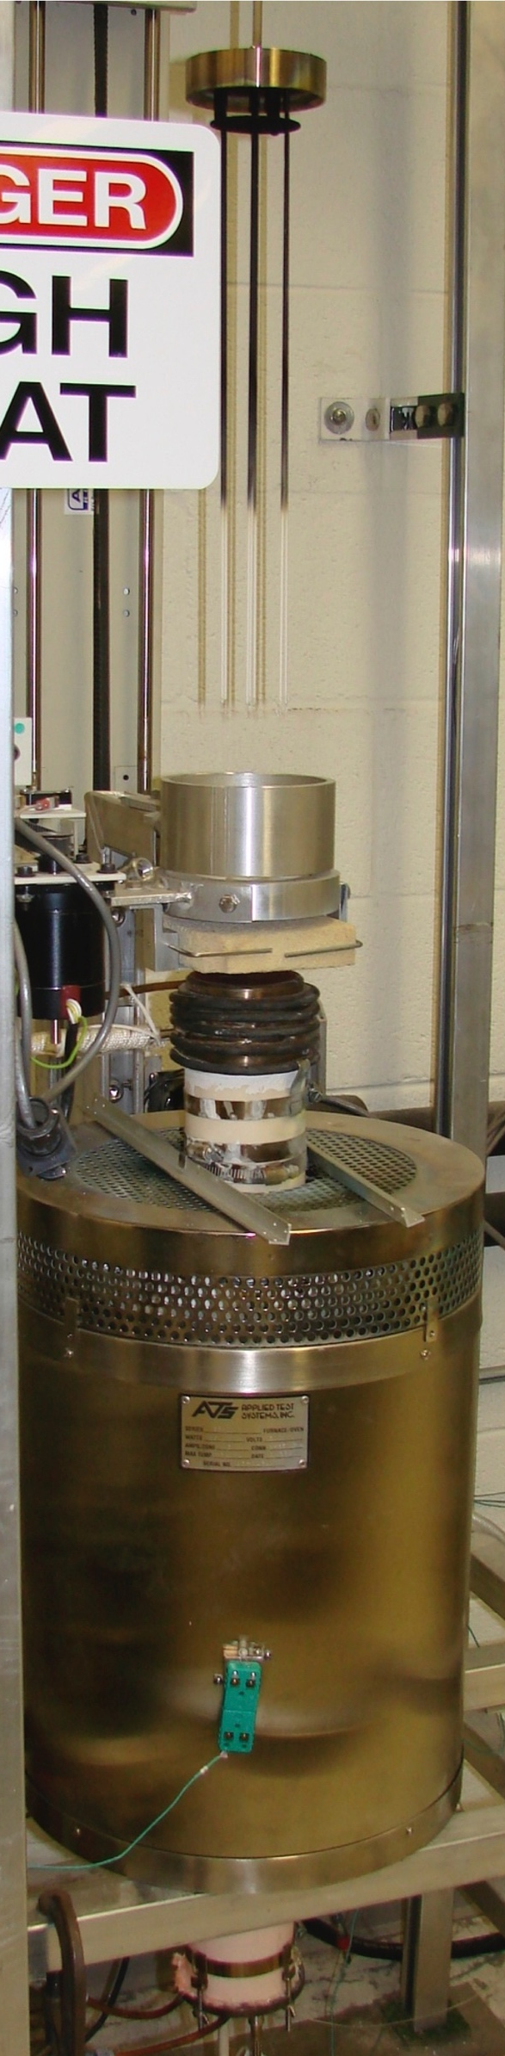
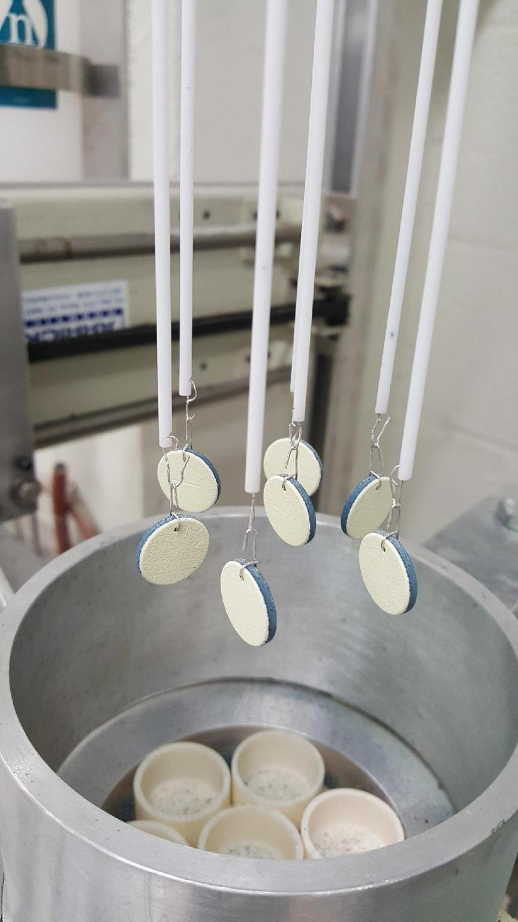
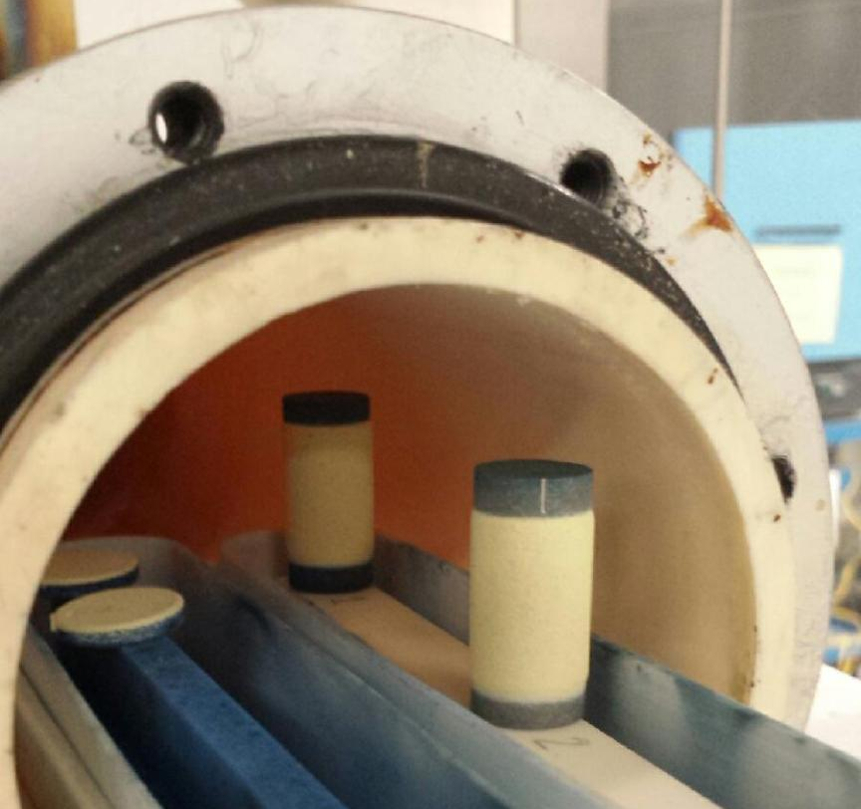
All TBC testing in simulated exhaust gas: air + 10%H₂O
Many studies have shown that water vapor decreases FCT life
lid
furnace
1-h cycles:
automated cyclic rig
(10 min cool in lab. air)
20 cycles/day
100-h cycles (base-load):
Tube furnace with endcaps
1 cycle/week

Slide 6
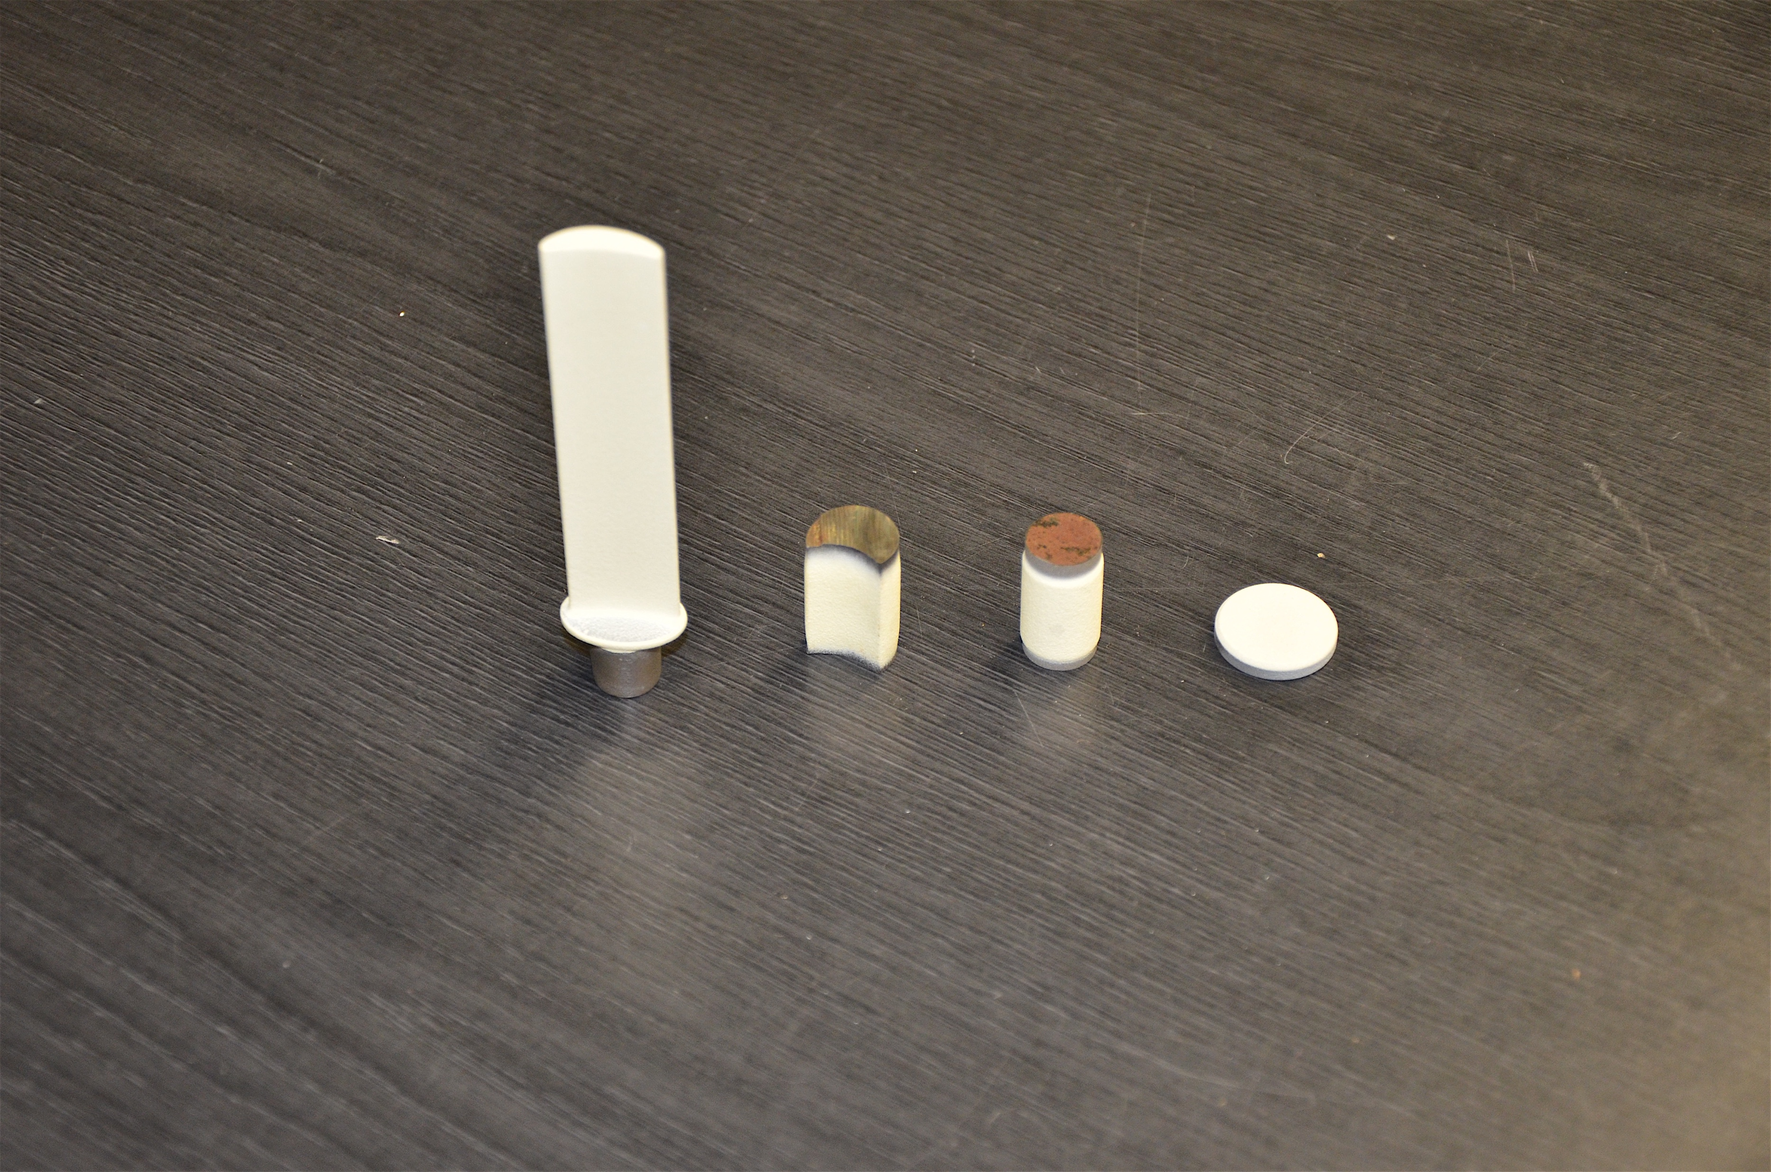
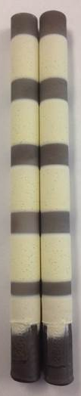
Learned many things by changing specimen geometry…
Superalloy 247 substrates
Jülich 2014
2015: 247 rods
2018
Not pursued
AM 718 “blade”
Coating development not linear with time
Cranfield 2013

Slide 7
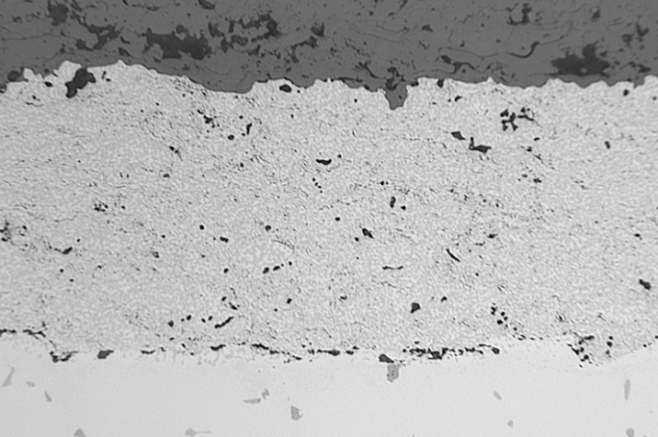
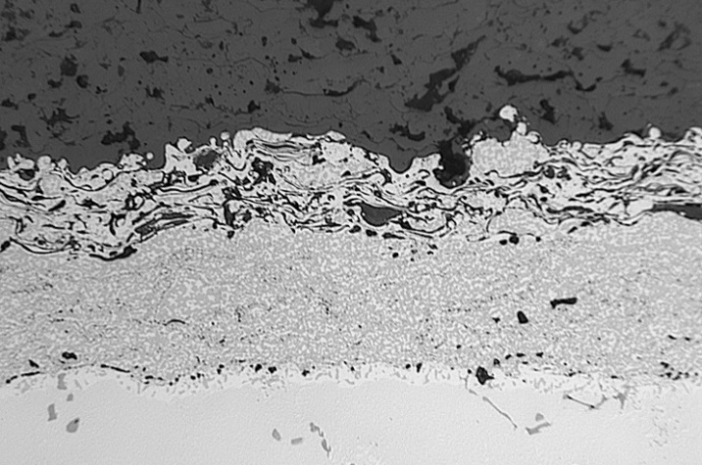
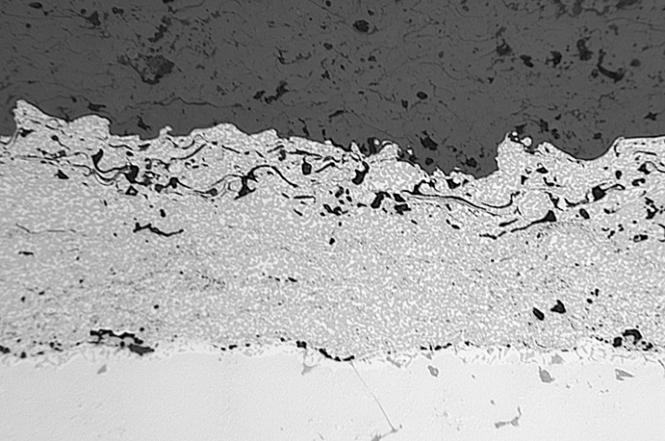
APS Flash coatings (Y vs. YHfSi) on alloy 247 disks
YHfSi HVOF-only
(0.68 Y, 0.25 Hf, 0.36 Si)
YHfSi Flash Coating
(0.68 Y, 0.25 Hf, 0.36 Si)
Y-only Flash Coating
(0.42 Y)
YSZ
YSZ
YSZ
APS
APS
HVOF
HVOF
HVOF
247
247
100 µm
247
Dense YHfSi HVOF layer in each case
Outer APS flash coatings contain internal oxidation generated during APS deposition
More internal oxidation in YHfSi APS layer
  Sprayed same powder size
  Due to higher RE content?
Material | Ni | Co | Cr | Al | Y | Hf | Si | Ti | W | Ta | Mo | C | Other (ppmw)
YHfSi Bond Coating | 48.0 | 21.6 | 16.7 | 12.3 | 0.68 | 0.25 | 0.36 | < | 0.01 | < | < | < | 2 S
Y-only Bond Coating | 47.1 | 23 | 16.6 | 12.8 | 0.42 | < | 0.04 | < | 0.02 | < | < | < | 8 S
Alloy 247 | 59.1 | 10.2 | 8.5 | 5.6 | < | 1.32 | 0.06 | 1.0 | 10.0 | 3.2 | 0.6 | 0.2 | 200 Re, 11 S
Notes:
Same powder size.

Slide 8
Y-only flash coating out-performed HVOF by 71%
HVOF as baseline
50 µm APS flash coating
Y only (0.42%Y) vs.
YHfSi (Y+Hf = 0.93%)
5 specimens of each coating
1-h cycles
1100°C
Air+10%H₂O
+71%
+12%
Statistically significant results!
Lance et al. Oxidation of Metals 2019

Slide 9
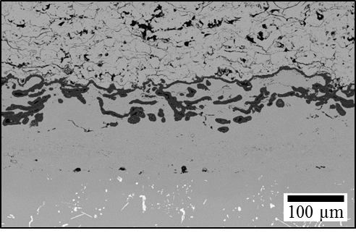
Why did the Y-only flash coating increase lifetime 71%?
YSZ
Flash coating
HVOF coating
Substrate
Intermixed alumina-metal layer inhibited crack growth; possibly acted to reduce CTE mismatch in system
Dense HVOF layer was a barrier for substrate attack and provided an Al reservoir for the flash coating (inhibited Ni-rich oxide).
Less reactive element in the Y-only flash coating reduced the rate of Al consumption, thereby increasing lifetime

Slide 10
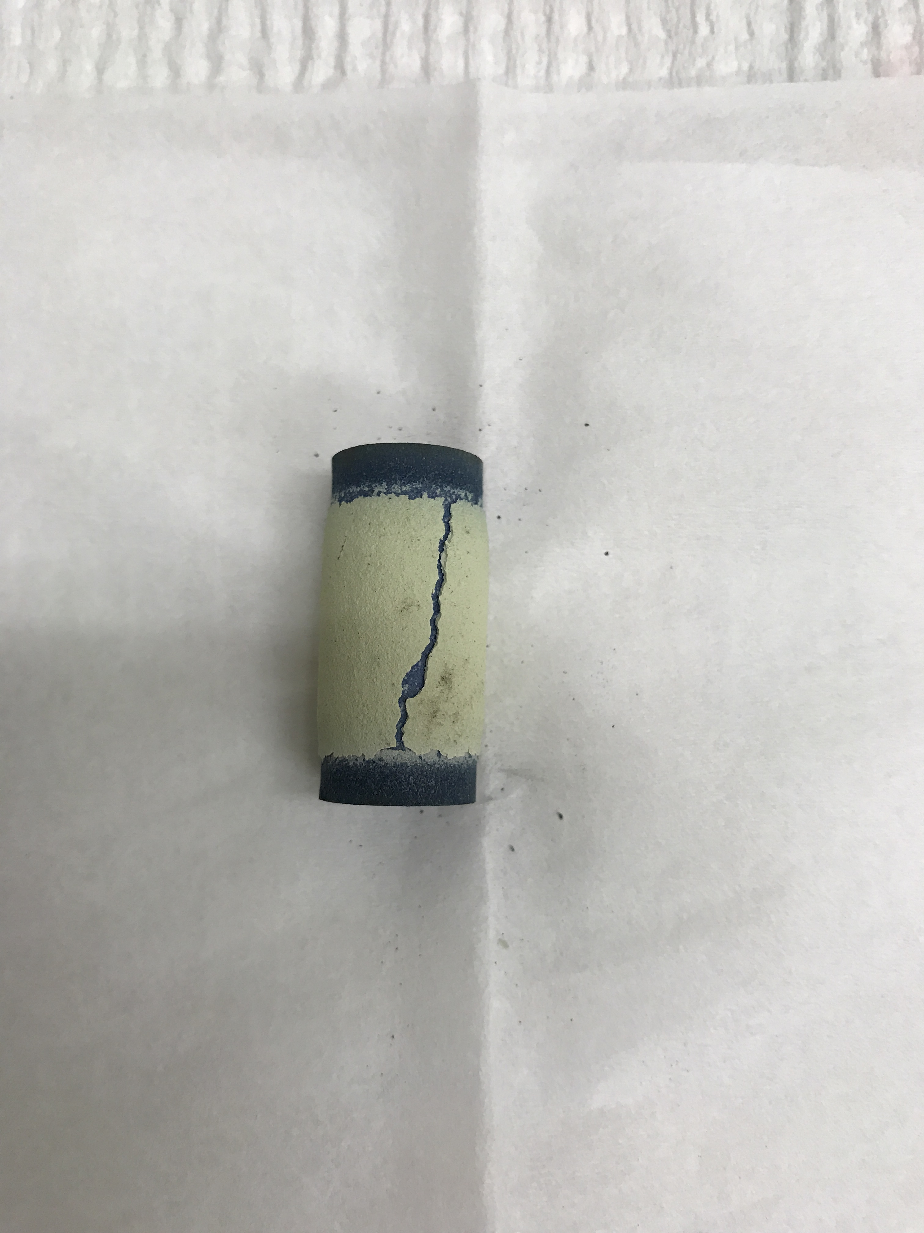
2019 Rods: all flash coatings outperformed HVOF and VPS
Statistically, did not see additional benefit of Y-only flash
Porous YSZ
Porous YSZ
epoxy
epoxy
Flash Y-only Rod (2900 h)
Flash YHfSi Rod (2800 h)

Slide 11
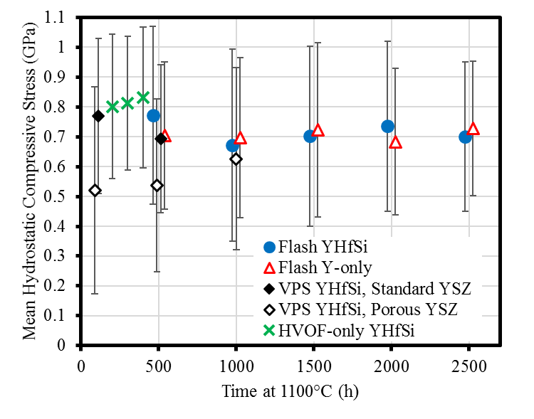
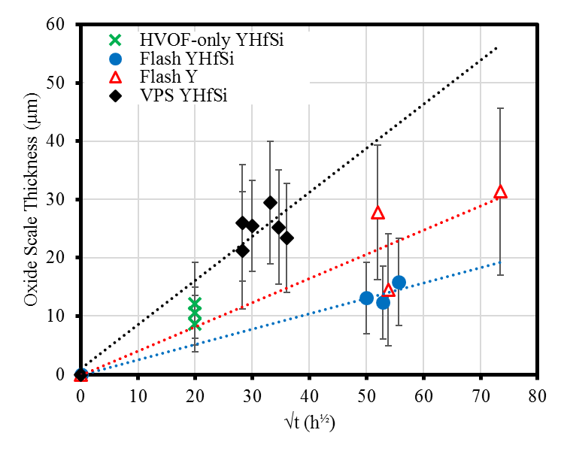
Rod characterization:
All coatings show similar residual stress in alumina
Faster alumina growth on VPS bond coatings with Y+Hf
(a)
Faster alumina growth on VPS
= faster alumina consumption
Similar alumina residual stress
YSZ
oxide scale
10 µm
HVOF YHfSi, 2500 h
(b)
YSZ
oxide scale
10 µm
VPS YHfSi, 1200 h
Oxidation extrapolation
Assuming parabolic kinetics
PSLS of rod specimens
Measure same location each time
SEM backscattered electrons
Z-contrast shows Y- & Hf-rich oxides
Lance et al. Surf. Coat. Tech. in press (presentation at ICMCTF 2019)

Slide 12
Had to try one more TBC experiment…
Lots of questions about flash coating comparison to:
100% APS bond coating and thicker flash coating
5 of each specimen type

Slide 13

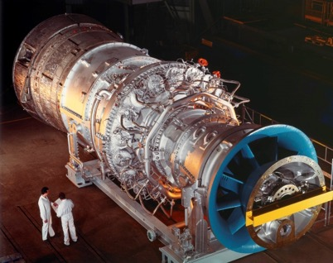
LEAP: 1st Gen. Fiber-reinforced ceramic matrix composites deployed
2nd Gen. to enable ≥65% combined cycle power generation efficiency
Structural materials temperature capacity
UHT
CMCs
DOE turbine targets
~175ºC
150ºC
SiC/SiC
CMCs
LEAP aero engine
DOE Impact: Next generation, ultra high efficiency, utility turbines may require ~1500°C structural materials capability AND 25,000 h lifetime (~10X increase vs. aero applications)
Superalloys/TBCs
CMC = Ceramic Matrix Composite, UHT = ultra high temperature

Slide 14
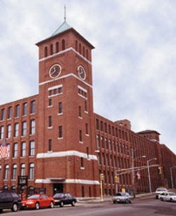
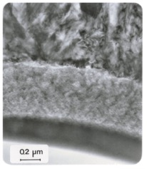
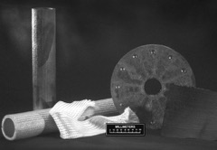
Past, Present & Future: ORNL Contributions to CMCs
CVI
matrices
New
ceramics
Malden Mills
CMC liner for
CHP (1999)
-Solar Turbines
-ORNL
-Pratt & Whitney
-BF Goodrich
-Honeywell
-ANL
After CFCC, GE invested
15 yr & ~$1.5B in CMCs
Gen-1: Si-MI SiC matrices
Gen-2
UHT
SiC/SiC to engine market >25 yr
Beyond SiC
Si-free SiC/SiC
CFCC
begins
CFCC
ends
2016
LEAP engine
ORNL future
1970
BAP
arrives
2020
1960
1980
1990
2000
2010
2030
ORNL: Vapor coating of
ceramic fuel particles
ORNL Developed
forced-flow, thermal-gradient,
Chemical Vapor Infiltration (CVI) process
(1992-2002) DOE Continuous
Fiber Ceramic Composite (CFCC) Program led by ORNL
in close collaboration w/ industry (e.g., GE).
• Advanced CVI
• Interfaces & coatings
• Characterization
• Oxidation testing
ORNL Recent: SiC/SiC
for accident tolerant
nuclear fuels, CVD ZrC
for Space Power.
CVD SiC Matrix
CVI : 1980s – 2000’s
Pyrolytic C Interlayer
(1994-2001) DOE Advanced Turbine Systems (ATS) Program transferred aero-engine technology to power generation
Thermal barrier coatings
Single crystal superalloys
Ceramic Fiber

Slide 15
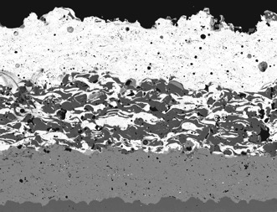
Where to get started in 2018 on EBCs?
Parameters
  Coat high-purity CVD SiC (CMCs hard to find)
  First experiments at 1425°C: No Si bond coating
  Coatings made at Stony Brook CTSR
    What parameters to use?
Objectives:
  FY18: Does coating porosity affect performance?
  FY19: What does a lifetime model look like for CMCs in turbine?
    What are failure mechanisms and reaction rates?
      Milestone #1: measure oxidation kinetics at 3 temperatures ±Si bond coating
    What is failure criteria?
      Milestone #2: measure CTE of 2+ EBC components
    Milestone #3: initial estimate of critical temperature for 25,000 hr lifetime
  Difficult to coat CVD SiC without bond coating
  What parameters to use?
  Does coating porosity affect performance?
    Spray distance affects coating porosity: 100 vs. 180 mm
Ba-Sr-Al-Si-O
Mixed
100 μm
Si
SiC

Slide 16
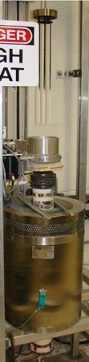
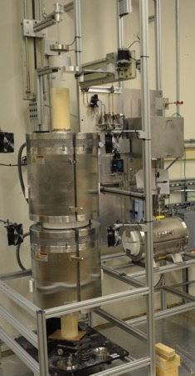
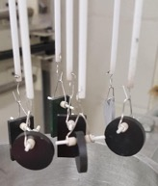

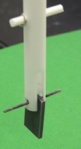
Exposures to H₂O in several rigs at 1300°-1425°C
Nuclear Severe Accident Test Station
1-h cycles: automated cyclic rigs
(10 min cool in lab. air)
lid
furnace
1500°C
maximum
1700°C
maximum
Current:
maximum 1300°C
New rig:
>1400°C

Slide 17
Start at 1425°C with bare SiC specimens
High temperature furnace:
Gas flow
  ~16 cm/s in steam (slow relative to turbine)
  ~6 cm/s in air (500 cc/min)
Expected mass loss due to Si(OH)₄ evaporation
Similar mass loss for both CVD SiC and Hexoloy
Improved holder made for exposures in TGA at 1425°C

Slide 18
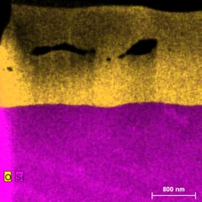
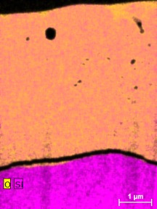
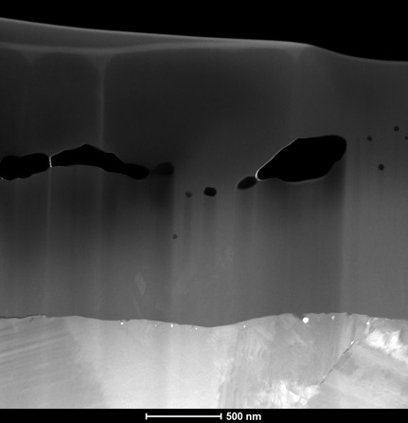
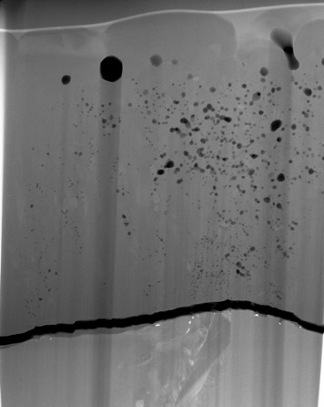
TEM: Thicker scale formed in steam and finer porosity
Note: different magnification
100 h, dry air
100 h, steam
Scale
Voids/porosity
TEM annular
dark field
Substrate
1µm
Crack parallel to the matrix/scale interface
1.8±0.04 µm
4.9±0.5 µm

Slide 19
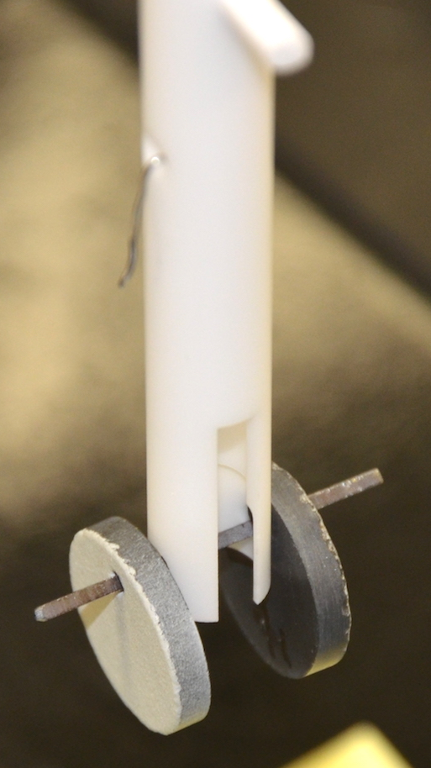
1425°C exposures: similar mass change for 4 coated SiC
5 x 20-h cycles in 100% H₂O
Gas flow rate ~16 cm/s 100% steam
Only one side of CVD SiC specimen coated with sprayed Yb₂Si₂O₇
Similar mass loss for all 4 specimens
Comparisons to isothermal uncoated CVD SiC specimens
  No thermal cycling on uncoated SiC

Slide 20
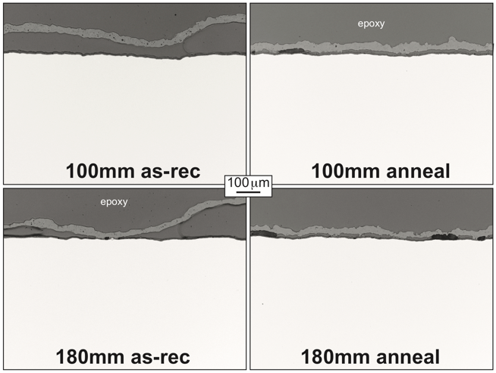
Yb₂Si₂O₇ coated CVD SiC: Δ porosity by spray distance
100 mm (15.4±1.8%) vs. 180 mm (13.1±3.4%)
2nd parameter: 1300°C pre-anneal to crystalize Yb₂Si₂O₇
Poor EBC adhesion without anneal
With anneal:
Not much better
Light microscopy
After 100h, 1425°C, 100% steam

Slide 21
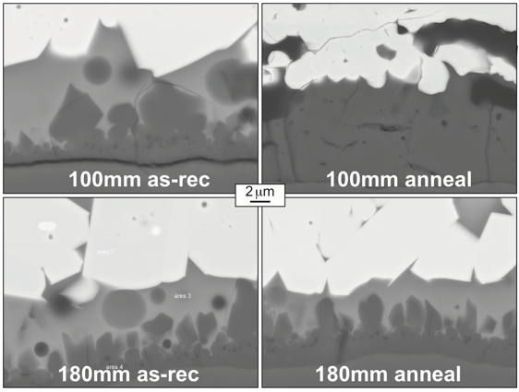
Sections showed reaction products under EBC all were similar in thickness to uncoated SiC: no EBC effect
Thicker oxide than formed on bare SiC
After 100h, 1425°C, 100% steam

Slide 22
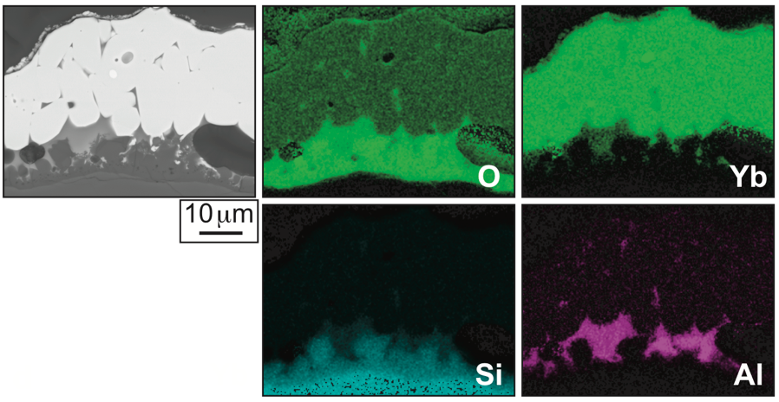
Issue with Al contamination at 1425°C in steam
Reaction of Al₂O₃ specimen holder and reaction tube
SEM/EDS maps
Annealed 180 mm spray distance after 100h, 1425°C, 100% steam

Slide 23
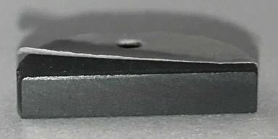
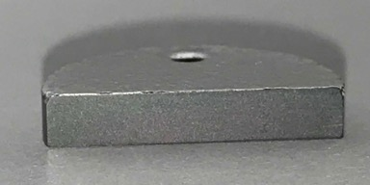
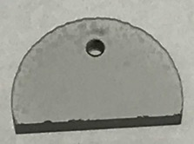
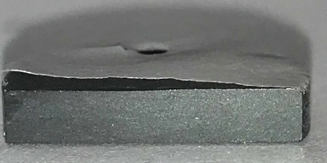
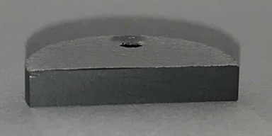
All future EBC specimens will be annealed
1300°C: EBCs without anneal failed within 20 1-h cycles
All images after 20, 1-h cycles
in air+90%H₂O
100 mm spray distance
No anneal prior to cycling
Annealed 4h/1300°C
All specimens cut first
180 mm spray distance

Slide 24
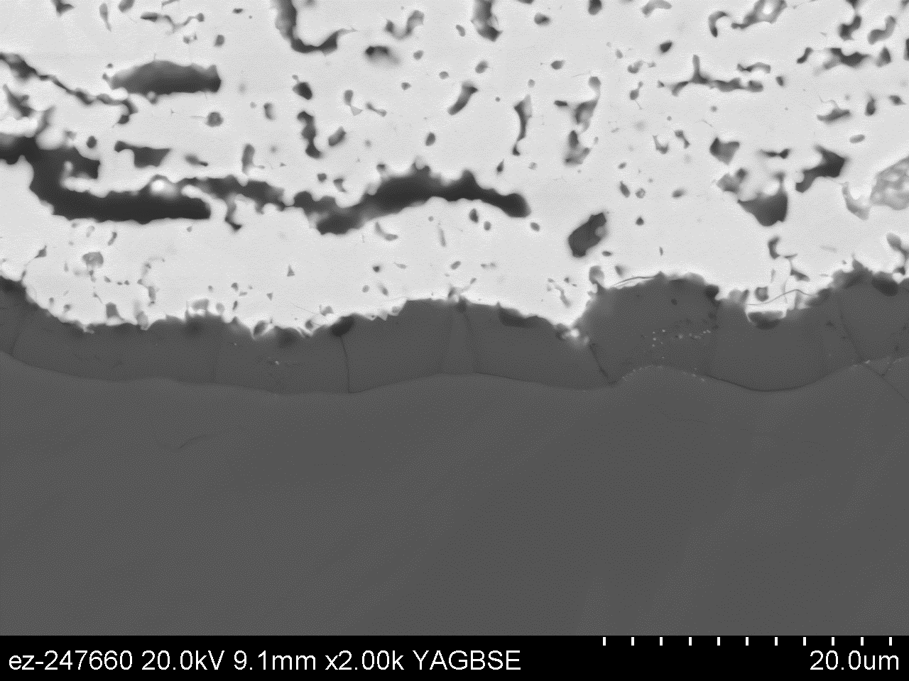
With annealing, coatings survived 500 1-h cycles in air+90%H₂O
YbDS
Silica
20µm
SiC

Slide 25
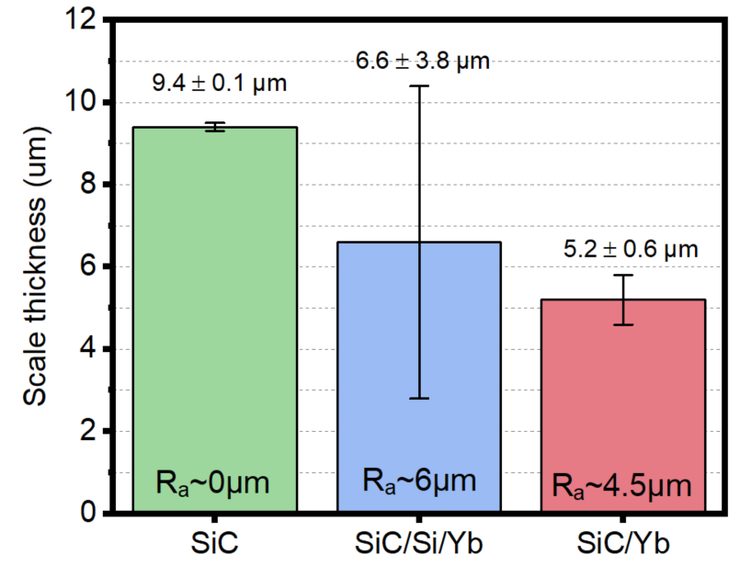
With & without Si bond coating, EBC was effective at 1300°C in reducing SiO₂ thickness after 500 x 1-h cycles
Measured SiO₂ thickness
Part of FY19 Milestone #1
Reduced silica thickness: EBC effective

Slide 26
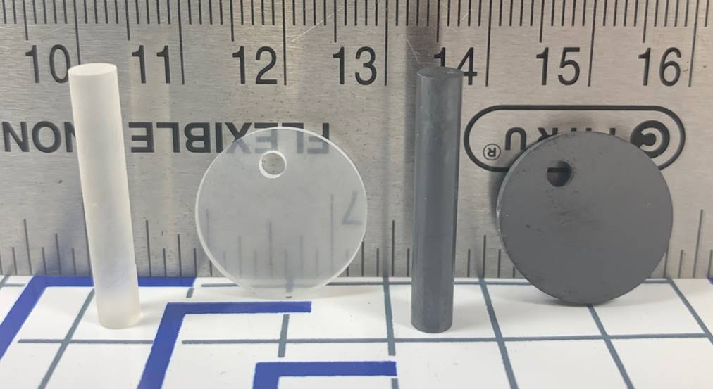
Initial CTE measurements
SiO₂ and SiC specimens:
SiC Δα ~ 4 at 1200°C
Making Yb₂Si₂O₇ and Yb₂SiO₅ samples
Part of FY19 Milestone #2
Thermal (cooling) stress: σ_{ox} = - E_{ox}•ΔT•(α_{alloy} - α_{oxide})/(1-υ)
Strain Energy: W = f(δ_{oxide}) : δ_{spall} = f(ΔT•Δα⁾⁻² (critical scale thickness for spallation)

Slide 27
Initial CTE measurements
If NiAl: Δα ~5.8
δ=10 µm at 1200°C
Then SiC: Δα ~4
δ=15 µm at 1400°C
& Si: Δα ~3.4
δ=21 µm at 1400°C
SiC Δα ~ 4 at 1200°C
Thermal (cooling) stress: σ_{ox} = - E_{ox}•ΔT•(α_{alloy} - α_{oxide})/(1-υ)
Strain Energy: W = f(δ_{oxide}) : δ_{spall} = f(ΔT•Δα⁾⁻² (critical scale thickness for spallation)

Slide 28
Annealing: more affect on EBC performance than porosity
1st batch of EBC specimens evaluated with two porosity levels
  Yb₂Si₂O₇ on CVD SiC with and without annealing
  No coatings were protective at 1425°C
  Better 1300°C adhesion after initial 4h/1300°C anneal
Experimental procedure being evaluated in high T steam
  Issue with alumina contamination
Assessing the next generation of EBC’s for power generation
  Is 25,000 h lifetime viable?
  Collecting more data at 1250°-1350°C
  With and without Si bond coating
  Collecting CTE data to model failure

Slide 29
Backup slides

Slide 30
1300°C: EBCs without anneal failed within 20 1-h cycles
All images after 20, 1-h cycles in air+90%H₂O
100 mm spray distance
No anneal prior to cycling
Annealed 4h/1300°C
180 mm spray distance
All specimens cut first

Slide 31
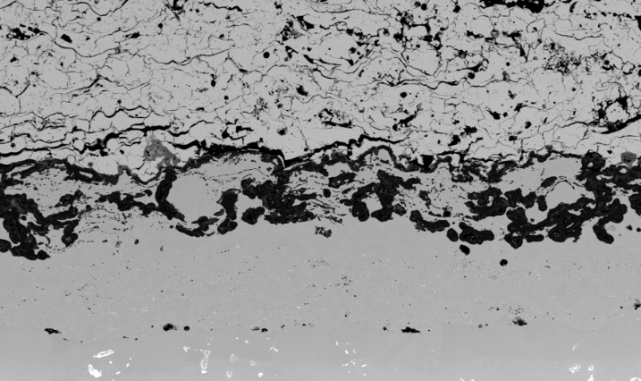
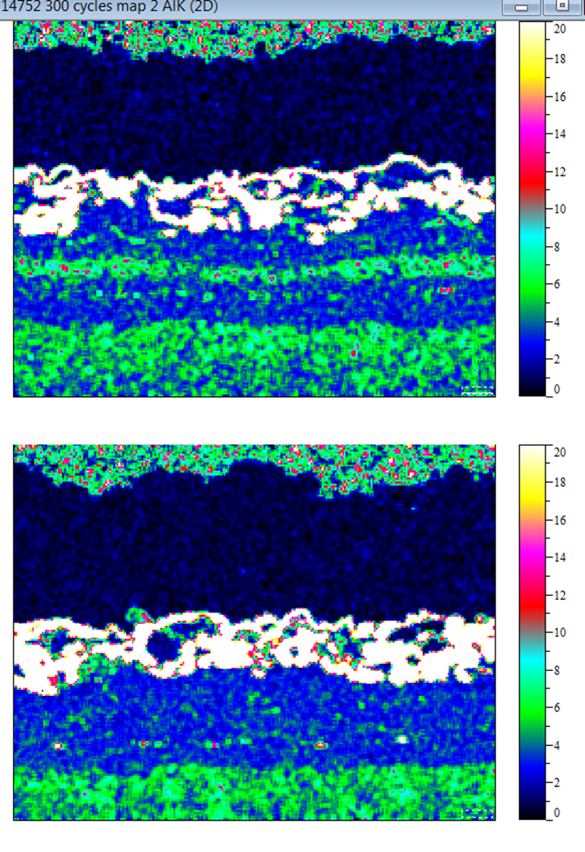

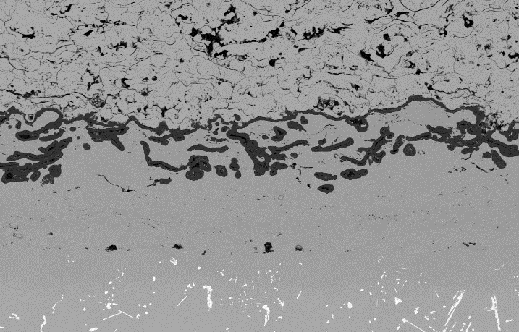
Ran two more flash-coated specimens to 300 cycles:
YHfSi flash coating: Al was more depleted in HVOF layer
SEM images
Aluminum EDS Concentration Maps
YHfSi Bi-layer
Al₂O₃
Al wt.%
100 µm
Y-only Bi-layer
Al₂O₃
β-NiAl
100 µm
After 300 1-h cycles at 1100°C in air+10%H₂O
YHfSi: more oxide = more Al consumed = shorter life
Notes:
These are two NOT FAILED sections.
We didn’t think there would be a large difference.
The finer splat size in the YHfSi outer flash coating compared to the Y-only flash coating in the as sprayed condition leads to more oxidation and more rapid Al depletion and earlier lifetimes. Therefore, the benefits of having an APS flash coat layer are partially offset for the YHfSi coating by too much internal oxidation.

Slide 32
Failure microscopy: HVOF and flash-coat differences
YHfSi HVOF-only, 620 cycles
YHfSi Flash, 760 cycles
Y-only Flash, 1080 cycles
YSZ
100 µm
100 µm
100 µm
HVOF-only: smoother interface, more uniform oxide
Much more oxide formed with flash coatings
Underlying HVOF layer inhibited superalloy oxidation
Intermixed metal/oxide layer: inhibited interface crack growth
Intermixed metal-oxide layer: did it create a graded interface & reduce CTE mismatch?
Notes:
which may explain its earlier failure as the interfacial crack can easily extend across the entire specimen without deflecting
We grade to Al2O3 not YSZ.
Segue: It is hard to make comparisons after failure because they each lasted different cycle times, so we took another samples and cycled to 100 and 300 cycles.

Slide 33
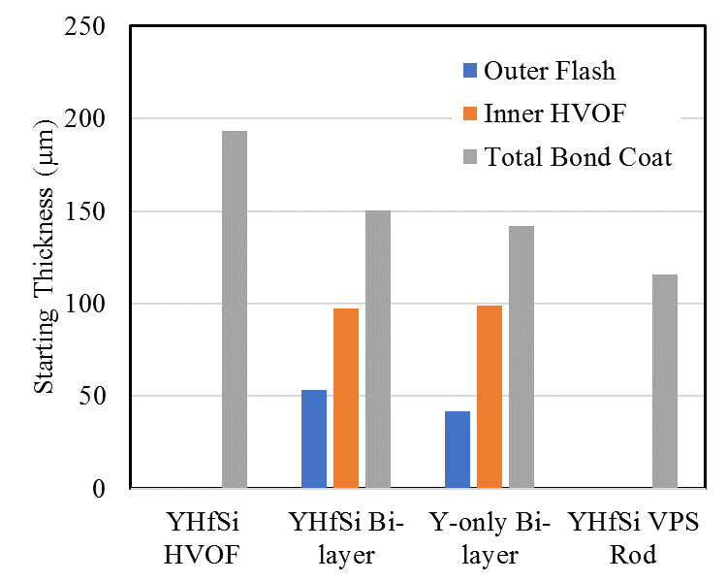
Starting bond coating conditions
Starting Bond Coating Thicknesses
Starting Roughness and Fractal Dimension
HVOF-only coating slightly thicker (but had lowest life)
Roughness did increase with flash coating
Measured fractal dimension (D_{f}) as described by Nowak et al. (Jülich)
  Fairly small differences measured to explain 12% and 71% increase in lifetime
Notes:
Roughness was significantly lower than reported for other bond coatings.
Just state what the thicknesses were; don’t apologize.
Couldn’t test the effect of this parameter like Nowak did.
We are working on the fractal dimension like Nowak.
Summit density

Slide 34
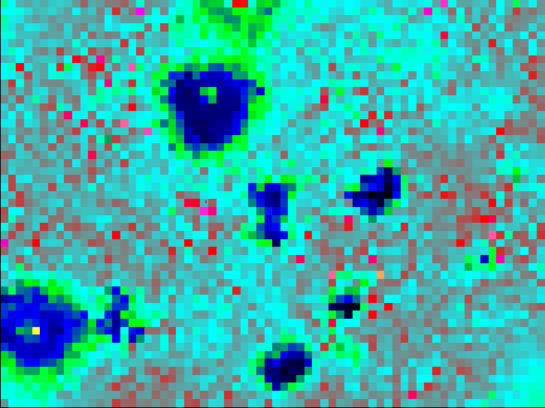
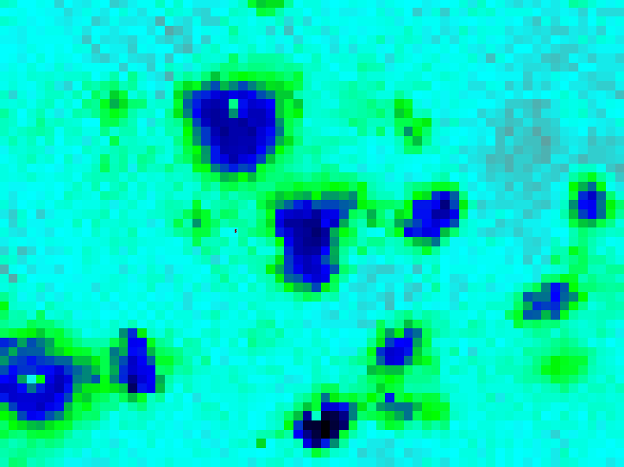

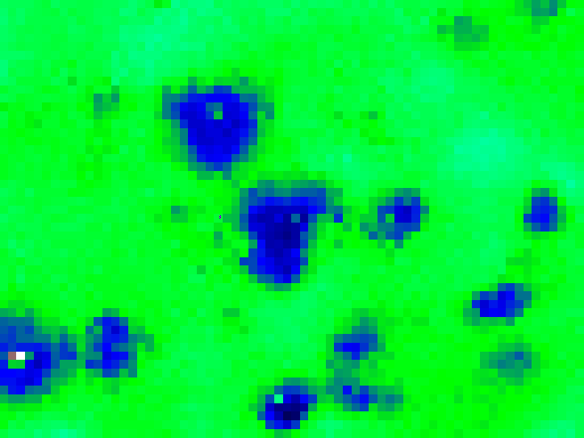
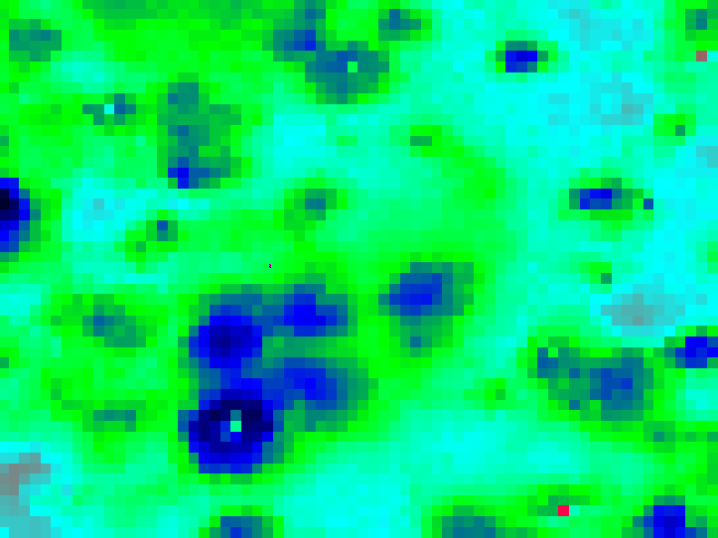
In-situ coating characterization using PLPS through YSZ
1-h cycles in ”wet” air (10%H₂O)
5 cycles at 1100 °C
100 cycles at 1100 °C
a
b
Compressive
Stress (GPa)
300 cycles at 1100 °C
100 cycles at 1150 °C
c
d
200 µm
PLPS: photo-stimulated luminescence piezospectroscopy

Slide 35
Is roughness really the “flash” coating advantage?
Stony Brook: could not correlate roughness with lifetime
1100°C (2102°F)
24-h cycles
Laboratory air
3 specimens/group
15 profilometry measurements to determine roughness

Slide 36
PLPS results: very weak signal through 300µm top coating
Similar residual stress in alumina scale on both bond coatings
Higher residual stress in flat disk specimen compared to rods

Slide 37
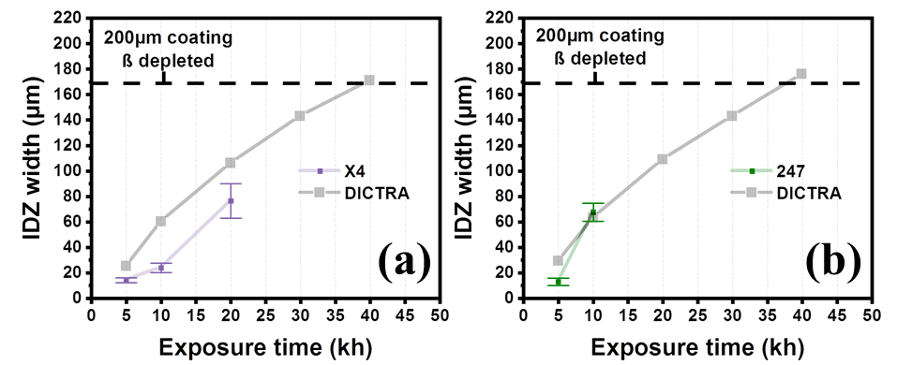
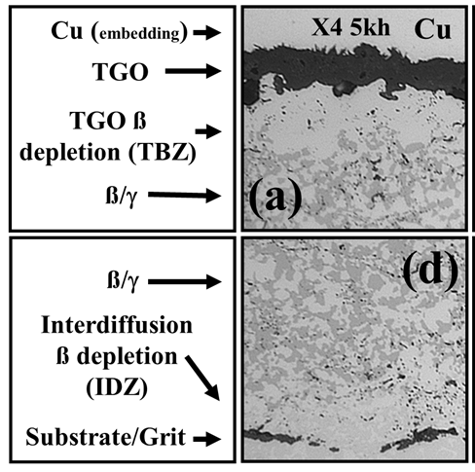
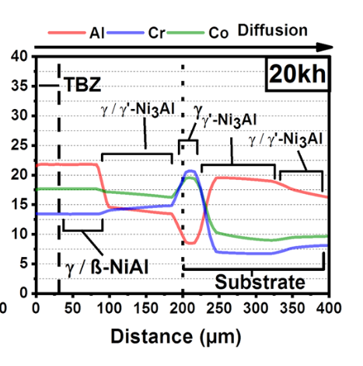


2nd Iteration Model of 900°C (1650°F) coating performance
Experiments (isothermal)
Model predictions at 900°C (DICTRA)
Concentration (%)
Molar Phase Fraction
Results by K. Kane (VCU) and R. Pillai (ORNL)
Cr content (%)
Distance (µm)

