Slide 1
Supercritical Carbon Dioxide Primary Power Large - Scale Pilot Plant

Slide 2
Background and Overview
DOE-funded project (DE-FE0031585)
Phase I – Complete
Conceptual design of a 10 MWe (net) coal-fired sCO₂ pilot power plant
Identification and selection of host site
Phase II – in process
Front-end-engineering design of 10 MWe (net) pilot plant
sCO₂ power cycle
Turbomachinery
Primary heater
Environmental control system
Balance of plant
Permitting
NEPA
Construction
Cost share commitments
Techno-economic analysis
Pilot plant configuration (AACE Class 3)
Commercial scale (AACE Class 4)
Commercial scale – opportunity (AACE Class 4)
Phase III – Construction and operation
Notes:
Echogen project DE-FE0031585 – Supercritical CO₂ (sCO₂) power cycle + coal-fired stoker heater
Leverages Echogen commercial sCO₂ power cycle
Leverages DOE-funded study (DE-FE-0025959)
Complementary to DOE STEP R&D project
Good lead-in to ongoing DOE “Coal FIRST” project

Slide 3
Background and Overview
Leverages Echogen commercial sCO₂ power cycle and DOE-funded study (DE-FE-0025959)
Complementary to DOE STEP project
Operating power plant vs component and system R&D
1000’s hours per year vs 100’s
Good lead-in to ongoing DOE “Coal FIRST” (89243319CFE000022) project
100 MWe scale coal-fired modular power plant
sCO₂ power cycle
CCS
Energy storage integration
Same team as current project plus Mitsubishi Heavy Industries (CCS)
Notes:
Echogen project DE-FE0031585 – Supercritical CO₂ (sCO₂) power cycle + coal-fired stoker heater
Leverages Echogen commercial sCO₂ power cycle
Leverages DOE-funded study (DE-FE-0025959)
Complementary to DOE STEP R&D project
Good lead-in to ongoing DOE “Coal FIRST” project

Slide 4
Coal Plant Integration Study (DE-FE0025959)
Techno-economic study of combining an sCO₂ power cycle with an advanced coal power plant
Case 1 – 550 MWe Oxy-combustion (593°C)
Case 2 – 550 MWe Oxy-combustion (730°C)
Case 3 – 550 MWe Chemical Looping (593°C)
Case 4 – 550 MWe Chemical Looping (730°C)
Case 5 – 90 MWe Air-fired PC (593°C)
Case 6 – 90 MWe Air-fired PC (730°C)
Compared to existing air-fired coal plant
Turbine conditions not matched
Net plant efficiency gains from sCO₂ cycle of 2–4% points on HHV basis compared to a steam-Rankine cycle for same turbine inlet conditions
Costs were comparable with potential for improvements

Slide 5





Project team
Echogen Power Systems (Prime Recipient)
Power cycle design
Fired heater and environmental equipment design
Turbomachinery design
Louis Perry and Associates, a CDM Smith Co.
EPC – FEED contractor
Balance of plant engineering
Electric Power Research Institute
Economic analysis
Test planning
Industry voice
University of Missouri
Host site
Plant operations
Riley Power (subcontractor)
Coal-fired heater
Emissions control systems

Slide 6
Program Highlights
sCO₂ power cycle provides transformational improvements in efficiency and flexibility
Project has a fully engaged host site at the University of Missouri CHP Plant
This is a real power plant producing MWh used for campus power
Pilot plant is coal-fired but the sCO₂ power cycle is agnostic to heat source. Project advances will benefit solar, nuclear, biomass, and other primary power applications.
sCO₂ power cycles scale well and could potentially be economic for smaller-scale power plants (< 100 MWe)

Slide 7
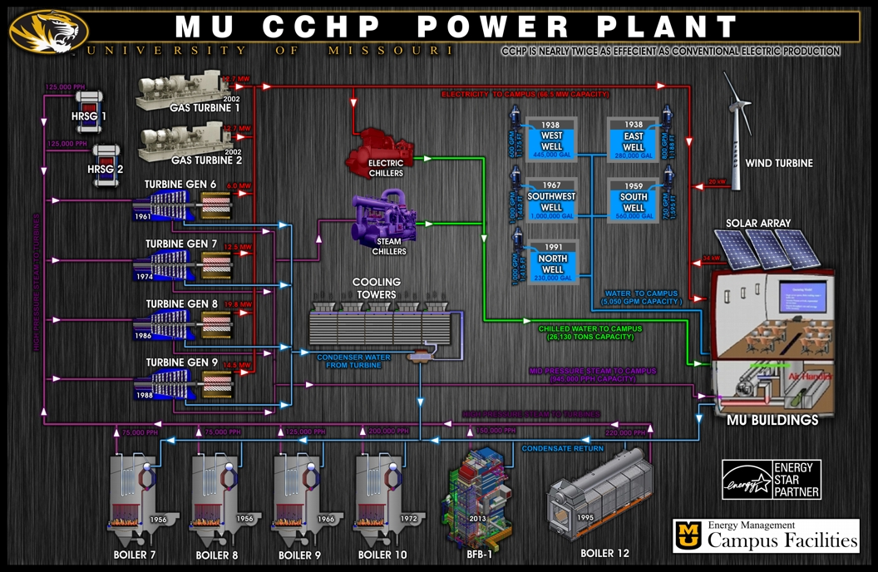
MU CHP Plant
Notes:
Operates year around to provide heat, power and chilled water to the University of Missouri of campus.
Present capacity is 1.1 MMlb/hr of 60 psig steam and 66 MW of electrical power.
Decommissioning three existing boiler and replacing with new stoker heater and sCO2 power cycle.
Make use of existing infrastructure including boiler buildings, structures and foundations, cooling towers, electrical infrastructure and coal handling.
MU is interested in operating plant beyond DOE funded demonstration.

Slide 8
Project schedule by Task
 |  | Sept |  |  |  | Oct |  |  |  | Nov |  |  |  | Dec |  |  |  | Jan |  |  |  | Feb |  |  |  | Mar |  |  |  | Apr |  |  |  | May |  |  |  | Jun |  |  |  | July |  |  |  | Aug
Task/Subtask No. | Title
1.0 | Project Management and Planning | Project Management
2.0 | FEED Study | FEED
2.1 | SCO₂ Power Cycle Preliminary Design | SCO₂ Power Cycle
2.2 | Turbomachinery Conceptual Design |  |  |  |  |  |  | Turbomachinery
2.3 | Primary Heater Preliminary Deisgn | Primary Heater
2.4 | Environmental Control System Preliminary Design | Enviromental Control System
2.5 | Balance of Plant Engineering and Construction |  |  |  |  |  |  |  |  |  |  |  |  | Prepare Eng. Packages |  |  |  |  |  |  |  |  |  |  |  |  |  |  |  | Bid |  |  |  |  |  |  |  |  |  |  |  | Report
3.0 | NEPA/Construction Permitting |  |  |  |  |  | NEPA/Construction Permitting
3.1 | NEPA Determination for Host Site |  |  |  |  |  | NEPA - If Required
3.2 | Complete Permitting Required for Host Site |  |  |  |  |  | Permitting
4.0 | Team and Cost Share Commitments |  |  |  |  |  |  | Inkind |  |  |  |  |  |  |  |  |  | State and Strategics |  |  |  |  |  |  |  |  |  |  |  |  |  |  |  | Utilities
5.0 | Updated Technoeconomic Analysis |  |  |  |  |  |  |  |  |  |  |  |  |  |  | Plant Costing |  |  |  |  |  |  |  |  |  |  |  |  |  | TEA Report

Slide 9
Recompression Brayton Cycle (RCBC)
sCO₂ cycle for primary power applications
Parallel, turbine-driven compressors
Narrow temperature range for heat addition due to high heat recuperation

Slide 10
Phase I Architecture
Conventional recompression Brayton cycle with single point of heat addition
Dual turbine-driven compressors
Steam generating bank to reduce flue gas temperature and provide low pressure steam to plant
Complete environmental control system – NOx, SOx and particulate control

Slide 11
Phase II Architecture
Remove steam generating bank
Add convective bank (PHX-2) with partial, low-temperature CO₂ flow (+10% in heater efficiency)
Split PHX-2 around SCR
Move air heater down stream
Make use of existing cooling tower

Slide 12
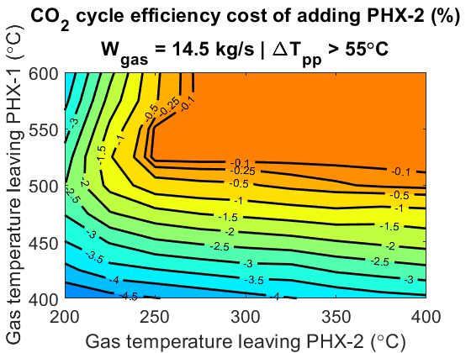
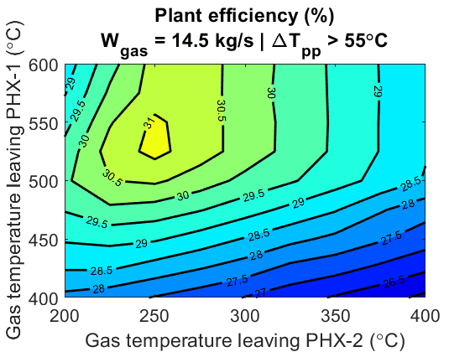
Power cycle / fired heater efficiency balancing
 | η_{heater} | η_{CO2} | η_{plant}
Baseline | 76.3% | 37% | 28.2%
Phase II | ~86% | ~37% | ~32%
Note: Based on ΔT_{pp} ≥ 100°F (55°C) per Riley Phase I proposal , where ΔT_{pp} is the difference between the gas temperature leaving PHX-1 and the CO2 temperature entering PHX-1.
Notes:
Addition of low-grade heat addition bank (PHX-2) can be added for small cost to CO2 cycle efficiency
Assuming temperature leaving PHX-1 > 525°C (≥ 55°C pinch)
Assuming temperature leaving PHX-2 > 250°C
PHX-2 bank can improve overall system efficiency due to improvement in fired heater efficiency

Slide 13
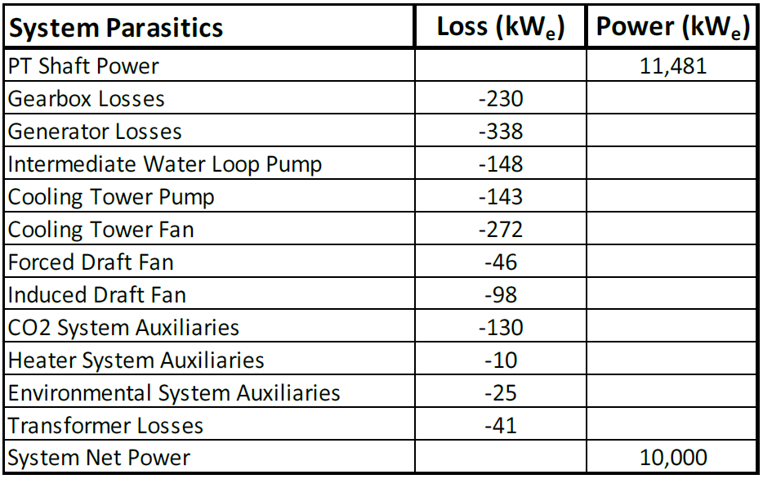
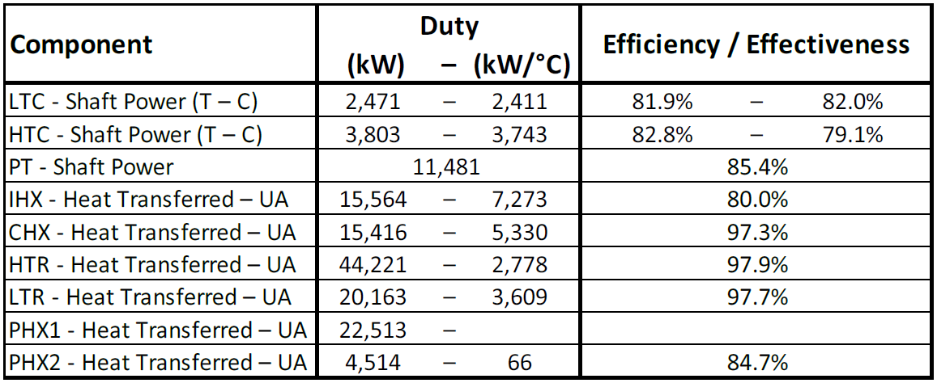
Phase II Cycle and Equipment Summary

Slide 14
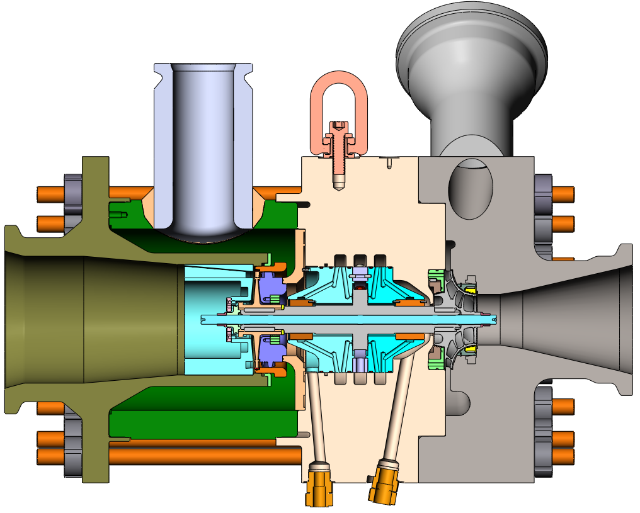
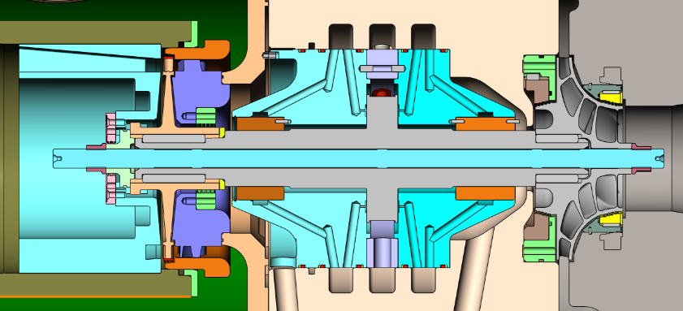
High Temperature Compressor
Turbine
Single stage axial
Efficiency – 76.2%
Compressor
Single stage radial
Efficiency – 79.0%
CO2 hydrostatic bearings
Operating speed – 43KRPM
Hermetically sealed
Conceptual design and cost estimate completed in Phase I

Slide 15
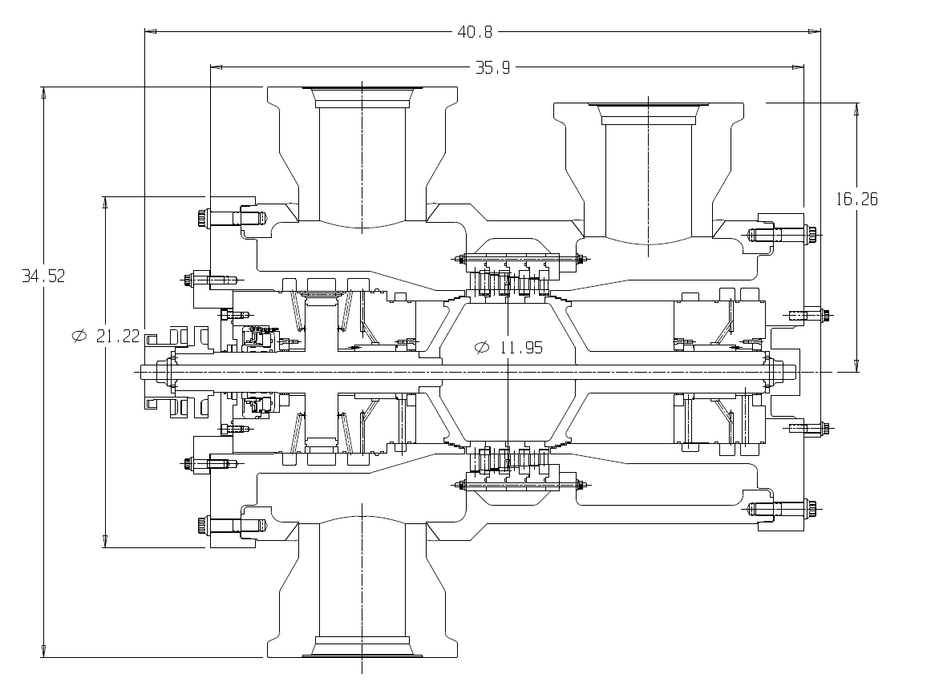
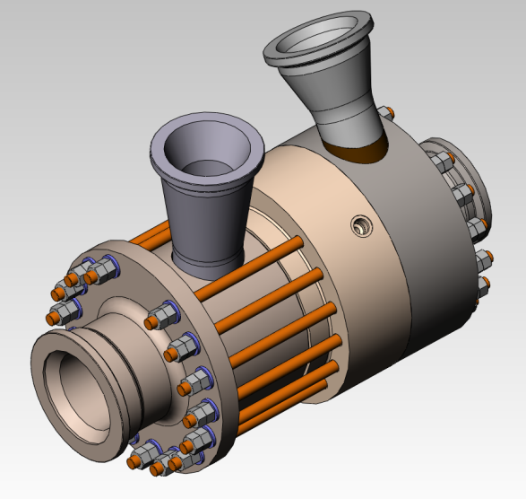
Power Turbine and Low Temperature Compressor
LTC similar in size and scale to EPS100 turbo-compressor
4 Stage axial turbine
Utilize EPS STEP turbine concept
Conceptual designs and cost estimates to be completed in Phase II

Slide 16
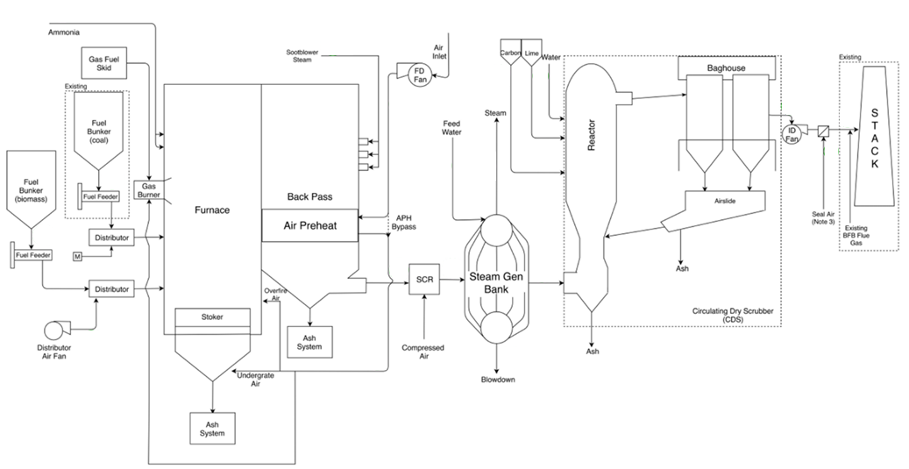
Fired Heater & AQCS Process Flows
Note: Replacing steam generating bank with CO₂ economizer in Phase II

Slide 17
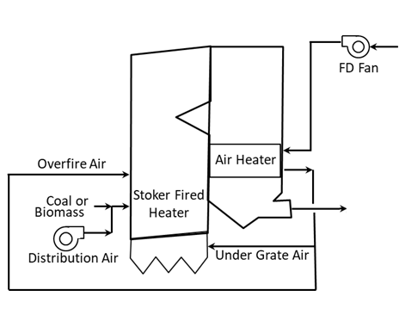
Fired Heater Combustion
Considered air fired PC and stoker combustion
Stoker selected
Provides long-term fuel flexibility (host site priority)
Does not require coal pulverizing
Host site presently utilizing stoker heaters

Slide 18
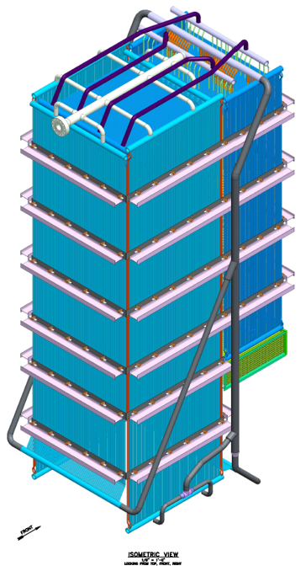
Primary Heat Exchanger
Furnace tubes stainless steel (Super 304H)
Convective tube materials to be optimized in FEED study (assumed austenitic SS in Phase I)

Slide 19
Emission Requirement Summary
 | 105 MMBtu/hr (10 MW_{e} Output) | < 100 MMBtu/hr (~9 MW_{e} Output)
PM (per NSPS and Boiler MACT) | 0.051 lb PM /MMBtu and 99.8% reduction (Note: We must burn 75% Coal for pilot program) and 1.1E-3 lb/MMBth of heat input or 1.4E-2 per MWhr of heat absorbed by CO2 and Less than 43 tpy (PM10) and 38 tpy (PM2.5)
Opacity (per NSPS) | 20% opacity or If PM CEMS and 0.03 lb PM/MMBtu, then no opacity limit
SO2 (per NSPS and Netting) | 0.20 lb/MMBtu SO2, or 92% reduction and Less than 2,208 tpy | 0.20 lb/MMBtu SO2, or 90% reduction and Less than 2,208 tpy
NOx (per NSPS and Netting) | Less than 198 tpy | 0.20 lb NOx/MMBtu and Less than 198 tpy
HCl (per Boiler MACT) | 2.2E-2 lb/MMBtu or heat input or 0.28 lb/MW-hr heat absorbed CO2
Hg (per Boiler MACT) | 8.0E-7 lb/MMBtu heat input or 1.1E-5 lb/MW-hr heat absorbed CO2
CO (per Netting and Boiler MACT) | Less than 132 tpy and 130 ppm per volume dry gas basis, corrected to 3% oxygen or 1.4 lb/MW-hr heat absorbed CO2
VOC (per Netting) | Less than 40 tpy

Slide 20
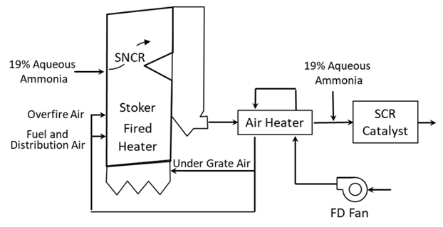
NOx Control
Limited by NSPS regulation
0.20 lb/MMBtu
Controlled by selective catalytic reduction (SCR)
Notes:
SCR – SNCR

Slide 21
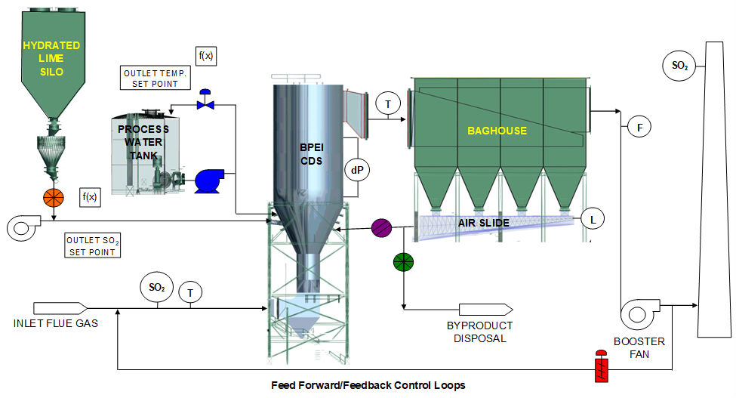
SO2 and Particulate Control

Slide 22
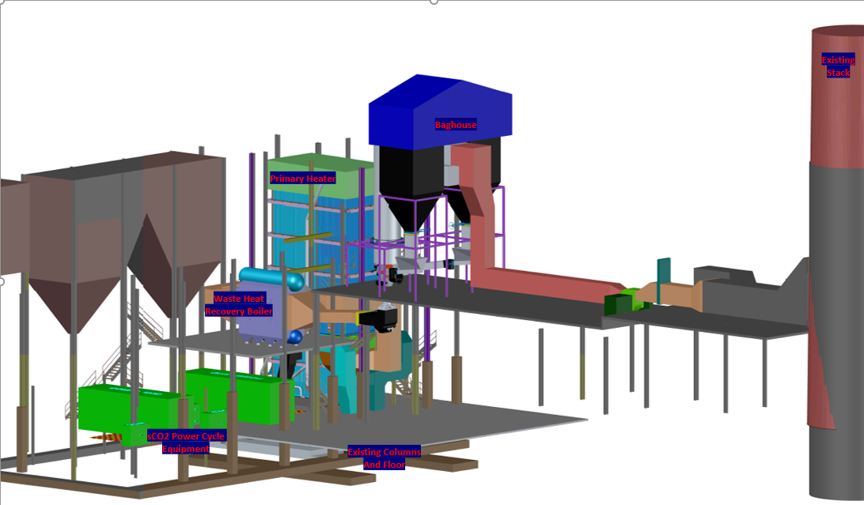
Phase I Plant Layout

Slide 23
Summary
Project goal: sCO₂ power plant in continuous operation with practical coal-fired heater
Phase II (FEED study) in process
Cycle design balances power cycle and fired heater efficiency values to maximize plant efficiency
Fired heater designed for flexibility, emissions compliance
Phase III application due August 30, 2020, start January 2021

Slide 24
The Fine Print
This material is based upon work supported by the Department of Energy under Award Number(s) DE-FE0031585.
This report was prepared as an account of work sponsored by an agency of the United States Government. Neither the United States Government nor any agency thereof, nor any of their employees, makes any warranty, express or implied, or assumes any legal liability or responsibility for the accuracy, completeness, or usefulness of any information, apparatus, product, or process disclosed, or represents that its use would not infringe privately owned rights. Reference herein to any specific commercial product, process, or service by trade name, trademark, manufacturer, or otherwise does not necessarily constitute or imply its endorsement, recommendation, or favoring by the United States Government or any agency thereof. The views and opinions of authors expressed herein do not necessarily state or reflect those of the United States Government or any agency thereof.

