Slide 1


U.S. DOE 2019 UTSR Meeting
Bechtel National, Inc. – FE0031618
Turbo-Compound Reheat Gas Turbine Combined Cycle
PI: John Gülen (scgulen@bechtel.com)
PO: Robin Ames (robin.ames@netl.doe.gov)
CS: Bethan Young

Slide 2
Project Objectives
The objective of this project is to develop of the proposed Turbo-Compound Reheat Gas Turbine Combined Cycle (TC-RHT GTCC) technology to a stage of readiness for a small-scale demo/test system to be built and run to prove:
successful integration of the key components;
operability; and
multifuel compatibility.
This effort will advance the maturity of this technology to a TRL 3.
© 2019 Bechtel | 2

Slide 3
Turbocompound Advantage
Exhaust
Natural Gas
Turbocharger
To HRSG
Integrally-Geared
Intercooled
Air Compressor
0 MWe
Exhaust
M
G
40 MWe
28 MWe
Air
Gas Turbine
(Fired Expander)
Air
5 x 16 MWe
+ 40 MWe – 28 MWe
+ 16 MWe (Steam Turbine)
5 x 16 MWe

Slide 4
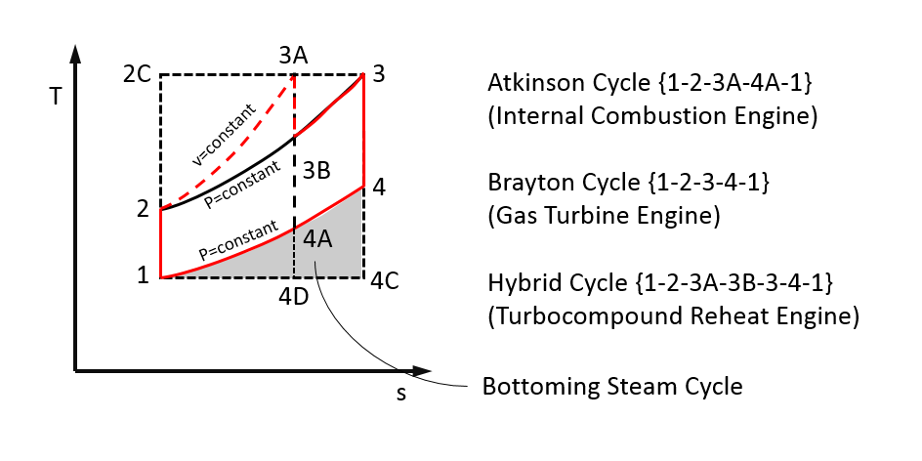
Thermodynamic Background

Slide 5
Project Tasks
PMP
Market Study
Investigation of Fuel Flexibility
Conceptual Plant Design
Heat and Mass Balances
Technology Maturity Plan
© 2019 Bechtel | 5

Slide 6
Conceptual Design
Heat and Mass Balances (24)
Mechanical Equipment List
Electrical Equipment List
Major Equipment Specs
P&ID Diagrams
One Line Diagram
Plant Layout
3D Model
Pipe Quantities
Cost Roll-Up
© 2019 Bechtel | 6

Slide 7
Detailed Engine Models
Jenbacher J920 (Base Performance Engine)
FM-MAN 51/60 DF (Vintage Engine)
FM Trident OP (Small Engine)
100% CH₄
H₂-CH₄
Coal-Water Slurry
© 2019 Bechtel | 7

Slide 8
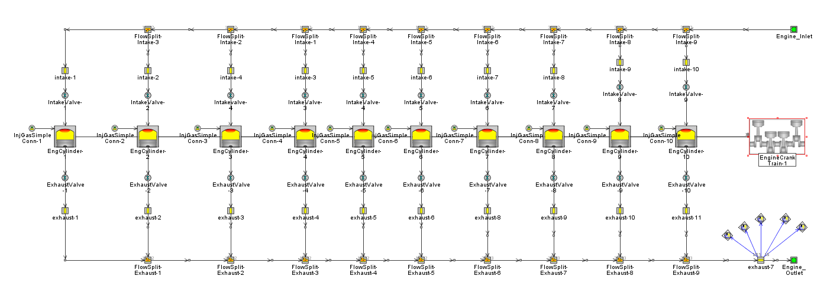
Full Scale System Analysis - Engine Model – GT Power
V-10 (half engine model)
Weibe heat release model – Calibrated using baseline engine data
CARB natural gas mole fractions:
Methane: 90.45%
Butane: 4.02%
Propane: 2.01%
N2: 3.52%
Prescribed Intake and Exhaust Manifold Boundary Conditions
Block diagram of GT Power model
© 2019 Bechtel | 8

Slide 9
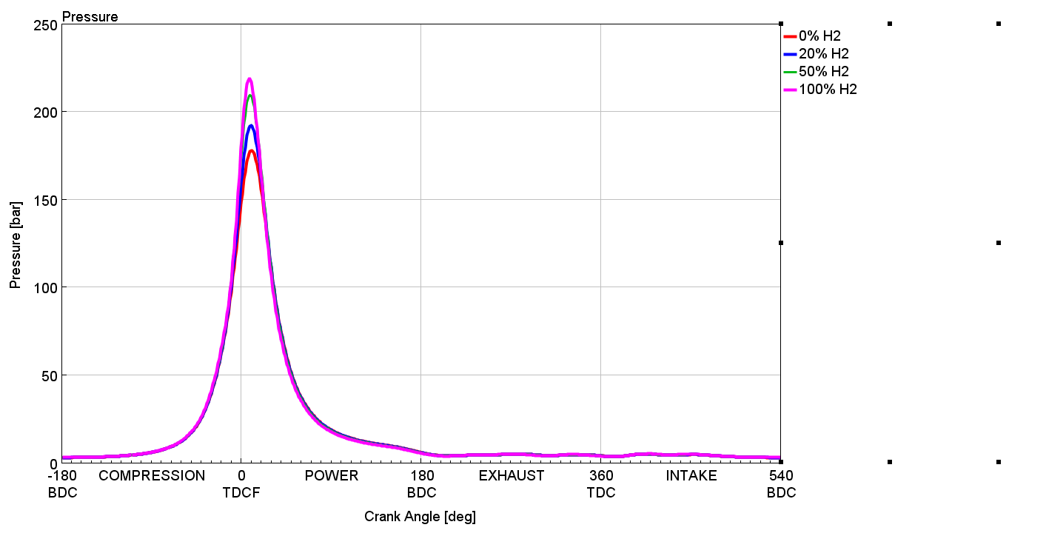
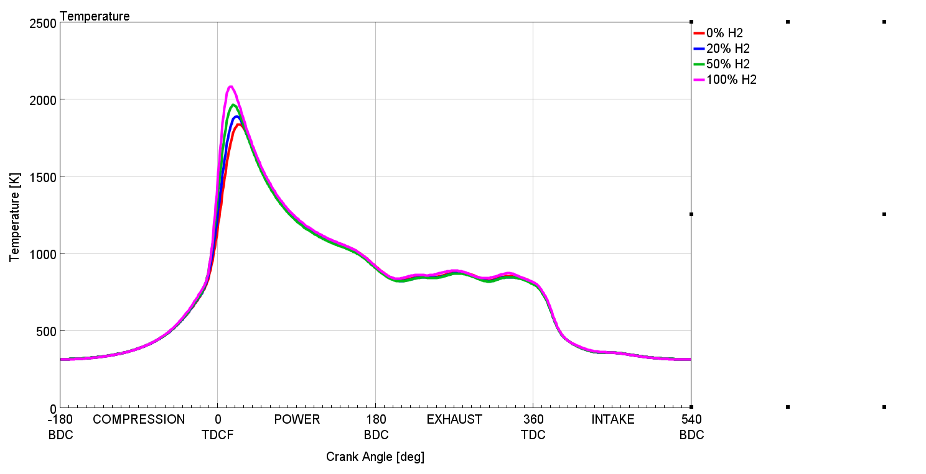
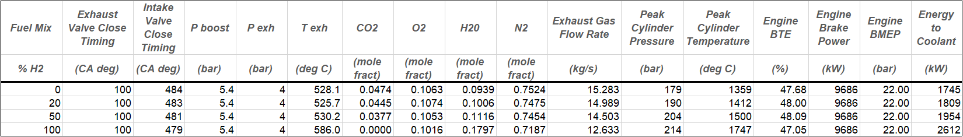
Fuel mixture sweeps at baseline conditions
Cylinder Pressure
GE Jenbacher J920 engine model
Operating conditions for fuel sweep
Inlet air: P = 5.4 bar, T = 320 K, dry air
Lambda = 2.13
Constant 22 bar BMEP
Exhaust Pressure = 4.0 bar
Results:
Addition of hydrogen increases cylinder pressures and temperatures, resulting in larger heat losses to coolant. This, along with advanced start of combustion, tend to limit the efficiency gains that are enabled by hydrogen’s faster combustion rate.
Cylinder Temperature
© 2019 Bechtel | 9

Slide 10
Model Results-Cam Duration DoE - 0% H₂, 5bar boost, 10bar BP
Results shown for cam duration DoE.
Intake duration: 198-322 deg.
Exhaust duration: 190-317deg.
IVO fixed at 330deg aTDC.
EVC fixed at 400deg aTDC.
CA50 and 10-90% burn duration from Bechtel.
0% H₂.
5 bar boost, 10 bar back pressure.
White line on graphs for ~14.7MW.
System efficiency includes:
Compressor power with 78% efficiency.
CAC available energy with 300 K reference state.
Exhaust available energy with 300 K reference state.
Energy to coolant including friction, cylinder and port heat transfer.
© 2019 Bechtel | 10

Slide 11
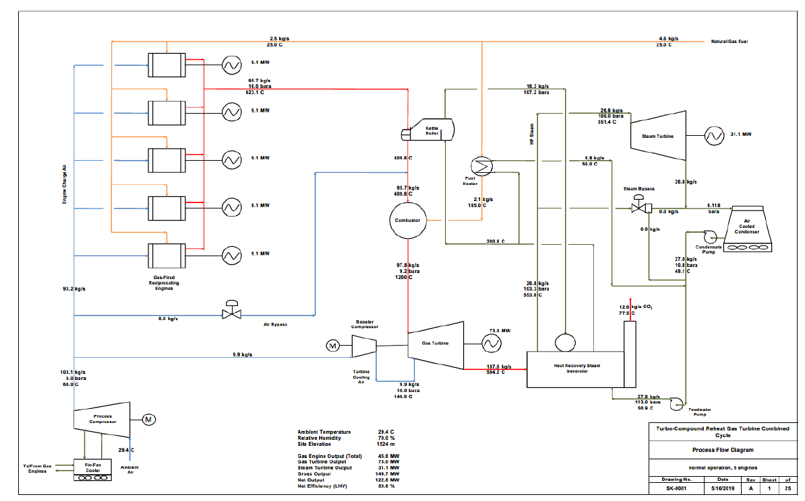
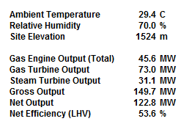
Design HMB – Hot & High

Slide 12
Heat & Mass Balance Cases
Normal operation, 5 engines at 100% load
Normal operation, 5 engines at 90% load
Normal operation, 5 engines at 80% load
Normal operation, 4 engines at 100% load
Normal operation, 3 engines at 100% load
Normal operation, 2 engines at 100% load
Normal operation, 2 engines, with main air compressor (MAC) supplying air to gas turbine (GT) combustor
Normal operation, 1 engine at 100% load
Normal operation, 1 engine, with MAC supplying air to GT combustor
Steam turbine (ST) bypass, 5 engines at 100% load
Cold startup, engines OFF, MAC bypass air (one-fifth) to GT combustor (firing to maximum exhaust temperature), ST bypass
Cold startup, engines OFF, MAC bypass air (one-fifth) to GT combustor (firing to 700C), ST bypass
Cold startup, engines OFF, MAC bypass air (one-fifth) to GT combustor, combustor firing to 650C, ST bypass
Cold startup, engines OFF, MAC bypass air (one-fifth) to GT combustor (firing to 600C), ST bypass
Cold startup, engines OFF, MAC bypass air (one-fifth) to GT combustor (firing to 500C), ST bypass
Cold startup, engines OFF, MAC bypass air (one-fifth) to GT combustor (firing to maximum exhaust temperature), ST in service
Cold startup, engines OFF, MAC bypass air (two-fifths) to GT combustor (firing to maximum exhaust temperature), ST bypass
Cold startup, engines OFF, MAC bypass air (two-fifths) to GT combustor (firing to maximum exhaust temperature), ST in service
Cold startup, 1 engine, MAC bypass air (one-fifth) to GT combustor (firing to maximum exhaust temperature), ST bypass
Cold startup, 1 engine, MAC bypass air (one-fifth) to GT combustor (firing to maximum exhaust temperature), ST in service
Normal operation, 5 engines at 100% load, kettle-type evaporator out-of-service
Normal operation, 5 engines at 100% load, 15°C ambient
Normal operation, 5 engines at 100% load, -18.2°C ambient
Normal operation, 5 engines at 100% load, 34.9°C ambient
© 2019 Bechtel | 12

Slide 13
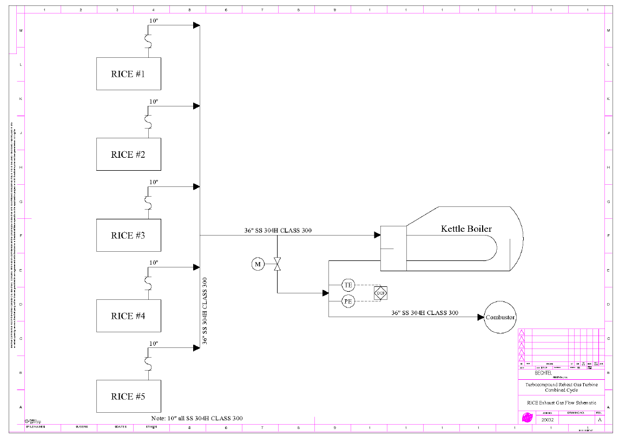
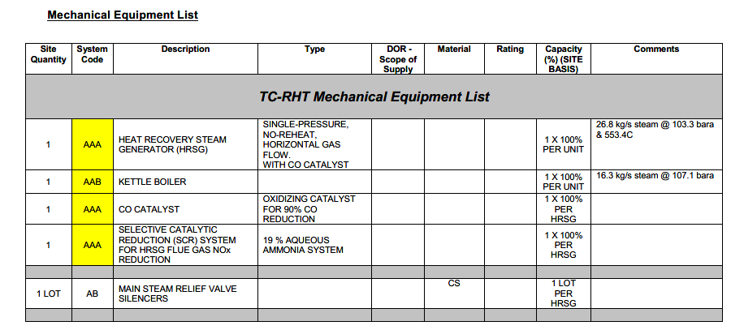
Mechanical – P&IDs
© 2019 Bechtel | 13

Slide 14
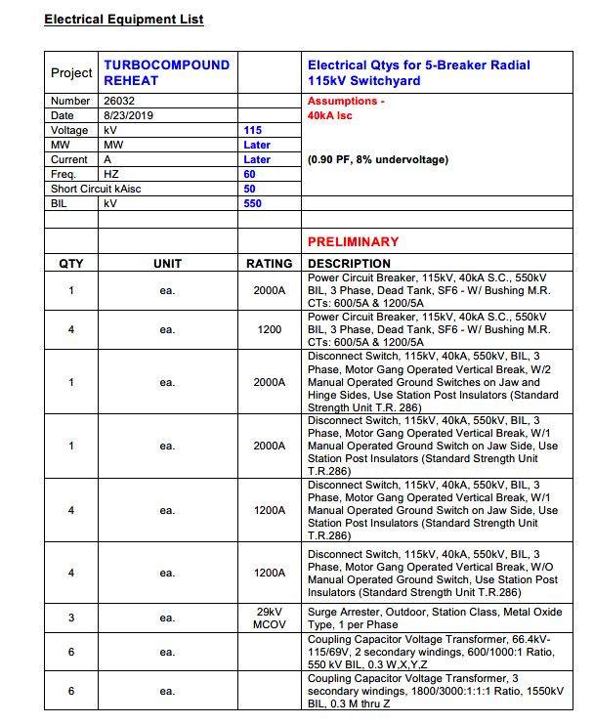
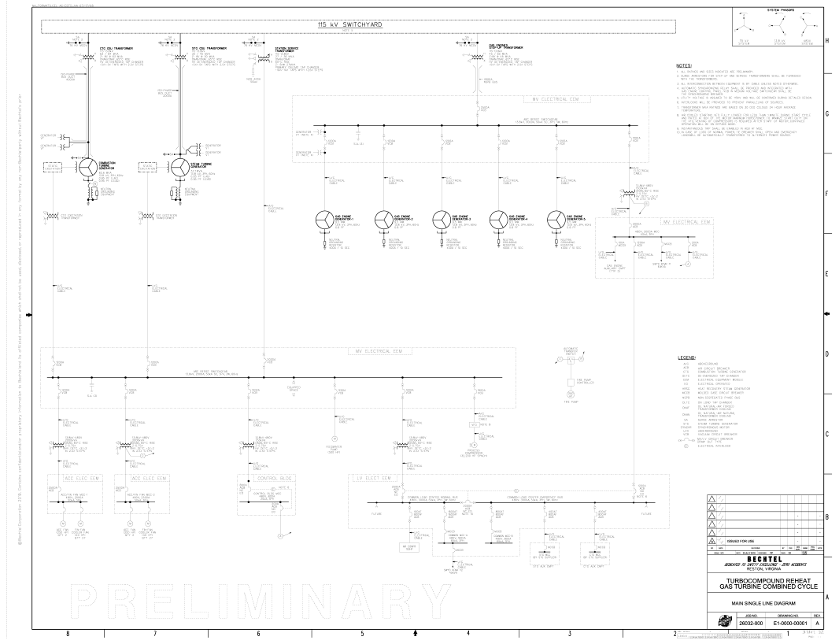
Electrical
© 2019 Bechtel | 14

Slide 15
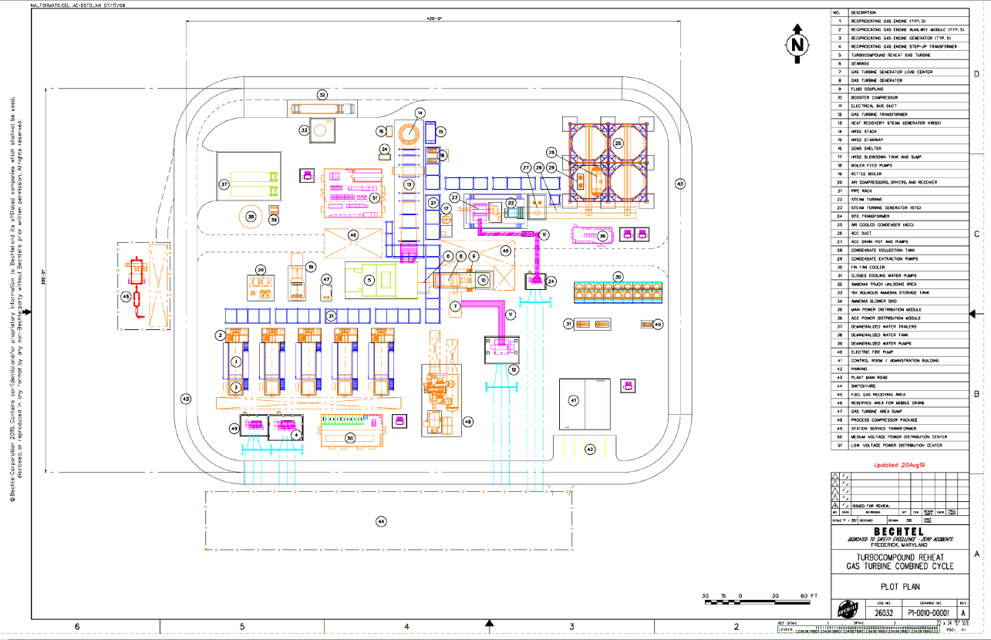
© 2019 Bechtel | 15

Slide 16
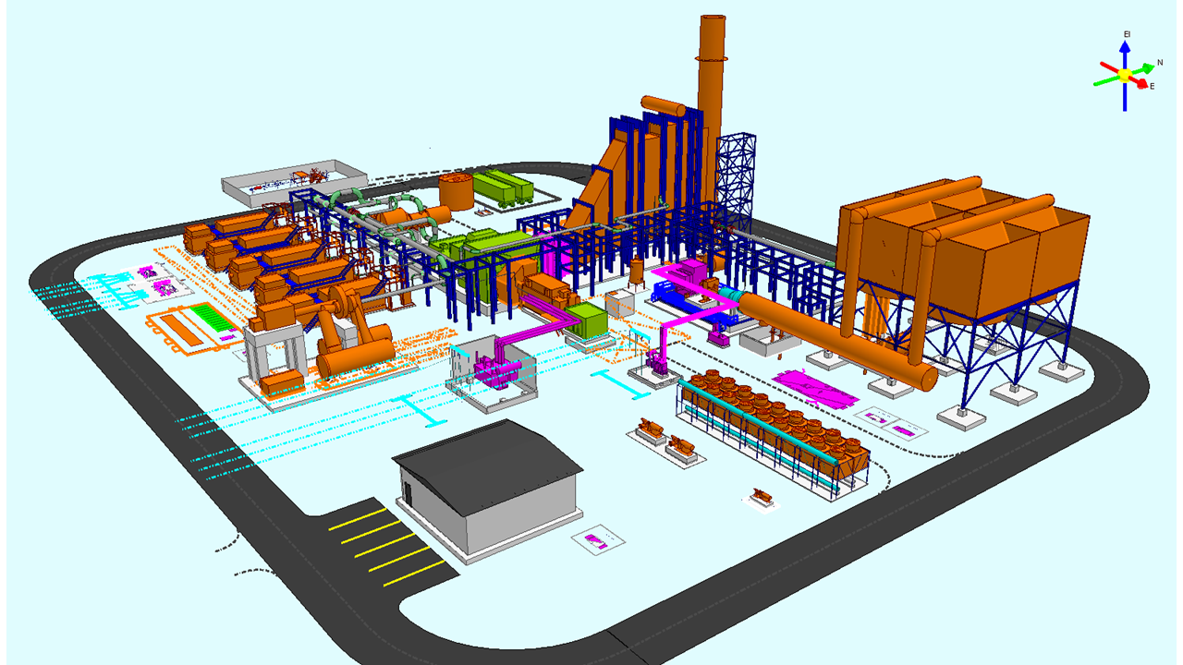
3D Model
© 2019 Bechtel | 16

Slide 17
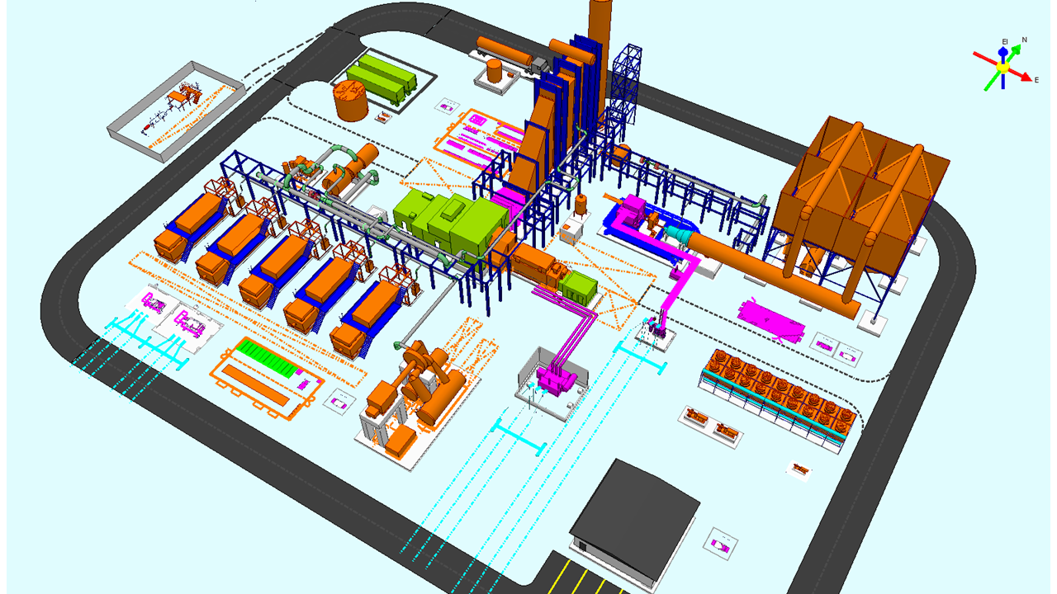
3D Model
© 2019 Bechtel | 17

Slide 18
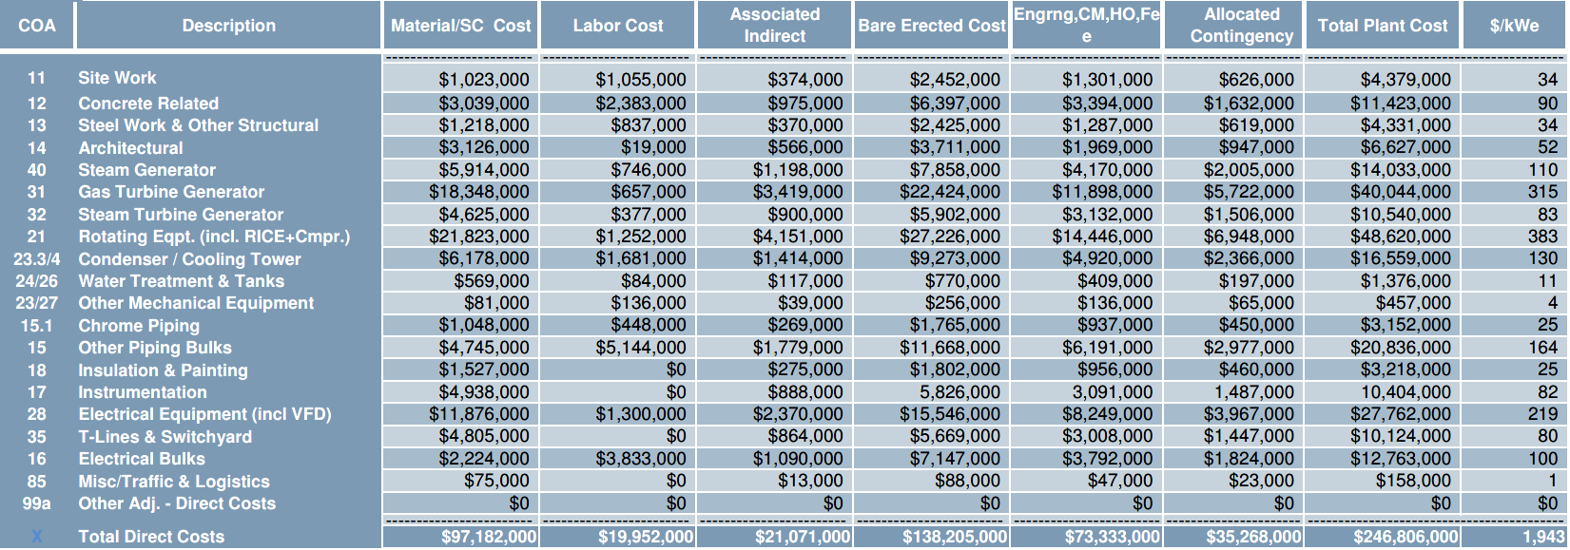
Total Installed Cost
Total Direct Cost, $117MM
Total Installed Cost, $170MM
Plus
Overhead (G&A) and Fees
Bare Erected Cost, $138MM
© 2019 Bechtel | 18

Slide 19
Comparison w/ Other Technologies (Nat Gas)
 |  | F Class |  | E Class |  | Recips
 | TCRHT-CC | 1x6FA.03 CC | 2x6FA.01 CC | 1x7E.03 CC | 1xSGT6-2000E | 13xJ920 | 12xJ920 CC
ambient temperature, F | 85 | 85 | 85 | 85 | 85 | 85 | 85
relative humidity, % | 70 | 70 | 70 | 70 | 70 | 70 | 70
barometric pressure, psia | 12.23 | 12.23 | 12.23 | 12.23 | 12.23 | 12.23 | 12.23
GE output, kW | 45,596 | 0 | 0 | 0 | 0 | 121,406 | 112,066
gas turbine output, kW | 73,024 | 64,297 | 84,844 | 68,047 | 78,058 | 0 | 0
steam turbine output, kW | 31,075 | 33,851 | 40,434 | 34,283 | 36,561 | 0 | 4,951
gross output, kW | 149,695 | 98,148 | 125,278 | 102,330 | 114,619 | 121,406 | 117,017
total aux load, kW | 26,929 | 2,278 | 2,888 | 2,324 | 2,638 | 2,564 | 2,654
fuel energy to GEs, kW | 124,957 | 0 | 0 | 0 | 0 | 257,402 | 237,603
fuel energy to combustor, kW | 104,263 | 182,559 | 229,468 | 204,659 | 240,265 | 0 | 0
total fuel energy input, kW | 229,220 | 182,559 | 227,576 | 204,659 | 240,265 | 257,402 | 237,603
plant net output, kW | 122,766 | 95,870 | 122,390 | 100,006 | 111,981 | 118,842 | 114,363
plant efficiency, LHV | 53.56 | 52.51 | 53.78 | 48.86 | 46.61 | 46.17 | 48.13
EPC contractor's cost, MM$ | 170.2 | 109.2 | 149.5 | 113.4 | 126.6 | 96.7 | 125.3
$/kW | 1,386 | 1,139 | 1,222 | 1,134 | 1,131 | 814 | 1,096
© 2019 Bechtel | 19

Slide 20
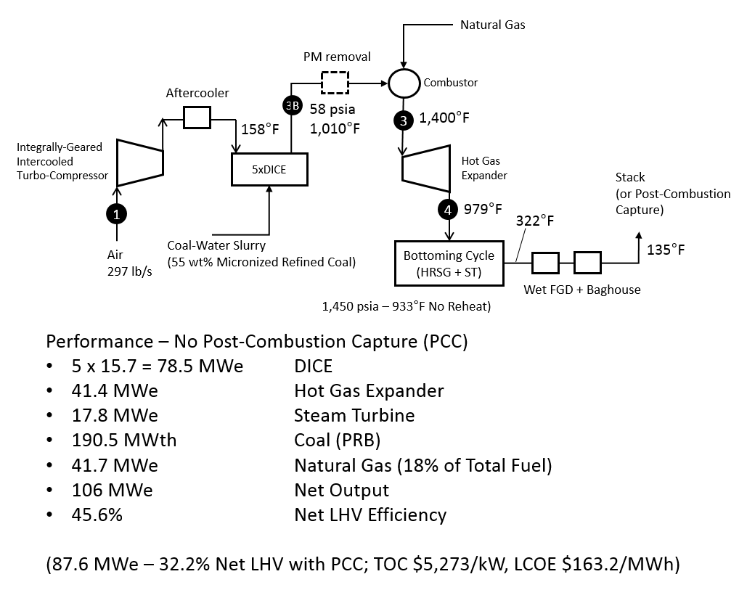
Coal-Fired Engines (DICE*)
*: Direct Injection Carbon Engine

Slide 21
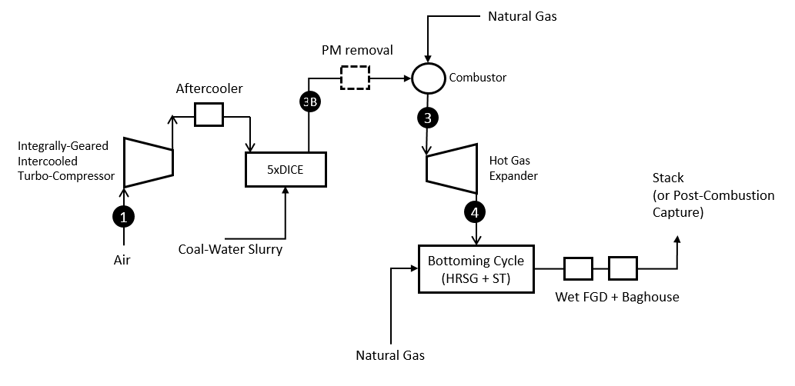
Energy Storage Ready
115 MWe – 42.4% Net LHV
In Generation Mode
With Capture!!
Storage Cavern

Slide 22
Phase I Findings
Compact, Modular & Flexible Power Plant
Conceptual Plant Design Complete
Technology Gap Analysis – Complete
Technology Maturity Plan – Complete
Phase II Test Plan – Complete
Huge Potential – Small/Flexible/Efficient/Modular Coal Firing

