Slide 1
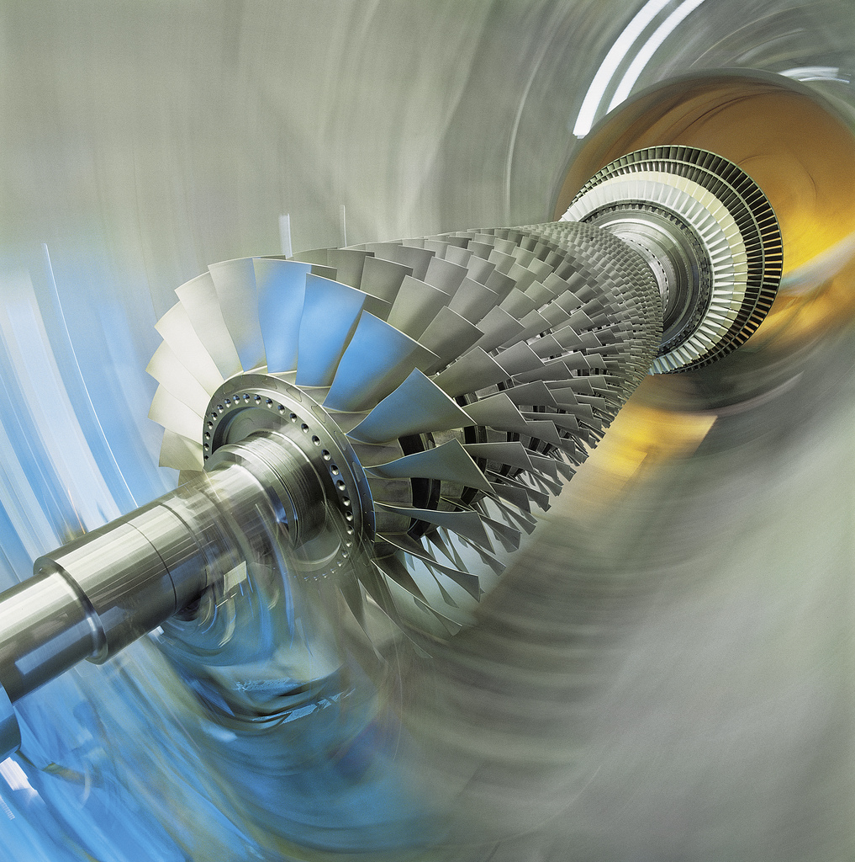
Analysis of Turbine Cooling Technologies to Increase NGCC Efficiency
Month Day, Year
Selcuk Can Uysal, PhD
Notes:
SubCLIN 202 Activity 005
Task 5-Final Meeting
Good afternoon, this presentation is about a study that is about the impacts of several turbine cooling technology improvements on NGCC efficiency. The details of this study will soon to be made available in a public report at NETL’s website.

Slide 2
Agenda
Objective
Introduction
Baseline Performance Metrics
Sensitivity Analysis
Techno-economic Analysis
Conclusion
Notes:
The presentation has 7 main sections; the objective of the study and introduction will be presented first. The integration process of CGTM to NGCC-Sim, validations, and determination of the baseline performance case will be presented next. Following that section, the results of the sensitivity analysis that led to determine the advanced blade configurations will be presented next. The techno-economic analysis that is used to select the best advanced blade configurations will be presented at the end.

Slide 3
Objective
This study aims to evaluate impacts on NGCC efficiency from general turbine cooling parameters such as:
  Various cooling configurations
  External blade cooling effectiveness
  Internal blade cooling effectiveness
  Material properties
  Thermal barrier coatings(TBCs)
The ultimate goal is to identify and evaluate cooling technologies that will lead to combined cycle efficiency of 65% and more
The model will also be able to analyze the effects of pressure gain combustion, and cooling of the coolant flow on NGCC performance
Notes:
The ultimate goal of this study is to quantify the turbine blade cooling improvements that will lead to combined cycle efficiency of 65% and more. Analyzed turbine cooling parameters are the external and internal blade cooling effectiveness, blade cooling configurations and material properties.

Slide 4
NGCC Simulation Development
Analysis Tool
An ASPEN Plus model (NGCC-Sim) has been developed in NETL for NGCC analyses¹
Cooled Gas Turbine Model (CGTM) is developed in MATLAB/Simulink and validated with H-Class GT data²
The NGCC Simulation with Cooled Turbine Analysis is developed by integrating CGTM into NGCC-Sim³
Steam cycle has been modified to give H-Class GT integrated NGCC performance (2x1 Configuration)³
1) National Energy Technology Laboratory (NETL), "Cost and Performance Baseline for Fossil Energy Plants Volume 1: Bituminous Coal and Natural Gas to Electricity," DOE/NETL-2019/1885, September 25, 2019, Pittsburgh, PA
2) Uysal, S.C., (2017), "Analytical Modelling of the Effects of Different Gas Turbine Cooling Techniques on Engine Performance, West Virginia University, Ann Arbor, MI
3) Uysal, S.C., (2019), “Sensitivity and Techno-Economic Analysis for Turbine Cooling Technologies for Higher Combined Cycle Efficiency “, NETL-PUB-22369
Notes:
An NGCC steady-state performance estimation model has been developed in NETL, which includes a combustion turbine model, steam cycle model that includes HRSG and steam turbines, an acid-gas regulator model and carbon capture system model. Cooled Gas Turbine Model is developed in MATLAB/Simulink and previously validated with H-Class gas turbine data, the details of which can be found in the referenced thesis and the TurboExpo paper. For this study, the CGTM was integrated into the NGCC model without carbon capturing to perform the indicated sensitivity analysis. The steam cycle parameters also been modified to give a typical H-Class GT integrated performance.

Slide 5
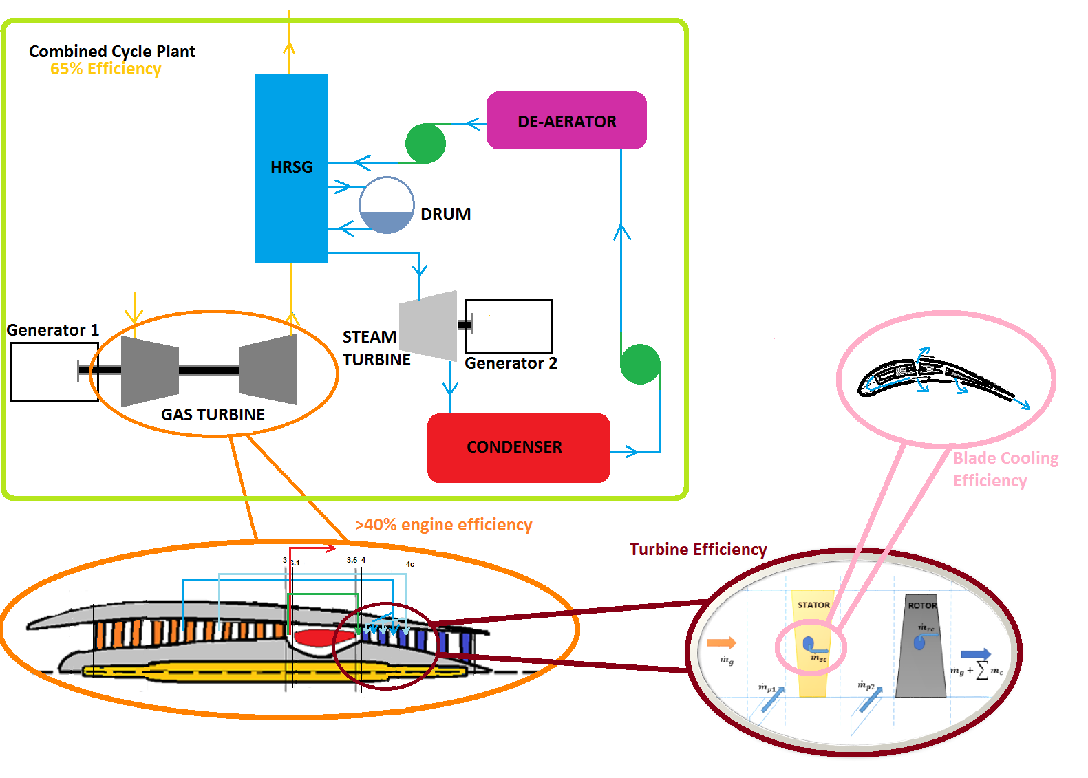
Introduction
Location of CGTM in CC Performance Calculations
Cooled Turbine Model
Cooled Gas Turbine Model
Notes:
In this illustration, the location of the cooled gas turbine model in the combined cycle performance model is summarized. Cooling models for various cooling techniques are used in the cooled turbine model, and this model is integrated into an engine performance calculation model called as “cooled gas turbine model”. This model is later used as a sub-system in the combined cycle plant simulation, where it produced required outputs to quantify the impacts of turbine cooling parameters.

Slide 6
NGCC Simulation Development
Calibration of the NGCC-Sim and Determining the Baseline CC Performance
Validation of the integrated model was made by comparing the simple cycle performance outputs and comparing the steam cycle parameters with publicly available H-Class data
Some of the CC component parameters were also compared with publicly available data for calibration^{A}
Parameter | NGCC-Sim (with CGTM) | Data for H-Class NGCC^{B, C}
B31A BB-Midwest Ambient Conditions in 2x1 Conf.
Combustion Turbine Power [MWe] | 684 | 686
Steam Turbine Power [MWe] | 338 | 325
CC Total Gross Power [MWe] | 1022 | 1011
CC Net Heat Rate (lower heating value [LHV] Based) [Btu/kWh] | 5506 | 5480
LHV Combustion Turbine Efficiency [%] | 42.2 | 42.2
Steam Turbine Cycle Efficiency [%] | 40.4 | <43.6
CC Net Plant Efficiency [%] | 62.0 | 62.3
^{A}Uysal, S.C., (2019), “Sensitivity and Techno-Economic Analysis for Turbine Cooling Technologies for Higher Combined Cycle Efficiency “, NETL-PUB-22369
^{B}Data from G. T. World, "2016 GTW Simple Cycle Specs," Gas Turbine World 2016 Performance Specs, pp. 10-20, 1 February 2016
^{C}Data (used for STF-D650 steam turbine) from General Electric, "GE Combined Cycle Steam Turbines Fact Sheet," GE Power, Atlanta, GA, 2018
Notes:
The calibration of the new NGCC-Sim was made by using several NGCC performance parameters obtained from vendors and public sources. Comparison used in the calibration is shown for an H-Class gas turbine integrated NGCC plant, where the compared performance parameters are within acceptable tolerance levels.

Slide 7
Baseline Performance Metrics
Baseline performance metrics were determined for the H-Class engine scenario used in the calibration study
Auxiliary load calculations follow the methodology used in NETL Bituminous Baseline Reports for NGCC*
Calculations were based on 85% plant capacity factor
Calculated baseline plant net CC efficiency(LHV based) is 62.0% for 2x1 H-Class GT NGCC Plant
*National Energy Technology Laboratory (NETL), "Cost and Performance Baseline for Fossil Energy Plants Volume 1:
Bituminous Coal and Natural Gas to Electricity," DOE/NETL-2019/1885, September 25, 2019, Pittsburgh, PA
Notes:
Baseline performance metrics are used in the following sections of the study to quantify the improvements to NGCC performance from advanced cooling features. The baseline performance is determined such that it would represent the current NGCC performance metrics with H-Class gas turbines. Calculations based on 85% plant capacity factor and the baseline LHV combined cycle efficiency is calculated to be 62%.

Slide 8
Baseline Performance Metrics
Performance
Summary
Parameter | Value
Combustion Turbine Power, MWe | 684
Steam Turbine Power, MWe | 338
Total Gross Power, MWe | 1,022
CO₂ Capture/Removal Auxiliaries, kWe | 0
CO₂ Compression, kWe | 0
Balance of Plant, kWe | 17,712
Total Auxiliaries, MWe | 18
Net Power, MWe | 1,004
LHV Net Plant Efficiency, % | 62.0%
LHV Net Plant Heat Rate, kJ/kWh (Btu/kWh) | 5,809 (5,506)
LHV Combustion Turbine Efficiency, % | 42.2%
Steam Turbine Cycle Efficiency, % | 40.4%
Steam Turbine Heat Rate, kJ/kWh (Btu/kWh) | 8,908 (8,443)
Condenser Duty, GJ/hr (MMBtu/hr) | 1,717 (1,628)
Acid Gas Removal (AGR) Cooling Duty, GJ/hr (MMBtu/hr) | – (–)
Natural Gas Feed Flow, kg/hr (lb/hr) | 123,578 (272,442)
HHV Thermal Input, kWt | 1,795,147
LHV Thermal Input, kWt | 1,620,297
Raw Water Withdrawal, (m³/min)/MW_{net} (gpm/MW_{net}) | 0.013 (3.5)
Raw Water Consumption, (m³/min)/MW_{net} (gpm/MW_{net}) | 0.010 (2.7)
Notes:
The performance summary items are listed for the baseline 2x1 H-Class gas turbine integrated NGCC plant, which produces 1004 MW of net power, with 18 MW auxiliary load. Gas turbine efficiency is 42.2%, steam turbine efficiency is 40.4% and net plant LHV efficiency is 62%.

Slide 9
Sensitivity Analysis
The sensitivity analysis was made for the impact of several turbine cooling parameters on the gas turbine, steam cycle, and combined cycle performance parameters
Analysis inputs were the following turbine cooling parameters
  Blade metal material properties (through Biot number and max. allowable metal temperature)
  TBC material properties (through TBC Biot number)
  Internal cooling effectiveness
  Film cooling effectiveness
  Purge cooling flow fractions and distribution
Notes:
The sensitivity analysis investigated the effects of several turbine cooling parameters on the gas turbine, steam turbine and combined cycle parameters. Blade metal material properties, TBC material properties, internal and external cooling effectiveness, purge cooling fraction and distribution are the analysis input parameters.

Slide 10
Sensitivity Analysis
Performance Parameters Used in the Analysis
Parameter | Unit
Gas Turbine (H-CGT)
Shaft Power Output | kW
Heat Rate (LHV Based) | Btu/kWh
Thermal Efficiency (LHV Based) | %
HRSG (H-STMCYC)
Inlet Temperature | °F
Condenser Duty | MMBtu/hr
Steam Turbine (H-STMCYC)
Shaft Power Output | kW
Heat Rate | Btu/kWh
Thermal Efficiency | %
Power Plant Performance and Emissions
Stack Temperature | °F
Balance of Plant (Total Auxiliaries) | kW
H₂O Withdrawal | gpm/MW_{net}
H₂O Consumption | gpm/MW_{net}
CO₂ Emission | Ton/yr
Net Power | MW
LHV Net Plant Heat Rate | Btu/kWh
LHV Net Plant Efficiency | %
Notes:
The combined cycle performance parameters that are used in the analysis are selected as listed in this slide. The parameters are selected from the NGCC-Sim outputs that reflect the key performance metrics and also the ones that strongly affect the cost calculations.

Slide 11
Sensitivity Analysis
Effect of Individual Cooling Parameters
Gas turbine cooling parameters used in this part of the study were determined in accordance with the previous sensitivity analysis made for gas turbines
The baseline reference values are in accordance with the parameters used in a study by Wilcock et al.* for “advanced turbine cooling technology” levels
The upper limits were determined by considering the values given as “super-advanced technology” by Wilcock et al.*
The negative limits were used to analyze the impact of operational conditions on the performance
Parameter | Description | Related Component | Reference Value for Baseline | Change Limits
Bi_{m} | Metal Biot Number | Blade Material | 0.15 | ±13.3%
T_{b, max} | Maximum Metal Temperature |  | 1990 °R | ±3.01%
Bi_{TBC} | TBC Biot Number | TBC Material | 0.31 | ±64.5%
ε_{c} | Internal Cooling Flow Effectiveness | Blade Internal Cooling | 0.65 | ±30.8%
ε_{fc} | Blade Film Cooling Effectiveness | Blade External Cooling | 0.341 | ±44.0%
Purge% | Purge Flow Cooling Fraction | Turbine Inter-Stage Cooling, Rim/Seal Cooling | 0.5% | ±40.0%
*R. C. Wilcock, J. B. Young and J. H. Horlock, "The Effect of Turbine Blade Cooling on the Cycle Efficiency of Gas Turbine Power Cycles," Journal of Engineering for Gas Turbines and Power, vol. 127, pp. 109-120, 2005..
Notes:
The turbine cooling parameters used in the analysis are listed with their reference values for the baseline performance case and their change limits. The limits are determined from a study by Wilcock et al. that the cooled turbine model algorithm is based on. Upper limits are determined from this study for “super-advanced technology” levels, and negative limits are used to include the impact of operational conditions.

Slide 12
Sensitivity Analysis
Effect of the Metal Biot Number
Metal Biot number is higher if blade metal wall thickness is higher, which requires more coolant to cool the blade to design temperature (negative impact on performance)
Baseline
Baseline
%0.35
%0.12
%0.3
Notes:
The first parameter related to the blade metal material properties is the Metal Biot number, which is higher when the blade metal wall thickness is high, that causes more coolant to be used to cool the blade. As the metal Biot number is reduced, increased cooling performance causes gas turbine and power plant performance to increase.

Slide 13
Sensitivity Analysis
Effect of the TBC Biot Number
TBC Biot number is higher if the TBC material conductivity is low, and/or the coating thickness is high. The higher the TBC Biot number, the better the insulation of the blade (positive impact on performance)
Baseline
Baseline
%2.40
%2.34
%1.66
%1.7
Notes:
TBC is used to form an insulation layer over the blade to protect it from the hot gas flow. As the TBC Biot number is increased through using a lower conductivity material and/or increasing the coating thickness, the increased insulation performance results in an increase in the gas turbine and power plant performance. The steam turbine performance is also increased, although not as pronounced as the gas turbine.

Slide 14
Sensitivity Analysis
Effect of the Design Maximum Blade Metal Temperature
Design maximum blade metal temperature represents the highest allowable metal temperature of the blade metal to operate safely within thermal and mechanical stress limits. Higher temperatures can be achieved with advanced alloy materials and production techniques
Baseline
Baseline
%4.49
%4.5
%3.1
%3.19
Notes:
Design maximum blade metal temperature is high for the advanced materials that can operate safely in elevated hot gas temperatures. This is the second parameter that is related to blade materials and increasing of this limiting value means reduction in coolant flow requirements and allows an increase in the gas turbine exit temperature. Therefore, increasing the value improves the gas turbine, steam turbine and power plant efficiencies.

Slide 15
Sensitivity Analysis
Effect of the Internal Cooling Flow Effectiveness
Internal cooling effectiveness is higher in advanced blade internal cooling designs. The higher the effectiveness, the more effective the usage of the coolant to cool the blade → lower coolant requirements (positive impact on performance)
Baseline
Baseline
%2.98
%2.98
%2.04
%2.09
Notes:
Advanced internal cooling designs that have higher effectiveness values use coolant effectively when cooling the blade from the inside. Reduction of the coolant requirements improves the gas turbine efficiency through reducing the cooling related losses at the turbine and allows for higher turbine exit temperatures. Overall impact is an increase in the steam turbine and power plant efficiencies.

Slide 16
Sensitivity Analysis
Effect of the Film Cooling Effectiveness
Film cooling effectiveness is higher in advanced external cooling designs that features advanced cooling holes. The higher the effectiveness, the more effective the usage of the coolant to cool the blade surface → lower coolant requirement (positive impact on performance)
Baseline
Baseline
%5.64
%5.64
%0.4
%3.96
%3.98
Notes:
Advanced cooling holes and effective distribution of them over the blade increases the blade film cooling effectiveness, which means more effective usage of the coolant flow to cool the blade surface. Reduced coolant requirements cause the gas turbine performance to increase, which results in an increase in the power plant performance. Steam turbine performance is also increased, due to the slight increase of the turbine exit temperature from less coolant mixing to the flow.

Slide 17
Sensitivity Analysis
Effect of the Purge Cooling Flow Fraction
Purge cooling is primarily used to cool the rims and seals of turbine blades. The higher the flow fraction, the more flow mixing in the turbine → lower turbine efficiency (negative impact on performance)
Baseline
Baseline
%2.26
%2.25
%0.6
%1.69
%1.71
Notes:
Purge cooling is a supplemental cooling system that is primarily used to cool the rims and seals of the turbine blades, where the highest thermal and structural stresses occur. Excess air from this cooling is injected to the main stream to further cool down the hot gas flow before it encounters with the blades. Increasing the rim/seal cooling effectiveness reduces the purge fraction that need to be used, which impacts the gas turbine performance positively due to reduced flow mixing losses. Reduced purge fraction also improves the steam turbine and power plant performance.

Slide 18
Sensitivity Analysis
Effect of the Purge Cooling Flow Distribution
The relative amounts of the purge cooling fractions used in the stator and rotor sections are important because of the impact on the pressure distribution of the turbine stage. Stator-front favored injection is better for turbine performance
Notes:
In CGTM, the purge cooling flow is assumed to be mixed with the main stream at two locations: first being at the location in front of the stators and second one being the location after the stators and before the rotors. In this part of the sensitivity analysis, the total purge fraction per stage is kept constant at 1% but the distribution of the purge cooling is changed between two locations. The impact to the gas turbine and power plant efficiency is not calculated as significant as for the flow fractions, but the stator front favored injection gave better performance due to reduced flow mixing losses at the rotor station.

Slide 19
Sensitivity Analysis
Sensitivity for Plant Thermal Efficiency
Impact Strength: Advanced Metals > Film Cooling Eff. > Int. Cooling Eff. > Purge Fraction > Advanced TBC
Notes:
In this sensitivity chart, the impacts from the analysis parameters are compared for their impact on Lower Heating Value NGCC efficiency. Note that higher slopes mean higher impact strength from that analysis parameter. The impact to net plant efficiency follows the same trend with the gas turbine and being highest from the advanced metals, followed by the advanced film and internal cooling effectiveness, purge fraction and advanced TBC materials.

Slide 20
Sensitivity Analysis
Sensitivity of Other Performance Metrics
Impact Strength:
1.Advanced Metals
2. Film Cooling Eff.
3. Int. Cooling Eff.
4. Purge Fraction
5. Advanced TBC
Impact Strength:
1.Advanced Metals
2. Purge Fraction
3. Film Cooling Eff.
4. Int. Cooling Eff.
5. Advanced TBC
Notes:
The sensitivity of other performance metrics such as the gas turbine efficiency, power plant CO2 emissions, and steam cycle performance are also analyzed. For the gas turbine efficiency and power plant CO2 emissions, the impact strengths rank same with the previous sensitivity cases. However, purge cooling fraction has more impact on the steam cycle due to its stronger impact on the gas turbine exit temperature than cooling effectiveness and advanced TBC materials.

Slide 21
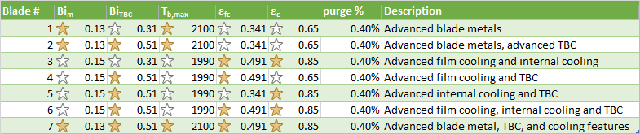


Techno-economic Analysis
Determination of Blade Configurations for 65% CC Efficiency
Based on the results of the sensitivity analysis, 7 different cooled turbine blade configurations were determined
Each configuration is a combination of advanced cooling features
Each configuration provides minimum 65% LHV net CC efficiency at Midwest (ISO) conditions
indicates an advanced feature
indicates same value with baseline
Notes:
The results of the sensitivity analysis are used to determine 7 different cooled blade configurations that yield 65% combined cycle efficiency at Midwest ISO conditions. Each configuration is generated by using a combination of advanced features, with the parameter values determined from the sensitivity charts of the previous section. Yellow stars indicate which advanced features has been used to determine the advanced blade configurations, whereas white stars indicate the cooling technology is the same with H-Class baseline levels.

Slide 22
Techno-economic Analysis
Used Methodology and Assumptions
A cost estimation analysis was run for each case
The Quality Guidelines for Energy System Studies ( QGESS) method¹ was used for cost estimation by using the “BBR4 Cost Spreadsheet Rev. E” template
The cost spreadsheet currently has rev.3 values for raw capital cost data
A cost scaling was made by using the QGESS Scaling Methodology² for the H-Class Baseline configuration from F-Class (rev.4) values
Another cost scaling from H-Class Baseline to advanced blade configurations was made by using the QGESS method
Bare Erected Costs with Blade-1
Bare Erected Costs with Blade-n
H-Class Baseline Bare Erected Costs
F-Class Baseline Bare Erected Costs
…
Gerdes K. , Summers W. M. and Wimer J., (2011), “Cost Estimation Methodology for NETL Assessments of Power Plant Performance”, DOE/NETL-2011/1455
Turner M.J., and Pinkerton L.L., (2013), “Capital Cost Scaling Methodology”, DOE/NETL-341/013113
Notes:
The increase in performance from each advanced configuration is a direct result from the sensitivity analysis, however the relative advantage to power plant costs and cost of electricity from using these blades can be quantified by using a techno-economic analysis. NETL has developed a cost estimation methodology, which is known as the QGESS method. As of the time of doing this study, baseline cost spreadsheets were based on F-Class gas turbine costs for raw capital cost data, therefore a cost scaling is made to obtain the baseline plant costs for H-Class gas turbine using plants. The raw capital costs for each blade configuration is then obtained from the baseline H-Class plant costs by using the relative increase in certain power plant parameters from using each of the advanced blade options.

Slide 23
Techno-economic Analysis
Used Methodology and Assumptions (cont’d)
The engineering, development, and material costs of the advanced blades were assumed to be included in the scaled “Combustion Turbine Equipment Cost” from the baseline performance
The following outputs were calculated and compared for each blade configuration
  Cost of Electricity (COE)
  Total Overnight Costs (TOC)
  Total As-Spent Costs (TASC)
  Owner’s Costs and Cost Breakdown
  Operating Costs and Cost Breakdown
The following sensitivities were investigated for each configuration
  Natural Gas Fuel Price
  Power Plant Capacity Factor
Notes:
In this study, the engineering, development and material costs of the advanced blade configurations are assumed to be included in the scaled “combustion turbine equipment costs”, which is scaled by using the gas turbine power output as the scaling parameter. Cost of electricity, total overnight costs, total as spent costs, owner’s costs and operating costs are the compared costs for each blade configuration. Natural gas fuel price and power plant capacity factor sensitivities for each configuration are also studied.

Slide 24
Thermo-economic Analysis
Cost of Electricity (COE)
41.9
38.8
37.3
37.4
37.0
36.9
36.9
36.6
36.1
Cost of Electricity : Blade 7 < Blade 6 < Blade 4 < Blade 3 < Blade 2 < Blade 1 < Blade 5
Notes:
The cost of electricity calculated for each blade configuration is compared in this slide. The lowest cost of electricity is obtained with blade 7 and 6, whereas blades 5 and 1 provide the least improvement from H-Class baseline values. Overall, the advanced blade configurations provide 1.4 to 3 dollars per megawatt hour reduction in the cost of electricity.

Slide 25
Thermo-economic Analysis
Total Overnight Cost (TOC) and Total-as-Spent Cost (TASC)
TOC and TASC: Blade 5 < Blade 1 < Blade 3 < Blade 2 < Blade 4 < Blade 6 < Blade 7
Notes:
Owner’s Costs breakdown is made for the total overnight cost and compared for each configuration with the H-Class baseline values. The ranking of the TOC and TASC follows the opposite order with the cost of electricity; blades 5 and 1 give the lowest costs whereas blades 6 and 7 require higher plant costs, which makes them the most expensive in comparison.

Slide 26
Thermo-economic Analysis
Total Overnight Cost Margin and Cost Breakdown
TOC margin is determined for the total plant cost upper degree of freedom to have at least H-Class baseline COE values ($38.8/MWh)
25.3%
17.1%
19.9%
13.5%
16.8%
16.9%
12.5%
Notes:
Total Overnight Cost margins are determined for each blade configuration to understand how much the gas turbine price could increase to have cost of electricity less than or equal to the current H-Class machines. The price increase in this part of study is assumed only for the costs related to using an advanced turbine with the indicated blade options. For example for Blade 7, 25.3% increase in the gas turbine cost brings the cost of electricity to baseline H-Class values, whereas for Blade 1 the same amount of increase in the plant costs could result in higher cost of electricity than the current H-Class engines.

Slide 27
Thermo-economic Analysis
Sensitivity of COE on Natural Gas Price
Study Base Price Level ($3.78/MMBtu)
$\frac{∂COE}{∂NG Price}$ : Blade 7 < Blade 6 < Blade 2 < Blade 3 < Blade 4 < Blade 1 < Blade 5
Notes:
In order to have the highest profit from the power plant, the cost of electricity from that plant should be impacted less from the natural gas price changes. NG Price sensitivity is directly related to the power plant thermal efficiency and therefore the plant using the gas turbines with Blade 7 is the least sensitive to the natural gas price, whereas the plant using Blade 5 is being the most sensitive. The rankings are obtained by comparing the slopes of the sensitivity graphs.

Slide 28
Thermo-economic Analysis
Sensitivity of COE on Plant Capacity Factor
$\frac{∂COE}{∂Capacity Factor}$ : Blade 7 < Blade 6 < Blade 3 < Blade 4 < Blade 2 < Blade 1 < Blade 5
Notes:
Another important parameter for the cost of electricity is the plant capacity factor, which is the fraction of the total electricity that would be generated if the plant operated at full load without interruption. Interruptions during the operations are inevitable but it is desired to have the least impact to the cost of electricity from this fact. For the power plants with the gas turbines having blades 7 and 6, such sensitivity to the capacity factor is the lowest, whereas the sensitivity is the highest for the cases with blades 1 and 5.

Slide 29
Conclusion
Sensitivity analysis was made for CC performance parameters and the ranking of the impacts of turbine cooling parameters followed the same trend with the GT sensitivity:
7 different advanced blade configurations were determined for 65%+ CC efficiency
Techno-economic analysis was made for 7 blade configurations to find the best possible configuration
Advanced Metals > Film Cooling Eff. > Int. Cooling Eff. > Purge Fraction > Advanced TBC
Notes:
Sensitivity analysis with gas turbine cooling parameters showed that the highest impact to power plant efficiency comes from advanced blade materials, then from advanced film cooling techniques, internal cooling techniques, purge effectiveness and advanced TBC materials. Based on the results of the sensitivity analysis, 7 different advanced blade configurations were determined. A thermo-economic analysis was made for the 7 blade configurations to find the best possible configuration.

Slide 30
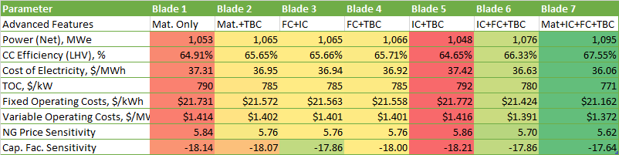
Conclusion(cont’d)
Overall Rank: 6 5 3 4 7 2 1
The top 3 best configurations feature advanced film cooling and advanced internal cooling together (blades 3, 6, and 7)
Between advanced TBC materials and advanced internal cooling, the latter provides more improvement (blades 3 and 4)
Advanced internal and external cooling features also increase operating costs due to increased maintenance and production costs
Notes:
From the comparison of the power plant performance and thermo-economic analysis parameters, the top 3 best blade configurations are blades 7, 6 and 3 where advanced film cooling and internal cooling features exist together. From the comparison of the Blades 3 and 4, it can be said that advanced internal cooling provides more improvement than advanced TBC materials. However, the best blade configurations also have the highest operating costs which are mainly due to increased maintenance and production costs.

Slide 31
Questions/Comments
Month Day, Year
Notes:
Thank you for your attention, I would be glad to answer your questions now.

