Slide 1
Existing Plants – Fleet Assessment
2019 Annual Project Review Meeting for Crosscutting, Rare Earth Elements, Gasification and Transformative Power Generation
Jeff Hoffmann, Systems Engineering & Analysis Directorate
April 9, 2019

Slide 2
Briefing Outline
Coal Fleet Trends
Diversity in Coal Plant Design and Operation
Diversity in Electricity Markets
Coal Plant Retirements
Closing Thoughts

Slide 3
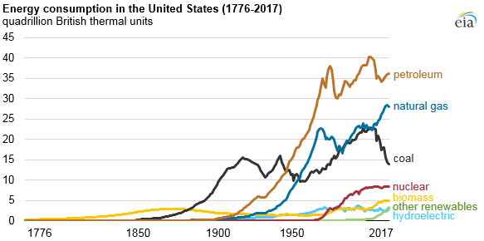
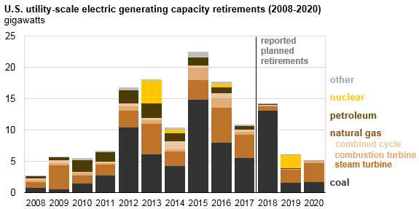


Recent Trends of the U.S. Coal Fleet
Annual Average Capacity Factor of the U.S. Coal Fleet, 1998-2018
Impact on Coal Fleet
Update
reported
planned
retirements
Owners’ Response
Decreasing coal-based electricity generation has driven retirement of uneconomic assets
Credits: Left – EIA, Petroleum, natural gas, and coal still dominate U.S. energy consumption, https://www.eia.gov/todayinenergy/detail.php?id=36612
Top Right - NETL analysis of EIA data
Bottom Right -EIA, Almost all power plants that retired in the past decade were powered by fossil fuels, https://www.eia.gov/todayinenergy/detail.php?id=34452, 2018 and 2019 updated with current EIA Data (Preliminary Monthly Electric Generator Inventory, January 2019)

Slide 4
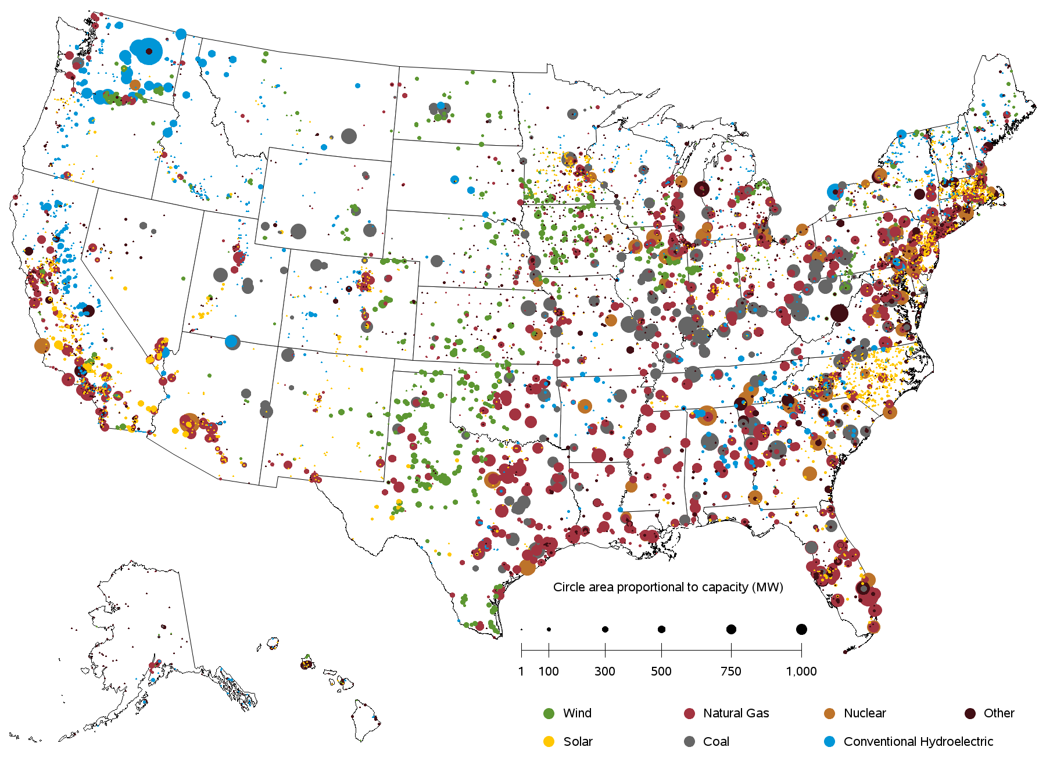
Changing Generation Mix
2018 Installed Electricity Generating Capacity
% Share of ~1,200 GW
Operable Utility-Scale Generating Units (as of January 2019)
Coal
Coal, 23%, ~270 GW
Nuclear
Natural Gas
All Other
Conv. Hydro
Nuclear, 9%, ~110 GW
Wind
Solar
NG, 44%, ~520 GW
2018 Annual U.S. Electricity Generation
Net Generation, Thousand MWh
Credits: Top Left – Adapted from OE Energy Market Snapshot, National – Data through October 2018, FERC Office of Enforcement, November 2018
Bottom Left – NETL analysis of monthly data as provided in EIA’s Electricity Data Browser
Right -EIA, https://www.eia.gov/electricity/data/eia860M/ (Release Date March 26, 20`9)

Slide 5
Monthly Data Provide Greater Insight
Summer Peaks
Winter Peaks
Net Generation
Coal
Spring/Fall Valleys
Nuclear
Natural Gas
Net Generation, Thousand MWh
All Other
Conv. Hydro
Wind
Solar
Source: NETL analysis of monthly data as provided in EIA’s Electricity Data Browser

Slide 6
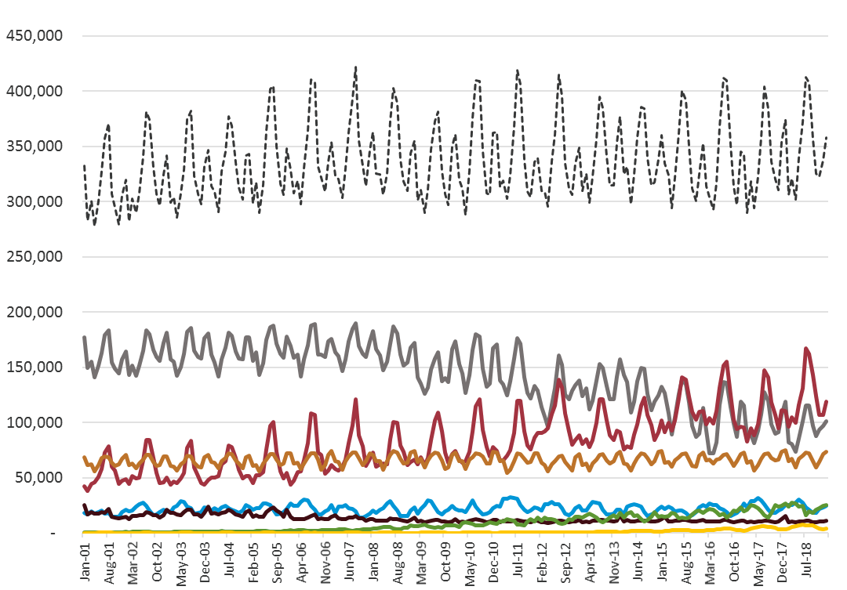
Coal Relatively Stable Through 2008
Net Generation
Coal
Nuclear
Natural Gas
All Other
Conv. Hydro
Wind
Net Generation, Thousand MWh
Solar
Source: NETL analysis of monthly data as provided in EIA’s Electricity Data Browser

Slide 7
Coal Decline Starts 2009 and Continues
Net Generation
Coal
Nuclear
Natural Gas
All Other
Conv. Hydro
Wind
Net Generation, Thousand MWh
Solar
Source: NETL analysis of monthly data as provided in EIA’s Electricity Data Browser

Slide 8
Renewable Variability is Interesting
Net Generation
Coal
Nuclear
Natural Gas
All Other
Conv. Hydro
Wind
Spring Peaks
Net Generation, Thousand MWh
Solar
Summer Valleys
Source: NETL analysis of monthly data as provided in EIA’s Electricity Data Browser

Slide 9
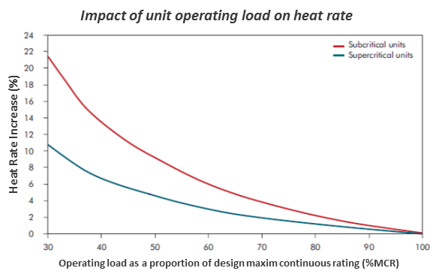
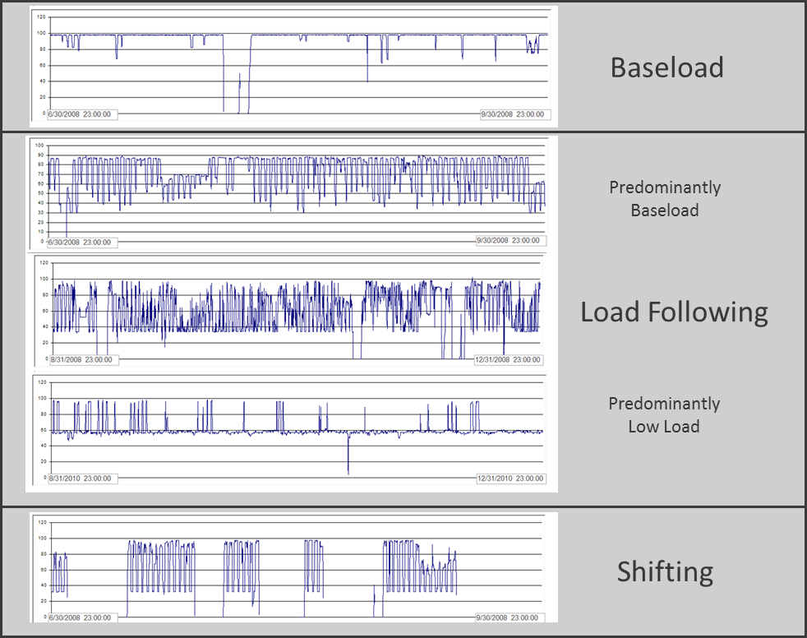
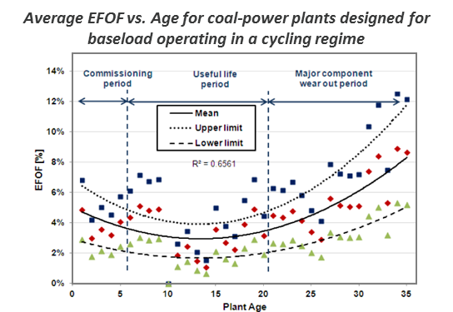
Utilization Trends of the Existing Fleet
Power Plant Operating Profiles
Credits: Left – Analysis of unit-level hourly output
Top Right – Adapted from IEA Coal Industry Advisory Board, Power Generation from Coal, 2010
Bottom Right – Adapted from European Technology Development Ltd, Impacts of Cyclic Operation on Maintenance Programs

Slide 10
Observations on Coal Plant Performance and Design

Slide 11
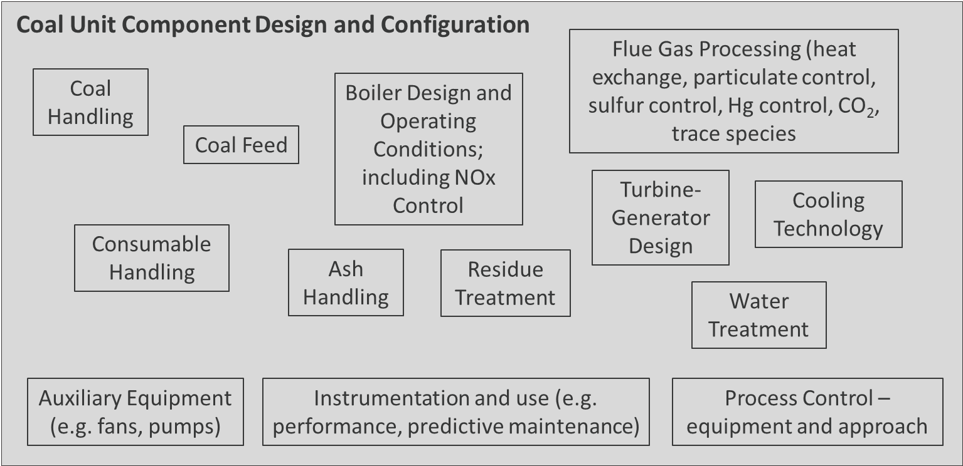
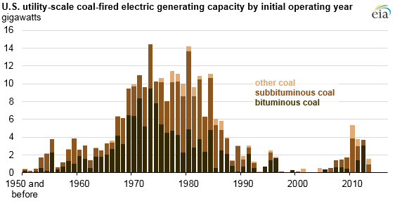
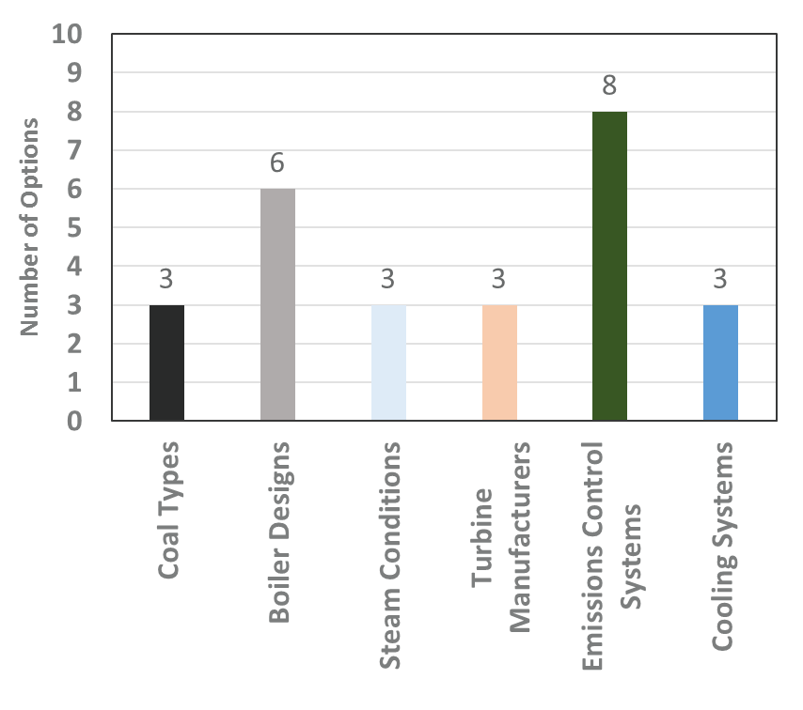
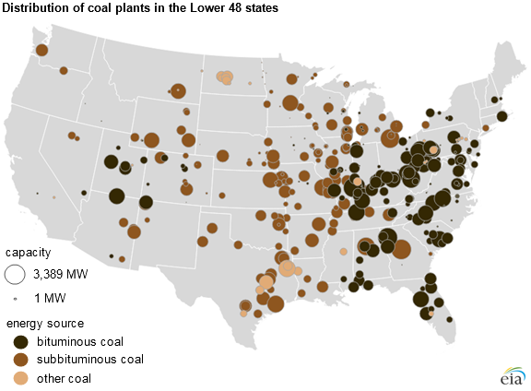
Diversity Across the U.S. Coal Fleet
Credits: Bottom Left, NETL analysis of Ventyx Energy Velocity Suite Database information
Center: Samaras, C., et.al., Characterizing the U.S. Industrial Base for Coal-Powered Electricity, RAND Corporation, 2011
Right Top and Bottom, DOE EIA

Slide 12
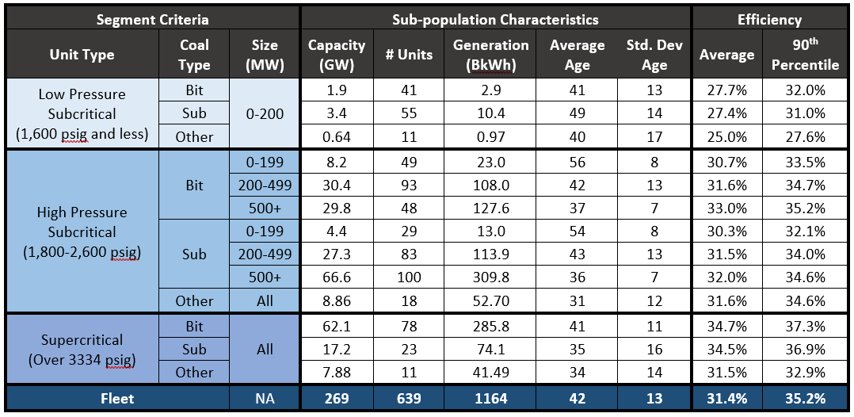
2016 Fleet Performance Characteristics
Sources: NETL analysis of Ventyx Energy Velocity Suite Database, Platts 2016 UDI Database

Slide 13
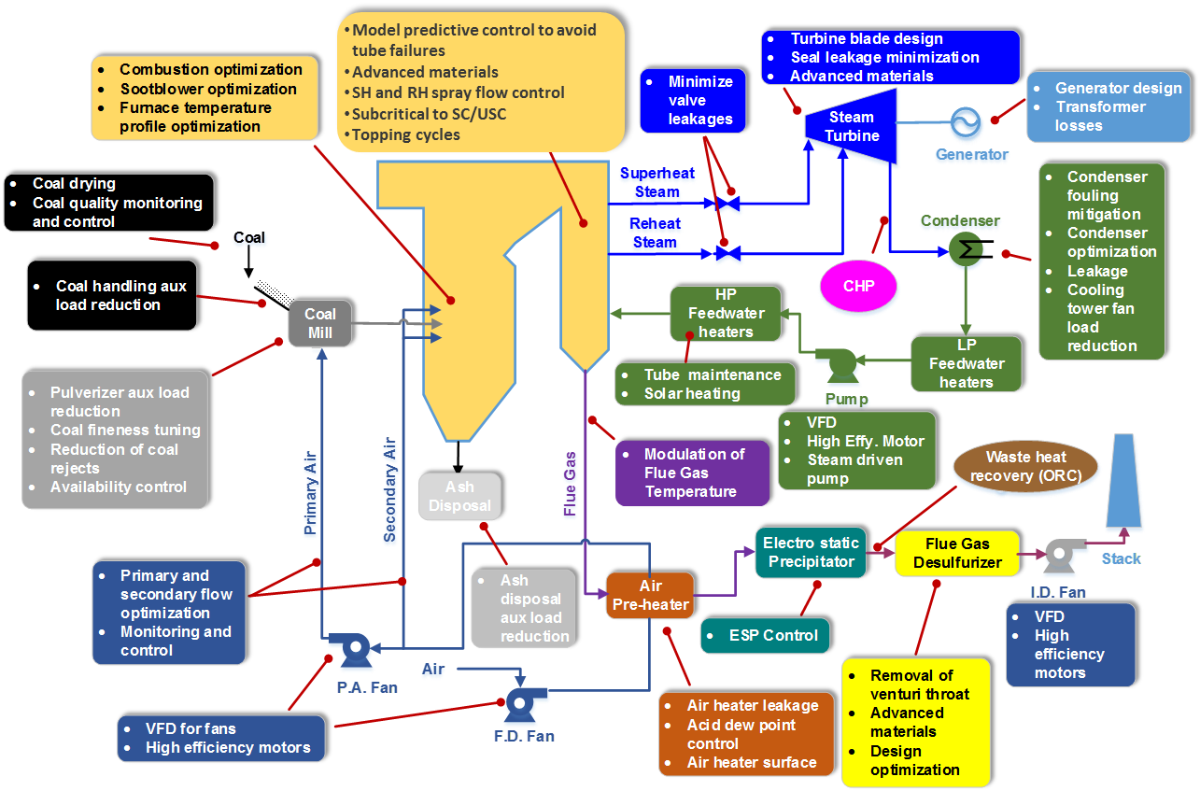
Technologies to Improve Performance
Many plant areas have room for improvement
Solutions are commercially offered
Key factors limiting implementation:
  High cost
  Inadequate performance improvement

Slide 14
Sample List of Improvement Opportunities
Upgrade Options
Boiler Island | Redesign/replace economizer
 | Boiler tube coatings
 | Fuel delivery upgrades
 | Sootblower upgrades
 | Air heater upgrades/lower outlet temp.
 | Condenser upgrades
 | Ash handling upgrades
Turbine Island | Upgrade (e.g., blades, seals, materials, coatings)
 | Boiler feed pump upgrades
 | Generator upgrades
Flue Gas System | Fan and pump upgrades
 | Emissions control modifications
Upgrade Options
Water Treatment | Cooling tower upgrades
 | FGD waste water treatment
Instrumentation & Control | Digital controls
 | Neural network
Coal Choices | Pre-beneficiation
 | Reduce moisture
 | Reduce ash
 | Change fuel
CHP Opportunities | Waste heat utilization
 | Sell low-pressure steam
 | Incorporate thermal energy storage
For any given unit, only a subset will be technically feasible, of which only a few may be economically feasible
The implication is that there is no practical one-size-fits-all solution

Slide 15
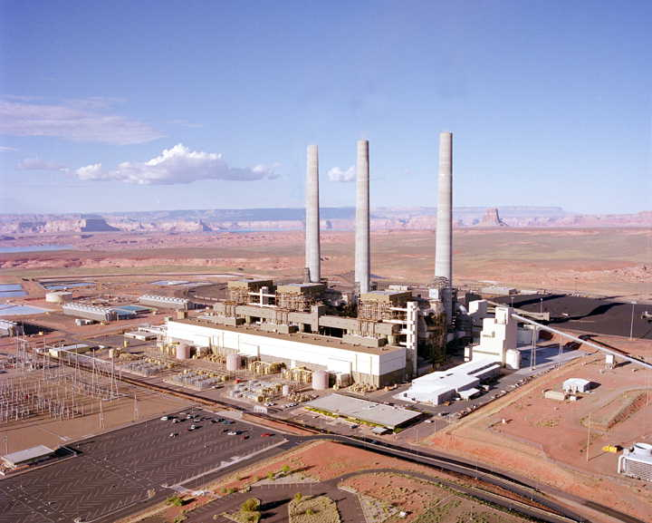
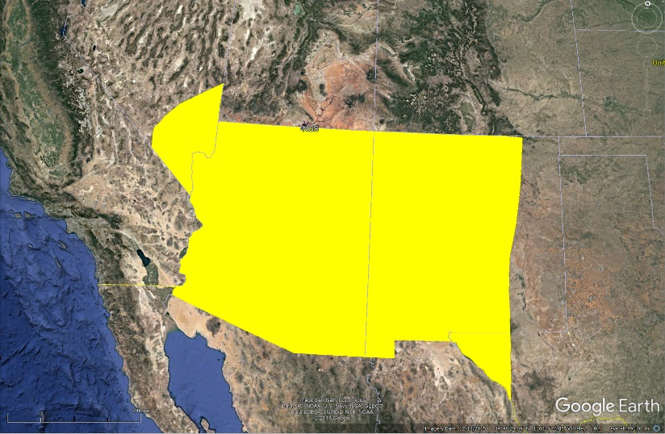
Performance Improvement Opportunity
Navajo Generating Station
  3 x ~800 MWe (Nameplate)
  1970’s vintage bituminous-fired supercritical units
  Env. Control - Hot-side ESP (PM), Wet FGD (SO₂) and ACI (Hg)
  Supplies the WECC Desert Southwest market
  Online years – 1974-1976, scheduled retirement in 2019
Primary drivers for retirement
  Changing economic circumstances (low NG prices, low demand)
  Required future retrofit of SCR on Units 2 &3 to comply with Regional Haze regulations
  Other site-specific drivers (site lease, closure requirements)
Western Area Power Administration
Desert South West Region
Western Area Power Administration
Desert South West Region
Credits: Top: Salt River Project
Bottom, NETL modification of Google Earth imagery

Slide 16
Case Study – Navajo Generating Station
Annual Operational Statistics 2011-2018
 | Plant Level (all Net) |  |  |  | Unit Level CF, %
 | Output, MWh | HR, BTU/kWh | CF, % |  | U1 | U2 | U3
2011 | 16,951,775 | 10,060 | 80.2 |  | 69.0 | 84.4 | 87.4
2012 | 15,888,068 | 10,042 | 75.3 |  | 75.2 | 75.7 | 74.8
2013 | 17,131,763 | 10,135 | 81.2 |  | 82.8 | 75.0 | 85.3
2014 | 17,297,076 | 10,263 | 82.0 |  | 79.5 | 85.7 | 80.6
2015 | 13,572,760 | 10,392 | 64.3 |  | 71.6 | 65.6 | 55.6
2016 | 12,058,583 | 10,417 | 57.1 |  | 59.3 | 54.6 | 57.4
2017 | 13,781,218 | 10,349 | 65.3 |  | 61.2 | 68.3 | 66.3
2018 | 13,017,437 | 10,545 | 61.7 |  | 61.0 | 61.9 | 62.0
Source – EIA Form 923
Already showing negative effects
  Decreasing EAF
  Increasing EFOR
Approximate 100% of MCR
Approximate 40% of MCR
Hourly load data source - https://ampd.epa.gov/ampd/

Slide 17
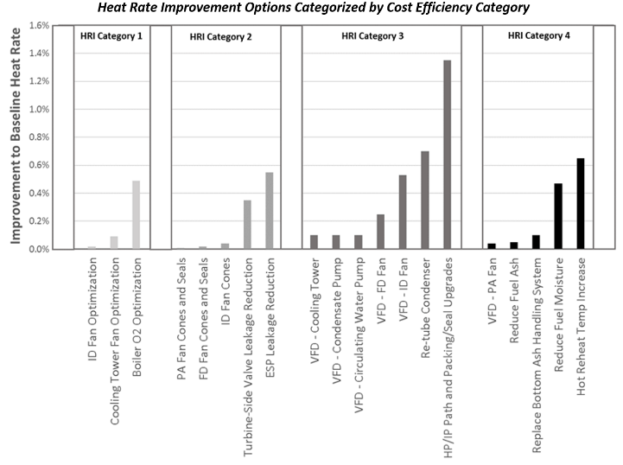
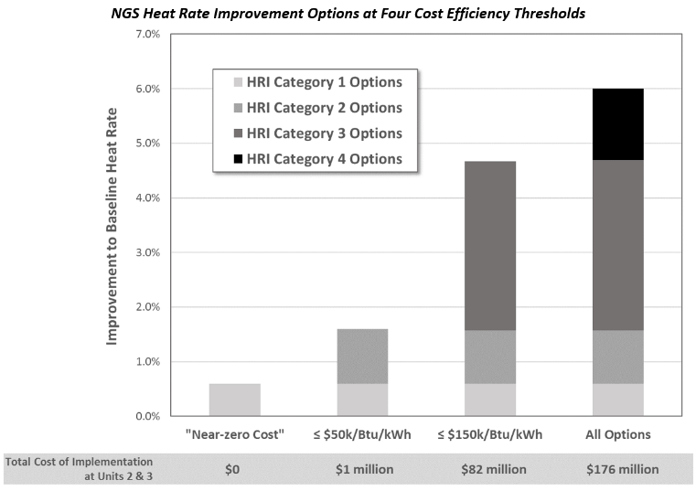
Case Study – Navajo Generating Station
Study Objective
  Identify and evaluate potentially feasible heat rate improvement (HRI) opportunities
  Consider only commercially-available, state-of-the-art technologies
  Focus on technical assessment including magnitude of potential HRI and order of magnitude implementation costs
Study Findings
  Twenty three individual HRI opportunities identified and evaluated
    Individual improvements ranging from very small to ~1.4%
    Individual implementation costs from negligible to ~$18M/unit (~$24/kW)
    Individual cost efficiencies ranging from “free” to >$150k per Btu/kWh improvement to unit heat rate
  Maximum “feasible” HRI ~4.7% at cumulative implementation cost ~$40M/unit (~$55/kW)
NGS Operator (Salt River Project) Perspective
  Has “considered many of the options” identified by Black & Veatch
  Acted on or dismissed options based on “operating and economic factors”
Credits: NETL, Plant Efficiency Evaluation at Navajo Generating Station, DOE/NETL-2018/1891, January 2018

Slide 18
Observations on U.S. Electricity Markets

Slide 19
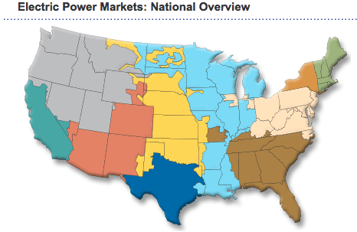
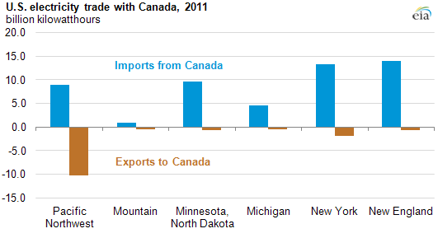
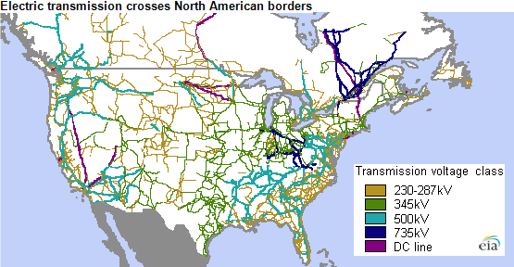
Diversity Across U.S. Electricity Markets
 | 2016 Nameplate Capacity, MW | Capacity Composition |  |  | Market Characteristics
 |  | Coal | Gas | Int¹
CAISO | 82,379 | 0% | 53% | 23% | Access to electricity markets across eight western states; CO₂ constraints
MISO | 184,427 | 38% | 43% | 11% | Access to shale gas and wind; a number of state utilities continue to be vertically integrated monopolies; seasonal (i.e., winter) challenges for flexibility and reliability, capacity market and ancillary service opportunities; power import/export with Canada
ISO-NE | 31,798 | 3% | 52% | 8% | Increasing NG capacity; NG infrastructure challenge; power import/export with Canada
NYISO | 41,646 | 3% | 53% | 5% | Declining electricity demand and aging infrastructure; increasing NG and wind with coal & oil declining; hydro & nuclear (mostly) constant; changing demand profile due to efforts focused on energy efficiency and other behind-the-meter opportunities; power import/export with Canada
Northwest | 81,494 | 15% | 25% | 16% | Heavy reliance on hydro; legacy state-regulated, vertically integrated, monopoly markets; significant Federal presence (Bonneville Power); power import/export with Canada
PJM | 200,440 | 32% | 38% | 6% | Declining electricity demand and aging infrastructure; changing demand profile due to efforts focused on energy efficiency; large legacy generation disproportionate in some states; capacity market and ancillary service opportunity
Southeast | 232,614 | 28% | 49% | 3% | Legacy state-regulated, vertically integrated, monopoly markets
Southwest | 59,070 | 29% | 47% | 17% | Legacy state-regulated, vertically integrated, monopoly markets
SPP | 87,255 | 30% | 39% | 12% | Increasing NG capacity, wind generation, ancillary service opportunity
ERCOT | 107,569 | 17% | 59% | 22% | Excess capacity, increasing wind growth
Total | 1,108,691 | 25% | 45% | 12%
1. % Intermittent includes wind and solar; does not include geothermal, landfill gas, MSW, black liquor, biomass or hydro
Credits: Ventyx Energy Velocity Suite Database (data); EIA, FERC (graphics)

Slide 20
Market Variability – Capacity Mix
Generation Capacity Mix – Continental United States
Operating or Standby Status, June 2018
Coal
Nuclear
% of Installed MW
Natural Gas
All Other
Conv. Hydro
Wind
Solar
Credits: Adapted from OE Energy Market Snapshot, National – Data through October 2018, FERC Office of Enforcement, November 2018
Wind & Solar split based on FERC-cited data source (EIA Form 860M, June 2016)

Slide 21
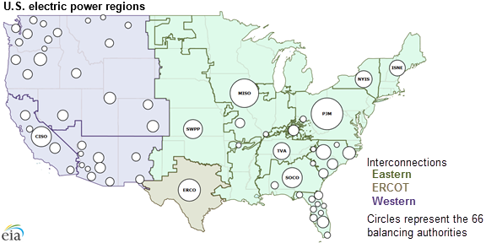
Market Variability – Priced Components
Comparison of Market Components Across Competitive Electricity Markets (as of 2015-2016)
Bulk Power Grid of the Continental United States
 | ISO-NE | NYISO | PJM |  | MISO | SPP | ERCOT | CAISO
Energy | DA/RT | DA/RT | DA/RT |  | DA/RT | DA/RT | DA/RT | DA/RT
Ancillary Services
Regulation | RT | DA/RT | RT |  | DA/RT | DA/RT | DA | DA/RT
Reserves¹ | FP/RT | DA/RT | DA/RT |  | DA/RT | DA/RT | RT | DA/RT
Voltage Support | Yes² | Yes² | Yes² |  | Yes² | Yes² | Yes² | Yes²
Black Start | Yes² | Yes² | Yes² |  | Yes² | No | Yes² | Yes²
Transmission | FTR | TCC | FTR |  | FTR | TCR | CRR | CRR
Capacity | Yes | Yes | Yes |  | Yes | No | No | Yes
Notes: 1. Reserves include one or more of the following services: Spinning, Non-Spinning, 30-minute, Supplemental 2. Voltage support and black start ancillary services are compensated through cost-based mechanisms and are not a “competed” component of the market structure. Table Abbreviations:
DA – Day Ahead RT – Real Time FP – Forward Planning (pre-DA) FTR – Financial Transmission Rights |  |  |  | TCC – Transmission Congestion Contracts TCR – Transmission Congestion Rights CRR – Congestion Revenue Rights
Credits: Left – EIA, U.S. electric system is made up of interconnections and balancing authorities, July 2016, Online at: https://www.eia.gov/todayinenergy/detail.php?id=27152#
Right – Adapted from Wholesale Electricity Market Design Initiatives in the United States: Survey and Research Needs. EPRI, Palo Alto, CA:2016, 3002009273

Slide 22
Market Variability – Power Pricing
2018 Spot Power Prices ($/MWh)
Credit: OE Energy Market Snapshot, National – Data through October 2018, FERC Office of Enforcement, November 2018

Slide 23
Observations on Coal Plant Retirements

Slide 24
A Significant Decade for Coal Retirements
~66 GW of Retired Coal
Source – NETL analysis of EIA data, augmented with information from ABB Energy Velocity Database

Slide 25
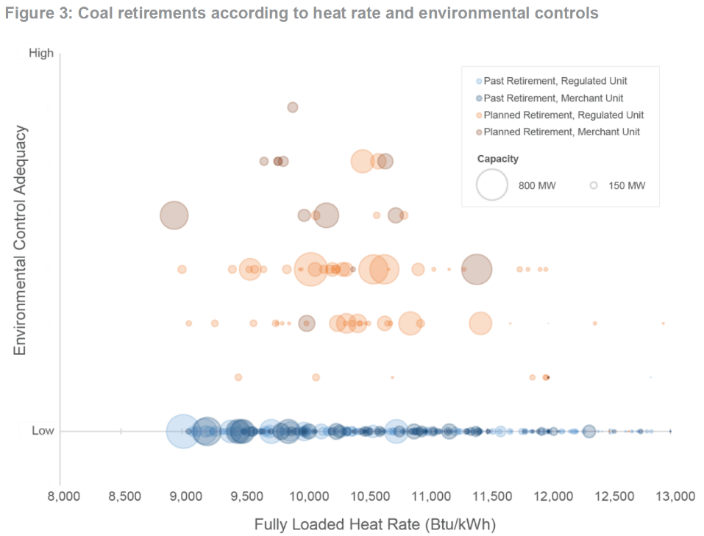
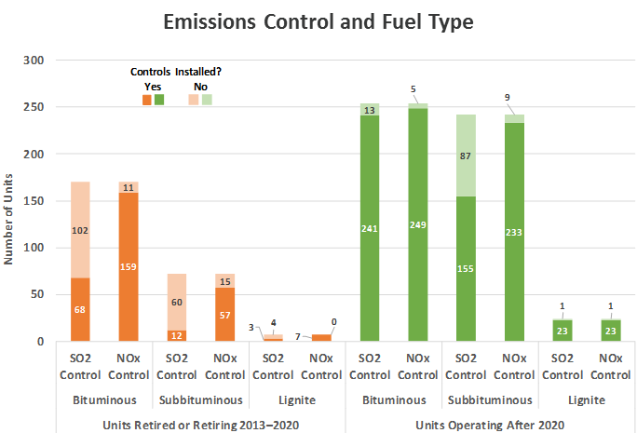
Attributes of Retired and Operating Units
Coal Retirements According to Heat Rate and Environmental Controls
Coal Plant Status - Environmental Controls and Fuel Type
Credits: Left – Charles River Associates, The growing risks of regulated coal ownership, CRA Insights: Energy, April 2016
Right - – NETL analyses of EIA unit-level data

Slide 26
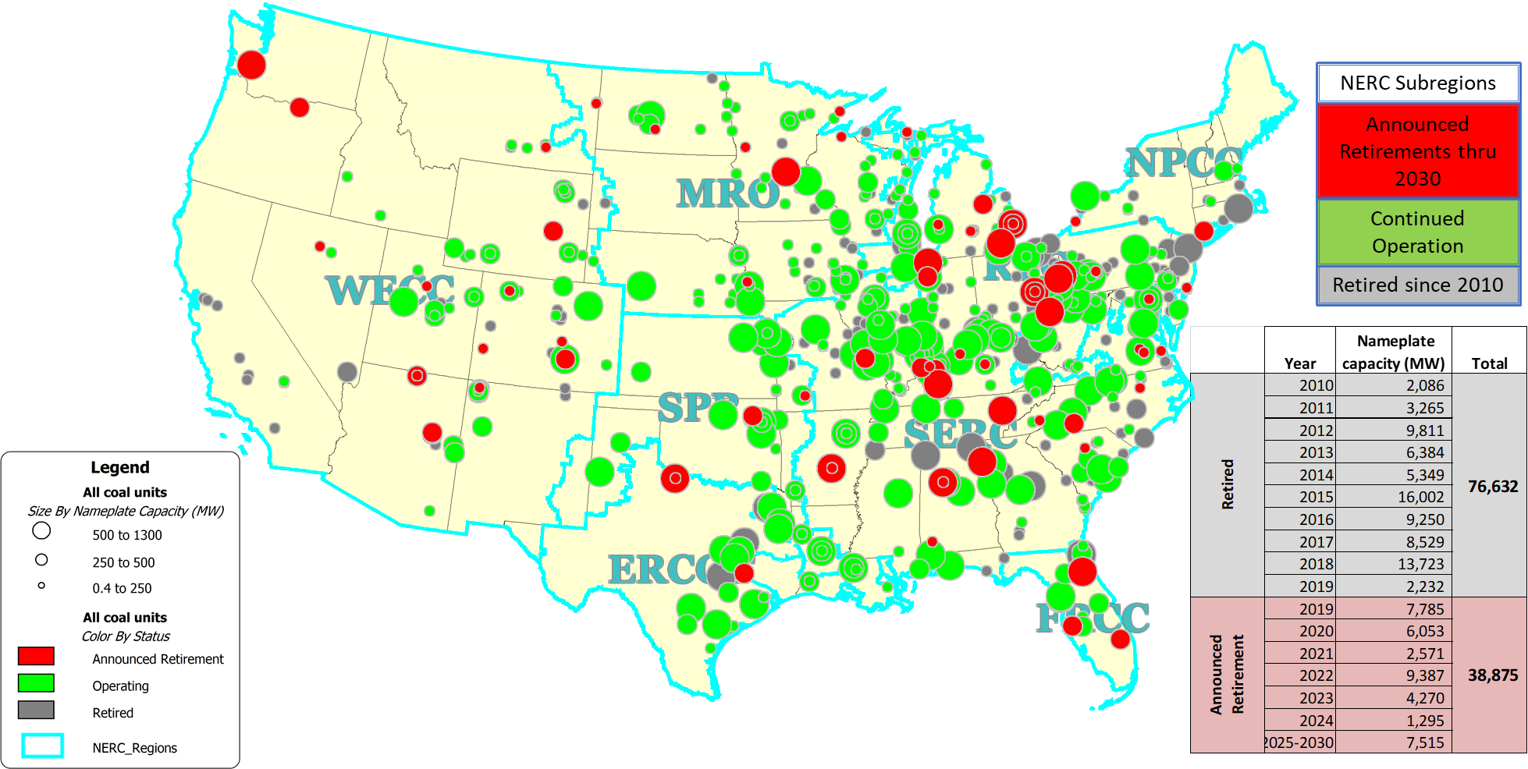
U.S. Coal Fleet Through 2030
Source: NETL analysis

Slide 27
Why do coal plants retire?
Revenue insufficient to cover cost of ownership
  “Routine” increased costs associated with aging and normal use of plant equipment
  “Non-routine” increased costs due to accelerated wear from non-baseload operations
  Decreased capacity utilization
Factors that influence decision
  Competition with lower-cost alternatives (e.g., natural gas, renewables)
  Changing market conditions, largely unfavorable to coal (e.g., decreasing demand, market incentives for renewables, inadequate or non-existent compensation mechanisms)
  Increasing corporate/investor focus on “clean” energy options
  Public policies (e.g., renewable portfolio standards, state and federal regulations)
  Societal concerns (e.g., “customer choice” for renewables, active opposition resulting in protracted permitting efforts, uncertainty in future public policy)

Slide 28
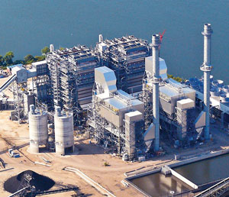
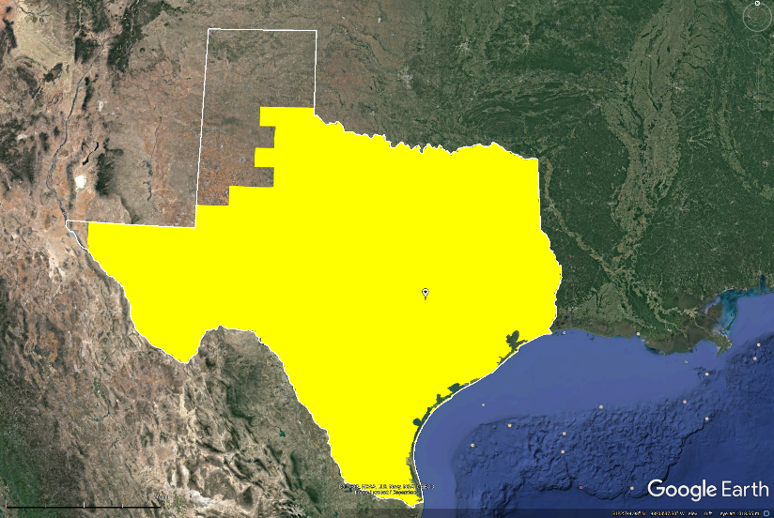
Retirement Example (Retired in 2018)
Sandow Power Plant
  Unit 5 – 692 MWe Lignite-fired fluidized bed combustor
  Full-load efficiency – 35%
  Full suite of environmental controls
  Supplied the competitive wholesale ERCOT market
  Online year – 2010, retired in 2018
Primary drivers for retirement
  Low wholesale power prices due to oversupply of generation, largely due to:
    Recent and continued addition of wind and solar generation
    Sustained low natural gas prices
ERCOT
Credits: Top: Luminant, https://www.luminant.com/wp-content/uploads/2017/07/sandow-300px.jpg
Bottom, NETL modification of Google Earth imagery

Slide 29
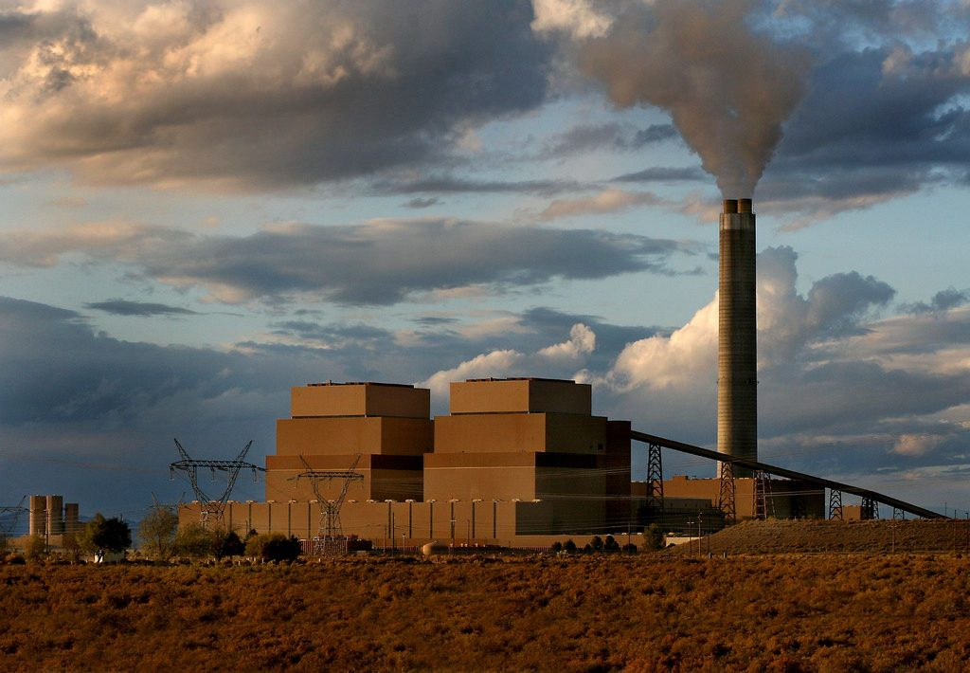
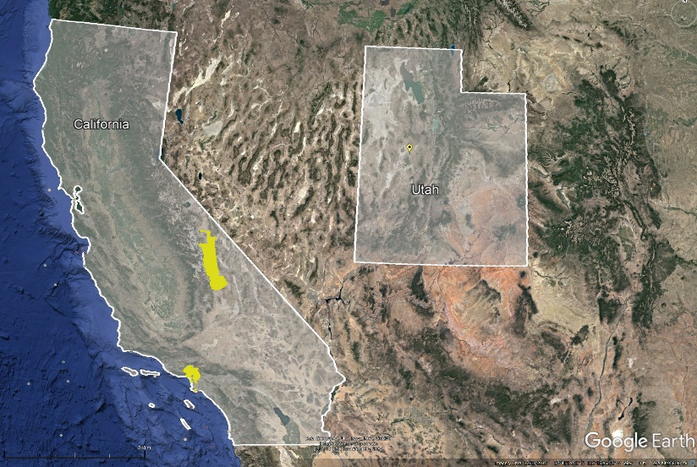
Retirement Example (Planned for 2025)
Intermountain Generating Station
  Units 1 & 2 – 1,775 MWe Bituminous-fired pulverized coal
  Full-load efficiency – 35.2% (Unit 1), 35.9% (Unit 2)
  Full suite of environmental controls
  Supplied multiple customers in Utah and California
  Online year – 1986 (Unit 1), 1987 (Unit 2), both scheduled for retirement in 2025
Primary drivers for retirement
  LADWP (plant operator and purchaser of 48.6% of generation) will not renew power purchase agreement, in part due to CA limitations on CO₂ emissions
  New NGCC planned for site of existing coal units
LADWP
Balancing Areas
Credits: Top: Power Engineering, https://www.power-eng.com/articles/2017/05/utah-s-largest-coal-plant-to-close-convert-by-2025.html
Bottom, NETL modification of Google Earth imagery

Slide 30
Closing Thoughts

Slide 31
Time is of the Essence
Solutions relevant to the existing fleet are needed in the near-term
Must bring meaningful improvements to targeted attribute (e.g., efficiency, flexibility, reliability)
Must be low cost, rapid return on investment
Must be low risk in all aspects
  Performance – must function as intended
  Reliability – must not negatively impact the existing plant
  Cost – must have high cost certainty, minimal “collateral costs” (i.e., costly investments in other parts of the plant for system integration, life extension, etc.)
  Integration – must be easily “absorbed” by existing plant infrastructure (including workforce)
  Execution – predictable implementation, acceptable impact to short- and long-term operations

Slide 32
Opportunities for Targeted R&D
R&D Focus | Benefit to Owner/Operator | Benefit to System and Society
Improved Efficiency | Increased capacity utilization via higher unit dispatch lower cost of generation | Lower electricity cost to the consumer Decrease in environmental emissions from coal-fired electricity production
Increased Flexibility | Greater agility to respond to rapid changes in electricity supply and demand | Improved system capability to handle increased penetration of VERs Lower system cost due to decreased need for replacement generation capacity
Enhanced Reliability | Decreased maintenance costs Fewer and shorter unplanned outages | Improved energy security supported through higher system reliability Lower cost to consumer through decreased need to source higher cost replacement power when unplanned outages occur

Slide 33


Thank You
Jeff Hoffmann
Jeffrey.Hoffmann@netl.doe.gov
Visit us at www.netl.doe.gov

