Slide 1
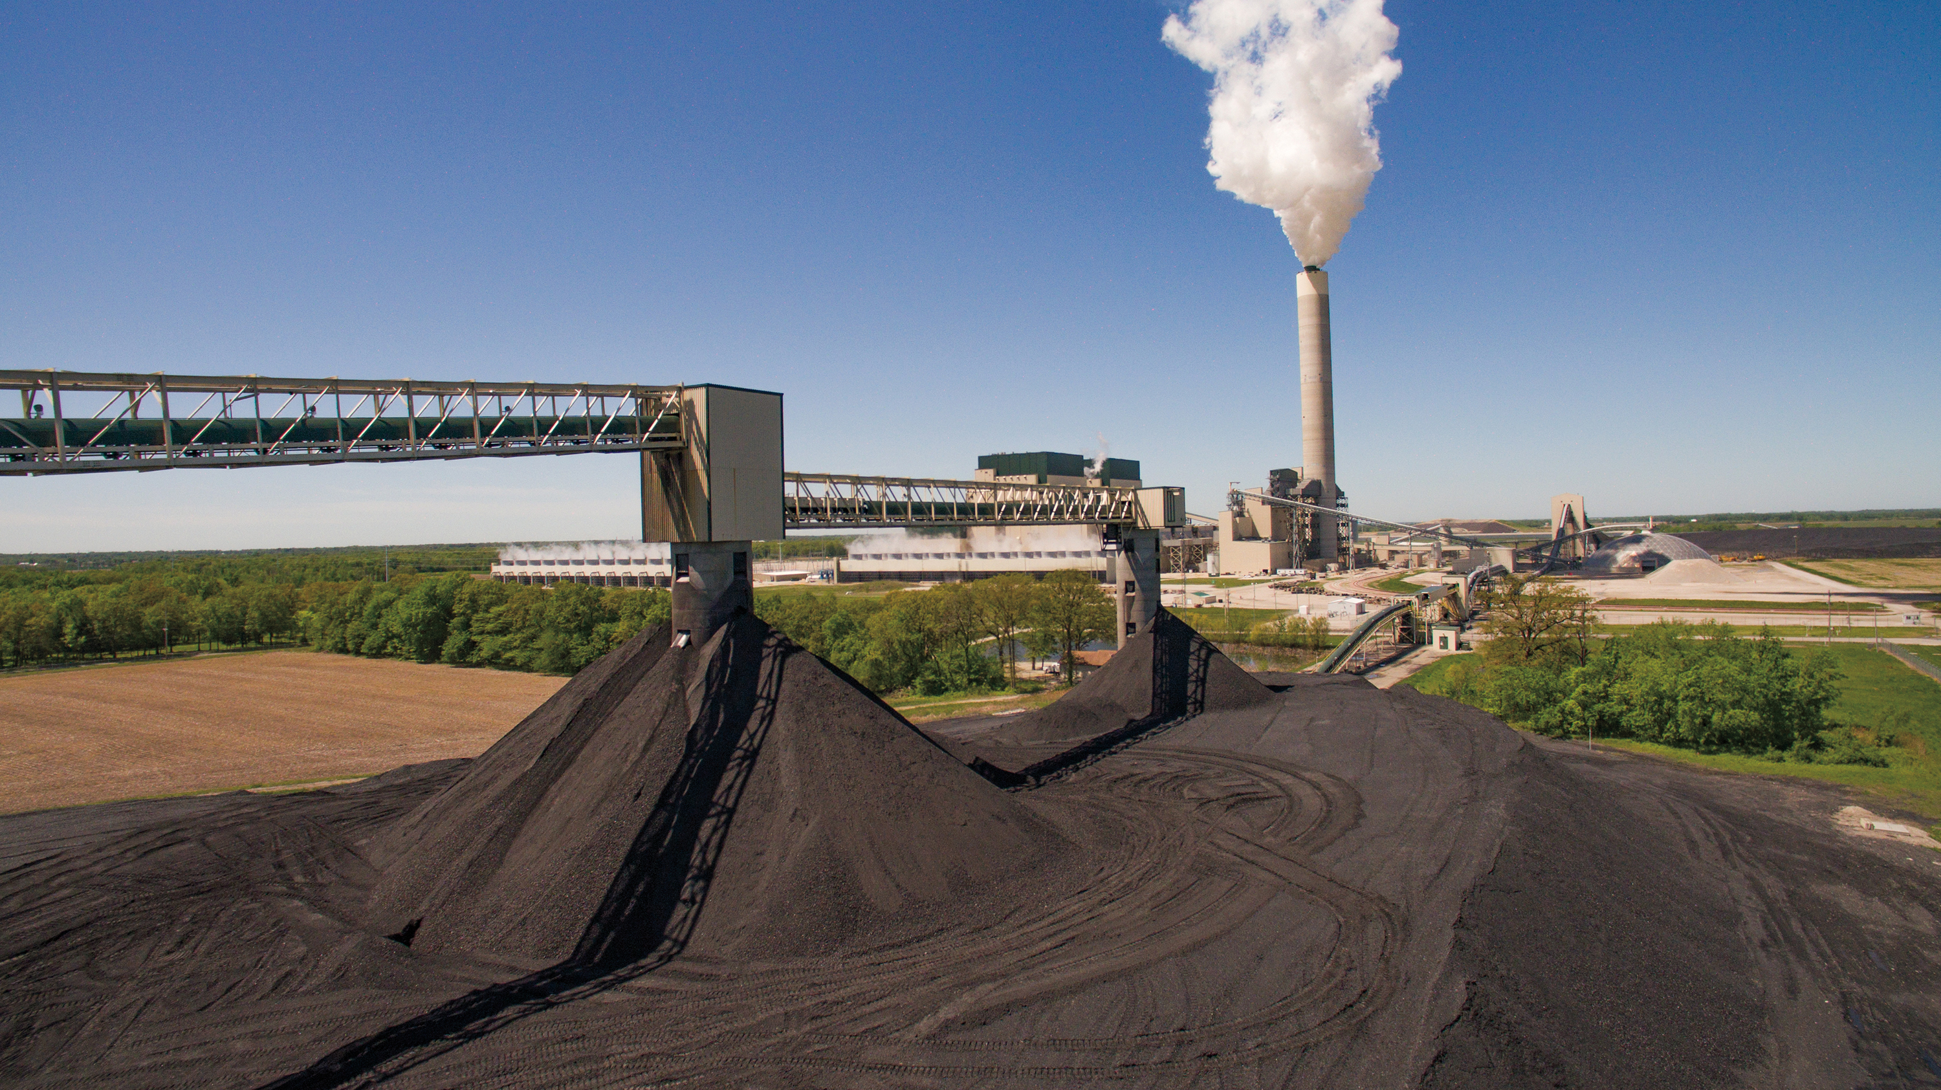
Full-Scale FEED Study For a 816 MWe Capture Plant at the Prairie State Generating Company Using Mitsubishi Heavy Industries of America Technology
Kevin C OBrien, PhD Director, Illinois Sustainable Technology Center Director, Illinois State Water Survey Prairie Research Institute University of Illinois at Urbana-Champaign
DOE/NETL Project Closeout Meeting
Pittsburgh, PA / June 14, 2022

Slide 2
Disclaimer
This report was prepared as an account of work sponsored by an agency of the United States Government. Neither the United States Government nor any agency thereof, nor any of their employees, makes any warranty, express or implied, or assumes any legal liability or responsibility for the accuracy, completeness, or usefulness of any information, apparatus, product, or process disclosed, or represents that its use would not infringe privately owned rights. Reference herein to any specific commercial product, process, or service by trade name, trademark, manufacturer, or otherwise does not necessarily constitute or imply its endorsement, recommendation, or favoring by the United States Government or any agency thereof. The views and opinions of authors expressed herein do not necessarily state or reflect those of the United States Government or any agency thereof.

Slide 3
Agenda
Introduction, Overview & Summary of Results (UIUC)
Results of Studies and Investigations
UIUC Lead Investigations (UIUC)
S&L/Kiewit Lead Investigations (Kiewit)
MHI Lead Investigations (MHI)
Constructability Review (Kiewit)
Outline of Resulting Plot Plan (Kiewit)
ISBL Detailed Design Results (MHI)
OSBL Detailed Design Results (Kiewit)
Overall Plant Performance (Kiewit)
Overall Plant Cost (Kiewit)
Closing Discussions (PSGC)

Slide 4
PROJECT OBJECTIVES: Overall: Perform a Front-End Engineering Design (FEED) study for the retrofit of the Prairie State Generation Company’s (PSGC) coal-fired power plant with post-combustion carbon capture. The FEED study will outline the use of Mitsubishi Heavy Industries’ (MHI) Advanced KM CDR Process™ to retrofit one of PSGC’s two generating units (approximately 816 MWe). The FEED study will enable PSGC to move forward with actual build/operate in future work.
Cooperative Agreement No. DE-FE0031841
PROJECT OVERVIEW
Funding: $17,509,676 DOE: $14,004,676 20% Cost Share: $3,505,000 (PSGC)
Work Period: 1 Jan 2020 – 31 Dec 2021
Incurred Expenses (1 April 2022)
DOE: $13,349,525
Cost Share: $3,454,337

Slide 5
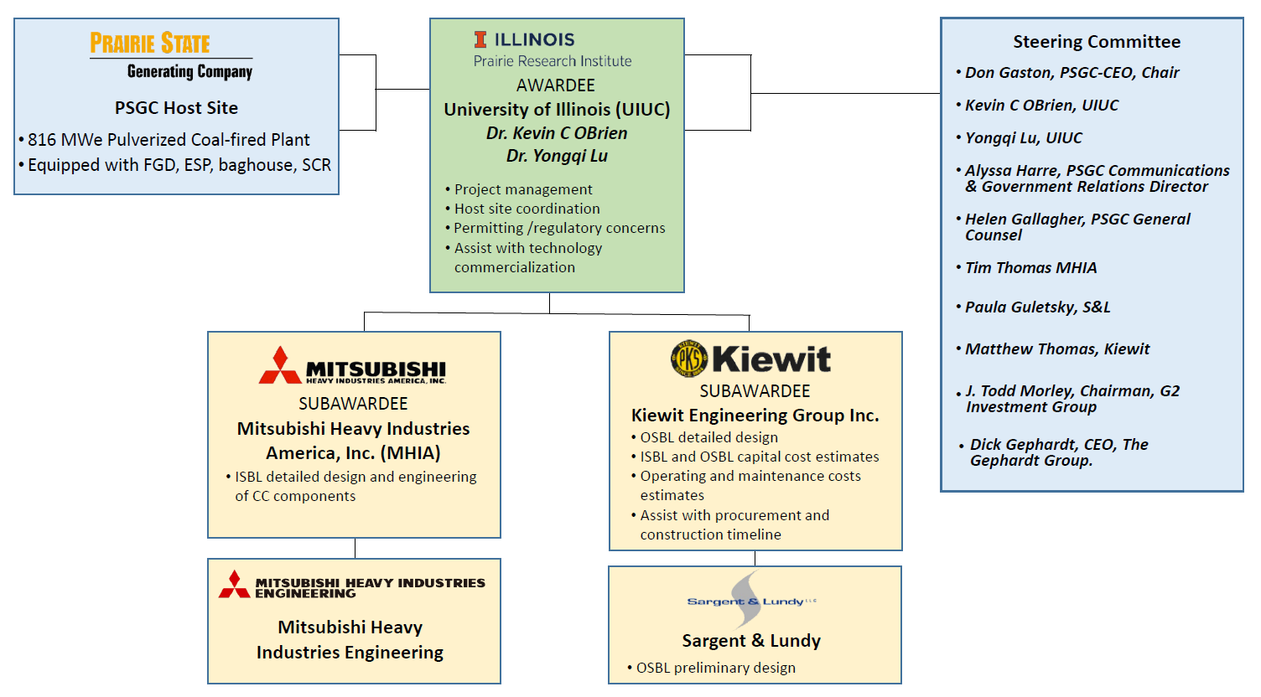
Project Team Management Structure

Slide 6
THE TECHNOLOGY
FRONT-END ENGINEERING DESIGN STUDIES FOR CARBON CAPTURE SYSTEMS ON COAL AND NATURAL GAS POWER PLANTS

Slide 7
Mitsubishi Heavy Industries’ (MHI) Advanced KM CDR Process™

Slide 8
KS-21TM Solvent
MHI has been able to conclude that there are likely operating cost benefits for using KS-21™ instead of KS-1™
KS-21™ has several advantageous properties such as lower volatility and greater stability which result in:
Lower amine emissions
Lower solvent make-up
Lower compression energy

Slide 9
THE PROJECT
FRONT-END ENGINEERING DESIGN STUDIES FOR CARBON CAPTURE SYSTEMS ON COAL AND NATURAL GAS POWER PLANTS

Slide 10
Project Tasks
Task # | Task
1.0 | Project Management and Planning
2.0 | Front-End Engineering Design (FEED) Study
2.1 | Design Basis
2.2 | Preliminary Engineering
2.3 | ISBL Detailed Engineering
2.4 | OSBL Detailed Engineering
2.5 | Studies and Investigations
2.6 | Cost Assessment
3.0 | Regulatory and Permitting at Host Site
4.0 | Final FEED Study Package

Slide 11
Project Milestones
Task # | Deliverable Title | Due Date
1.0 | Project Management Plan Update | 3/3/2020
2.0 | Design Basis Document Complete | 10/30/20
2.0 | Report on Utility Requirements | 11/19/20
3.0 | Preliminary Regulatory and Permitting Pathway | 2/18/21
2.0 | HAZOP Review | 4/30/21
2.0 | Impact on Kaskaskia Watershed Document Complete | 5/28/21
2.0 | Constructability Review Complete | 6/30/21
3.0 | Regulatory and Permitting Analysis Complete | 8/6/2021
2.0 | Detailed Engineering Document Complete | 11/30/21
4.0 | Final Report Submitted | 12/31/21
4.0 | FEED Study Package Complete | 12/31/21
All quarterly advisory board meetings were held as planned

Slide 12
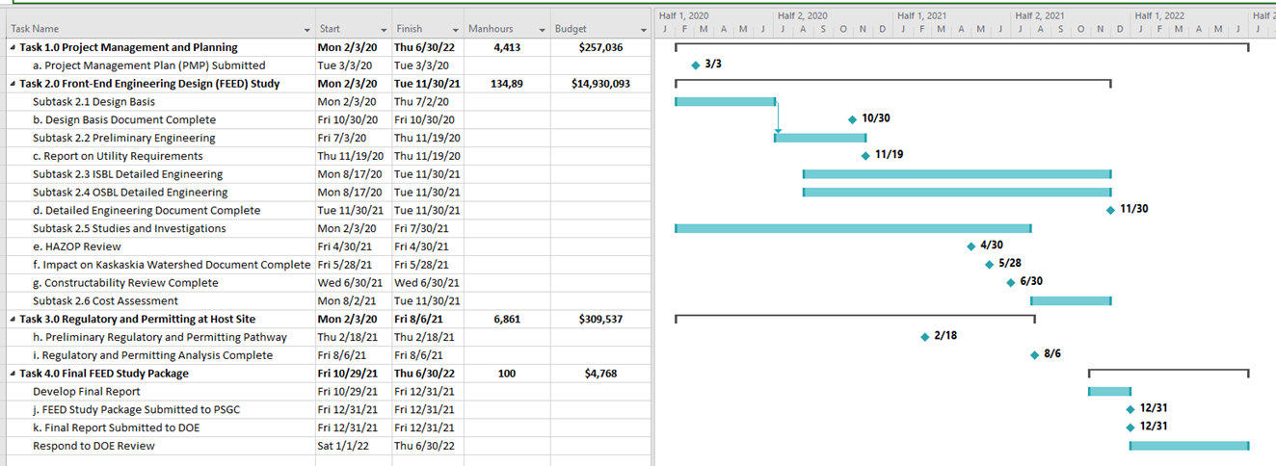
Project Timeline
Project was completed within budget and on-time despite challenges due to COVID-19 pandemic

Slide 13
Summary of Results
8,462,000 ston annually of CO₂
Project Capital Cost Estimate (+/- 15%)
$2,044,465,000
Cost of Capture
$43.42/metric tonne of CO₂

Slide 14
Studies and Investigations
UIUC Lead Studies
Water Supply Study
Air Permitting Pathway
Water Permitting Pathway

Slide 15
Water Supply Study
Draw raw water from the Kaskaskia River
14 million gallons per day (mgd)
Build a storage pond for drought conditions
Water is available for use during wet (normal) conditions
No allocation remaining, unable to draw water during drought conditions
Store 26 days of water (25-year drought)

Slide 16
Regulatory and Permitting at Host Site
Air Permitting Pathway
Carbon Capture Plant as a Separate Source with Only Emissions Created by the Carbon Capture Plant Subject to Permitting
Advantages
Carbon capture plant will have own air permit with no overlapping requirements
Only address emissions generated by carbon capture plant
Disadvantages
IEPA may impose new requirements to PSGC existing permits
Believed to be unlikely given that the monitoring of emission could be implemented upstream of the divergence of the flue gas to the carbon capture plant

Slide 17
Regulatory and Permitting cont.
Water Permitting Pathway
Raw Makeup Water
File a request to Illinois Department of Natural Resources (IDNR) to use public water from the Kaskaskia River
New construction activities outside waterway - only a request to use public water is needed to be filed to IDNR.
New construction activities inside waterway - a joint permit application to IDNR, Illinois Environmental Protection Agency (IEPA), and USACE will be required
Limiting conditions based on draw needs during draught conditions
May be able to gain allocation rights if other users shutdown operations

Slide 18
Regulatory and Permitting cont.
Water Permitting Pathway
Wastewater
Discharging treated cooling tower blowdown into the Kaskaskia River will require a National Pollutant Discharge Elimination System (NPDES) permit
Removal of trace metals to the concentrations indicated in 35 Illinois Administrative Code (IAC) 302
No mixing zone at the new cooling tower blowdown discharge to the Kaskaskia River will be allowed.
NPDES discharge limitations for total suspended solids (TSS) expected to be like existing PSGC cooling tower blowdown

Slide 19
Studies and Investigations
Kiewit and S&L Lead Studies
Site Selection
Ammonia Scrubber Study
Cooling Sourcing Study
Water and Wastewater Treatment Study
Steam and Electric Sourcing Study
Flue Gas Tie-In Study

Slide 20
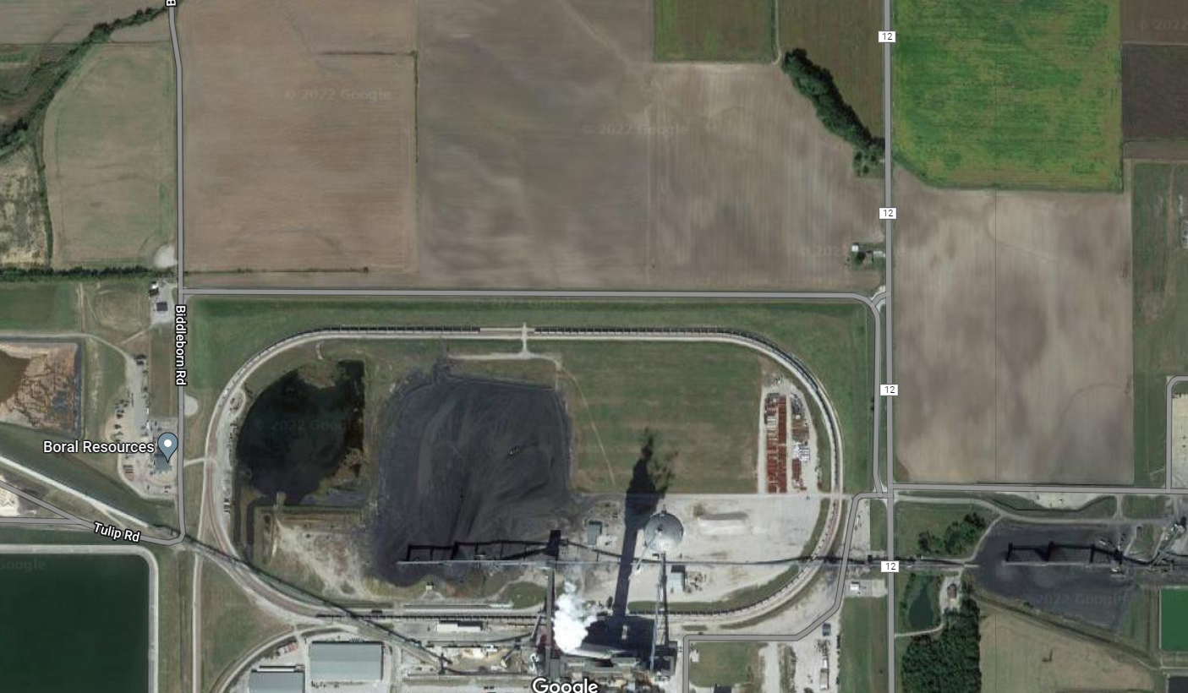
Site Selection
West
North
North
West
East
East
Rail Loop
Rail
Notes:
Show all option that were considered and inside rail loop and East were narrowed down for final consideration.
Reason for elimination to be discussed later.

Slide 21
Site Selection
West and North Locations​
Ruled out after consulting with Mine Engineer
Concerns of causing structural issues
Use of either site would require extensive mine remediation​
Rail Loop
Tight location, Requires Modifications to Rail Loop, Prevents future power block use of this area
Shortest Duct Length
Extended Impact to Power Plant Operations during construction
East Location SELECTED
Requires longer Ducting – optimized with diagonal path
More land availability
Clean separation of company assets with physical barriers
North
West
East
Rail Loop
Notes:
Show all option that were considered and inside rail loop and East were narrowed down for final consideration.
Reason for elimination to be discussed later.

Slide 22
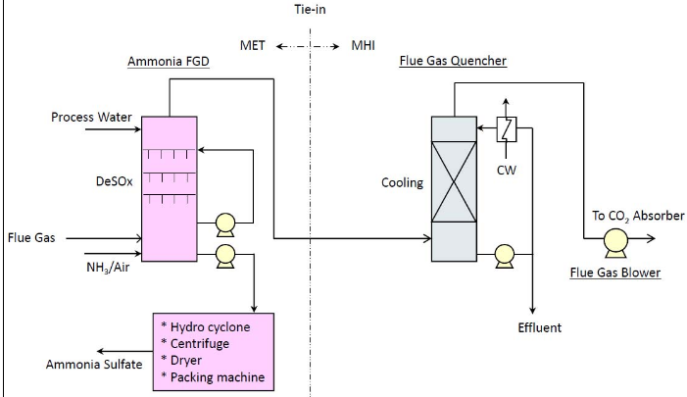
Ammonia Scrubber Study
Evaluated: Ammonia Scrubber and separate Quencher
Additional material handling system required to produce Ammonia sulfate
Notes:
Integrated scrubber / quencher not feasible
MET would need to study effect combining an ammonia scrubber with quencher might have on the byproduct quality - critical to having a salable output.
Marsulex Environmental Technologies (MET) was contacted to provide a budgetary quote and info on their ammonia scrubber.

Slide 23
Ammonia Scrubber Study
Results:
Table Below
Payback Period >25 years
Conclusion:
Insufficient economic benefit to justify added complexity
Integrated Quencher (Base) Selected
 | Base | Ammonia Scrubber
Capital Cost | Base | 103,954,000
First Year Operating Costs, $/yr | 2,780,000 | (5,958,000)

Slide 24
Cooling Sourcing Study
Evaluated best-fit cooling technology for project
Evaluated Technologies
Mechanical Draft Cooling Tower(MDCT)
Hybrid MDCT/Air-Cooled Fin Fan Heat Exchanger(FFHE)
Wet Surface Air Cooler(WSAC)
Description | Cost | Recommended | Notes
MDCT | $14MM | Yes | Lowest Cost.
Hybrid MDCT/FFHE | - | No | Not technically feasible. Hot water temperature is low relative to high ambient, no benefit.
WSAC | $36MM | No | High cost. 50% water savings.
Notes:
MDCT we also considered shapes for the Mechanical draft towers. The Octaonal tower shape results in less downsdraft during high winds and much higher plume b

Slide 25
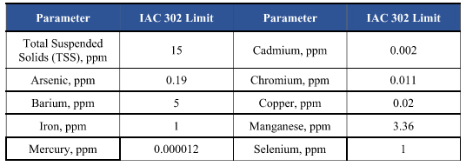
Water and Wastewater Treatment
Evaluation of available treatment options, maximize re-use, and minimize overall cost.
Water Sources:
Kaskaskia River
Quencher Blowdown
Requirements Driving Water Treatment Equipment:
Cooling Tower Makeup
Steam Generation System Makeup
Carbon Capture system Makeup
NPDES Permit Discharge Requirements
Illinois Administrative Code(IAC)
IAC 302 limits indicative of the most
stringent limits that may be applied.
Determined to be appropriate
for this study.

Slide 26
Water and Wastewater Treatment
Results:
Water Sources:
Water Inputs:
8,300 gpm makeup water required from Kakaskia River
2,300 gpm Caustic Flue Gas Condensate Wastewater
Discharge:
3,450 gpm to New Kakaskia River Outfall
Treatment Selected:
Raw Water Treatment(CT Makeup): Hardness and TSS removal by lime softening, clarification, and multi-media filtration
Demineralized Water(Steam and CC Makeup): TDS Removal by RO
Wastewater Treatment: Trace Metal Removal by sulfide precipitation
Notes:
Room for some slight increase to COC, reducing blowdown and makeup water required.
8000 gpm is roughly equal to the makeup water consumed by unit 2.

Slide 27
Steam and Electric Sourcing Study
Evaluation of available options for providing the facility with steam and electricity.
Option 1: Package boilers, power from grid
Option 2: Co-generation facility employing gas-fired CTs
Option 3: Co-generation with package boilers and a backpressure steam turbine for power generation.
Option 2 was broken down into four sub-options:
Option 2a – 1x SGT6-800 CT, package boilers
Option 2b – 1x SGT6-2000E CT + HRSG, package boilers
Option 2c – 2xGE7F.04 CTs + HRSGs, package boiler
Option 2d – 3x3 Combined Cycle SGT6-2000E CTs
Steam integration with host plant was initially explored, but this option was eliminated from further evaluation as host plant could not accept a derate.
Notes:
Worth noting why we use 8 package boilers instead of 1 combined boiler. It’s cheaper.

Slide 28
Steam and Electric Sourcing Study
Option 2, Challenges with Co-generation Configurations
Power generated and steam output do not align well with capture facility needs. All configurations require one or both of (a) auxiliary boilers to supplement steam (b) sale of excess power to market.
PSGC did not want to generate significant additional power that would need to be sold
The large quantity of low-quality steam, as required for the capture plant, would require a specialized HRSG design which would need to be developed.
Results below:
Option 1 Selected, Lowest Cost
*Evaluated Cost and Cost of Capture do not include ISBL costs.
Option | Description: | Notes: | Evaluated Cost* | Evaluated Cost of Capture* | Selected
1 | Package Boilers | Lowest CAPEX | $496MM | $23.91 | X
3 | Package Boilers with BP Steam Turbine | Higher Capex, Lowest Cost of Capture | $570MM ($74MM) | $23.59 $0.32
Notes:
All options would require
NG pipeline
Switchyard upgrades (either to bring in power or to export excess power)
Added costs with BPST included
1) Large boilers to produce higher pressure steam
2) Alloy piping required for higher pressure steam(between boiler and STG)
3) LPS piping
4) Added equipment (STG)
BPST reduces risk of exposure

Slide 29
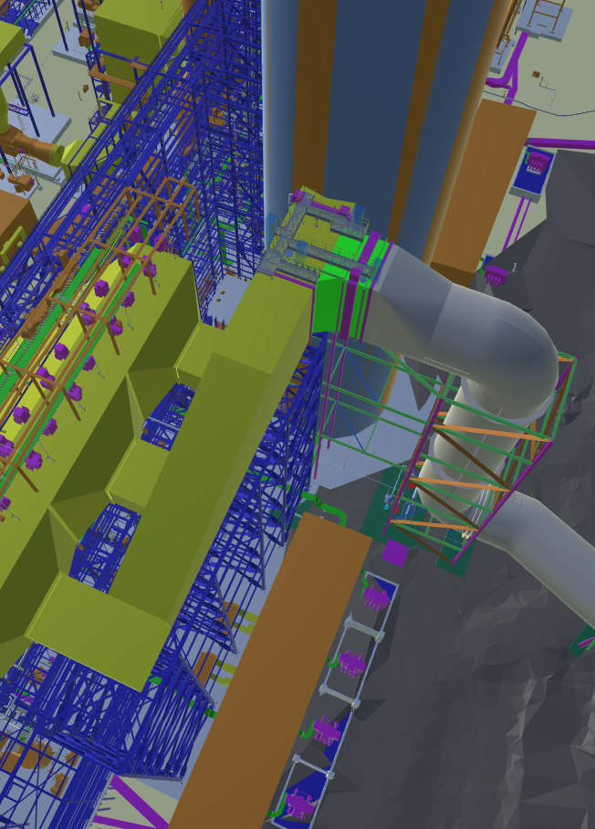
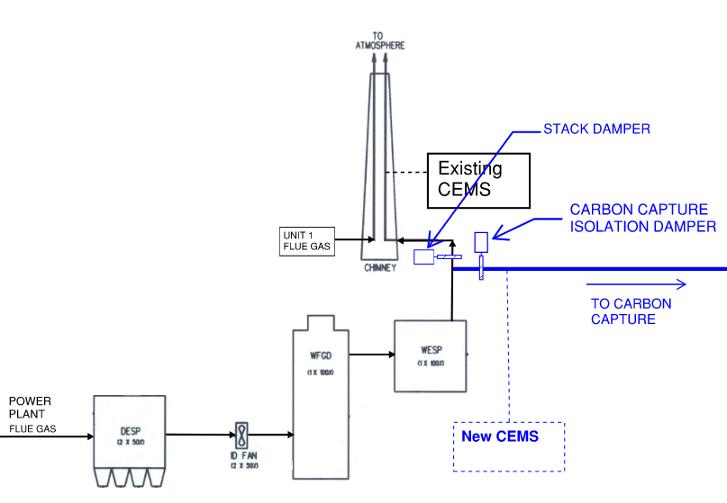
Flue Gas Tie-In Study
Purpose:
Calculate pressure drop for use sizing MHI flue gas fans
Provide preliminary tie-in/duct design
Identify opportunities and risks for further investigation
Tie-In Location
Stack
New Duct
To Capture
Existing
Wet ESP
Outlet
Plenum
Notes:
Tie-In Location is downstream of existing Wet Electrostatic Precipitator (WESP) and upstream of existing stack.
Damper locations, and the control interface between the existing plant and carbon capture were an area of discussion.

Slide 30
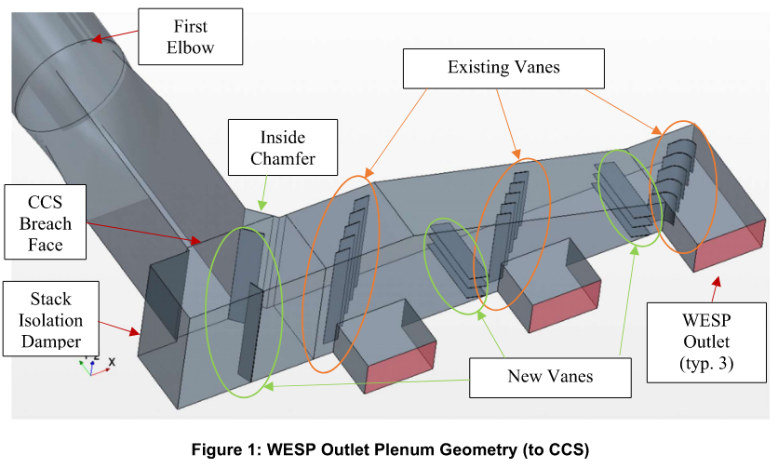
Flue Gas Tie-In Study
Pressure Drop Results
Train 1&3: 9.05 inWC
Train 2&4: 8.04 inWC
From Wet ESP inlet to Quencher Inlet (ISBL Scope)
Flow Modifications to Existing Wet ESP Outlet Plenum(right)
Opportunities
Optimization of Vane Placement
Risk Mitigation, Example
Mixing at Quencher Inlet; control instrumentation
Allowance for study during project
Agreed Plan to reconfigure instrumentation if proper mixing cannot be achieved
Notes:
From study:
Note that these results are indicative of design that has not been optimized with flow correction devices; in certain
areas where there is high turbulence impacting the convergence of the model, vanes were added. Vanes have not been
optimized for pressure drop or flow mixing; instead they have been placed to minimally help with pressure drop while
trying to minimize the effect on the flow to the existing stack

Slide 31
Studies and Investigations
MHI Studies
Flue Gas Testing
Transportation Study
Hazard and Operability (HAZOP) Review

Slide 33
•Inland Transportation Studies Made
•Module Size decided
•Challenges
Need to modify Power(44)/Utility Lines prior to the Module transportation which will take 9 months Engineering and 18 months modification work
Dock | Location | Distance to Site | Selected
Ingram Dock | Mississippi River | 50.0 miles | -
KRPD Dock | Kaskaskia River | 19.0 miles | X
Evansville Dock | Kaskaskia River | 36.4 miles | -
 | Dimension | Restriction
Length | 80’-0” | River Barge Size
Width | 50’-0” | River Barge Size
Height | 29’-6” | River Bridge Head Clearance

Slide 34
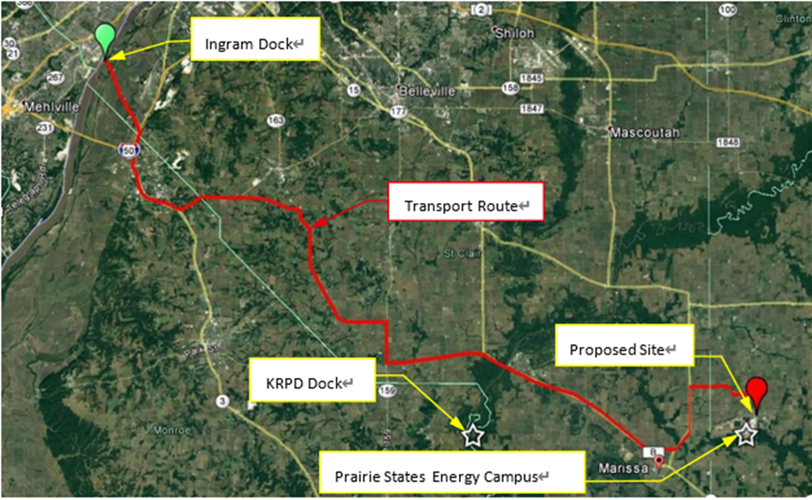
Transportation Study

Slide 35
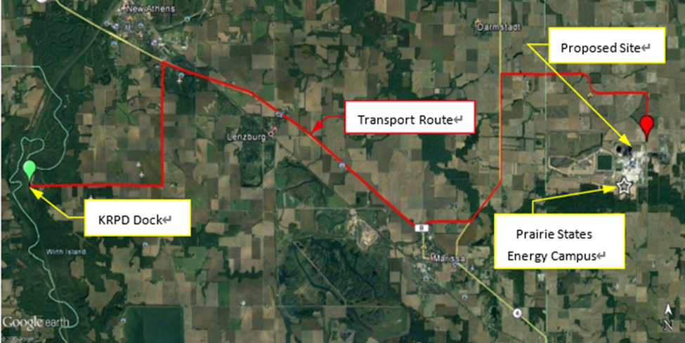
Transportation Study

Slide 36
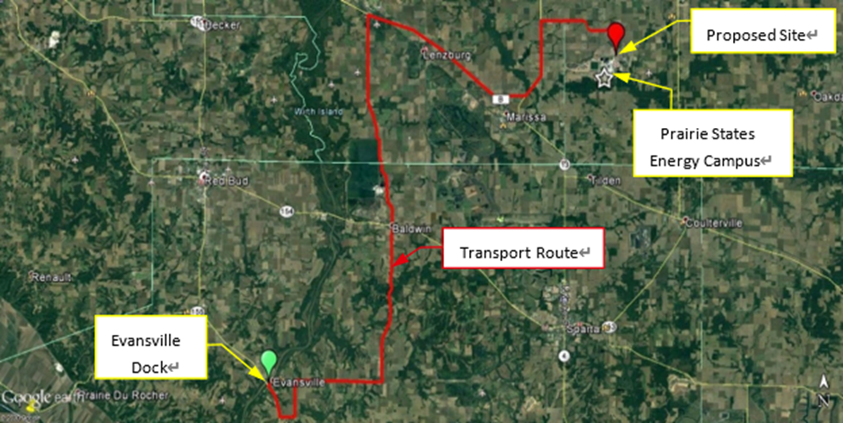
Transportation Study

Slide 37
Hazard and Operability (HAZOP) Review
An in-depth examination of the ISBL section to identify and evaluate any process or equipment risks.
0 recommendations address “A” - Critical risk items
0 recommendations address “B” - Serious risk items
13 recommendations address “C” - Moderate risk items
0 recommendations address “D” - Minor risk items
0 recommendations address “E” - Negligible risk items
5 recommendations address “O” - Operating issue items

Slide 38
Constructability Review
Kiewit

Slide 39
Constructability Review
Systematic process that provides a framework for improving the project’s buildability by identifying obstacles during the pre-construction phase to reduce and prevent errors, delays, and cost overruns.
Evaluated and identified construction access, lay-down areas, lift plans, and sequencing of construction work

Slide 40
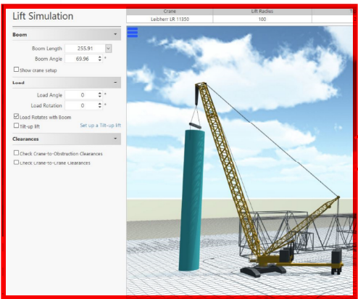
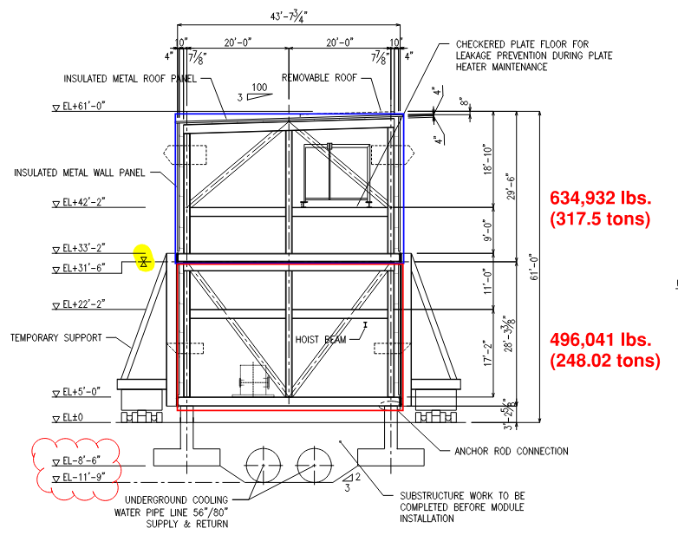
Constructability Review
Mirrored arrangement limits movement of heavy lift crane
Modules dressed and stacked directly north of plot

Slide 41
Constructability Review – Project Schedule

Slide 42
Carbon Capture Location
Source: Google Earth

Slide 43
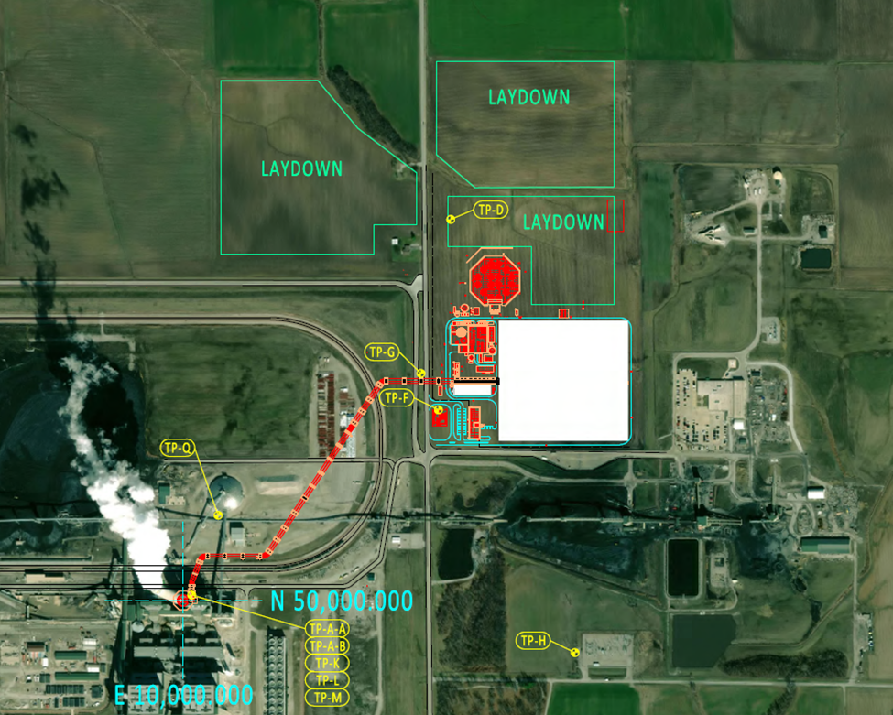
Carbon Capture Facility

Slide 44
ISBL Detailed Engineering
Break from slideshow to review:
Block Flow Diagram (BFD)
ISBL Plot Plan
Process Flow Diagram (PFD)

Slide 45
OSBL Detailed Engineering
Break to review 3D model

Slide 46
Review of Overall Plant Performance
Output
8,462,000 ston annually of CO2
95% Capture
Power Consumption: ~85.5MW
Notes:
MHI load list

Slide 47
Results and Closing Discussions
Project not currently economic without additional enhancements to federal tax credits
PSGC Owners may consider a partnership with a third-party developer/owner
Third-party developer would need to secure funding and necessary permits

Slide 48
Acknowledgements
Name | Organization
Andrew Jones, Carl Laird | National Energy Technology Laboratory / US Department of Energy
Don Gaston, Javier Arzola, Rich Meyer | Prairie State Generating Company
Kevin O’Brien, Yongqi Lu, Vinod Patel, Stephanie Brownstein, Jason (Zhenxing) Zhang, Jason Dietsch | Prairie Research Institute / University of Illinois Urbana-Champaign
Tim Thomas, Tiffany Wu, Cole Maas | MHIA
Keisuke Iwakura, Shintaro Kiuchi | MHIENG
Matt Thomas, Alan Donovan, Bob Slettehaugh, Bryan Lofgreen | Kiewit Engineering Group
Paula Guletsky, Anthony Baker | Sargent & Lundy
This project is supported by the U.S. Department of Energy / National Energy Technology Laboratory (DOE/NETL) through Cooperative Agreement No. DE-FE0031841

