Slide 1
Oxy-Combustion Fundamentals for Direct Fired Cycles Pete Strakey, NETL
Notes:
Title Slide

Slide 2
Outline
Effects of pressure and diluents on flames.
Identification of target conditions.
Overview of characteristic time and length scales.
CFD simulations of turbulent time and length scales.
Chemical kinetic mechanisms.
Carbon monoxide formation.
Thermo-acoustic instabilities.

Slide 3


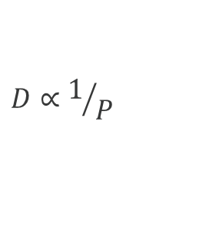
Effect of Pressure on Laminar Flame Speed
Cantera with GRI 3.0 used to calculate premixed laminar flame speed.
Flame speed with 31%O2/69%CO2 lower than air mainly due to lower diffusivity.
$$S_{L}∝\sqrt{RR∙D}$$
RR= Reaction Rate
D= Molecular Diffusivity
$$D∝1/P$$
Laminar Flame Thickness
$$δ_{L}=\frac{α}{S_{L}}$$
α = k/ρC_{P}

Slide 4
Cantera Premixed Laminar Flame Profiles
Temperature profiles through flame region.
CO2 dilution scaled to provide same equilibrium flame temperature as air flames.
Flames get much thinner at high pressure.

Slide 5
Cantera Premixed Laminar Flame Profiles
OH profiles through flame region.
CO2 dilution scaled to provide same equilibrium flame temperature as air flames.
Radical concentrations reduced at high pressure due to 3-body recombination reactions.

Slide 6
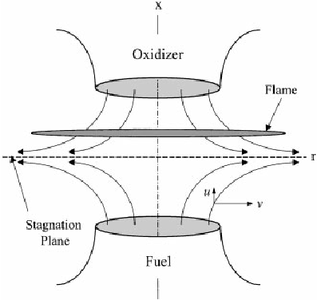
Cantera Non-Premixed Laminar Flame Profiles
Temperature profiles through flame region.
CO2 dilution scaled to provide same equilibrium flame temperature as air flames.
Sep= 2cm
V_{F}=V_{O}=27 cm/s

Slide 7
Cantera Non-Premixed Laminar Flame Profiles
OH profiles through flame region.
CO2 dilution scaled to provide same equilibrium flame temperature as air flames.

Slide 8
Extinction Strain Rate & Ignition Delay Time
AramcoMech 2.0 used for ignition delay time.

Slide 9
Allam Cycle
Goal is to estimate some characteristic combustion scales for high pressure oxy-fuel flames for direct-fired sCO2 cycles.
Target is the Allam cycle conditions (O₂ 15% to 30% molar concentration)*.
R.J. Allam et. al., ASME GT2014-26952, 2014
* Allam, et al., Energy Procedia 37, 2013, 1135-1149

Slide 10

Borghi Combustion Diagram
Borghi Diagram indicates regime of combustion (wrinkled flames, corrugated flames, stirred reactor, etc.
$$need: \frac{u′}{S_{L}} and \frac{l_{T}}{δ_{L}}$$
P=300 bar
50 MW Thermal Input
Phi=1.0
CO₂ (43.6 kg/s, T=1015K)
Gas Turbines
IC Engines
CO₂ (14.0 kg/s, T=1015K)
O₂ (4.2 kg/s, T=1015K)
combustor
CH4 (1 kg/s, T=496 K)
C. Sorusbay, “Turbulent Premixed Combustion in Engines”, Istanbul Technical University

Slide 11


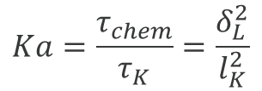
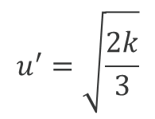

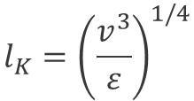
Characteristic Scales and Dimensionless Numbers
Included here for completeness…
$$Ka=\frac{τ_{chem}}{τ_{K}}=\frac{δ_{L}^{2}}{l_{K}^{2}}$$
K>1 means the smallest eddies can enter and thicken the flame front
Karlovitz Number (chemical time / Kolmogorov time)
D$a=\frac{τ_{turb}}{τ_{chem}}=.247\left(\frac{k}{ε}\right)\left(\frac{S_{L}^{2}}{α}\right)$
Damkohler Number (turbulent time / chemical time)
Da>>1 means the chemistry is fast compared to turbulent mixing
$$δ_{L}=\frac{α}{S_{L}}$$
Laminar flame thickness (thermal diffusivity / laminar flame speed)
$$l_{K}={\left(\frac{v^{3}}{ε}\right)}^{1/4}$$
Kolmogorov length scale (kinematic viscosity / turbulent dissipation rate)
$$l_{T}=0.2\frac{k^{1/2}}{ε}$$
Integral length scale (turbulent kinetic energy / turbulent dissipation rate)
$$u^{′}=\sqrt{\frac{2k}{3}}$$
Turbulent fluctuating velocity

Slide 12
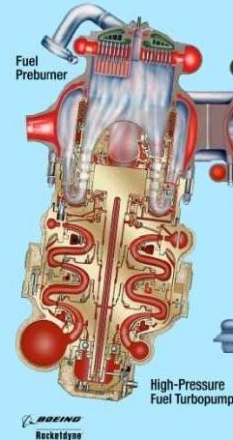
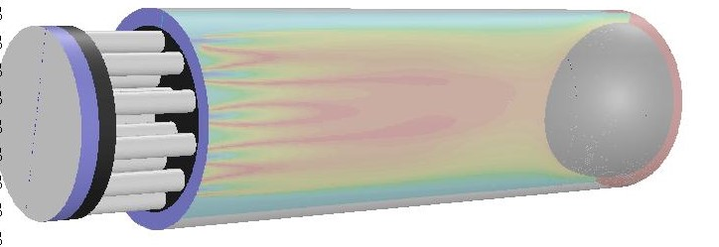
50 MW Conceptual Combustor
SSME Preburner type combustor – 21 coaxial injectors, 4M Cells
Oxidizer in
Fuel in
CO₂ (12.6 kg/s, T=1015K)
D=0.125 m
CH4 (1 kg/s, T=496 K)
O₂ (4.2 kg/s, T=1015K)
L=0.38 m
Purge in
P=300 bar
50 MW Thermal Input
CO₂ (43.6 kg/s, T=1015K)

Slide 13
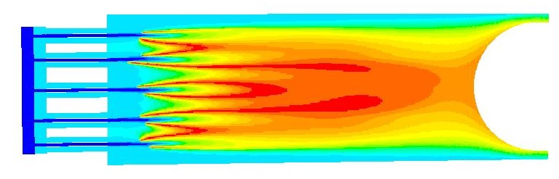
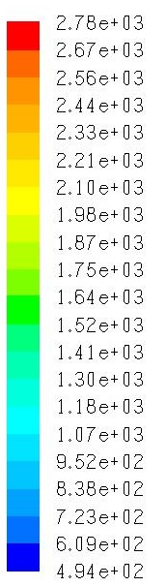
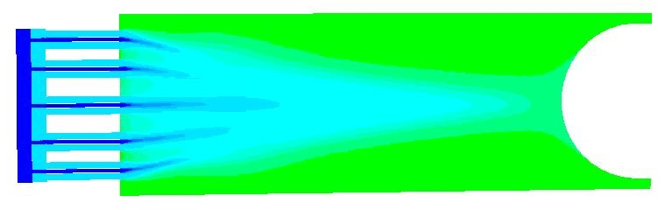
Turbulent Time and Length Scales
Two Limiting Cases:
25% of CO2 by mass mixed in with O2 (X_{O2}=0.30, φ=1.0)
Fully mixed (100% of CO2 mixed in with O2) (X_{O2}=0.09, φ=1.0)
Steady RANS k-e
DRM19 reduced CH4 mechanism
No Combustion model
T (K)
25% of CO2 with O2 (X_{O2}=0.30)
75% of CO2 through purge
l_{T}=1.9 mm
U’=7.5 m/s
100% of CO2 with O2 (X_{O2}=0.09)
l_{T}=2.0 mm
U’=23.8 m/s

Slide 14
Borghi Diagram for Oxy-Combustion
Two cases shown for 300 bar oxy-combustion define a range of conditions spanning the thickened, corrugated flame regime and stirred reactor.
Gas Turbines
IC Engines
300 bar sCO2 (.31O2+.69CO2)
S_{L} = 0.58 m/s (T_{F}=2690K)
δ_{L} = 0.67 μm
Ka=0.7
Tign=9.2e-4 s
Significantly outside the range of gas turbine and IC engine operation.
Requires assessment of appropriate turbulent combustion models.
300 bar sCO2 (.09O2+.91CO2)
S_{L} = 0.05 m/s (T_{F}=1610K)
δ_{L} = 6.60 μm
Ka=361
Tign=2.5e-3 s
Notes:
NETL Mission and Vision

Slide 15

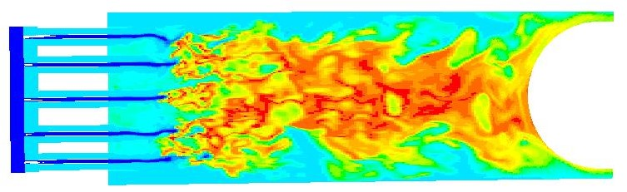
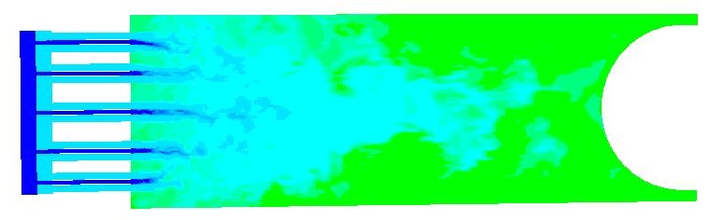
Potential Range of Operating Conditions
30% O2 case looks like a conventional turbulent flame.
9% O2 case looks like autoignition.
30%O2/70%CO2
U = 30 m/s
τ_{R} = 12.7 ms
τ_{T} = 2.6e-4 s
l_{T} = 1.9 mm
τ_{K}=3.4e-6 s
l_{K} = 1.6 μm
= 3.9e-7 m²/s
S_{L} = 0.58 m/s
τ_{ign} = 0.92 ms
9%O2/91%CO2
U = 50 m/s
τ_{R} = 7.6 ms
τ_{T} = 9.3e-5 s
l_{T} = 2.0 mm
τ_{K}=4.1e-7 s
l_{K} = 0.36 μm
= 3.3e-7 m²/s
S_{L} = 0.05 m/s
τ_{ign} = 2.5 ms
Large Eddy Simulations
T (K)

Slide 16
Chemical Kinetic Mechanisms
No detailed mechanisms validated at sCO2 conditions. Best available is likely Aramco Mech (U. Galway). Validated with flame-speed up to 60 bar and ignition delay to 260 bar. Likely better than GRI 3.0.
Huge mechanism, 103 species, 480 reactions after reduction to C2 and smaller.
Need for compact skeletal mechanisms amenable to CFD modeling (10-30 species maximum).
Need flame speed, species profiles and induction time data for direct-fired conditions!

Slide 17
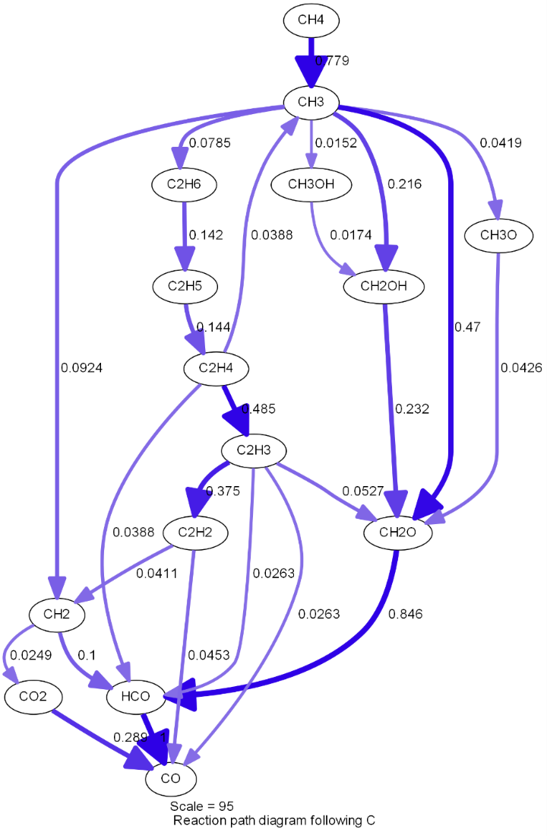
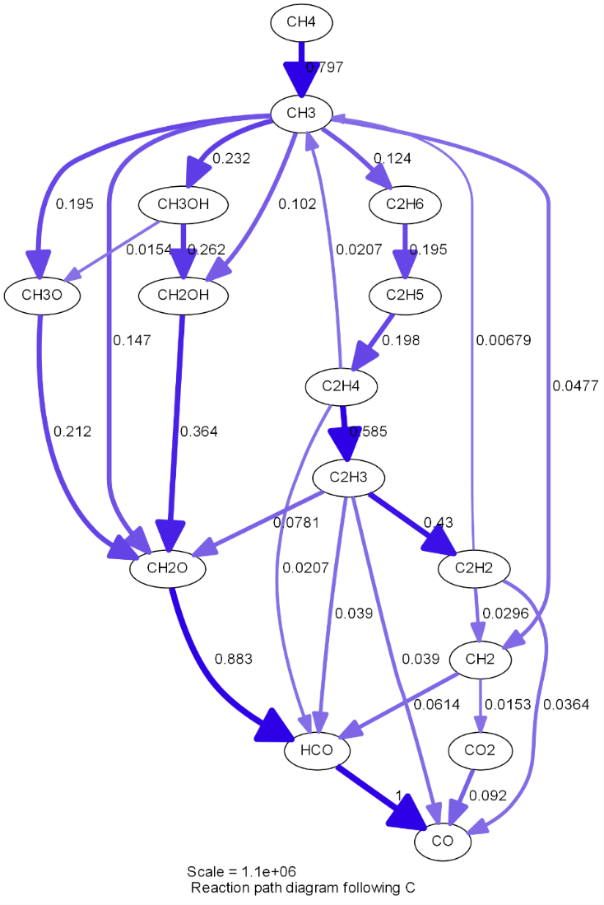
Mechanism Reduction
Reaction Path Analysis, 0-D Reactor
T=985K, CH4=.12989, O2=.27351, CO2=.5966
1 bar
300 bar
Methane oxidation kinetics very different at 300 bar.
More reaction paths play an important role, therefor larger skeletal mechanisms needed to adequately represent kinetics.

Slide 18
Mechanism Reduction
Combination of reaction path analysis, flame-speed sensitivity and ignition delay time sensitivity.
Optimized for Allam cycle combustor conditions
300 bar
T_{preheat} ~ 1000K
Oxidizer: 25% O₂ + 75% CO₂
Flame speed sensitivity at 300 bar
Several skeletal mechanisms developed with 33, 29, 26 and 17 species.

Slide 19
Mechanism Reduction
Performance comparison of various skeletal mechanisms.
Flame speed and ignition delay improve with the inclusion of more species and reactions.
33 and 29 species able to predict flame-speed and ignition delay very well.
17 species able to predict flame-speed to within ~40% error.

Slide 20
Mechanism Reduction
Performance comparison of various skeletal mechanisms.
All do very well for CO production profiles.
CO prediction important for accurate cycle efficiency calculations.

Slide 21
Estimation of CO Production
Large Eddy Simulation, Dynamic Smagorinksy
17-species skeletal mechanism
FDF Combustion Model, Modified Curl, C_{M}=2
Equilibrium Calcs
Flame (30% O2) : X_{CO}=.024
Comb Exit: X_{CO} = 1.2e-5
9%O2/91%CO2, φ=1.0
30%O2/70%CO2, φ=1.0
Instantaneous CO mass fraction
Time-Averaged CO mass fraction
X_{CO}=.00098
X_{C0}=.026

Slide 22
Fate of CO in Turbine
RANS, SST-kOmega, DRM19, V_{blade}=150 m/s, Pr=2.85
Temperature
Equilibrium Calcs
Flame: X_{CO}=.024 (30% O2, φ=1.0)
Comb Exit: X_{CO} = 1.2e-5
T (K)
Pressure
P (Pa)
X_{CO}
Simulation Results
Inlet: X_{CO}=.026
Outlet: X_{CO}=.023
X_{CO}
CO concentration is well above equilibrium at turbine inlet conditions.
CO oxidation reactions are slow relative to residence time in turbine.
CO is effectively “frozen” at flame conditions.

Slide 23
Effect of CO on sCO2 Cycle Efficiency
Preliminary cycle calculations indicate as much as a 1 percentage point decrease in cycle thermal efficiency per mole percentage of CO in the combustor exhaust.
Drop off in cycle and process efficiency is due to an increase in compression power as a result of CO in working fluid.
Source: NETL SEA (Chuck White)

Slide 24
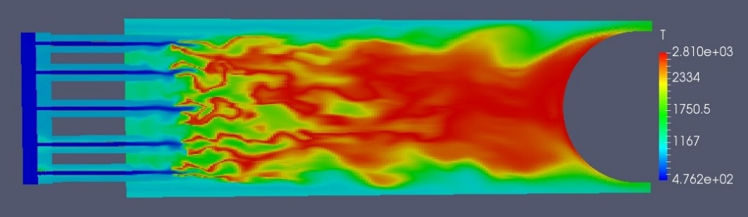

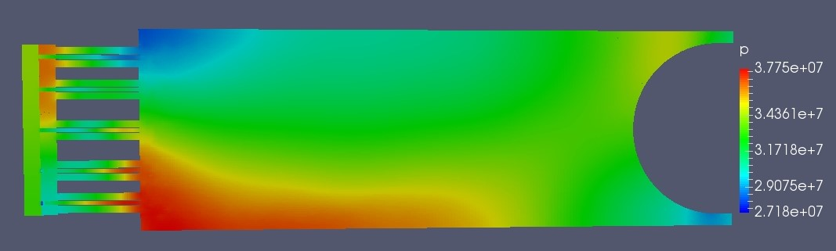
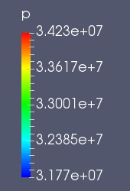
Modeling Thermo-Acoustic Instabilities
OpenFOAM LES, pressure-based solver
Aramco17 (17 species, 45 reactions)
50 mW (1 kg/s CH4 flow).
Oxidizer 25%O2 + 75%CO2 by mass.
3M cells, LES model
Radial mode thermoacoustic instability @ 3kHz.
Peak-to-Peak pressure oscillation 60% of mean combustor pressure.
Slice at Z=2 cm
Pressure Field (Pa)

Slide 25
Concluding Remarks
Oxy-combustion at 300 bar is somewhat uncharted territory.
Conditions more representative of rocket engines.
Limited data available.
Need for validated detailed chemical kinetic mechanisms as well as reduced mechanisms.
Must take care in selecting appropriate combustion models (fast mixing, flamelet, EDC, PDF, etc…).
CO levels must be kept low (X_{CO} < .0015) for maximum cycle efficiency.
Thermo-acoustic stability must be assessed.
Modeling can help.
Passive devises (baffles, Helmholtz resonators) may be necessary.

